Slide 1
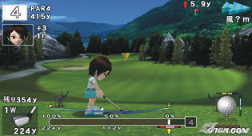

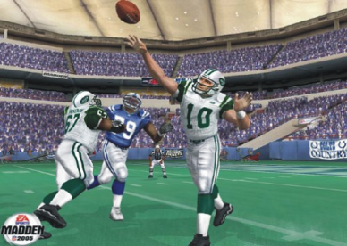

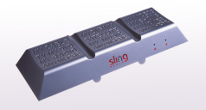
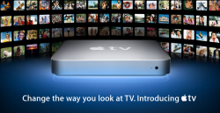
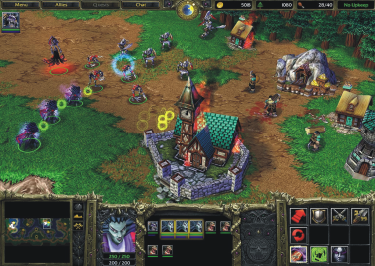

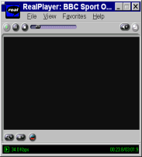
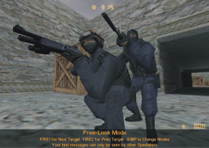
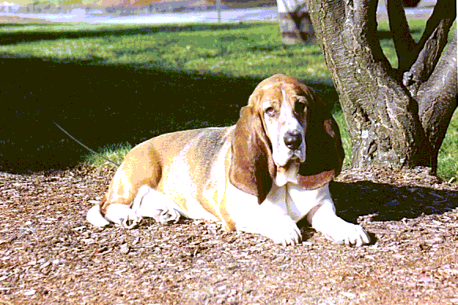




Mark Claypool’s MQP Projects
Network Games
Streaming Media
http://www.cs.wpi.edu/~claypool

Slide 2
Latency and Games
Latency affects how players experience online gameplay
Latency compensation techniques to mitigate latency → how effective?
Goal: Test effects of latency on gameplay
Methodology:
  build/mod game
  design game maps
  run user studies
  analyze data

Slide 3
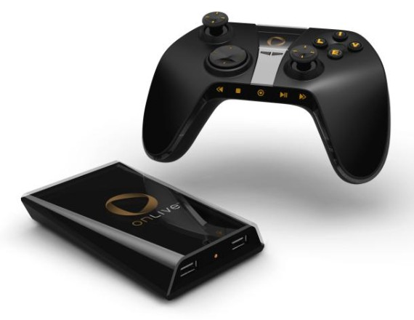
Games on Thin Clients
Server streams game to lightweight (“thin”) client
  Mobile phone, PDA, Sony PSP (remote play)
  Onlive
What is the network turbulence? Best way to use bandwidth with low latency?
Goal: Measure thin client performance for games, propose improvements, implement and evaluate
Methodology:
  Determine “streaming” game environment
  Performance evaluation of thin clients (Onlive, Sony, RDP, X, VNC …)
  Run experiments
  Feedback to drive innovation
Co-advisor: Prof. Finkel

Slide 4

HTTP Streaming Tracker
Video streaming is becoming HTTP streaming
  YouTube over HTTP ~15% of the Internet's global traffic
  Apple HTTP Live Streaming (HLS)
  Microsoft Silverlight Smooth Streaming
Performance of commercial HTTP streaming video?
  Largely unknown, but important to design better networks
Build tool and run experiments!
  Done a Media Tracker and Real Tracker, now HTTP Streaming Tracker
Methodology:
  Understand players (e.g. YouTube API, Javascript)
  Write wrapper to control/instrument application
  Run experiments to evaluate performance

Slide 5


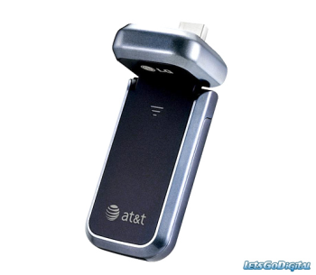
Mobile Network Measurements
New networks deployed promising greatness
  versus
Actual performance largely marketing
  What does computer science say about performace?
Goal: Measure performance for existing 4G network through experiments
Methodology:
  Setup end host (network card)
  Develop measurement software (e.g. bandwidth estimation)
  Design experiments (location, parameters)
  Run and analyze → apply to applications
Co-advisor: Prof. Kinicki

Slide 6
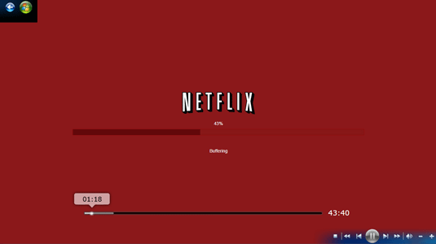

Video Buffer Sizing
Client side buffer critical for streaming video
  Avoid dreaded “rebuffering”
But how is buffer size chosen?
  Unknown! But evidence suggests poor (e.g. fixed size)
We have: method to determine optimal buffer size
  Includes heuristic to approximate optimal
Goal: Measure existing buffering, compare to optimal
Methodology:
  Setup testbed
  Design and Run experiments
  Analyze data
WPI
Server

Slide 7
Streaming Media in the Home
Many options to stream media in the home
  PCs (Orb)
  Game consoles (Sony PS3, Xbox 360)
  Slingbox, LocationFree, Apple TV
Much of it now wireless (802.11), which affects performance
  Loss rate, signal strength, other clients…
  Determines “best” streaming rate for video
Goal: characterize performance (network and application) for home streaming devices
Methodology:
  Setup laboratory (hardware, software)
  Design experimental parameters
  Measure and analyze data
  Propose and build better streaming devices

Slide 8
Questions?
http://www.cs.wpi.edu/~claypool
claypool@cs.wpi.edu

