Slide 2
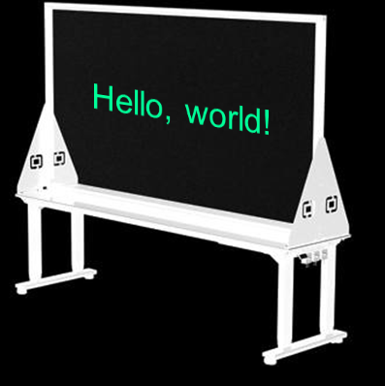
Live Lightboard
Camera
Prof

Slide 3
Live Lightboard Lectures
Camera
Prof

Slide 4
Live Lightboard Lectures
Camera
Prof

Slide 5
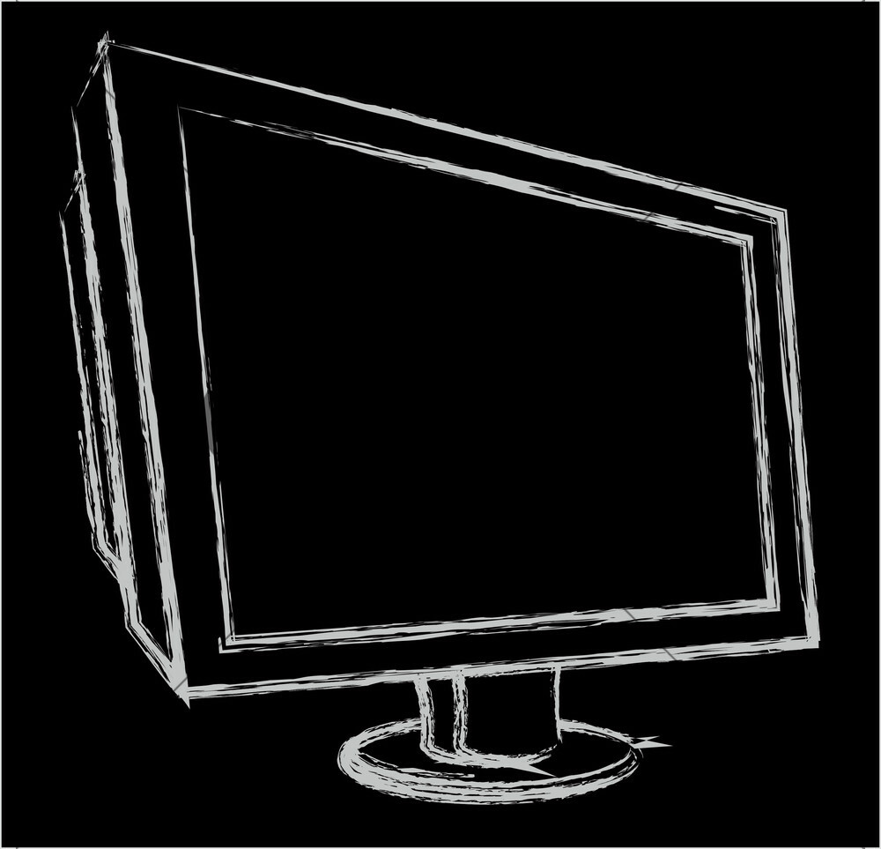
Live Lightboard Lectures
Hello, world!
Camera
Prof

Slide 6
Live Lightboard Lectures
Blog
Hello, world!
Camera
Prof
Mark Claypool
→ Misc
→ Lightboard

Slide 7
Live Lightboard Lectures
Blog
Hello, world!
Camera
Prof
Mark Claypool
→ Misc
→ Lightboard

