Slide 1
L³ - Live Lightboard Lectures
Mark Claypool

Slide 2
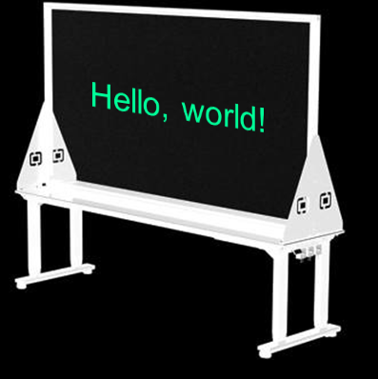
Live Lightboard Lectures
Glass
Lit from beneath
Neon markers make text “pop”
So what?
Students see professor (not just slides!)
Face students - better than whiteboard!
Affects student engagement
Camera
Prof

Slide 3
Motivation
Anywhere
Space
Same place
Synchronous
Asynchronous
Time

Slide 4
Overview
Build lightboard
Setup “studio”
Configure software
Lecture!

Slide 5
Find/Buy Parts
Tools: drill, screwdriver, adjustable wrench
Lightboard
Acrylic glass (2'x4', 1/4" or 3/8" thick)
Light strip, basic
Corner braces (4"-6") and screws
Board/table to mount on
Software
Zoom
PowerPoint
OBS (with VirtualCam)
Virtual Audio Cable
Studio
Lights
Camera stand/mount
Black backdrop
Neon markers
Micro-fiber cloths
Computer , Webcam

Slide 6
Build It!
Drill holes in glass (measure twice, drill once)
Screw in brackets to glass
Drill holes in board/table
Tape lightstrip on bottom
Mount to board
Done!
Glass
Corner
brace
Board
Side view

Slide 7
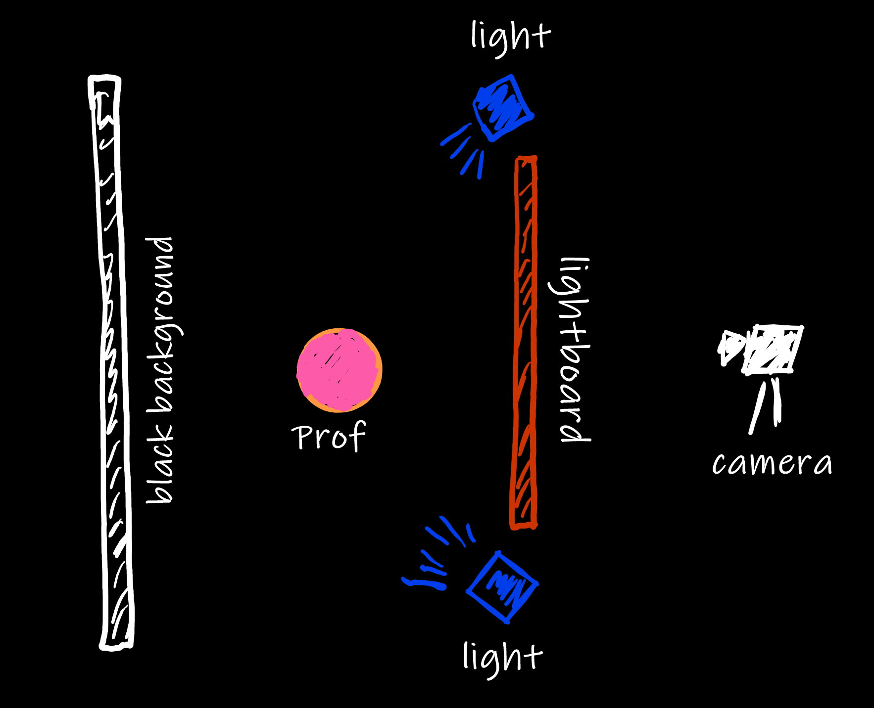
Light It!
Most challenge part of studio setup!
Light “talent” not screen, not backdrop
Household lights can work, but may need hoods or shutters

Slide 8
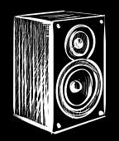
Configure Software
OBS (to flip video, add ppt)
Virtualcam (OBS “camera” for Zoom)
VB-Cable (Zoom speaker to go to OBS , else audio out of synch)
OBS, VoiceMeeter, Zoom, PowerPoint
Webcam
Speaker
Mic
Virtualcam
Window
Capture
Filters → +
→ Color Key (Black)
Mic:
VB-Cable
Mic:
VB-Cable

Slide 9
Lecture Prep
Original
(My Workflow)
Make slides with full text
Before present, copy slides
Delete all text/images to draw by hand
“Full” copy as present
Notes
Presentation

Slide 10
Slide Template
Black background
Keep space for yourself!
Don’t write on your face
Neon logo (tell it’s working)
Use blank slides!
Reminder to pause, question, write
Don’t wear a “busy” shirt
Lecture notes across my face!

Slide 11
Tips and Tricks
Blackout ceiling
Logitech Capture for adjustments
“Confidence” monitor
Polarizing lenses
Black pen for reference marks

Slide 12
L³ - Live Lightboard Lectures
Mark Claypool
Anywhere
Space
Same place
Synchronous
Asynchronous
Time

