Slide 1
Operating Systems
Processes
ENCE 360

Slide 2
Outline
Motivation
Control block
Switching
Control
Chapter 2
MODERN OPERATING SYSTEMS (MOS)
By Andrew Tanenbaum
Chapter 4
OPERATING SYSTEMS: THREE EASY PIECES By Arpaci-Dusseau and Arpaci-Dusseau

Slide 3
The Problem
Remember “CPU” program from day 1?
Each ran as if was only program on computer
A
B
D
C
THE CRUX OF THE PROBLEM:
HOW TO PROVIDE ILLUSION OF MANY CPUS?
Few physical CPUs available, so how can OS provide illusion of nearly-endless supply of said CPUs?

Slide 4
The Solution – The Process
“A program in execution”
Running several at once provides pseudo-parallelism
Time-sharing
A
A
B
C
A
Program
Counter
B
B
Conceptual View
C
C
Time
Low-level machinery (mechanisms)
Answer question of how. E.g., how to keep program context
High-level intelligence (policies)
Answer question of which. E.g., which process to run
Note: good design to separate!

Slide 5
Process States
Consider the shell command:
cat /etc/passwd | grep claypool
What is this command doing?
How many processes are involved?

Slide 6
Process States
Consider the shell command:
cat /etc/passwd | grep claypool
Clean up
Initialization
Running
Terminate
Dispatch
I/O request
Create
Interrupt
3 processes
cat
grep
bash
Ready
Waiting
I/O complete
(See process states with top)

Slide 7
OS as a Process Scheduler
cat
ls
...
disk
vid
OS
Process Scheduler
Simple OS view – just schedule processes! Even OS services (e.g., file system) are just processes
Small scheduler handles interrupts, stopping and starting processes (policy decides when)
Ok, what are mechanisms needed to make this happen?

Slide 8
Program → Process
int g_x
main() {
...
}
A() {
f = open()
...
}
What information do we need to keep track of a process (i.e., a running program)?
?

Slide 9
Program → Process
Low-level machinery (mechanisms) – to store program context
(Discuss policies later in scheduling)
Current execution location
Intermediate computations (heap and stack)
Access to resources (e.g., I/O and files open)
int g_x
main() {
...
}
A() {
f = open()
...
}
int g_x
main() {
...
}
A() {
f = open()
...
}
Heap
I/O
g_x
f
Stack
A
main
Process Control Block (PCB)

Slide 10
Outline
Motivation (done)
Control block (next)
Switching
Control

Slide 11
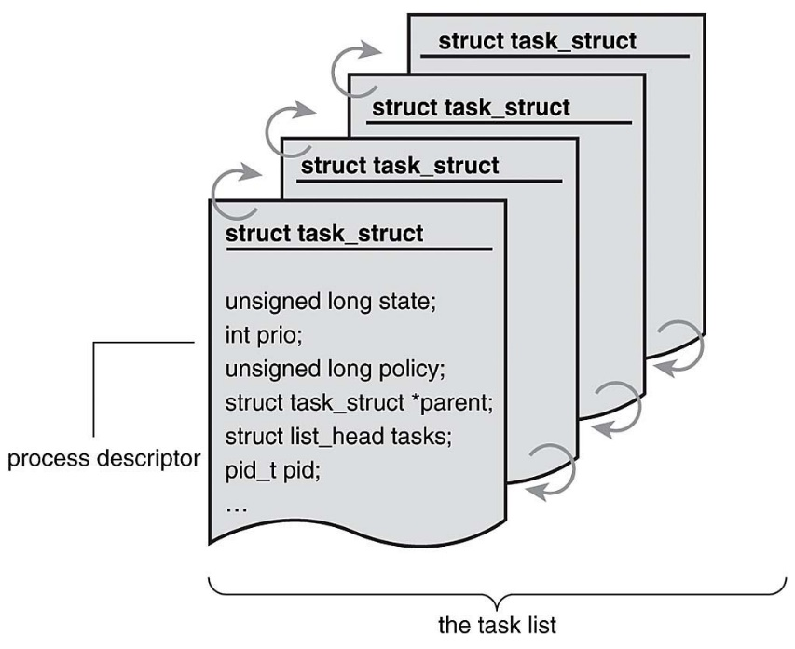
Process Control Block
OS keeps one Process Control Block (PCB) for each process
process state
program counter
registers
memory management
open devices
…
OS keeps list/table of PCB’s for all processes (use when scheduling)
Code examples:
SOS “pcb.h”: ProcessControlBlock
Xv6 “proc.h”: proc
Linux “sched.h”: task_struct

Slide 12
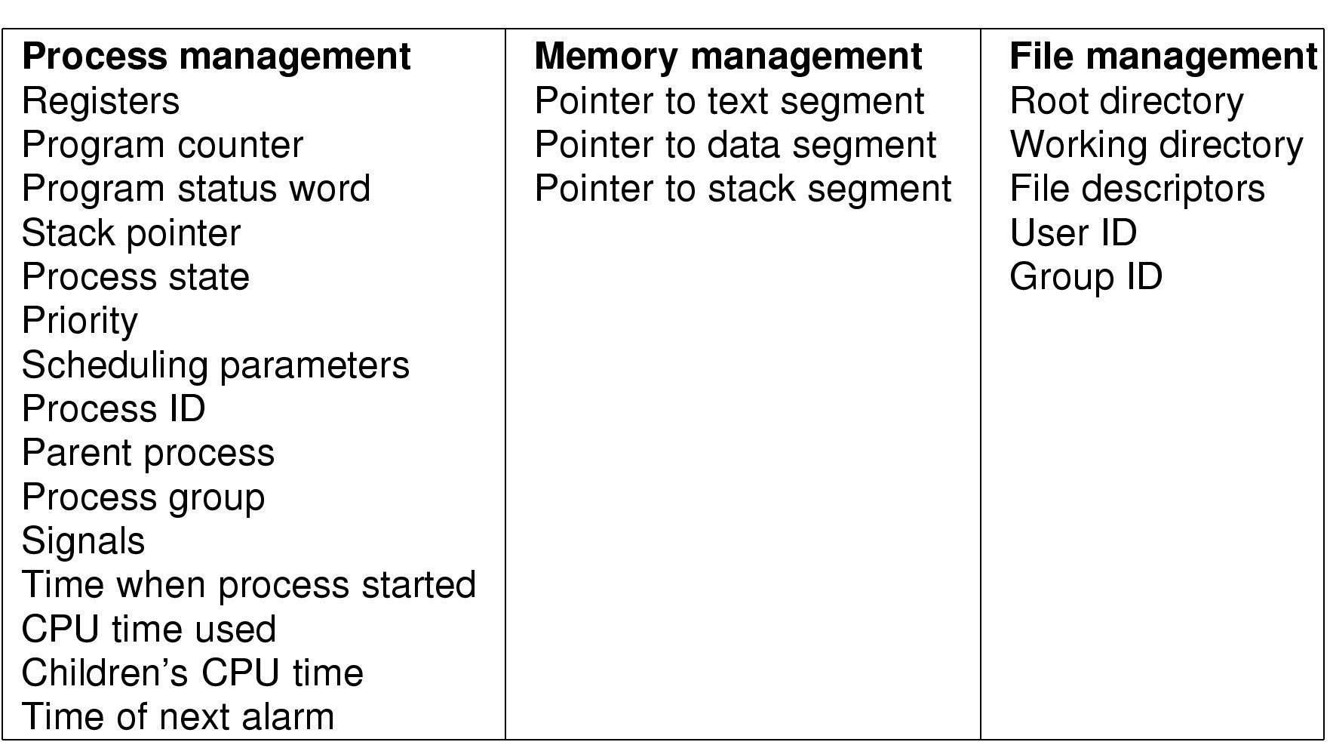
Process Control Block – Summary Info
List of typical attributes in PCB

Slide 13
Outline
Motivation (done)
Control block (done)
Switching (next)
Control

Slide 14
Process Creation
When are processes created?

Slide 15
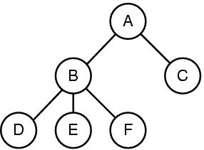
Process Creation
BIOS
Boot loader
System initialization
When OS boots, variety of system processes created
init – parent of all processes (pid 1)
Background, don’t need to interact with user (daemons for “guiding spirit”)
Note, foreground processes get input from user
Created on demand by user
Shell command or, e.g., double clicking icon
Execution of system call
Process itself may create other processes to complete task
Created by batch job
Queued awaiting necessary resources. When available, create process(es)
init
Daemons
Shell
User command
User command

Slide 16
Process Termination
When are processes terminated?

Slide 17
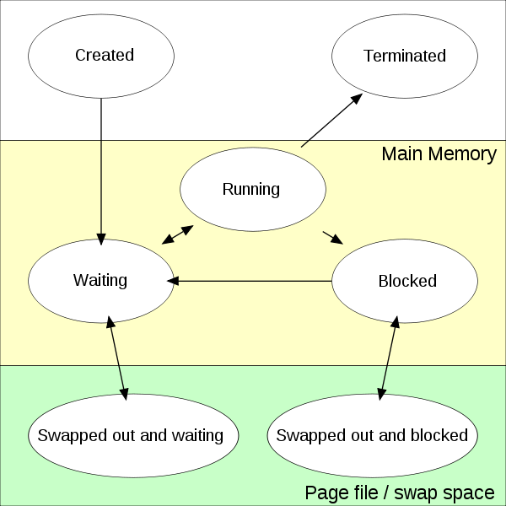
Process Termination
Voluntarily
Make system call to exit() or return from main()
Involuntarily
By OS if “misbehave” – e.g., divide by zero, invalid memory access
By another process (e.g., kill or signal())

Slide 18
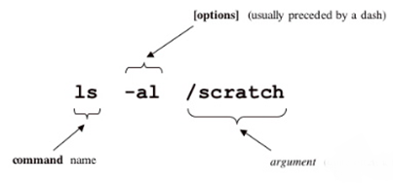
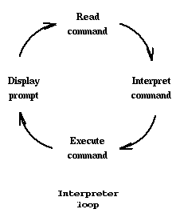
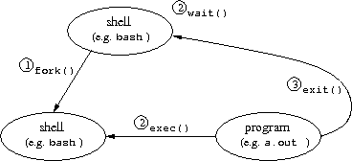
Creation/Termination Example – Unix Shell
See: “shell-v0.c”
System call: fork()
Creates (nearly) identical copy of process
Return value different for child/parent
System call: exec()
Over-write with new process address space
Shell
Uses fork() and exec()
→ Simple!
See: “shell-v1.c”

Slide 19
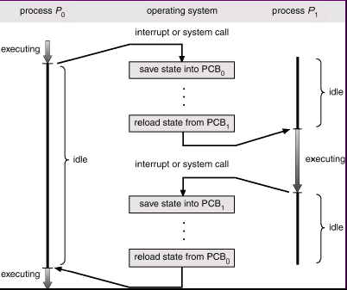
Model for Multiprogramming
CPU switches from process to process
Each runs for 10s or 100s of milliseconds
Block for I/O
E.g., disk read
Other interrupt
E.g., I/O complete
“timeslice” is over (configurable parameter)
scheduled
Silberschatz & Galvin, 5th Ed, Wiley, Fig 4.3
Operating System Concepts

Slide 20
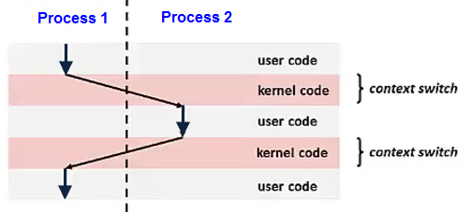
Context Switch
Pure overhead
So … want it to be fast, fast, fast
typically 1 to 1000 microseconds
Sometimes special hardware to speed up
Real-time wants worst case (e.g., max 20 microseconds)
When to switch contexts to another process is process scheduling

Slide 21
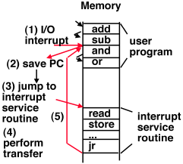
Interrupt Handling Mechanism
Store PC (hardware)
Load new PC (hardware)
Jump to interrupt service procedure
Save PCB information (assembly)
Set up new stack (assembly)
Set “waiting” proc to “ready” (C)
Service interrupt (C and assembly)
Invoke scheduler (C)
Newly awakened process (context-switch)
Previously running process

Slide 22
Outline
Motivation (done)
Control block (done)
Switching (done)
Control (next)
Chapter 6
OPERATING SYSTEMS: THREE EASY PIECES http://pages.cs.wisc.edu/~remzi/OSTEP/cpu-mechanisms.pdf

Slide 23
The Problem – Virtualizing CPU with Control
A
A
Illegal!
(e.g., read() w/out perm)
B
Ready?!
Time
Time
THE CRUX OF THE PROBLEM:
HOW TO EFFICIENTLY VIRTUALIZE CPU WITH CONTROL?
OS must virtualize CPU efficiently while retaining control over system. Note: hardware support required!

Slide 24
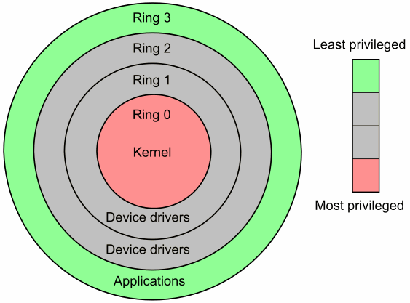
Solution – Limited Direct Execution
Still allow programs to directly run (e.g., on CPU) – i.e., no “sandbox” interpretation
But limit permissions
Hardware provides two (sometimes more) modes
User mode – certain operations/access not allowed
Kernel mode – full access allowed
Allows OS to protect against
Faulty processes
Malicious processes
Some instructions and memory locations are designated as privileged
Only executable or accessible in kernel mode
System calls, traps, and interrupts change mode from user to kernel
Return from system call resets mode to user

Slide 25
Trap – Transition User to Kernel Mode
Save {pc, registers, return} to stack
Restore (pop) stack
But … wow to know what code to execute for system call? i.e., how to know where system call is?

Slide 26
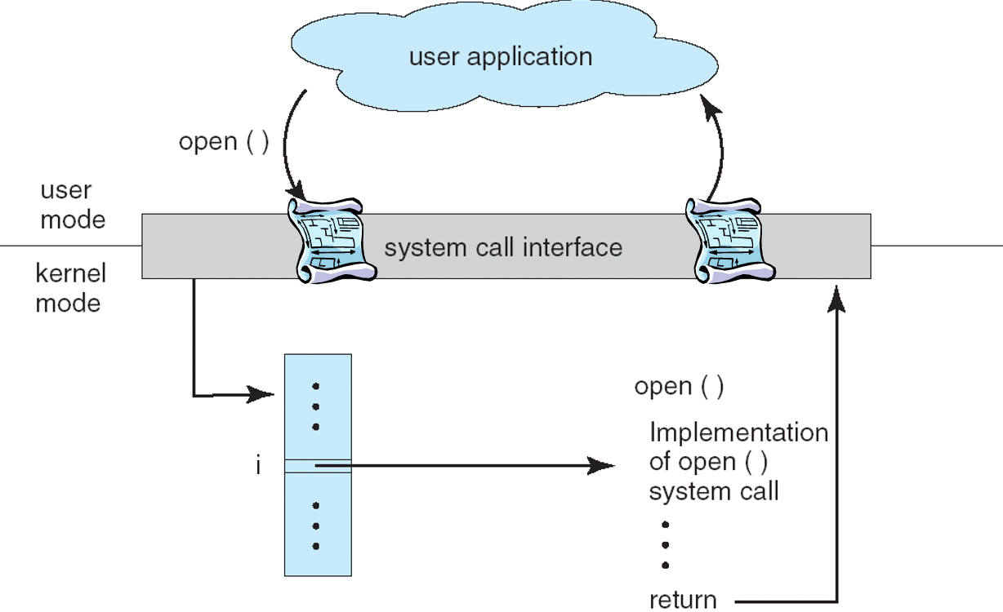
Trap – System Call Lookup Table
syscall number
syscall table
Each system call has own number/identity
Initialized at boot time
Kernel trap handler uses syscall number to index into table of syscall routines
Unique to each OS

Slide 27
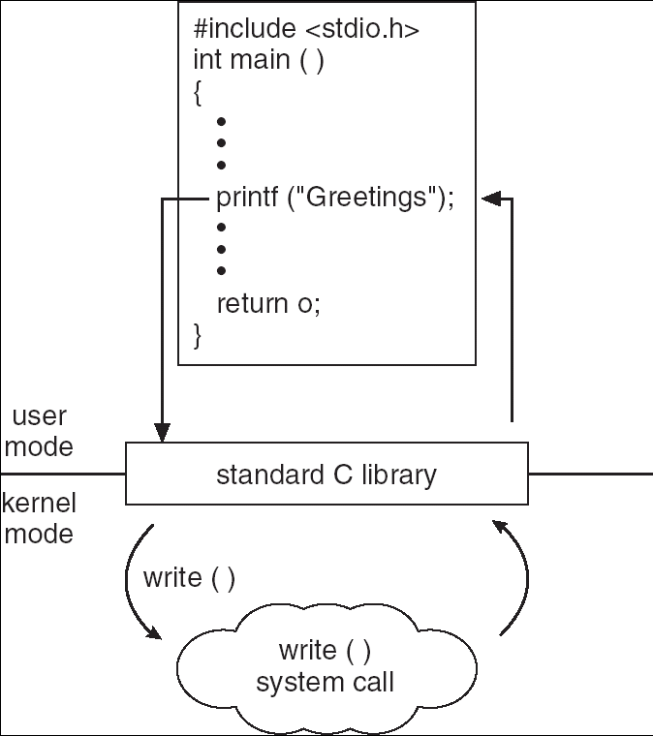
E.g., Accessing Kernel via Library

Slide 28
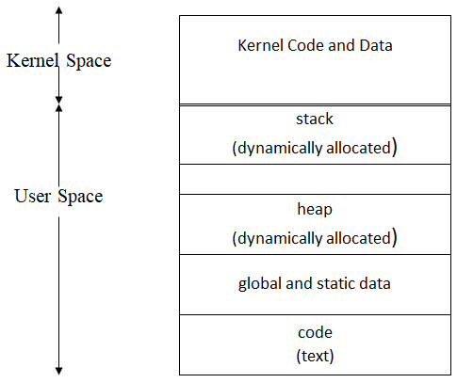
Inside Kernel Mode, OS can …
Not readable or writeable in user mode
Read and modify data structures not in user address space
Control devices and hardware settings forbidden to user processes
Invoke operating system functions not available to user processes
Access address of space of invoking process
SP →
PC →

Slide 29
Involuntary Transition User to Kernel Mode
E.g., in user mode, memory violation generates interrupt
Limit Register
Memory
CPU
yes
<
no
error
Switch to kernel mode
Handle error (e.g., terminate process)

Slide 30
The Problem – Virtualizing the CPU
A
A
✓
Illegal!
(e.g., read() w/out perm)
?
B
Ready?!
Time
Time
THE CRUX OF THE PROBLEM:
HOW TO EFFICIENTLY VIRTUALIZE CPU WITH CONTROL?
What if process doesn’t voluntarily give up control? It doesn’t make a system call (so, can’t check) and it doesn’t make a violation. e.g., while(1) {}

Slide 31
Solution – Special Timer Hardware
Pulse from 5 to 300 MHz
Crystal Oscillator
Decrement counter
when == 0
→ generate interrupt
Holding register to load counter
Use to control clock ticks (i.e., length of timer)
When timer interrupt occurs, OS regains control
E.g., can run scheduler to pick new process

Slide 32
Outline
Motivation (done)
Control block (done)
Switching (done)
Control (done)

