Slide 1
Interactive Media and Game Development
Frontiers 2009
Mark Claypool

Slide 2
What Do You Think Goes Into Developing Games?
Choose a game you’re familiar with
Assume you are inspired (or forced or paid) to re-engineer the game
Take 1-2 minutes to write a list of the tasks required
Chronological or hierarchical, as you wish
Trade write-ups with another student
What do we have?

Slide 3
Outline
Background (next)
Tutorial 1
What is a Game?
Genres
Tutorial 2
The Game Industry
Game Timeline
Team Sizes

Slide 4
Professor Background (Who am I?)
Dr. Mark Claypool (professor, “Mark”)
Computer Science
Interactive Media and Game Development
Research interests
Networks
Audio and Video over Internet
Network games
I’m playing
Fable II, deBlob, various Itouch games, FIFA’09
Looking forward to the next Uncharted!
Uncharted 2: Among Thieves

Slide 5
Teaching Assistant Background
Dan Tennant
WPI Alumnus (‘09), IMGD Major
Artistic concentration, Writer
What else…?

Slide 6
Student Background (Who Are You?)
Year?
Junior, Senior, …
Interest?
Art or Programming or ...
Computer Programming?
(what’s a program?) 1 to 5 (hacker!)
Gamer?
(casual) 1 to 5 (hard-core!)
Built any games?
What are you playing right now?
What type of game is it? Why is it fun?
Other …

Slide 7
Course Materials
Facebook group:
http://tinyurl.com/imgd-frontiers-09
Will have:
Slides (ppt and pdf)
Links to tutorials, etc.
Discussion groups
Need permission to join
Dan and I are both admins

Slide 8
Overall Course Structure
8:30-10:30
Technical/Design aspects of IMGD
Several 3D games,
10:30-12:30
Communication Workshops
1:30-3:30
Artistic/Design aspects of IMGD
3D game, Unreal Tournament Mod
3:30-4:30
Lab – work on either morning or afternoon stuff on your own

Slide 9
Technical Course Structure (1 of 2)
Start around 8:30
Me: lecture + discussion for 15-30 minutes
You: work for 30-60 minutes
Repeat
Probably more of me talking the first few days, more of you working last few
During work, Dan & I circulate around for help

Slide 10
Technical Course Structure (2 of 2)
Topics
Game Programming
No previous programming experience required!
Game Design
What is a game, what makes it fun, how to design
Game Art
Not make your own, but principles
Use game development environment… Kodu
Make games using only your Xbox controller!
(More shortly)

Slide 11
Rough Timeline
Days 1-4
Aspects of game development, several small games
End of day 4
Idea for your own, final game
Day 5-7
Work on game (or games!), including play testing
Day 8
Game fest!
Day 9
Field trip
Day 10
Closing ceremonies

Slide 12
Outline
Background (done)
Tutorial 1 (next)
What is a Game?
Tutorial 2
Genres
Tutorial 3
The Game Industry
Game Timeline
Team Sizes

Slide 13
Tutorial 1 – Kodu Basics
The Main screen
Within a Level
Tool palette
Selecting objects
Programming and Tweaking
Terrain
…

Slide 14
Assignment 1 - Combat
Two-player combat
Make basic world
From scratch or modify tutorial level
Add one object
Move with stick, fire with buttons
Blips and Missiles
Repeat for player 2
Play!
Even more:
Can you make powerups? Sheilds? Limited ammo?
What are the differences in the objects?
What can you do to make it have more long-term appeal?

Slide 15
Outline
Background (done)
Tutorial 1 (done)
What is a Game? (next)
Genres
Tutorial 2
The Game Industry
Game Timeline
Team Sizes

Slide 16
What is a Game? (1 of 3)
Movie? (ask: why not?)
→ no interaction, outcome fixed
Toy? (has interaction … ask: why not?)
→ no goal, but still fun (players can develop own goals)
Puzzle? (has goal + interaction … ask: why not?)
→ strategy and outcome is the same each time
“A computer game is a software program in which one or more players make decisions through the control of game objects and resources, in pursuit of a goal.”

Slide 17
What is a Game (2 of 3)
A Computer Game is a Software Program
Not a board game or sports
Consider: Chess vs. Soccer vs. Warcraft
Ask: What do you lose? What do you gain?
Lose: 1) physical pieces, 2) social interaction
Gain: 1) real-time, 2) more immersive, 3) more complexity
A Computer Game involves Players
“No, Duh”. But stress because think about audience. The game is not for you but for them.
Don’t just think about your story or the graphics or the interface, but consider the players.
Ex: complicated flight simulator (say, you are a flying geek) but audience is beginner

Slide 18
What is a Game (3 of 3)
Playing a Game is About Making Decisions
Ex: what weapon to use, what resource to build
Can be frustrating if decision does not matter
Want good gameplay (next major topic)
Playing a Game is About Control
Player wants to impact outcome
Uncontrolled sequences can still happen, but should be sparing and make logical
Ex: Riven uses train system between worlds
A Game Needs a Goal
Ex: Defeat Ganandorf in Zelda
Long games may have sub-goals
Ex: recover Triforce first, then Sword of Power
Without game goals, a player develops his/her own (a toy)

Slide 19
What a Game is Not (1 of 2)
A bunch of cool features
Necessary, but not sufficient
May even detract, if not careful, by concentrating on features not game
A lot of fancy graphics
Games need graphics just as hit movie needs special effects … but neither will save weak idea
Again, may detract
Game must work without fancy graphics
Suggestion: should be fun with simple objects
“When a designer is asked how his game is going to make a difference, I hope [s/]he … talks about gameplay, fun and creativity – as opposed to an answer that simply focuses on how good it looks”
– Sid Meier (Civilizations, Railroad Tycoon, Pirates)

Slide 20
What a Game is Not (2 of 2)
A series of puzzles
Most games have them
But not gameplay in themselves
Puzzles are specific, game systems spawn more generic problems
An intriguing story
Good story encourages immersion
But will mean nothing without gameplay
Example: Baldur’s Gate, linear story. Going wrong way gets you killed. But not interactive. Interaction in world all leads to same end.

Slide 21
Games are Not Everything
Most important … is it fun, compelling, engaging?
And these come from a superset of games
Computers are good at interactivity
Allow for interactive fun
Interactive Media and Game Development ☺

Slide 22
Discussion
What are some examples of interactivity that is fun but not a game?
SimCity - very compelling, but mostly no goals. More of toy than a game, but still fun.
What are some examples of fun graphics and video that are not interactive?
Uncharted - good visuals, story, etc. But need to play the game to proceed. Could have skipped to just watch story. Would still have been fun without the gameplay.

Slide 23
Outline
Background (done)
Tutorial 1 (done)
What is a Game? (done)
Tutorial 2 (next)
Genres
Tutorial 3
The Game Industry
Game Timeline
Team Sizes

Slide 24
Tutorial 2 – Levels in Kodu
Tutorials – games that teach you something about Kodu programming
Techniques – simple worlds to illustrate one behavior (tricks, methods to do something)
Sample Games – mini games, see what Kodu can do. All fully editable!

Slide 25
Assignment 2 – Breadth of Kodu
Try out all the sample games!
Play for fun
Keep mind open for exposure of ideas
Consider genres (types of games)
Keep in mind the tutorial and techniques for when you need them

Slide 26
Outline
Background (done)
Tutorial 1 (done)
What is a Game? (done)
Tutorial 2 (done)
Genres (next)
Tutorial 3
The Game Industry
Game Timeline
Team Sizes

Slide 27
Game Types/Genres
What are some types of games?
Provide examples
What separates them from others?

Slide 28
Arcade Games
Reaction speed are the most important aspect of the game
Examples: scrolling shooters, maze games like Pacman, paddle games like Breakout, Pong
Relatively easy to make
Normally 2-d graphics
Good starting point for first game

Slide 29
Puzzle Games
Clever thinking is the most important aspect
Ex: Many maze games are actually more based on puzzle solving rather than on reaction speed
Other examples include board games and sliding puzzles
Normally 2-dimensional
Relatively easy to create
Except when played against a computer opponent
Artificial Intelligence can be harder
Ex: How to program the computer to play chess?

Slide 30
Role Playing Games
Steer a character through a difficult world
Examples are Diablo and Baldur's Gate
Development of character to learn new skills, becoming more powerful, and finding additional and better weapons
Opponents become more powerful as well
Can create 2-d or 3-d
Generally harder to make because must create the mechanism of character development
Also normally need large world
Good level design is crucial

Slide 31
Strategy Games
Real-time (RTS) or turn-based
Player only indirectly controls the character
Tactics less important than Strategy
Examples include Age of Empires, Warcraft III…
Also, usually “God Games”, such as B&W
Generally take a lot of time to create
Require many different game objects, each with animated images and specific behavior

Slide 32
Adventure Games
Game is about adventure and exploration
Story line is rather crucial
Can be 2-d or 3-d
Actions easy (just move)
Difficulty is in making exploration/adventure interesting
Interesting, funny, and surprising story line
Corresponding artwork
Artists role crucial

Slide 33
First-Person Shooters
3-d version of many arcade-style games (move and shoot)
Emphasis is on fast-paced action and reaction speed, not on cleverness and puzzle solving
Many examples: Doom, Quake, …
Need to be 3-d
Relatively difficult to create because of models

Slide 34
Third-Person Action
Player directly controls a game character (avatar) through a hostile world
Ex: Tomb Raider
Not much emphasis on character development
Fast action and discovering the game world
Some have story line, other adventure game aspects
Can be 2-d or 3-d
Can sometimes be created easily

Slide 35
Sports Games
Real-life sport, made virtual
Ideas, rules in place
Making realistic, challenging, fun like sport can be difficult

Slide 36
Racing Games
Drive a vehicle, as fast as possible or sometimes for exploration or combat
Special type of sport game
Either realistic (ex: Formula 1) or focused on fun aspects (Midtown Madness)
Both 2-d or 3-d

Slide 37
Party Games
Variety of types
Ex: Mario Party, DDR, Karaoke
Social aspects important with participants in the same space
Allow for rapid change of turns
Allow for disparate abilities (beginners and experts, both have fun)

Slide 38
Simulators
Try for realistic representation
Ex: flight simulators
Other simulations include world simulation
Ex: simCity or simEarth
Relatively difficult to create since getting details right a challenge

Slide 39
Educational Games
Games are great at teaching … how to play the game!
Educational games are designed to teach player knowledge or skill that is valuable outside the game
Ex: math, reading, problem solving

Slide 40
Kodu and Frontiers
Can make many genres, but best for:
Arcade, Puzzle, Racing …
Small games (but cool!)
More difficult:
Large world exploration
Leveling up, inventory,
Lots of AI
Given time:
Think small, but expand if time
Few levels (show core idea)
Have playable game early
Discuss/share ideas on Kodu Forum!

Slide 41
Outline
Background (done)
Tutorial 1 (done)
What is a Game? (done)
Tutorial 2 (done)
Genres (done)
Tutorial 3 (next)
The Game Industry
Game Timeline
Team Sizes

Slide 42
Tutorial 3
TBD

Slide 43
The Game Industry
60% of all Americans play video games
35% of Americans rated playing computer and video games as the most fun entertainment activity for the third consecutive year
Over 50% for young people
Computer/video game industry on par with box office sales of the movie industry
$7-8 Billion/year for U.S. Sales
Development
Costs $3M to $10M to develop average game
Takes 12-24 months

Slide 44
Game Studios – Vertical Structure
Developers
Publishers
(Distributors)
Retailers
Much like a mini-Hollywood

Slide 45
Developers
What are some game development studios you know?

Slide 46
Developers
Design and implement games
Including: programming, art, sound effects, and music
Historically, small groups
Analogous to book authors
Structure varies
May exist as part of a Publisher
May be “full-service” developers or may outsource some
Motion Capture (to replicate realistic movement)
Art and Animation (can be done by art house/studio)
Many started on PC games (console development harder to break into)
Typically work for royalties & funded by advances
Do not have the capital, distribution channels, or marketing resources to publish their games
May seem that developers don’t get fair share of profits
Can be unstable

Slide 47
Publishers
What are some game publishing companies you know?

Slide 48
Publishers
Fund development of games
Including: manufacturing, marketing/PR, distribution, and customer support
Publishers assume most of the risk, but they also take most of the profits
Relationship to developers
Star Developers can often “bully” Publishers, because publishers are desperate for content
Most Developers are at the mercy of the almighty Publisher
Originally grew out of developers
Massive consolidation in recent years
Most also develop games in-house

Slide 49
Retailers
What are some game retailers you know?

Slide 50
Retailers
Sell software
Started with mail-order and computer specialty stores
Shift in 80’s to game specialty stores, especially chains (today about 25%)
EB Games, GameStop
Shift in 90’s to mass market retailers (Today 70%) (ask)
Target, WalMart, Best Buy
Retailers generally earn 30% margin on a $50 game
Electronic download of games via Internet still in infancy
Big but not huge (today about 5%)

Slide 51
Outline
Background (done)
What is a Game? (done)
Genres (done)
The Game Industry (done)
Game Timeline (next)
Team Sizes

Slide 52
Game Development Timeline (1 of 5)
Inspiration
getting the global idea of the game
duration: 1 month (for a professional game)
result: treatment document, decision to continue
Conceptualization
preparing the "complete" design of the game
duration: 3 months
result: complete design document
(continued next slide)

Slide 53
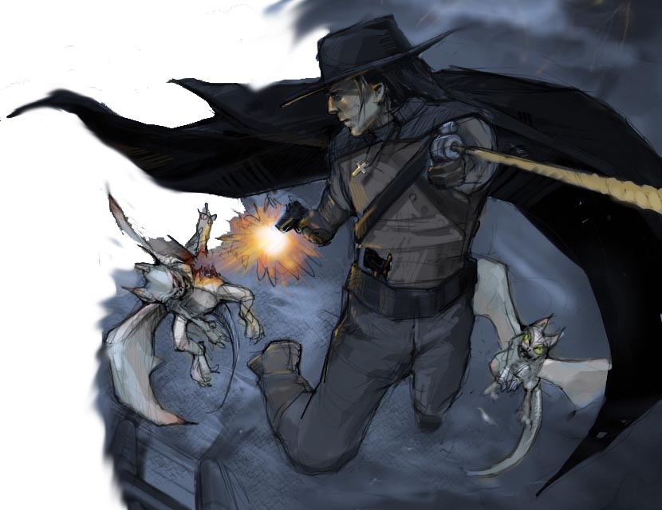
Concept
Define Game Concept
Define Core Game Features
Find/Assign Developer
Estimate Budget & Due Date
Based on notes from Neal Robison, ATI

Slide 54
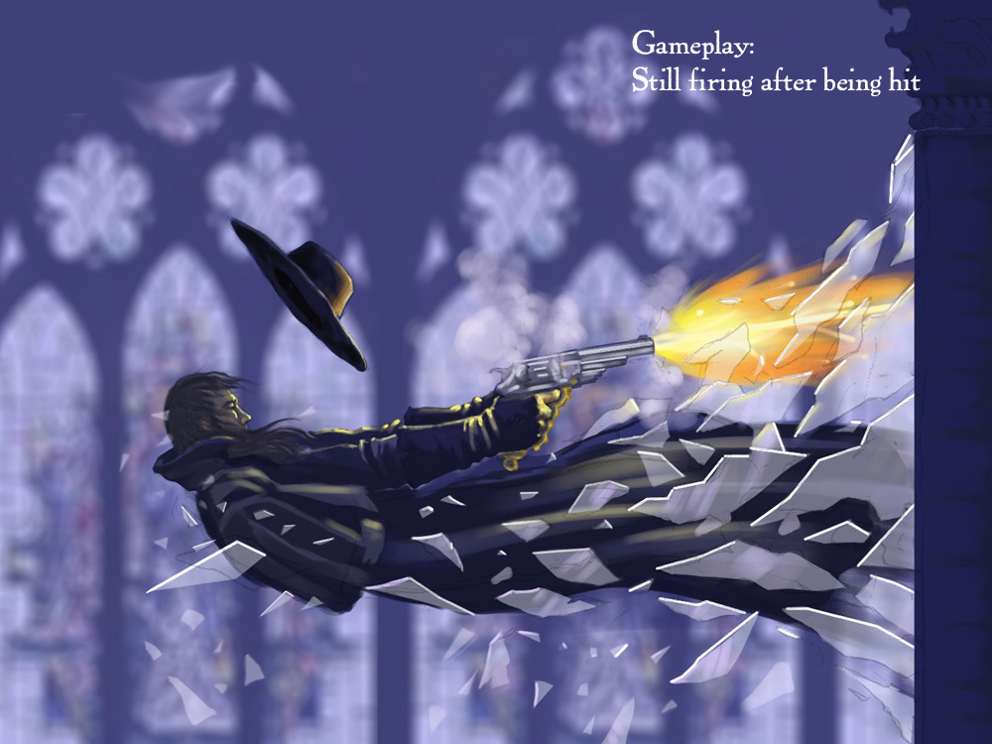
Concept: Van Helsing (1 of 4)
Based on notes from Neal Robison, ATI

Slide 55
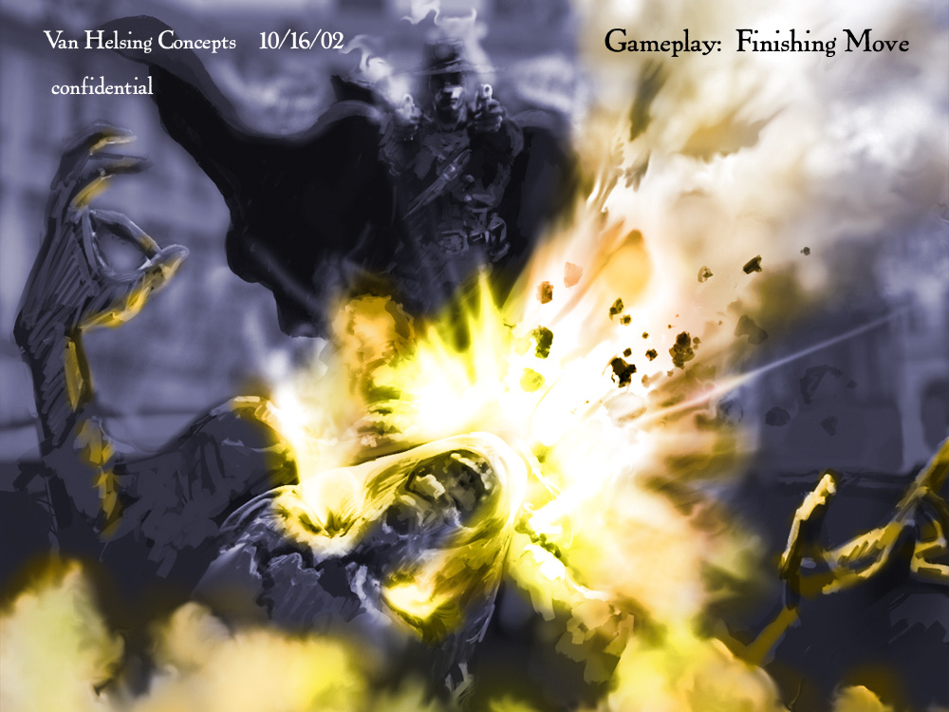
Concept: Van Helsing (2 of 4)
Based on notes from Neal Robison, ATI

Slide 56
Concept: Van Helsing (3 of 4)
(Van Helsing Pre-Production)
Based on notes from Neal Robison, ATI

Slide 57
Concept: Van Helsing (4 of 4)
(Van Helsing Finished Concept)
Based on notes from Neal Robison, ATI

Slide 58
Game Development Timeline (2 of 5)
Prototypes
Build prototypes as proof of concept
Can take 2-3 months (or more)
Typically done a few months in
In particular to test game play
Throw them away afterwards
Pitch to Publisher
(Continued next slide)

Slide 59
Prototype or 1st Playable
GDD & TDD = “The Bibles”
Production Budget & Detailed Schedule
Submit Concept to Sony, etc.
Working Prototype, with Game Mechanics
Focus Test
Based on notes from Neal Robison, ATI

Slide 60
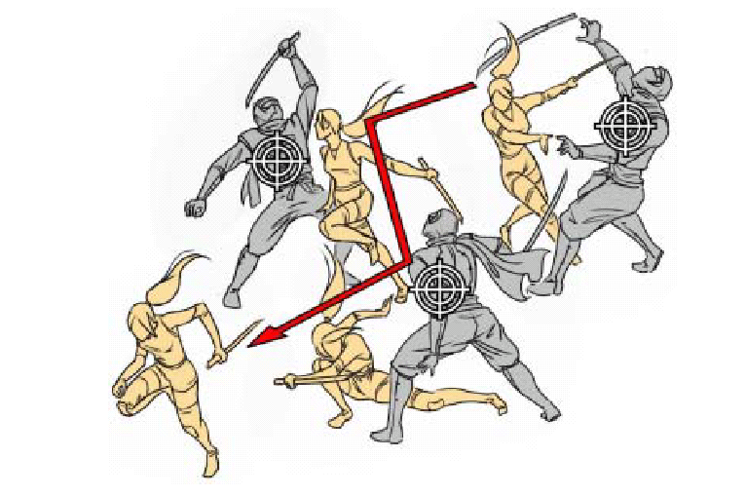
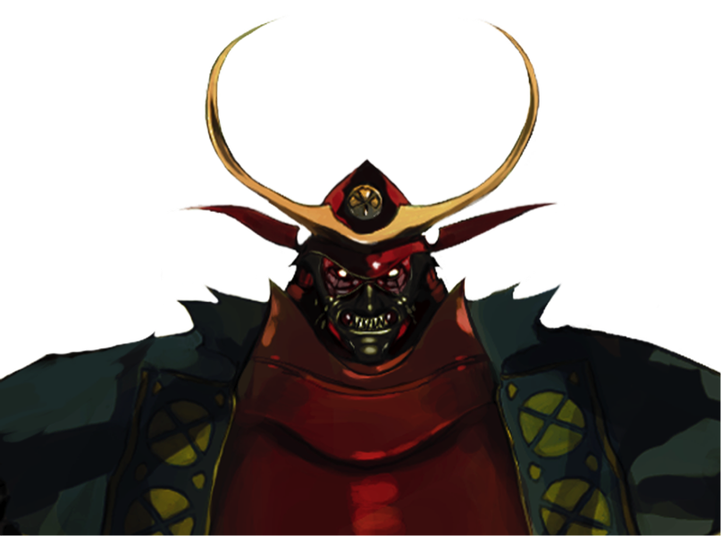
Prototype: Red Ninja (1 of 3)
Based on notes from Neal Robison, ATI

Slide 61
Prototype: Red Ninja (2 of 3)
(Red Ninja Pre-Production)
Based on notes from Neal Robison, ATI

Slide 62
Prototype: Red Ninja (3 of 3)
(Red Ninja Final Production)
Based on notes from Neal Robison, ATI

Slide 63
Game Development Timeline (3 of 5)
Blueprint
separate the project into different tiers
duration: 2 months
result: several mini-specification
Architecture
creating a technical design that specifies tools and technology used
duration: 2 months
result: full technical specification

Slide 64
Game Development Timeline (4 of 5)
Tool building
create a number of (preferably reusable) tools, like 3D graphics engine, level builder, or unit builder
duration: 4 months
result: set of functionally tools (maybe not yet feature complete)
Assembly
create the game based on the design document using the tools; update design document and tools as required (consulting the lead designer)
duration: 12 months
result: the complete game software and toolset

Slide 65
Other Development Milestones: Alpha Definition
At Alpha stage, a game should:
Have all of the required features of the design implemented, but not necessarily working correctly
Be tested thoroughly by QA to eliminate any critical gameplay flaws
Still likely contain a certain amount of placeholder assets
(Continued next slide)

Slide 66
Alpha Definition
Feature Complete
“Localization” Begins
Focus Test
Play Testing
Marketing Continues
Based on notes from Neal Robison, ATI

Slide 67
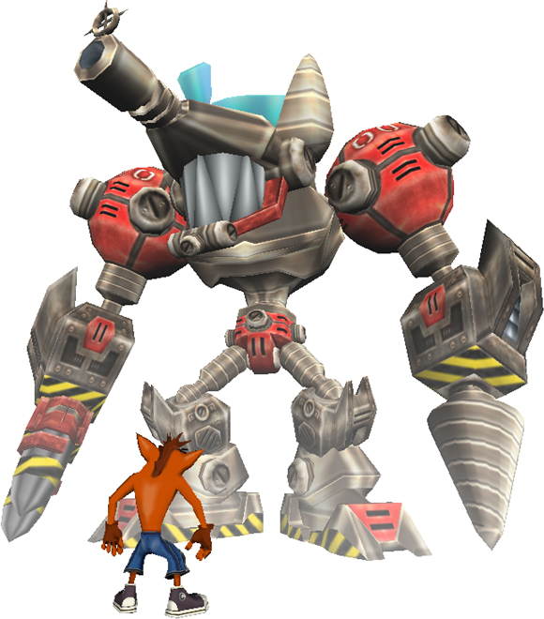
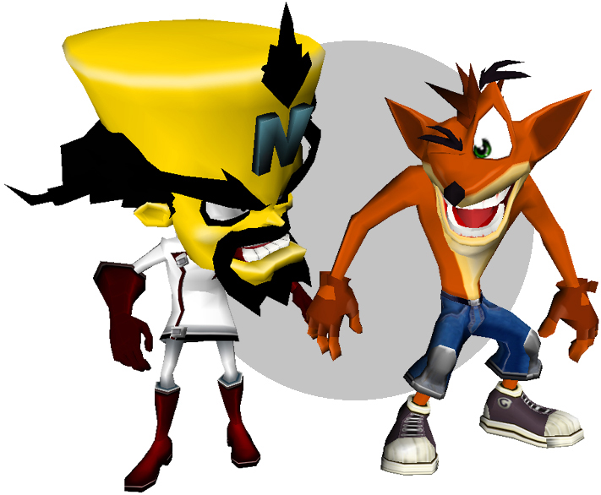
Alpha: Crash Bandicoot (1 of 2)
Based on notes from Neal Robison, ATI

Slide 68
Alpha: Crash Bandicoot (2 of 2)
(Crash Bandicoot)

Slide 69
Game Development Timeline (5 of 5)
Level design
create the levels for the game
duration: 4 months
result: finished game with all levels, in-game tutorials, manuals
Review
testing the code, the gameplay, and the levels
duration: 3 months (partially overlapping level design)
result: the gold master

Slide 70
Other Development Milestones: Beta Definition
At Beta stage, a game should:
Have all content complete
Be tested thoroughly for bugs and gameplay tweaks
Be shown to press for preview features
(Continued next slide)

Slide 71
Stages of Development: Beta
Polish, Polish, Polish
Game Balancing
Localization Continues
Demo Versions
Based on notes from Neal Robison, ATI

Slide 72
Other Development Milestones: Gold Master Definition
At Gold Master stage, a game should:
Be sent to the platform holder/s (where applicable) for TRC testing
Be sent to press for review
Be sent to duplication for production
Be backed up and stored
(Continued next slide)

Slide 73
Final/GMC/Gold
The Game is “Done”
Testing, Testing, Testing
Intense Pressure
Submit to Console developers
Manufacturing Timing
Based on notes from Neal Robison, ATI

Slide 74
Post-Mortem
Analysis of PR, Marketing
Analysis of Production, Source Code
Archive All Assets
What went right, what went wrong
Kick-off the Sequel!
Based on notes from Neal Robison, ATI

Slide 75
Outline
Background
What is a Game?
Genres
The Game Industry
Game Timeline
Team Sizes (next)

Slide 76
Development Team Size
As late as the mid-80’s teams as small as one person.
Today, teams today ranging from 10-60 people.
Programming now a proportionally smaller part of any project
Artistic content creation proportionally larger
See Gamasutra, (www.gamasutra.com)
Search for “post mortem”
Game data at bottom includes team size and composition
Laird and Jamin, EECS 494, Umich, Fall 2003

Slide 77
Development Team 1988
Sublogic’s JET (early flight sim)
Sublogic later made scenery files for Microsoft flight simulator
3 Programmers
1 Part-Time Artist
1 Tester
Total: 5
Laird and Jamin, EECS 494, Umich, Fall 2003

Slide 78
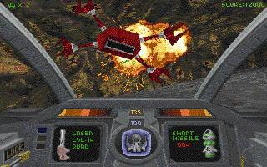
Development Team 1995
Interplay’s Descent
Used 3d polygon engine, not 2d sprites
6 Programmers
1 Artist
2 Level Designers
1 Sound Designer
Off-site Musicians
Total: 11
Laird and Jamin, EECS 494, Umich, Fall 2003

Slide 79
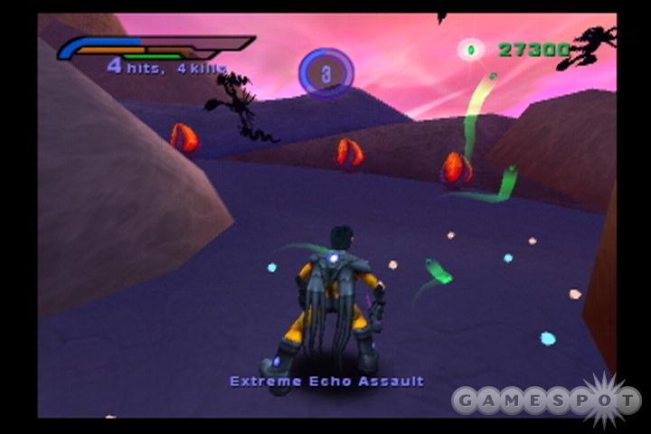
Development Team 2002
3 Character Modelers and Animators
1 2d and Texture Artist
1 Audio Designer
1 Cinematic Animator
1 QA Lead and Testers
THQ’s AlterEcho
1 Executive Producer
1 Producer
4 Programmers
2 Game Designers
1 Writer
3 Level Designers
Total: 19+
Laird and Jamin, EECS 494, Umich, Fall 2003

Slide 80
Development Teams for Online Games
Star Wars online (2003?)
Development team: 44 people
50% Artists
25% Designers
25% Programmers
3 Producers
“Live” Team (starting at Beta, 6 months before done)
8 Developers
50-60 Customer support (for 200K users)
1000 Volunteer staff (for 200K users)
Laird and Jamin, EECS 494, Umich, Fall 2003

Slide 81
A (Larger) Developer Company Today
Designing and creating computer games is serious business
Large budgets ($1 million+)
Large number of people involved
Large risk
Wisdom
Use modern software development techniques
Keep creativity were it belongs
In the design
Not during the programming

