Slide 1
Interactive Media and Game Development
Debugging

Slide 2
Debugging Introduction
Debugging is methodical process for removing mistakes in program
So important, whole set of tools to help. Called “debuggers”
Trace code, print values, profile
New Integrated Development Environments (IDEs) (such as Game Maker) have it built in
But debugging still frustrating
Beginners not know how to proceed
Even advanced can get “stuck”
Don’t know how long takes to find
Variance can be high
What are some tips? What method can be applied?

Slide 3
Outline
5-step debugging process
Game Maker specifics
Debugging tips

Slide 4
Step 1: Reproduce the Problem Consistently
Find case where always occurs
“Sometimes game crashes after kill boss” doesn’t help much
Identify steps to get to bug
Ex: start single player, room 2, jump to top platform, attack left, …
Produces systematic way to reproduce

Slide 5
Step 2: Collect Clues
Collect clues as to bug
Clues suggest where problem might be
Ex: if crash using projectile, what about that code that handles projectile creation and shooting?
And beware that some clues are false
Ex: if bug follows explosion may think they are related, but may be from something else
Don’t spend too long - get in and observe
Ex: see reference pointer from arrow to unit that shot arrow should get experience points, but it is NULL
That’s the bug, but why is it NULL?

Slide 6
Step 3: Pinpoint Error
1) Propose a hypothesis and prove or disprove
Ex: suppose arrow pointer corrupted during flight. Add code to print out values of arrow in air. But equals same value that crashes. Hypothesis is wrong. But now have new clue.
Ex: suppose unit deleted before experience points added. Print out values of all in camp before fire and all deleted. Yep, that’s it.
And/Or, 2) divide-and-conquer method
Sherlock Holmes: “when you have eliminated the impossible, whatever remains, however improbably, must be the truth”
Setting breakpoints, look at all values, until discover bug
The “divide” part means break it into smaller sections
Ex: if crash, put breakpoint ½ way. Is it before or after? Repeat.
Look for anomalies, NULL or NAN values

Slide 7
Step 4: Repair the Problem
Propose solution. Exact solution depends upon stage of problem.
Ex: late in code cannot change data structures. Too many other parts use.
Worry about “ripple” effects.
Ideally, want original coder to fix.
If not possible, at least try to talk with original coder for insights.
Consider other similar cases, even if not yet reported
Ex: other projectiles may cause same problem as arrows did

Slide 8
Step 5: Test Solution
Obvious, but can be overlooked if programmer is sure they have fix (but programmer can be wrong!)
So, test that solution repairs bug
Best by independent tester
Test if other bugs introduced (beware “ripple” effect)

Slide 9
Debugging Prevention
Add infrastructure, tools to assist
Alter game variables on fly (speed up)
Visual diagnostics (maybe on avatars)
Log data (events, units, code, time stamps)
Always initialize variables when declared
Indent code, use comments
Use consistent style, variable names
Avoid identical code – harder to fix if bug found
Use a script
Avoid hard-coded (magic numbers) – makes brittle
Verify coverage (test all code) when testing

Slide 10
Outline
5-step debugging process (done)
Kodu specifics (next)
Debugging tips

Slide 11
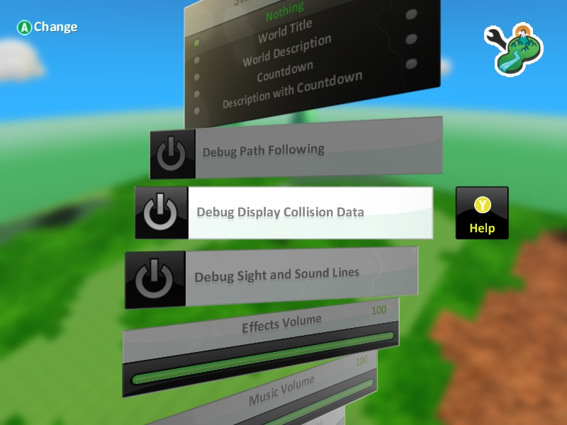
Debugging in Kodu (1 of 4)
Built-in debugging aids
Path
Collision
Sight and sound

Slide 12
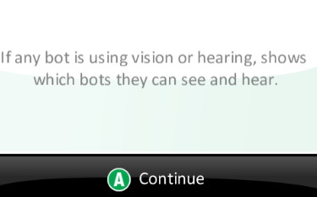
Debugging in Kodu (2 of 4)
Path
Sight and Hearing
Collisions

Slide 13
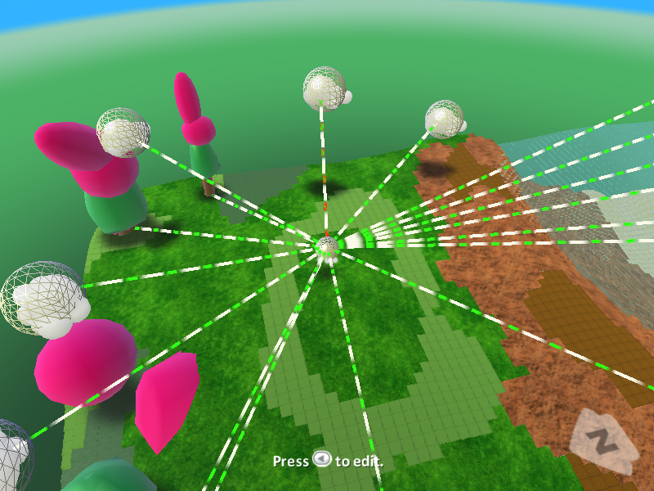
Debugging in Kodu (3 of 4)

Slide 14
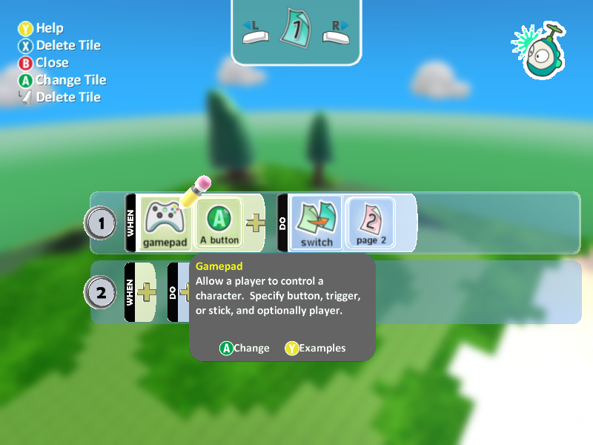
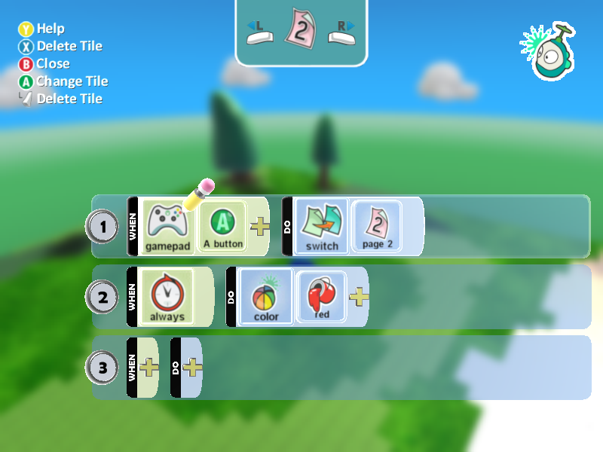
Debugging in Kodu (4 of 4)
To help see when/if events triggered, add own debug “messages”
Color, express …

Slide 15
Debugging Tips (1 of 3)
One thing at a time
Fix one thing at a time – don’t try to fix multiple problems
Change one thing at a time – test hypothesis. Change back if doesn’t fix problem.
Start with simpler case that works - then add more complex code, one thing at a time
Question your assumptions – don’t even assume simple stuff works, or “mature” products
Ex: libraries and tutorials can have bugs

Slide 16
Debugging Tips (2 of 3)
Check code recently changed – if bug appears, may be in latest code (not even yours!)
Use debugger – breakpoints, memory watches, stack …
Break complex calculations into steps – may be equation that is at fault or “cast” badly
Check boundary conditions – classic “off by one” for loops, etc.
Minimize randomness –
Ex: can be caused by random seed or player input. Fix input (script player) so reproducible

Slide 17
Debugging Tips (3 of 3)
Take a break – too close, can’t see it. Remove to provide fresh prospective
Explain bug to someone else – helps retrace steps, and others provide alternate hypotheses
Debug with partner – provides new techniques
Same advantage with code reviews, peer programming
Get outside help – tech support for consoles, Web examples, libraries, …

