Slide 1
Interactive Media and Game Development
Tiles, Sprites and Concept Art

Slide 2
Tiles
A tile is a small, square 2d image for a sprite-based game
Needed for commonly backgrounds
Often repeated
Too hard to make every pixel different!
RPGs make heavy use
Grass, trees, water, sand
Similar to repeating textures in 3D game
Start with a grass tile to warm up

Slide 3
Grass is Green
Use a basic green square
But looks unnatural
Like flat, shiny metal
No illusion of movement

Slide 4
Grass has Variation
Can do a lot with simple enhancement of color shades

Slide 5
Make Random
Use the “spray” tool

Slide 6
Make Look Random with Control
Draw by hand for more control
4 pixel line strokes

Slide 7
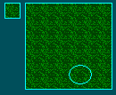
The “Grid” (1 of 3)
Looks too much like tiles
“Large” blank is problem, so remove

Slide 8
The “Grid” (2 of 3)
Still, some “lines” are visible when repeated
Break up with more color

Slide 9
The “Grid” (3 of 3)
Much better!

Slide 10
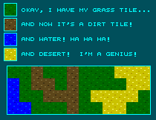
Don’t Try This at Home
Don’t use same texture for all, else not much better than just colors

Slide 11
When the Rubber Hits the Road?

Slide 12
Outline
Tiles (done)
Sprites (next)
Concept Art

Slide 13
Animation
Animation → produces the illusion of movement
Display a series of frames with small differences between them
Done in rapid succession, eye blends to get motion
Unit is Frames Per Second (fps). For video:
24-30 fps: full-motion (Game Maker does 30)
15 fps: full-motion approximation
7 fps: choppy
3 fps: very choppy
Less than 3 fps: slide show
(2D Sprites can get away with about about ½ the above)
To do successfully, need to keenly observe, focus on differences in movement
Apply basic principles (next)

Slide 14
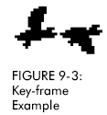
Key Frames
Images at extremes in movement
Most noticeable to observer
Ex: for flight wings up and wings down
Ex: for walking, right leg forward, leg together
The more the better?
Smoother, yes
But more time to develop (tradeoffs)
And more prone to errors, “bugs” that interfere with the animation
Based on Chapter 9, Designing Arcade Computer Game Graphics, by Ari Feldman

Slide 15
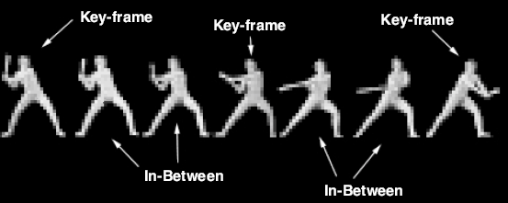
In-Between Frames
Generated to get smooth motion between key-frames
Can be tedious and time consuming to make
Most software allows duplication
Based on Chapter 9, Designing Arcade Computer Game Graphics, by Ari Feldman

Slide 16
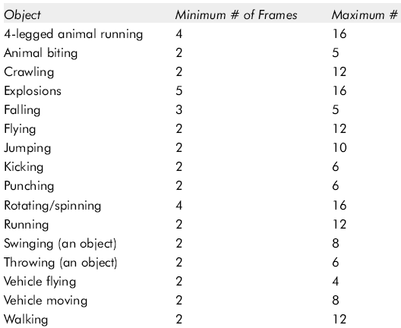
Frame Animation Guidelines
(See GameMaker tutorial shooter for examples of
Enemy Planes, Explosions)
Based on Chapter 9, Designing Arcade Computer Game Graphics, by Ari Feldman

Slide 17
Secondary Actions
Animation part that does not lead movement, but follows it
Add extra dimension of reality
Ex: Hair moving in wind
Ex: Cape billowing backward
Based on Chapter 9, Designing Arcade Computer Game Graphics, by Ari Feldman

Slide 18
Steps in Creating Animation Sequences (1 of 3)
Conceptualize – have vision (in mind or on paper) of what animation will look like
Decide on object behavior
Animated once (no looping)
Animated continuously (using cycles)
2nd choice means must make last key frame blend with first
Choose an image size – will contain and constrain object
Test and experiment briefly to have plenty of room
Design key-frames - drawing the motion extremes
Use simple shapes to represent main actions
Ex: stick figures or basic shapes (circles, squares)
Based on Chapter 9, Designing Arcade Computer Game Graphics, by Ari Feldman

Slide 19
Steps in Creating Animation Sequences (2 of 3)
Estimate the in-betweens – think of how many you will need to complete the sequence smoothly
Be conservative. Easier to add additional transition frames than remove them
Apply secondary enhancements - Embellish to look convincing and enticing
Based on Chapter 9, Designing Arcade Computer Game Graphics, by Ari Feldman

Slide 20
Steps in Creating Animation Sequences (3 of 3)
Test each movement
Can be done with ‘copy’ and ‘undo’ in tool
Others have animation rendering (ex- Game Maker)
Look for flaws (movement, discolored pixels …)
Repeat - Repeat for all animations
Based on Chapter 9, Designing Arcade Computer Game Graphics, by Ari Feldman

Slide 21
Outline
Tiles (done)
Sprites (done)
Concept Art (next)

Slide 22
Why Not Just Prototype?
Even creating prototypes can be time consuming and expensive
Getting it right on the first try is unlikely
Revising instantiated work can be difficult
Thus the need for some forethought!
Art and organization by Paolo Piselli, http://www.paolopiselli.com

Slide 23
What is a Better Way?
Make decisions on paper, where changes and variations can be made quickly and easily.
Art and organization by Paolo Piselli, http://www.paolopiselli.com

Slide 24
Who Is Involved?
We can think of the process as a two-part system:
The BOSS supplies the constraints that the drawing needs to fill.
The ARTIST generates drawings based on the given constraints.
Art and organization by Paolo Piselli, http://www.paolopiselli.com

Slide 25
The BOSS (1 of 3)
Takes part in a higher-level design process with goals of its own
Attract web-goers
Sell more widgets
Win an Oscar
Art and organization by Paolo Piselli, http://www.paolopiselli.com

Slide 26
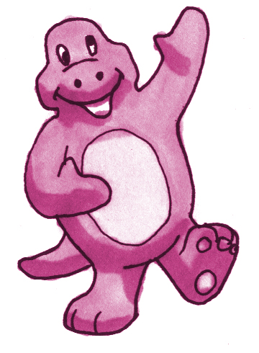
The BOSS (2 of 3)
Communicates constraints inherited from this higher-level process to the ARTIST
We need a happy, purple dinosaur to sell more widgets!
Happy Purple
Dinosaur
Art and organization by Paolo Piselli, http://www.paolopiselli.com

Slide 27
The BOSS (3 of 3)
Evaluates the fitness of the ARTIST’s solutions based on various heuristics
Market research
says its good
Wife likes it
Magic 8-Ball says
outlook not so good
Art and organization by Paolo Piselli, http://www.paolopiselli.com

Slide 28
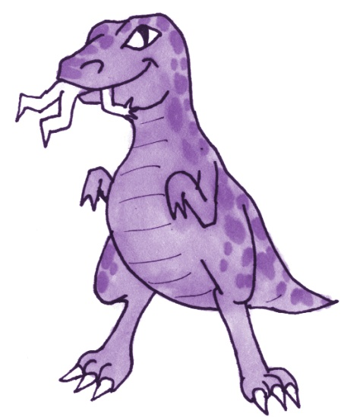
The ARTIST (1 of 4)
Generates drawings based on the given constraints
We need a happy, purple dinosaur to sell more widgets!
Happy Purple
Dinosaur
Art and organization by Paolo Piselli, http://www.paolopiselli.com

Slide 29
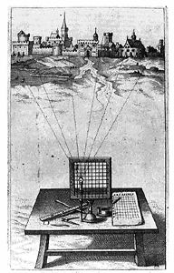
The ARTIST (2 of 4)
Has expert knowledge of drawing materials and techniques
Art and organization by Paolo Piselli, http://www.paolopiselli.com

Slide 30
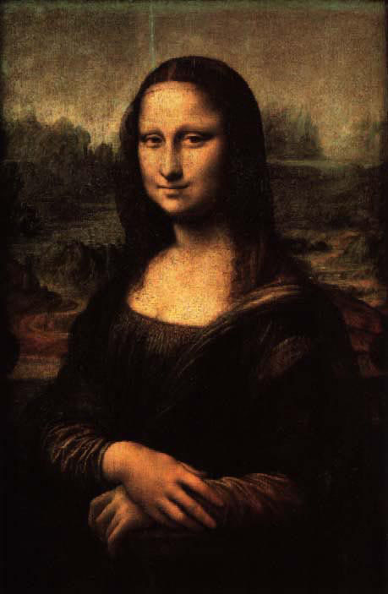
The ARTIST (3 of 4)
Has aesthetic heuristics (acquired by studying style, design and master artwork)
Art and organization by Paolo Piselli, http://www.paolopiselli.com

Slide 31
The ARTIST (4 of 4)
May need to cache domain-specific knowledge (dinosaur anatomy, typical dress of a noblewoman in 13th century England, etc.)
Art and organization by Paolo Piselli, http://www.paolopiselli.com

Slide 32
Beginning with Thumbnails (1 of 2)
The exploration of possible solutions often begins with ARTIST generating rough drawings.
These rough drawings - called “thumbnails” – are often little more than suggestive scribbles.
Thumbnails can be generated very rapidly. This allows ARTIST to generate many points of search space at little cost.
Art and organization by Paolo Piselli, http://www.paolopiselli.com

Slide 33
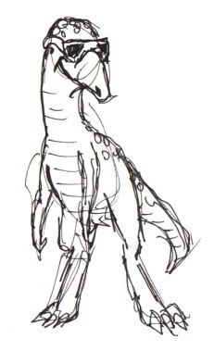
Beginning with Thumbnails (2 of 2)
I like the one with the sunglasses. Let’s see where we can go with that!
Thumbnails enable ARTIST and BOSS to quickly get their bearings and identify fruitful starting-points for exploration.
These rough drawings can quickly expose problems with the given constraints.
It doesn’t take highly detailed concepts to cull large portions of search space!
Art and organization by Paolo Piselli, http://www.paolopiselli.com

Slide 34
Drawing the Concept (1 of 5)
There are many techniques for creating more detailed concepts (pencils, markers, watercolors, etc.)
In general, the drawing process is one of iterative refinement.
For example, when rendering a concept with markers, the ARTIST will begin by roughly sketching most of the detail with a light marker.
Art and organization by Paolo Piselli, http://www.paolopiselli.com

Slide 35
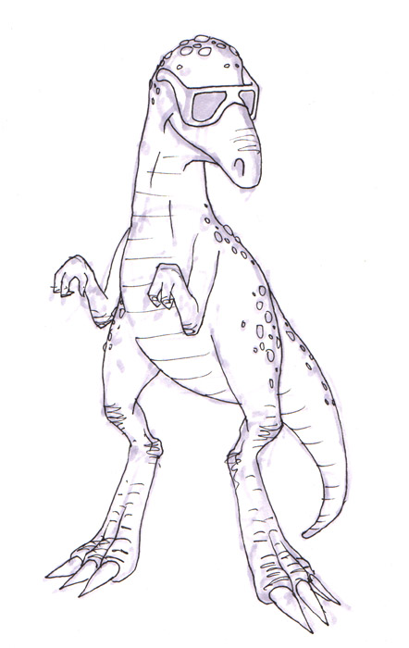
Drawing the Concept (2 of 5)
Next, the ARTIST does some line selection.
In this stage, the ARTIST is choosing the best of the rough details for inclusion in the final concept.
The ARTIST may also be adding some lower-level details as well, now that the higher-level details are becoming more specific.
Art and organization by Paolo Piselli, http://www.paolopiselli.com

Slide 36
Drawing the Concept (3 of 5)
Next, the ARTIST does some region coloring to separate the different elements of the drawing …
Art and organization by Paolo Piselli, http://www.paolopiselli.com

Slide 37
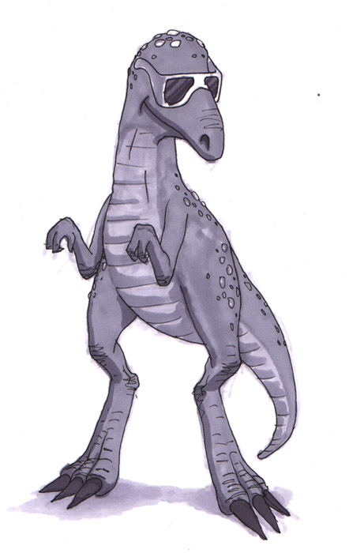
Drawing the Concept (4 of 5)
… and now a shading pass to reveal the 3D form of the concept …
Art and organization by Paolo Piselli, http://www.paolopiselli.com

Slide 38
Drawing the Concept (5 of 5)
… and finally a detail pass, picking out lines to reinforce and areas to highlight.
This concept is finished …
but wait!
Art and organization by Paolo Piselli, http://www.paolopiselli.com

Slide 39
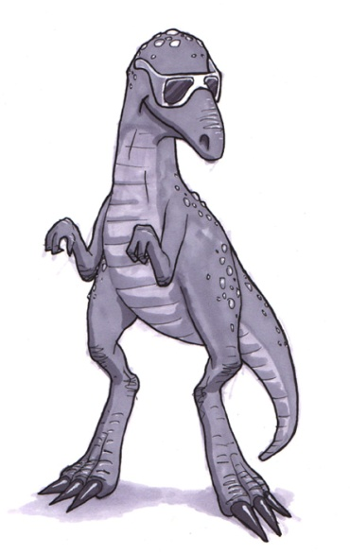
Back to the Drawing Board!
Very nice! But the Magic 8-Ball doesn’t like all those spots; and the VCs think it should have big, muscley arms!
!
Art and organization by Paolo Piselli, http://www.paolopiselli.com

Slide 40
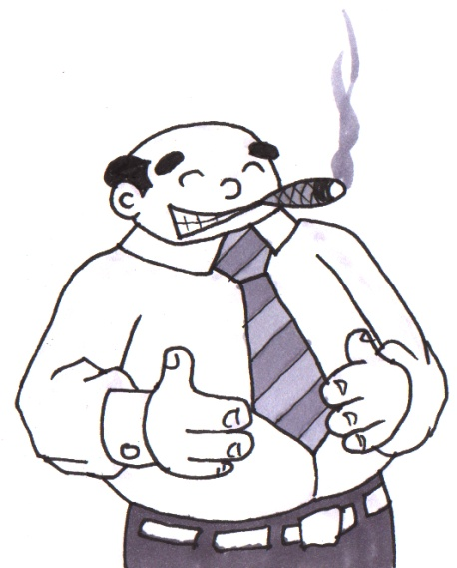
Questions and Discussion
Art and organization by Paolo Piselli, http://www.paolopiselli.com

