Slide 1
Scene Management

Slide 2
Introduction
Graphics cards can render a lot, and fast
  But never as much or as fast as we’d like!
Intelligent scene management squeezes more graphics performance out of limited resources
Outline
  Scene graphs
  Scene partitioning
  Visibility calculations
Notes:
Some from IMGD3000 C-term 2011 (Robert Lindeman)
Some from Ultimate 3D Game Engine Design and Architecture by Allen Sherrod
Some from Game Engine Architecture by Jason Gregory
Some from http://research.cs.wisc.edu/graphics/Courses/679-f2003/

Slide 3
Motivation for Scene Graphs
Consider game with people, in a car, on a road
People move around the car, don’t affect the position of car
But car moving affects position of people
If massive hand picks up road → affects location of car and people!
Exists beyond positions, too
  Consider animations or textures tied to skeletons
To make movement/drawing more efficient, structure that supports such relationships → Scene graphs

Slide 4
Scene Graphs
Specification of object and attribute relationships
  Spatial
  Hierarchical
  Material properties
Easy to “attach” objects together
  E.g. Riding in a vehicle
Implementation does not need to be objects in tree
  Can use pointers (e.g. to textures, sprites) instead
Logical and possibly spatial relationships
  Often goal is to make it easy to discard large swaths so do not need to render
→ Spatial data structures (next)

Slide 5
Spatial Data Structures
Spatial data structures store data indexed by location
  E.g. Store according to Position …
  Without graphics, used for queries like “Where is the nearest hotel?” or “Which stars are near enough to influence the sun?”
Multitude of uses in computer games
  Visibility - What can player see?
  Collision detection - Did bullet just hit wall?
  Proximity queries - Where is nearest health-pack?
Can reduce “cost” with fast, approximate queries that eliminate most irrelevant objects quickly
  Trees with containment property enable this
  Cell of parent completely contains all cells of children
  If query fails for cell, it will fail for all children
  If query succeeds, try it for children
  Cost? → Depends on object distribution, but roughly O(log n)

Slide 6
Spatial Data Structures
For games, focus on spatial data structures that partition space into regions, or cells, of some type
  Generally, cut up space with planes that separate regions
Uniform Grids
  Split space up into equal sized / number of cells
Quad (or Oct) Trees
  Recursively split space into 4 (or 8) equal-sized regions
  Can do with a sphere, too
Binary-Space Partitioning (BSP) trees
  Recursively divide space along a single, arbitrary plane
k-dimensional trees (k-d trees)
  Recursively partition in k dimensions until termination condition (e.g. 1 object per cell)
(Example of each next)

Slide 7
Uniform Grid
Cells can be approximately size of view distance
Only need consider objects in cell and neighbor
Pro: Easy to find, compute
Con: Not effective if many objects in one cell

Slide 8
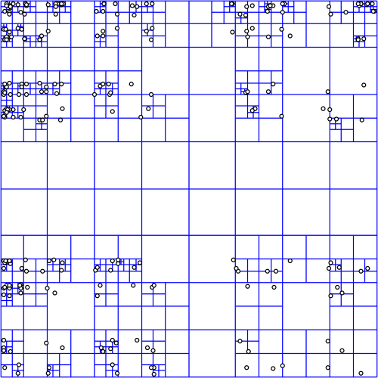
Quad Tree
Each node has exactly 4 children
For 2-d space, subdivide into 4 regions
Split until (max-1) objects in each cell
  E.g. 1 object in each

Slide 9
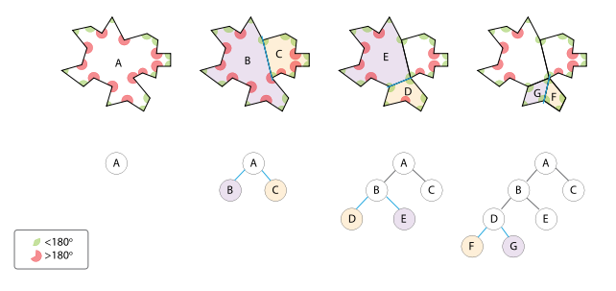
Binary Space Partitioning (BSP) Tree
Recursively sub-divide space into convex sets
For 3-d polygon scenes, can apply painter’s algorithm
  Draw leaves of tree up (back polygons written first)
  (Originally used in Doom before zbuffer to get fast rendering)

Slide 10
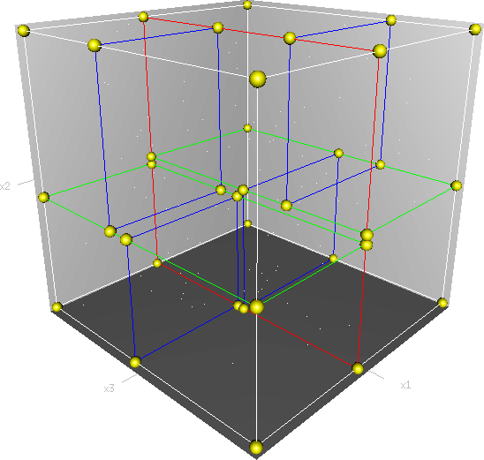
K-D tree
Instead of 2 dimensions (binary) can use k-dimensions
3-dimensional k-d tree. First split (red) cuts root cell (white) into two subcells, each of which is split (green) into two subcells. Finally, each is split (blue) into two sub-cells. Final eight called leaf cells.

Slide 11
Cell-Portal Structures
Cell-Portal data structures dispense with hierarchy → just store neighbor information
  Makes them graphs, not trees
Cells described by bounding polygons
Portals polygonal openings between cells
Good for visibility culling algorithms, OK for collision detection and ray-casting
Several ways to construct
  By hand, as part of authoring process
  Automatically, starting with BSP or k-d tree and extracting cells and portals
  Explicitly, as part of automated modeling process

Slide 12
Cell-Portal Visibility
Keep track of which cell viewer is in
Enumerate all visible regions
Preprocess to identify potentially visible set (PVS) for each cell
A
B
C
D
E
F

Slide 13
Potentially Visible Set (PVS)
PVS: Set of cells/regions/objects/polygons that man be seen from particular cell
  Want to identify objects that can be seen
  Trade-off is memory consumption vs. accurate visibility
Computed as pre-process
  Easy for static objects (e.g. cells)
  Need strategy to manage dynamic objects
Used in various ways:
  As only visibility computation - render everything in PVS for viewer’s current cell
  As first step - identify regions of interest, then apply more accurate run-time algorithms

Slide 14
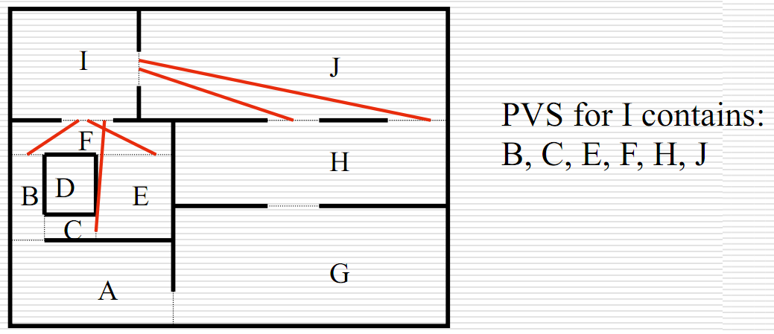
Cell-to-Cell PVS
Cell A in cell B's PVS if stabbing line from portal of B to portal of A
  Stabbing line → line segment intersecting only portals
  Neighbor cells are trivially in PVS

Slide 15
Putting It All Together
The "best" solution will be a combination
  Static things
    E.g. quad-tree for terrain
    E.g. cells and portals for interior structures
  Dynamic things
    E.g. quick reject using bounding spheres
Balance between pre-computation and run-time computation

Slide 16

Group Exercise (1)
Assume you want to SceneManager for Dragonfly
Support: Altitude
  Keep current levels, but have more efficient data structure
Design SceneManager
  Attributes (data structures)?
  Methods?
What existing code needs refactoring?
for alt = -MAX_ALTITUDE to MAX_ALTITUDE
// iterate through all objects
if (p_temp_go -> getAltitude() == alt)
// draw

Slide 17
Group Exercise (2)
Consider additional Scene Management functionality
  More efficient collision detection
Consider simple first (list), then advanced (grid)
To support, what is needed …
  Attributes (data structures)?
  Methods?
What existing code needs refactoring?

Slide 18
Group Exercise (3)
Consider views with SceneManager grid
  How can they be used for more efficient drawing with views?
Sketch out algorithm
See notes: SCENE.txt

