Slide 1
IMGD 3000
Game Engine Introduction

Slide 2
Introduction
Do you know the names of some game engines?
What, exactly, is a game engine?
How does it work?

Slide 3
What is a Computer Game? User Perspective
A goal (or set of goals)
Save the Princess (solve puzzles to get sword first)
Score points (get power ups)
Finish first (unlock new features)
A set of rules governing play
Turn taking, like RPGs
Reaction to events, like Tetris’ falling blocks
Legal actions
Visual and Audible content (graphics and sound)
Control techniques
Button mappings, mouse clicks

Slide 4
What is a Computer Game? Computer Perspective
Set of resources managed to support entertainment (usually) application
Graphical rendering
User interface
Script handling
Event processing
Timers, collisions, etc.
File I/O
Optional: Networking, AI, Physics

Slide 5
Game Code versus Game Engine Code
Line between game and game engine often blurry
E.g. One game, an engine may know how to “draw and orc”
E.g. Another game, engine provides rendering and shading, but “orcness” defined entirely in user code
No clear separation since “built-in” parts of game engine are often part of the game
E.g. sprite or animation, collision detection …

Slide 6
Game Engine Specificity
Reusable? Often
But many still make one game only
Efficient? Often
Can tune commonly used code
General purpose? Somewhat
Can make more than one game (e.g. mod)
Often designed with specific genre in mind
Some genres with likely very different engine support
Arcade (e.g. Tetris)
Side-scroller (e.g. Mario)
3d isometric (e.g. Diablo)
1st person (e.g. CoD)
MMORPG (e.g Warcraft)
Turn-based (e.g. Civ)
Story (e.g. Heavy Rain)
How do you think each may differ?

Slide 7
Game Engine Components
Substrate
Hardware (PC, Xbox, Ipad …) and Operating System (Windows 7, IOS, …)
Graphics API (OpenGL, DirectX, Curses)
Third-party libraries (STL, Networking)
Math libraries (trig, linear algebra)
Core Systems
Memory allocation
Engine configuration
Parsers (for config files)
Debugging and performance (unit testing, profiling, error logging)
Startup/Shutdown (initialization and final state)

Slide 8
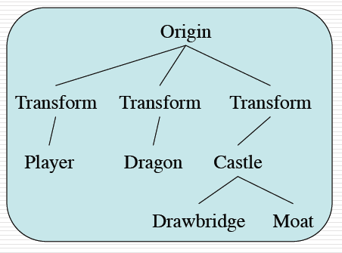
Game Engine Components
Representation of the world
Game objects
Possibly oriented, relative
Timing is very important
Events are time-based
Multi-player needs consistency
Low-level utilities
Updating objects, handling resources in/out, logging, memory management, encryption…

Slide 9
Game Engine Components
Rendering system (Dragonfly – yes)
How to display scene
Lighting, occlusion, textures, camera, viewport …
Special effects (particles)
Sound system
Music and dialog, formats and timing and resources
Physics
How objects may move and/or interact
Object physical states (location, velocity, orientation)
Bounding volumes and collision detection
Artificial intelligence
“Smart” objects, as opponents or NPC
Low-level utilities such as pathfinding

Slide 10
Game Engine Components
Input management
Map device specific commands (e.g. keystroke or mouse click) to generic game-specific command (e.g. left)
Resource Manager
3d models (skeleton, animations), Textures
Loading, decompression
Online Multiplayer
Authentication and registration
Game state replication
Latency compensation (dealing with lag)
Gameplay Foundations
Static world elements
Dynamic world elements
Events/messaging

Slide 11
Example Core System - Structures
Basic data structures
Arrays – fast indexing, fast insertion/deletion at end
Lists – slow indexing, fast insertion/deletion in middle
Maps (hash tables) – fast searching and insertion
May be provided standard libraries (e.g. C++ STL)
System-specific concepts
System time – converting from OS to game time
File system – open, close, read/write, directories and naming

Slide 12
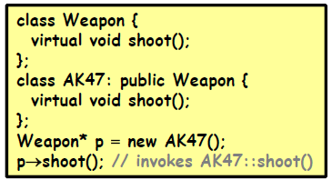
Example Core System – Object System
Key functionality → Run-time type information
Polymorphic at run-time
E.g. Engine just wants to make weapon “shoot”
→ object specific code knows how to do this
Note, C++ and Java do this automatically
But if C (or some other language), must do yourself
Notes:
http://www.cs.umd.edu/class/spring2011/cmsc498m/Lects/chapt04-engines.pdf

Slide 13
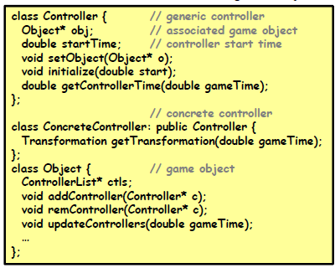
Example Core System – Object System
Controllers – most objects can be altered, so associate generic (and then specific) controller
Notes:
http://www.cs.umd.edu/class/spring2011/cmsc498m/Lects/chapt04-engines.pdf

Slide 14
Our Focus
Mainly on the tech stuff
How to build core engine components
How to use engine to make custom world
How to support user interaction
How to set rules of play and control
Less on content
Art
Sound
Game design

Slide 15
Game Engine Architecture
Have overview of what a game engine does, but how to go about designing your own engine?
Components
What are the major components?
How to separate game-independent components from game-dependent components?
Organization
How are components defined and organized?
Structure
Assume an object-oriented approach → what class structure should be used for various elements?
This class!

