Slide 1

Dragonfly

Slide 2
Goals
Understand use of Dragonfly from game programmer’s perspective
  Mostly, Project 1
Provide overview of Dragonfly architecture
  Class diagrams
Discuss details needed to fully implement Dragonfly classes

Slide 3
Outline – Part I
Saucer Shoot (next)
Overview
Managers
Logfile Management
Game Management

Slide 4
Saucer Shoot
\
~==-
/
____
/__o_\
What is this code doing?
When is this method called?
Why do it this way?
In Saucer::move():
…
move_countdown--;
if (move_countdown > 0)
return;
move_countdown = move_slowdown;
…

Slide 5
Saucer Shoot
\
~==-
/
____
/__o_\
What is this code doing?
Why not do it this way?
What should be done instead?
void Saucer::move() {
…
x = pos.getX();
y = pos.getY();
Position new_pos;
new_pos.setX(x-1);
new_pos.setY(y);
this -> setPos(new_pos)
…

Slide 6
Saucer Shoot
\
~==-
/
____
/__o_\
void Explosion::step() {
time_to_live--;
if (time_to_live <= 0){
WorldManager &world_manager=WorldManager::getInstance();
world_manager.markForDelete(this);
}
}
What is time_to_live here? What is it set to initially?
What is happening when time_to_live is 0?
Why not just call own destructor? i.e.
  this->~Saucer()

Slide 7
C++: Do Not Explicitly Call Destructor
void someCode() {
File f;
...code that should execute when f is still open...
← We want the side-effect of f's destructor here!
...code that should execute after f is closed...
}
Suppose File destructor closes file
Can you call destructor now?
If not, how to fix?

Slide 8
C++: Do Not Explicitly Call Destructor
void someCode() {
{
File f;
...code that should execute when f is still open...
} ← f's destructor automatically called here!
...code that should execute after f is closed...
}
What if cannot wrap in local block?
  make close()?

Slide 9
C++: Do Not Explicitly Call Destructor
class File {
public:
void close();
~File();
...
private:
int fileHandle; // fileHandle >= 0 iff it's open
};
File::~File() {
close();
}
void File::close() {
if (fileHandle >= 0) {
...code that calls the OS to close the file...
fileHandle = -1;
}
}
User then could call f.close() explicitly

Slide 10
C++: Do Not Explicitly Call Destructor
What if allocated via new (as in Saucer Shoot)?
Still, no!
Remember, delete p does two things
  Calls destructor
  Deallocates memory
Bob *p = new Bob();
p->~Bob(); // should you do this?
Bob *p = new Bob();
…
delete p; // automagically calls p->~Bob()

Slide 11
Summary – Destructors and Dragonfly
Don’t call destructor explicitly
For memory allocated by new, use delete when possible
For game engine (Dragonfly), want engine to release memory
  Use WorldManager::markForDelete()

Slide 12
Outline – Part I
Saucer Shoot (done)
Overview (next)
Managers
Logfile Management
Game Management

Slide 13
Dragonfly Game Engine
GAME CODE
Saucer: move()
Hero: key()
Star: onEvent()
GameOver: step()
DRAGONFLY
DrawCharacter
InsertObject
LoadSprite
GetKey
MoveObject
SendEvent
COMPUTER PLATFORM
Allocate memory
Clear display
File open/close
Get keystroke

Slide 14
Dragonfly Classes
Managers
Game objects
Support classes
LogManager
Manager
ResourceManager
WorldManager
GraphicsManager
InputManager
GameManager
GameObjectList
GameObject
GameObjectListIterator
Sprite
Clock
Box
Position
Event
EventStep
EventMouse
EventCollision
EventOut
EventKeyboard

Slide 15
Engine Support Systems - Managers
Support systems that manage crucial tasks
  Handling input, Rendering graphics, Logging data
  …
Many interdependent, so startup order matters
  E.g. Log file manager needed first since others log messages
  E.g. Graphics manager may need memory allocated for sprites, so need Memory manager first.
Often, want only 1 instance of each Manger
  E.g. Undefined if two objects managing the graphics
How to enforce only 1 instance in C++?

Slide 16
Managers in C++: Global Variables?
Could make Managers global variables (e.g. outside of main() )
  Constructors called before main(), destructors when main() ends
Then, declare global variable:
  RenderManager render_manager;
However, order of constructor/destructor unpredictable
  E.g. RenderManager r; GraphicsManager g;
  Could call g::g() before r::r()!
Plus, explicit globals difficult from library
  Names could be different in user code
How about static variables inside a function
Notes:
Gregory, Chapter 5

Slide 17
Managers in C++: Static Variables?
Remember, static variables retain value after method terminates
Static variables inside method not created until method invoked
Use inside Manager class method go “create” manager → the Singleton
void stuff() {
static int x = 0;
cout << x;
x++;
}
main() {
stuff(); // prints 0
stuff(); // prints 1
}

Slide 18
Managers: C++ Singletons
Compiler won’t allow
  MySingleton s;
Instead:
  MySingleton &s= MySingleton::getInstance();
Guarantees only 1 copy of MySingleton will exist
class MySingleton {
private:
// Private constructor
MySingleton();
// Can’t assign or copy
MySingleton(MySingleton const& copy);
MySingleton& operator=(MySingleton const& copy);
public:
// return the 1 and only 1 MySingleton
static MySingleton& getInstance() {
static MySingleton instance;
return instance;
}
};
Use for Dragonfly Managers
However, also want to explicitly control when starts (not at first getInstance()) call)
→ Use startUp() and shutDown() for each

Slide 19

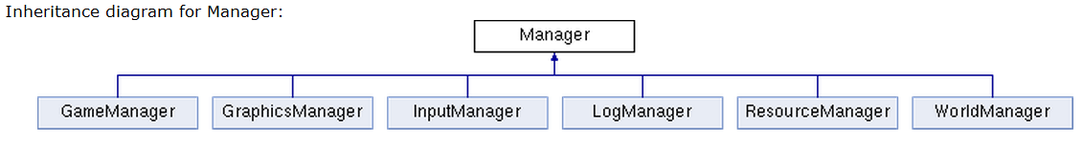
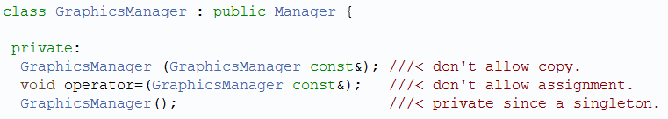
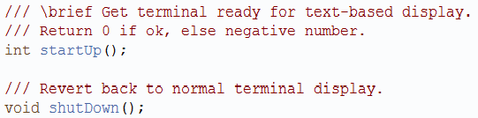
The Manager Interface
All Dragonfly “managers” inherit from this class

Slide 20
Outline – Part I
Saucer Shoot (done)
Overview (done)
Managers (done)
Logfile Management (next)
Game Management

Slide 21
Game Engine Messages
If all goes well, only want game output
But during development, often not the case
  Even for players, may have troubles running game
Generally, need help debugging
Debuggers are useful tools, but some bugs not easy to find in debugger
  Some bugs timing dependent, only happen at full speed
  Some caused by long sequence of events, hard to trace by hand
Most powerful debug tool can still be print messages (e.g. printf())
However, standard printing difficult when graphical display
One Solution → Print to file

Slide 22
The LogManager - Functionality
Control output to log file
  Upon startup → open file
  Upon shutdown → close file
Attributes
  Need file handle
What else?
  Method for general-purpose messages via writeLog()
    E.g. “Player is moving”
    E.g. “Player is moving to (x,y)” with x and y passed in
  Associate time with each message
    Could be in “game time” (e.g. game loop iterations)
    Could be in “real time” (i.e. wall-clock → we’ll do this)

Slide 23
General Purpose Output
For writeLog(), using printf() one of the most versatile
  But takes variable number of arguments
  printf(“Bob wrote 123 lines”); // 1 arg
  printf(“%s wrote %d lines”, “Bob”, 123); // 3 args
Solution → allow variable number of arguments passed into writeLog()
Specify with “…”:
void writeLog(const char *fmt, …) {
  …
}

Slide 24
General Purpose Output
Need <stdarg.h>
Create a va_list
  Structure gets initialized with arguments
va_start() with name of last known arg
Can then do printf(), but with va_list
  → vprintf()
va_end() when done
#include <stdio.h>
#include <stdarg.h>
void writeLog(const char* fmt, ... ) {
fprintf( stderr, “Error: ” );
va_list args;
va_start( args, fmt);
vprintf( stderr, fmt, args );
va_end( args );
}

Slide 25
Nicely Formatted Time String
Time functions not immediately easy to read
  time() returns seconds since Jan 1, 1970
  time_t time(time_t *t);
  localtime() converts calendar time struct to local time zone, returning pointer
  struct tm *localtime (time_t *p_time);
Combine to get user-friendly time string (e.g. “07:53:30”)
Wrap in method, getTimeString()
// return a nicely-formatted time string: HH:MM:SS
// note: needs error checking!
char *LogManager::getTimeString() {
static char time_str[30];
struct tm *p_time;
time_t time;
time(&time);
p_time = localtime(time);
// 02 gives two digits, %d for integer
sprintf(time_str, "%02d:%02d:%02d",
p_time -> tm_hour,
p_time -> tm_min,
p_time -> tm_sec);
return time_str;
}

Slide 26
Flushing Output
Data written to file buffered in user space before going to disk
If process terminates without file close, data not written
  fprintf(fp, “Doing stuff”);
  // program crashes (e.g. segfault)
  “Doing stuff” line passed, but won’t appear in file
Can add option to fflush() after each write
  Data from all user-buffered data goes to OS
  Note, incurs overhead, so perhaps only when debugging

Slide 27
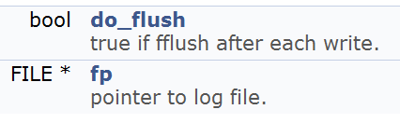
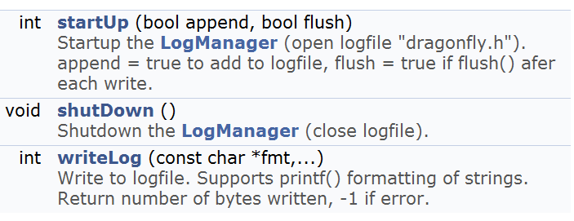
The LogManager
Protected attributes:
Public methods:

Slide 28
Once-only Header Files
LogManager used by many objects (status and debugging). So, all #include “LogManager.h”
During compilation, header file processed twice
  Likely to cause error, e.g. when compiler sees class definition twice
  Even if does not, wastes compile time
Solution? → "wrapper #ifndef"

Slide 29
Once-only Header Files
When header included first time, all is normal
  Defines FILE_FOO_SEEN
When header included second time, FILE_FOO_SEEN defined
  Conditional is then false
  So, preprocessor skips entire contents → compiler will not see it twice
// File foo
#ifndef FILE_FOO_SEEN
#define FILE_FOO_SEEN
(the entire file)
#endif // !FILE_FOO_SEEN
Convention:
  User header file, name should not begin with _ (underline)
  System header file, name should begin with __ (double underline)
  Avoids conflicts with user programs
  For all files, name should contain filename and additional text

Slide 30
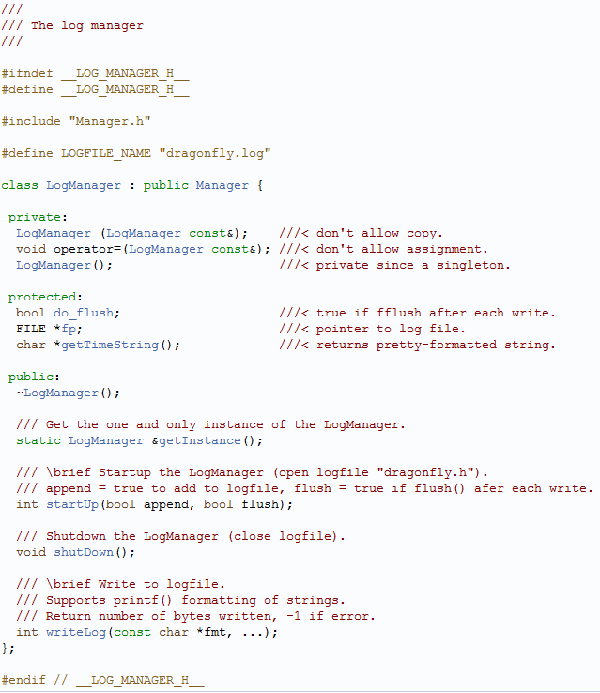
The LogManager – Complete Header File

Slide 31
Using the LogManager - Example
Convention: class name, method name
  Ease of finding code when debugging
LogManager &log_manager = LogManager::getInstance();
…
log_manager.writeLog( // 3 args
"GraphicsManager::startUp(): max X is %d, max Y is %d",
max_x, max_y);
…
log_manager.writeLog( // 1 arg
“GraphicsManager::startUp(): Current window set”);
07:53:30 *****************************************************
07:53:30 ** Dragonfly version 1.2 **
07:53:30 Log Manager started
07:53:30 GraphicsManager::startUp(): max X is 80, max Y is 24
07:53:30 ResourceManager::loadSprite(): label: saucer, file:
07:53:30 sprites/saucer-spr.txt

Slide 32
Controlling Verbosity Level
Lots of printfs() all over to fix and develop, so would be nice to leave them there
  Could be needed later!
  But noisy
Can control via engine setting
  → verbosity setting
int g_verbosity = 0; // user can chnge
…
void LogManager::writeLog(
int verbosity,
char *fmt, …) {
// Only print when level high enough
if (g_verbosity > verbosity) {
va_list args;
…
}
}
Verbosity level still has run-time overhead
  Can remove with conditional compilation

Slide 33
Conditional Compilation
#if, #ifdef, #ifndef, #else, #elif, #endif
Often used for platform-specific code
Also, control verbosity and debug messages (DEBUG1, DEBUG2…)
#ifdef LINUX
Linux specific code here
#elif WIN32
Windows specific code
#endif
#ifdef DEBUG1
LogManager &log_manager = LogManager::getInstance();
log_manager.writeLog(
"WorldManager::markForDelete(): will delete object %d",
p_go -> getId());
#endif

Slide 34
Outline – Part I
Saucer Shoot (done)
Overview (done)
Managers (done)
Logfile Management (done)
Game Management (next)
  Clock
  GameManager

Slide 35
Saucer Shoot
\
~==-
/
____
/__o_\
void Star::out() {
WorldManager &world_manager = WorldManager::getInstance();
pos.setX(world_manager.getBoundary().getHorizontal() + random()%20);
pos.setY(random() % world_manager.getBoundary().getVertical());
move_slowdown = random()%10;
}
When does the above code get called?
What is the above code doing?
We said that game code should use WorldManager::moveObject(). Should a Star?
Why or why not?

Slide 36
Saucer Shoot
\
~==-
/
____
/__o_\
A Bullet is a 12, 10
A Saucer is at 13, 10
During the next step, is there a collision?
If no, when will there be a collision?
If yes, how many collision events does the Bullet get? How many does the Saucer get?

Slide 37
The Game Loop
The Game Manager “runs” the game:
While (game not over) {
Get input from keyboard/mouse
Update world state
Draw new screen to back buffer
Swap back buffer to current buffer
}
How fast will the above loop run?
  Note, early games just moved objects fixed amount each loop
  → On faster computers, objects moved faster!
How to slow it down?

Slide 38
The Game Loop with Timing
While (1) {
Get input from keyboard/mouse
Update world state
Draw new screen to back buffer
Swap back buffer to current buffer
Measure how long last loop took
Sleep for (TARGET_TIME – elapsed)
}
But what is TARGET_TIME?
Frame rate is how often images updated to player → Unit is Hertz (Hz) or frames per second (fps)
30 frames/second typically full-motion video
Time between frames is frame time or delta time
At 30 fps, frame time is 1/30 or 33.3 milliseconds
  Milliseconds are a common unit for game engines
Ok, how to measure computer time?

Slide 39
Measuring Computer Time
time() returns seconds since Jan 1, 1970
  Resolution of 1 second. Far too coarse.
Modern CPUs have high-resolution timer
  Hardware register that counts CPU cycles
  3 GHz processor, timer goes 3 billion times/sec, so resolution is 0.333 nanoseconds → Plenty!
  64-bit architecture → wraps about every 195 years
  32-bit architecture → every 1.4 seconds
System calls vary with platform
  Win32 AP → QueryPerformanceCounter() to get value, and QueryPerformanceFrequency() to get rate
  Xbox 360 and PS3 → mftb (move from time base register)

Slide 40
Measuring Computer Time
64-bit high precision, more than needed so 32-bit could be ok
  However, still want to measure 64-bit if wrapping a problem
  Typical unit of 1/300th second is sometimes used (can slow down 30fps animation to 1/10th, for example)
Beware storing as floating point as distributes bits between mantissa and exponent so precision varies over time
For debugging breakpoints, may want to put in check to see if “large” gap (then assume breakpoint) and not necessarily that a lot of game time should have passed

Slide 41
Game Engine Need
Use to find elapsed time since last call
Call once per game frame to know how long it took
  Can then sleep for the right amount
  Or “catch up” with object updates if it took too long
→ So, how to measure elapsed time? On Windows? Linux?

Slide 42
Compute Elapsed Time – Linux (Cygwin)
#include <time.h>
struct timespec curr_ts;
long int curr_microsec, prev_microsec;
long int elapsed_time; // in microseconds
clock_gettime(CLOCK_REALTIME, &prev_ts); // start timer
// do something ...
clock_gettime(CLOCK_REALTIME, &curr_ts); // stop timer
// convert to total microseconds
curr_microsec = curr_ts.tv_sec*1000000 + curr_ts.tv_nsec/1000;
prev_microsec = prev_ts.tv_sec*1000000 + prev_ts.tv_nsec/1000;
elapsed_time = curr_microsec - prev_microsec;

Slide 43
Compute Elapsed Time - Windows
#include <iostream>
#include <windows.h>
LARGE_INTEGER frequency; // ticks per second
LARGE_INTEGER t1, t2; // ticks
double elapsed_time; // microseconds
QueryPerformanceFrequency(&frequency); // determine CPU freq
QueryPerformanceCounter(&t1); // start timer
// do something ...
QueryPerformanceCounter(&t2); // stop timer
// compute elapsed time in microseconds
elapsed_time = (t2.QuadPart-t1.QuadPart) * 1000000.0 / frequency.QuadPart;

Slide 44
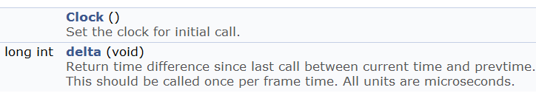
The Clock Class
Use to find elapsed time since last call
  For Dragonfly, this is sufficient
  More general purpose could provide “game time” and allow time scaling
Then, can call once per game frame to know how long it took
  Can then sleep for the right amount
  Or “catch up” if it took too long

Slide 45
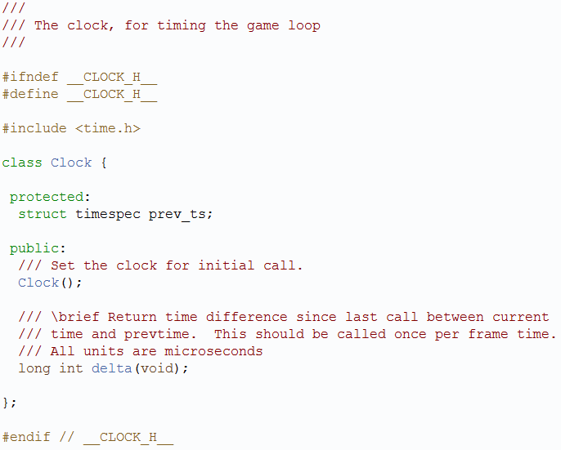
Clock.h

Slide 46
Additional Timing Topics (1 of 2)
At end of game loop, need to sleep for whatever is remaining
  Roughly milliseconds of granularity
On Linux/Unix (and Cygwin)
  usleep() → microseconds (need <unistd.h>)
  E.g. usleep (20000) // sleep for 20 millisec
On Windows
  Sleep() → milliseconds (need <windows.h>)
  E.g. Sleep(20) // sleep for 20 millisec

Slide 47
Additional Timing Topics (2 of 2)
What happens if game engine cannot keep up (i.e. elapsed > TARGET_TIME)?
  Generally, frame rate must go down
  But does game play (e.g. saucer speed)?
Could have GameManager provide a “step” event more than once, as required
  But note, if the step events are taking the most time, this could exacerbate the problem.
Could have elapsed time available to objects so they could adjust accordingly
  move_x = ((int) elapsed / TARGET) + 1
  position.setX(old_x + move_x)
→ Could be provided by Clock class

Slide 48
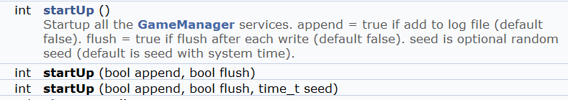

GameManager (1 of 2)
Run game loop
Startup/Shutdown all the other managers
  As of now, just LogManager
Other

Slide 49
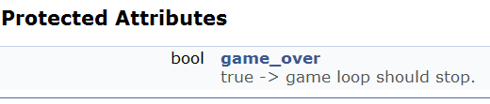

GameManager (2 of 2)
Ability for game code to indicate game is over:
When true, loop should stop and run() should return

Slide 50
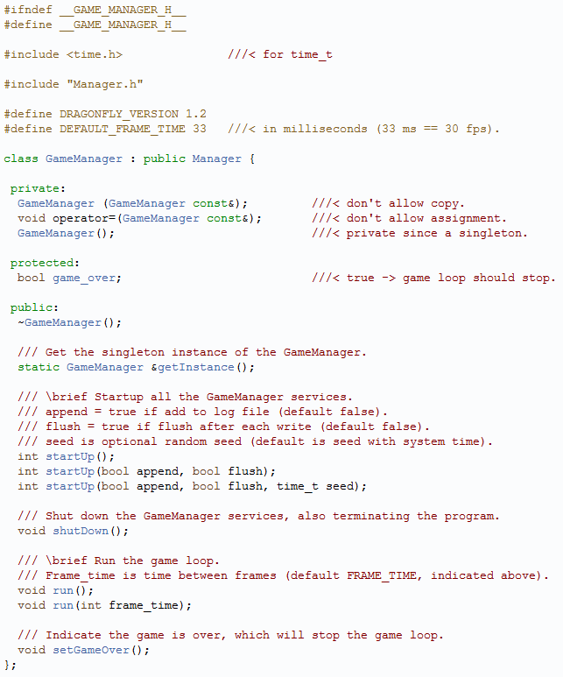
GameManager.h

Slide 51
Outline – Part I
Saucer Shoot (done)
Overview (done)
Managers (done)
The LogManager (done)
The GameManager (done)

Slide 52
Outline – Part II
Game Objects (next)
  Position
  GameObject
The Game World
Events
WorldManager

Slide 53
Game Objects
Fundamental game programmer abstraction for items in game
  Opponents (e.g. Saucers)
  Player characters (e.g. Hero)
  Obstacles (e.g. Walls)
  Projectiles (e.g. Bullets)
  Other (e.g. Explosions, Score indicator, …)
Game engine needs to access (e.g. to get position) and update (e.g. change position)
  → Core attribute is location in world, or position

Slide 54
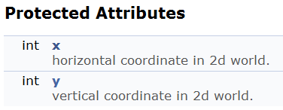
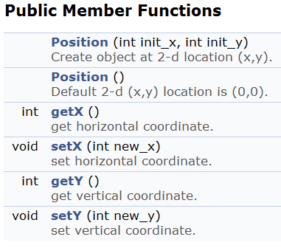
Position Class
By having a Position class rather than (x,y) integers → a game (or game engine) could inherit to add z coordinate

Slide 55
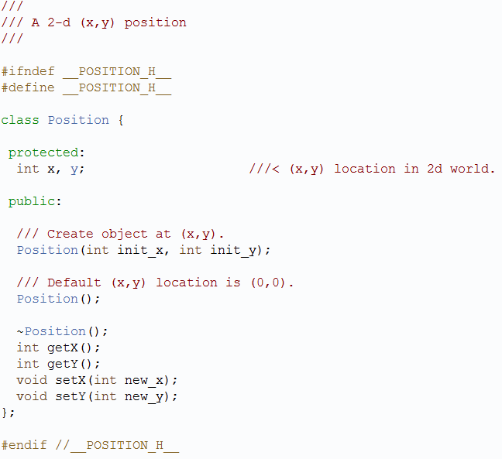
Position.h

Slide 56



GameObject
Ability to set and get position
Ability to set and get type
  Typically, set in constructor of specific object
    e.g. Saucer::Sacuer()
Ability to set and get id (globally unique)
  Set in the game WorldManager when object is loaded
Above are mostly useful for debugging, but may have other uses from game programmer perspective
Will have other attributes later
  E.g. altitude, sprite, bounding boxes…

Slide 57
Outline – Part II
Game Objects (done)
The Game World (next)
  Lists of Game Objects
  Updating game objects
Events
WorldManager

Slide 58
Lists of Game Objects
Different kinds of lists might want. E.g.
  List of all solid objects
  List of all objects within radius of explosion
  List of all Saucer objects
WorldManager will store, respond to queries
Lists should be efficient (e.g. avoid copying objects)
Updating objects in lists should update objects in game world

Slide 59
Object List
Different choices possible, but suggest array for ease of implementation
int item[MAX];
int count;
Constructor():
count = 0;
// same for clear()
bool remove(int x) {
for (int i=0; i<count; i++) {
if (item[i] == x) {
// found so scoot over
for (int j=i; j<count; j++)
list[j] = list[j+1];
count--;
return true; // found
}
}
return false; // not found
}
bool insert(int x) {
// check if room
if (count == MAX)
return false;
item[count] = x;
count++
}

Slide 60
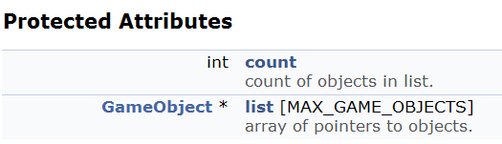
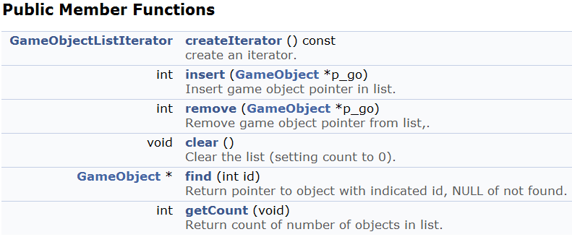
GameObjectList
Will have pointers to GameObjects

Slide 61
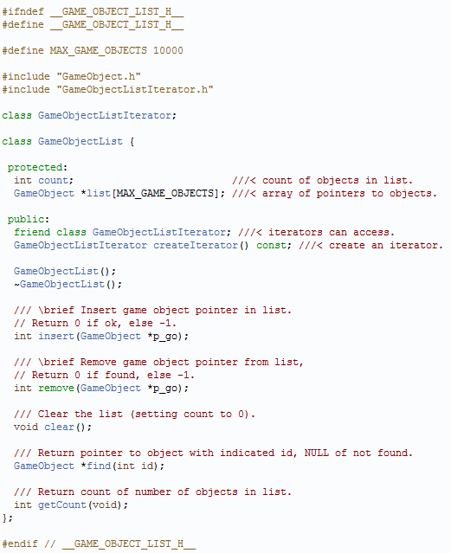
GameObjectList.h
← Iterator

Slide 62
Iterators
Iterators “know” how to traverse through container class
  Decouples container implementation with traversal
Can have more than one for a given list, each keeping position
Note, adding or deleting to list while iterating may cause unexpected results
  Should not “crash” but may skip items
Steps
  Design an “iterator” class for “container” class
  Add createIterator() member to container class
  Clients ask container object to create iterator object
  Clients use first(), isDone(), next(), and currentItem() to access
Notes:
http://sourcemaking.com/design_patterns/iterator

Slide 63
Example: Stack Iterator
// Step 1. Design an "iterator"
class StackIter {
class const Stack *stk;
int index;
public:
StackIter(const Stack *s) { stk = s; }
void first() { index = 0; }
void next() { index++; }
bool isDone() { return index == stk->sp + 1; }
int currentItem() { return stk->items[index]; }
};
Stack s;
// Step 3. Create iterator
StackIter si(&s);
// Step 4. Use
si.first();
while (!si.isDone()) {
int item = si.currentItem();
si.next();
}
class Stack {
int items[10];
int sp;
public: friend class StackIter;
Stack() { sp = - 1; }
void push(int in) { items[++sp] = in; }
int pop() { return items[sp--]; }
bool isEmpty() { return (sp == - 1); }
// Step 2. Add a createIterator() member
StackIter *createIterator()const {
return new StackIter(this);
}
};

Slide 64
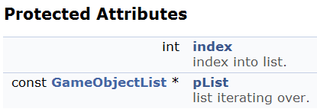
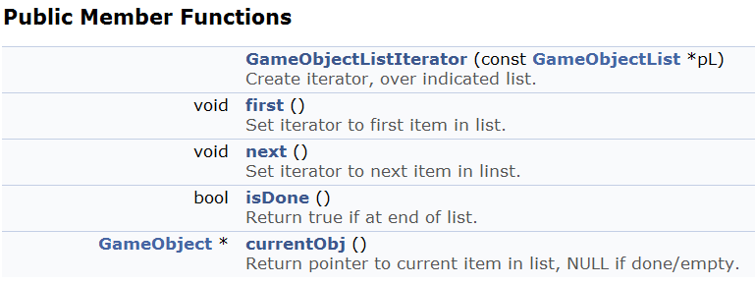
GameObjectListIterator

Slide 65
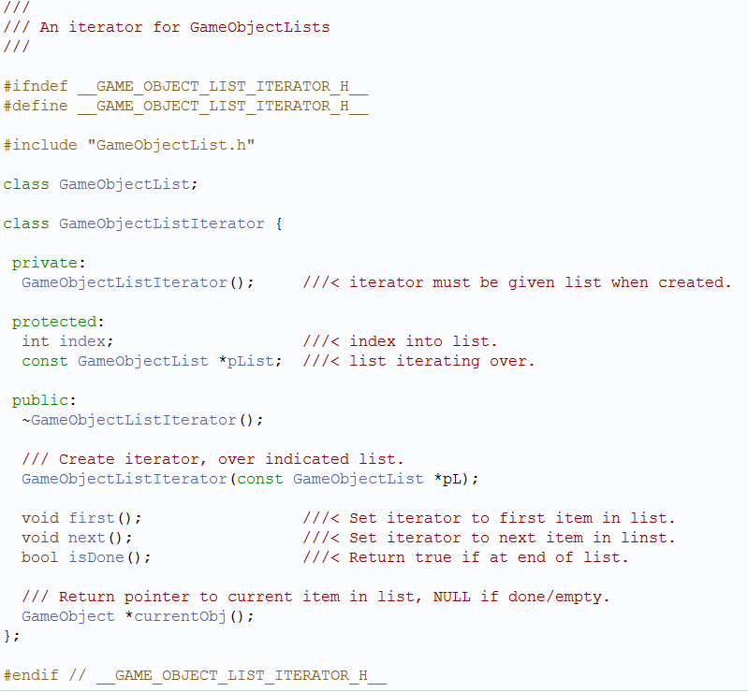
GameObjectListIterator.h

Slide 66
Updating the Game World
Games are … Dynamic, Real-time, Agent-based Computer Simulation
  Well researched Computer Science topic
As a developer, you can study wider field
  Agent-based simulations
  Discrete-event simulations
For now, concentrate on updating game objects

Slide 67

Updating Game Objects
Every engine updates game objects – one of its core functionalities, provides interaction:
  Makes game is dynamic
  Allows game to respond to player
While representation at a given time is static, better to think of world as dynamic where game engine samples
  S_{i}(t) denotes state of object i a time t
  This helps conceptually when engine cannot “keep up”
So, update is determining current state S_{i}(t) given state at previous time, S_{i}(t - Δt)
  Clock should provide Δt
  (Dragonfly assumes Δt is constant, 33 ms default)

Slide 68
Simple Approach (1 of 3)
Iterate over game object collection, calling Update()
  Update() declared in base object, declared virtual
Do this once per game loop (i.e. once per frame)
Derived game objects (e.g. Saucer) provide custom implementation of Update() to do what they need
Pass in Δt so objects know how much time has passed
virtual void Update(int dt)
  (Again, Dragonfly assumes this is constant so not passed)
Note, Update() could pass to component objects, too
  E.g. Update() to car sends it to riders and mounted gun
Seems ok, right? But the devil is in the details …

Slide 69
Simple Approach (2 of 3)
Note, game world manager has subsystems that operate on behalf of objects
  Animate, emit particle effects, play audio, compute collisions …
Each has internal state, too, that is updated over time
  Once or a few times per frame
Could do these subsystem updates in Update() for each object

Slide 70
Simple Approach (3 of 3)
(1)
(2)
Virtual void Tank::Update(int dt) {
// update the state of the tank itself
moveTank(dt);
rotateTurret(dt);
fireCannon(dt);
// update low-level engine subsystems
p_animationSystem -> Update(dt);
p_collisionSystem -> Update(dt);
p_audioSystem -> Update(dt)
}
// game loop
while(1) {
inputManager.getUserInput();
int dt = clock.getDelta();
for each game object // iterator
gameObject.Update(dt);
graphicsManager.swapBuffers();
}
So, what’s wrong with above?
Most engine subsystems operate in batched mode → consider rendering subsystem
If do all render operations at once, can cull occluded objects
  Increase efficiency
Also, order may matter
  E.g. can’t compute cat skeleton position until know human
So, efficiency and functionality demand alternate solution!

Slide 71
Simple Fix for Batch Updates (1 of 2)
Engine allows all objects to request rendering services in Update(), but rendering itself is deferred
(next slide)
Virtual void Tank::Update(int dt) {
// update the tank
moveTank(dt);
rotateTurret(dt);
fireCannon(dt);
// control properties, but do
// not update
if (didExplode)
p_animationSystem ->
PlayAnimation(“explosion”);
if (isVisbile) {
p_collisionSystem -> Activate();
p_renderingSystem -> Show()
}
}

Slide 72
Simple Fix for Batch Updates (2 of 2)
Game loop now updates subsystems at once
Benefits
  Better cache coherency
  Minimal duplication of computations
  Reduced re-allocation of resources (used by subsystems when invoked)
  Efficient pipelining
    Most render systems can pipeline if pipe filled
// game loop
while(1) {
inputManager.getUserInput();
int dt = clock.getDelta();
// objects update themselves
for each game object // iterator
gameObject.Update(dt);
// then update subsystems
p_animationSystem -> Update(dt);
p_collisionSystem -> Update(dt);
p_audioSystem -> Update(dt)
graphicsManager.swapBuffers();
}

Slide 73
Adding Support for Phased Updates (1 of 2)
Engine systems may have dependencies
  E.g. Physics manager may need to go first before can apply rag-doll physics animation
And subsystems may need to run more than once
  E.g. Ragdoll physics before physics simulation and then after collisions
// game loop
while(1) {
…
// then update subsystems
p_animationSystem -> CalculateIntermediatePoses(dt);
p_ragDollSystem -> ApplySkeletons(dt);
p_physicsEngine -> Simulate(dt);
p_collisionSystem -> DetectResolveCollisions(dt);
p_ragDollSystem -> ApplySkeletons(dt);
…
Game objects may need to add Update() information more than once
  E.g. before each Ragdoll computation and after

Slide 74
Adding Support for Phased Updates (2 of 2)
Provide “hooks” for game objects to have multiple updates
// game loop
while(1) {
…
for each game object
gameObject.PreAnimUpdate(dt);
p_animationSystem -> CalculateIntermediatePoses(dt);
for each game object
gameObject.PostAnimUpdate(dt);
p_ragDollSystem -> ApplySkeletons(dt);
p_physicsEngine -> Simulate(dt);
p_collisionSystem -> DetectResolveCollisions(dt);
p_ragDollSystem -> ApplySkeletons(dt);
for each game object
gameObject.FinalUpdate(dt);
…
(Note: iterating over all objects multiple times can be expensive → we’ll fix later)

Slide 75
Beware “One Frame Off” Bugs
Abstract idea has all objects simultaneously updated each step
  In practice, happens serially
Can cause confusion and source of bugs if objects query each other
  E.g. B looks at A for own velocity. May depend if A has been updated or not. May need to specify when via timestamp
The states of all game objects are consistent before and after the update loop, but they may be inconsistent during it.

Slide 76
Outline – Part II
Game Objects (done)
The Game World (done)
Events (next)
WorldManager

Slide 77
Events
Games are inherently event-driven
An event is anything that happens that an object may need to take note of
  E.g explosion, pickup health pack, run into enemy
Generally, engine must
  A) Notify interested objects
  B) Arrange for those objects to respond
  → Call this event handling
Different objects respond in different ways (or not at all)
So, how to manage event handling?

Slide 78
Simple Approach
Notify game object that event occurs by calling method in each object
E.g. explosion, send event to all objects within radius
  virtual function named onExplosion()
void Explosion::Update() {
// …
if (explosion_went_off) {
GameObjectList damaged_objects;
g_world.getObjectsInSphere(
damage_radius, damaged_objects);
for (each object in damaged_objects)
object.onExplosion(*this);
}
}
Statically typed late binding
  “Late binding” since compiler doesn’t know which → only known at runtime
  “Statically typed” since knows when object known
    E.g. Tank → Tank::onExplosion(), Crate → Crate:onExplosion()
So, what’s the problem?

Slide 79
Statically-Typed is Inflexible
Base object must declare onExplosion(), even if not all objects will use
  In fact, in many games, there may be no explosions!
Worse → base object must declare virtual functions for all possible events in game!
Makes difficult to add new events since must be known at engine compile time
  Can’t make events in game code or even with World editor
Need dynamically typed late binding
  Some languages support natively (e.g. C# delegates)
  Others (e.g. C++) must implement manually
How to implement?
  → add notion of function call in object and pass object around
  Often called message passing

Slide 80
Encapsulating Event in Object
Components
Advantages
Type (e.g. explosion, health pack, collision …)
Arguments (e.g. damage, healing, with what …)
Could implement args as linked list
Args may have various types
Single event handler
  Since type encapsulated, only method needed is
  virtual void onEvent(Event *p_e);
Persistence
  Event data can be retained say, in queue, and handled later
Blind forwarding
  An object can pass along event without even “knowing” what it does (the engine does this!)
  E.g. “dismount” event can be passed by vehicle to all occupants
struct Event {
EventType type;
int num_args;
EventArg args[MAX];
}
Note, this is also called the Command pattern

Slide 81
Event Types (1 of 2)
enum EventType {
LEVEL_STARTED;
PLAYER_SPAWNED;
ENEMY_SPOTTED;
EXPLOSION;
BULLET_HIT:
…
}
One approach is to match each
type to integer
  Simple and efficient (integers are
  fast)
Problem
  Events are hard-coded, meaning adding new events hard
  Enumerators are indices so order dependent
    If someone adds one in the middle data stored in files gets messed up
This works usually for small demos but doesn’t scale well

Slide 82
Event Types (2 of 2)
Encode via strings (e.g. string event_type)
Good:
  Totally free form (e.g. “explosion” or “collision” or “boss ate my lunch”) so easy to add
  Dynamic – can be parsed at run-time, nothing pre-bound
Bad:
  Potential name conflicts (e.g. game code inadvertently uses same name as engine code)
  Events would fail if simple typo (compiler could not catch)
  Strings “expensive” compared to integers
Overall, extreme flexibility makes worth risk by many engines

Slide 83
Event Types as Strings
To help avoid problems, can build tools
  Central dbase of all event types → GUI used to add new types
  Conflicts automatically detected
  When adding event, could “paste” in automatically, to avoid human typing errors
While setting up such tools good, significant development “cost” should be considered

Slide 84
Event Arguments
Easiest is have new type of event class for each unique event
Objects get parent Event, but can check type to see if this is, say, an ExplosionEvent.
class ExplosionEvent : public Event {
float damage;
point center;
float radius;
}

Slide 85
Chain of Responsibility (1 of 2)
Game objects often dependent upon each other
  E.g. “dismount” event passed to cavalry needs to go to rider only
  E.g. “heal” event given to soldier does not need to go to backpack
Can draw graph of relationship
  E.g. Vehicle ← Soldier ← Backpack ← Pistol
May want to pass events along from one in chain to another
  Passing stops at end of chain
  Passing stops if event is “consumed”

Slide 86
Chain of Responsibility (2 of 2)
virtual bool SomeObject ::onEvent(Event *p_event) {
// call base class’ handler first
if (BaseClass:onEvent(p_event)) {
return true; // if base consumed, we are done
}
// Now try to handle the event myself
if (p_event -> getType() == EVENT_ATTACK) {
respondToAttack(p_event -> getAttackInfo());
return false; // ok to forward to others
} else if (p_event -> getType() == EVENT_HEALTH_PACK) {
addHealth(p_event -> getHealthPack().getHealth());
return true; // I consumed event, so don’t forward
} … else {
return false; // I didn’t recognize this event
}
}
(Almost right → actually, need to upcast the event call – see later slides)

Slide 87
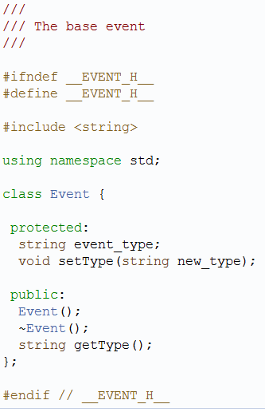
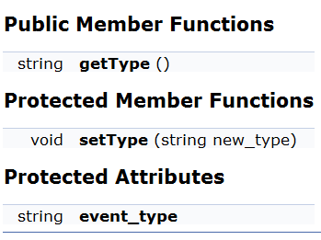
Events in Dragonfly
Engine has base class
Type is a string
  Flexible for game programmer to define however meaningful
    E.g. NUKE_EVENT == “nuke”
Event.h

Slide 88
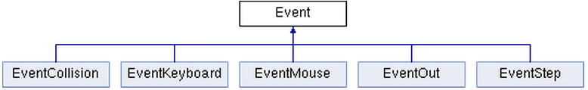
Events in Dragonfly
Specific events inherit from it
Engine defines a few used by most games
Will define most as needed, but do EventStep now

Slide 89
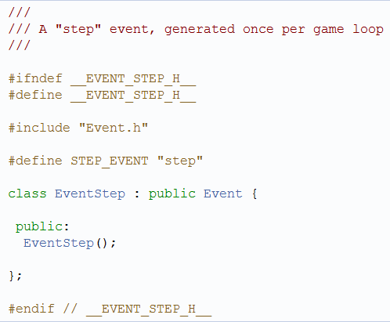
Step Event
Generated by GameManager every game loop
  Send to all (interested) GameObjects
Constructor just sets type to STEP_EVENT
EventStep.h

Slide 90
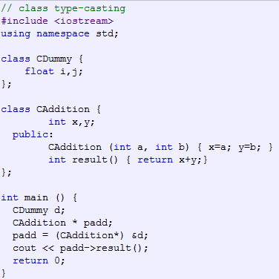
Runtime Type Casting
short a=2000; int b; b = (int) a;
Want to convert Event to EventStep
  If Event handler in game code (e.g. Saucer.cpp)
C++ strongly typed → conversion to another type needs to be made explicit
Note, can lead to run-time errors that are syntactically correct
  Objects not compatible, so padd->result() run-time error
Different modifiers to casting can help prevent errors
dynamic_cast <new_type> (expression)
static_cast <new_type> (expression)
reinterpret_cast <new_type> (expression)
Usage: (new_type) expression
Notes:
http://www.cplusplus.com/doc/tutorial/typecasting/

Slide 91
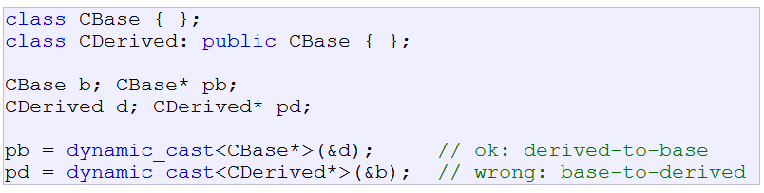
Dynamic Cast
Ensures that pointer cast is valid
Only for derived to base
Requires RTTI to keep track of dynamic types
  Sometimes off by default in compiler

Slide 92
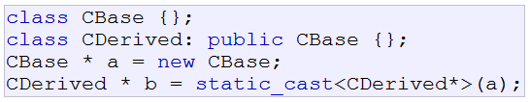
Static Cast
Conversions between related classes
  derived to base
  base to derived
In Dragonfly → Game code event handler to cast to right event object once know type
Bullet.cpp
int Bullet::eventHandler(Event *e) {
…
if (e->getType() == COLLISION_EVENT) {
EventCollision *p_collision_event =
static_cast <EventCollision *> (e);
hit(p_collision_event);
return 1;
}
…
}

Slide 93
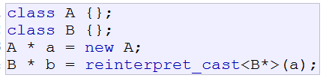
Re-Interpret Cast
Converts any pointer to any other type, even if unrelated
Works, but doesn’t really make sense since can’t safely dereference b
Mostly used for non-C++ code (e.g. memory copying)

Slide 94
Ok, What Do We Have?
Game objects
Lists of game objects
Iterators for game objects
Events
Means of passing them to game objects
→ Ready for World Manager!

Slide 95
Outline – Part II
Game Objects (done)
The Game World (done)
Events (done)
WorldManager (next)

Slide 96
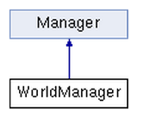


WorldManager (1 of 2)
Dragonfly Egg
Later
Manages game objects
  Insert, Remove, Move…
Provides “step” events to objects
Also manages world attributes (size, view, etc.)
Organizes drawing of objects
Provides “collision” and “outofbounds” events

Slide 97


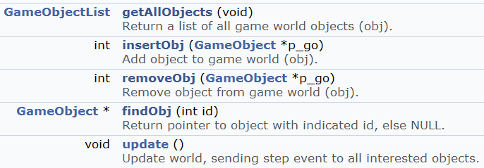
WorldManager (2 of 2)

Slide 98
Modifications to Game Object
Needs eventHandler →
  Virtual so derived classes can redefine
  Return 0 if ignored, else return 1
  Default is to ignore everything
Need to modify constructor
  WorldManager &game_world = WorldManager::getInstance();
  game_world.insertObj(this);
Need to modify destructor
  WorldManager &game_world = WorldManager::getInstance();
  game_world.removeObj(this);
Remember in Saucer Shoot?
  new Saucer; // without grabbing return value
Now you know how

Slide 99
WorldManager::update() Pseudo code
Create EventStep
Create GameObjectListIterator
Set iterator to first GameObject from obj
While not done
  Get current GameObject
  Call evenHandler for GameObject with EventStep
  Set iterator to next GameObject from obj
End of while

Slide 100

Ready for Dragonfly Egg!
Start GameManager
  Starts LogManager
  Starts WorldManager
Populate world
  Create some game objects (derive from base class)
    Will add themselves to WorldManager in constructor
  Can set object positions
Run GameManager
  Will run game loop with controlled timing
  Each iteration, call WorldManager to update
WorldManager update will iterate through objects
  Send step event to each
Objects should handle step event
  Perhaps change position
Should be able to shutdown
  GameManager.setGameOver()
Gracefully shutdown Managers
All of this “observable” from log file (“Dragonfly.log”)
Construct game code that shows all this working
  Include as part of your project
Make sure you test thoroughly!
  Foundational code for rest of engine
Complete by Friday
  Additional features coming

Slide 101
Outline – Part III
Filtering Events (next)
Managing Graphics
Managing Input
Moving Objects
Misc

Slide 102
Only Getting Some Events
Currently, all game objects get step event, whether want it or not
  Some objects may not need updating each step (e.g. early Hero from SaucerShoot didn’t fire)
Generally, not all objects want all events
Unwanted events can be ignored, but inefficient
How to fix?

Slide 103
Indicating Interest in Events
Game objects can indicate interest in specific event type
  E.g. want “step” events or “keyboard” events
  Even user-defined events, e.g. “nuke” events
Game objects register with Manager that handles that event
  E.g. InputManager for keyboard, WorldManager for step
  Manager keeps list of such objects (GameObjectList)
When event occurs, Manager calls eventHandler() on only those objects that are interested
When object no longer interested, unregister interest
  Important! Otherwise, will “get” event, even if deleted
    Remember, GameObjectLists have pointers to objects!

Slide 104
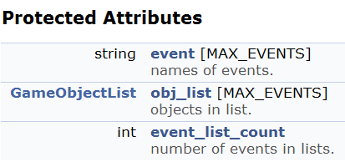
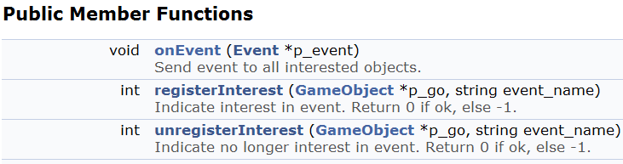
Interest Management in Manager
Need to store event
  string, since that is event type
Can be more than one event
(users could define many)
  Need a list of events
  Not needed by game code so simple array
Modify constructor to initialize
Register to add, unregister to remove

Slide 105
Manager::registerInterest → Pseudo code
int Manager::registerInterest(GameObject *p_go, string event_name);
// Check if previously added
  for i = 0 to event_list_count
    if event[i] == event_name
      Insert object into list
// Otherwise, this is a new event
Make sure not full (event_list_count < MAX)
event[i] = event_name
Insert object into list
Increment event_list_count

Slide 106
Other Manager Functions
Manager::unregister() interest similar
Manager::onEvent()
  Move code from update loop in WorldManager to Manager::onEvent()
  WorldManager.update() would then call onEvent(), passing it a pointer to a “step” event
virtual bool Manager::isValid(string event_name)
  Manager should check isValid() in registerInterest() before adding
  Checks if event is allowed by the manager (base class always “true”)
  Virtual, so can be overwritten by child classes
All Manager inherit this interface, so can use for other Managers
  E.g. will use for “keyboard” (InputManager)

Slide 107
Outline – Part III
Filtering Events (done)
Managing Graphics (next)
  Curses
  GraphicsManager
Managing Input
Moving Objects
Misc

Slide 108
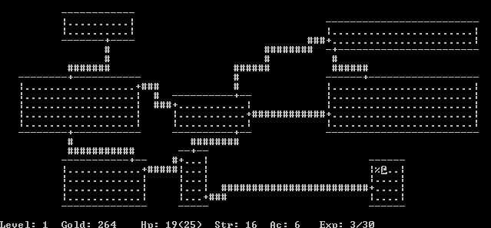
Curses History
Originally, BSD release, then AT&T System V, done 1990’s
Ncurses - freeware clone of curses, still maintained
Pdcurses - public domain for Windows, still maintained
Rogue a popular curses game
  Favorite on college computer systems, in 1980’s
  Spawned “dungeon crawler” trope, influenced games such as Diablo

Slide 109
Text-based Graphics with Curses
Cursor control involves raw terminal codes to draw/display characters anywhere on visible display
  Can become complicated, quickly
Curses is a library of wrappers for these codes
  (Curses – a pun on “cursor control”)
Functionality
  Move cursor
  Create windows
  Produce colors
  …
More than needed for Dragonfly → We’ll learn just what is needed for a game engine

Slide 110
Enabling Curses
Header:
#include <curses.h>
(or <ncurses/curses.h> in Cygwin)
Linker:
-lncurses
WINDOW is a structure defined for image routines
  Functions pass pointers to such structures
Can draw on it, but not “real” window
  To make display relevant, use: wrefresh()

Slide 111
Defined in Curses
int LINES – number of lines in terminal
int COLS – number of columns in terminal
ERR – returned by most routines on error (-1)
OK – value returned by most routines on success
Colors: COLOR_BLACK, COLOR_RED, COLOR_GREEN, COLOR_YELLOW, COLOR_BLUE, COLOR_MAGENTA, COLOR_CYAN, COLOR_WHITE

Slide 112
Starting Up
Setup curses
  Allocate space for curses data structures
  Determine terminal characteristics
initscr();
  Clear screen
  Returns pointer to the default window
Typically, very first curses instruction
Note, for shut down (restore terminal to default)
endwin();
Create a full-sized window
WINDOW *win = newwin(0,0,0,0);
Leave cursor where it ends
leaveok(window, TRUE);

Slide 113
Using Curses
Get terminal size
getmaxyx(stdscr, max_y, max_x);
  (Note! a macro, so don’t need &max_y, &max_x)
Make characters bold
wattron(win, A_BOLD);
Note, could set window foreground and background colors with
assume_default_colors(fg, bg)
  Default for color terminal is white on black

Slide 114
Life is Better with Color
Check for color
if (has_colors() == TRUE)
Then enable color
start_color();
Set pairs via: init_pair(num, fg, bg)
  Num is 1+
E.g.
init_pair(COLOR_RED, COLOR_RED, COLOR_BLACK);
init_pair(COLOR_GREEN,COLOR_GREEN, COLOR_BLACK);
…

Slide 115
Drawing with Curses
Note! All curses functions use (y, x) as coordinates
Draw single character
mvwaddch(window, y, x, char)
Draw string
mvwaddstr(window, y, x, char *)
If color, turn on color pair:
wattron(window, COLOR_PAIR(num))
Then, turn off
wattroff(window, COLOR_PAIR(num))
Clearing the screen
werase(window)

Slide 116
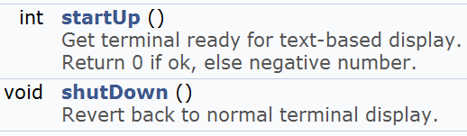
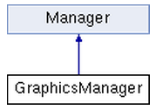

Managing Graphics
Ok, have enough curses for a game engine
  Time for the GraphicsManager!
Inherit from Manager
Singleton

Slide 117
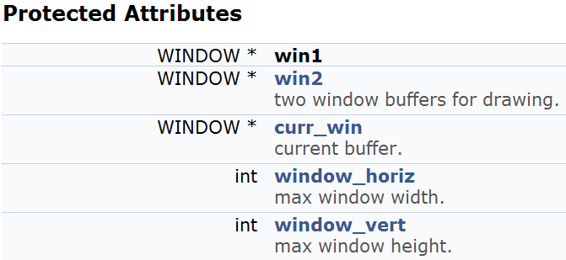
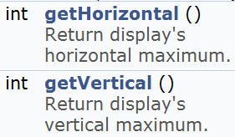

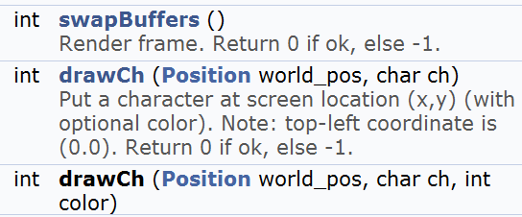
GraphicsManager

Slide 118
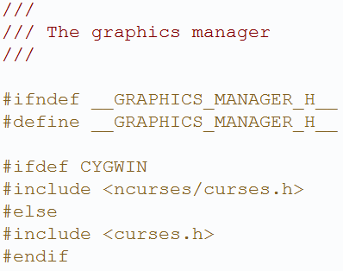

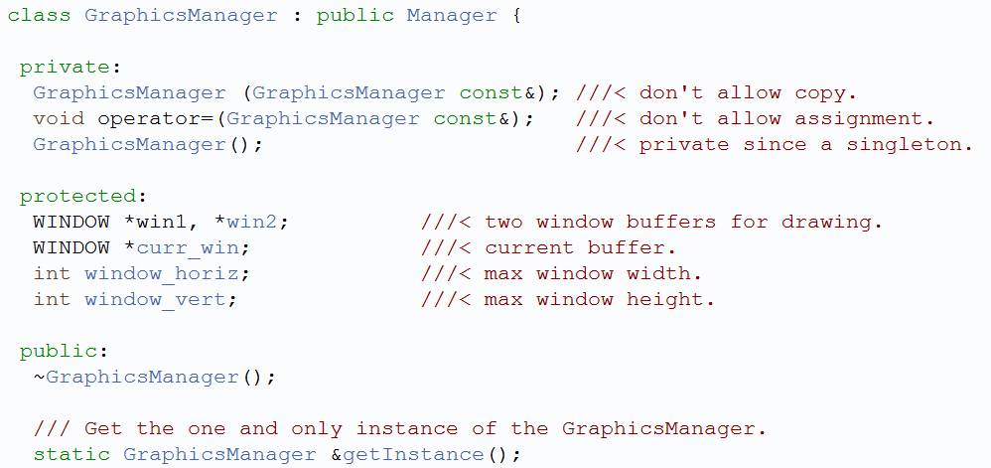
GraphicsManager.h

Slide 119
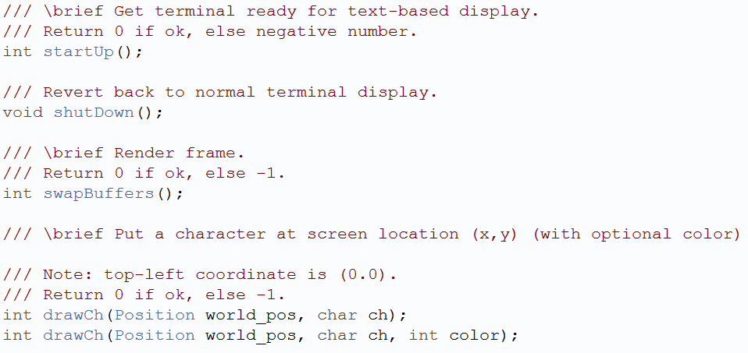
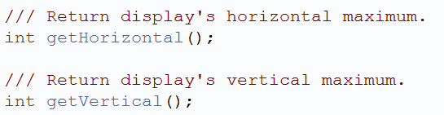
GraphicsManager.h

Slide 120
GraphicsManager::startUp
Initialize curses
Get maximum terminal window size
Create two windows:
  One for the current buffer being displayed
  The other for the next buffer being drawn
Create a third, a pointer that switched between the two, representing the current window
Let cursor remain where it is (cursor not really used for most games)
If the terminal supports color
  Enable colors
  Setup color pairs
Make all characters bold
shutDown() → Just needs to clean up curses

Slide 121
GraphicsManager:drawCh
Enable color using wattron()
  Note, may want to #define COLOR_DEFAULT
Draw character, using mvwaddch()
Turn off color using wattroff()
Note, later will make drawFrame() for Sprite frame, but that will still call drawCh()
Could make drawStr() and drawNum() functions, if needed

Slide 122
GraphicsManager::swapBuffers
Want to render current buffer, clear previous buffer to prepare for drawing
wrefresh() for current window
Clear other window
Set current window to other window
(Note, for this and other functions, should error check and log appropriately!)

Slide 123
Using the GraphicsManager (1 of 2)
Add draw method to GameObject
  virtual void draw()
  Does nothing in base class, but game code can override
Add draw method to WorldManager
  get iterator for list of game objects
  while (not done iterating)
  get current game object
  current game object → draw()
  increment iterator
void Star::draw() {
GraphicsManager &graph_mgr = GraphicsManager::getInstance();
graph_mgr.drawCh(pos, STAR_CHAR);
}
Example

Slide 124
Using the GraphicsManager (2 of 2)
Modify GameManager, game loop
  Call WorldManager.draw()
  Call to GraphicsManager.swapBuffers() at end of game loop
Later, will add support for Sprites

Slide 125
Outline – Part III
Filtering Events (done)
Managing Graphics (done)
Managing Input (next)
  Overview
  Curses for Input
  InputManager
  Input Events
Moving Objects
Misc

Slide 126
The Need to Manage Input
Game could poll device directly. E.g. see if press “space” then perform “jump”
Positives
  Simple (I’ve done this myself for many games)
Drawbacks
  Device dependent. If device swapped (e.g. for joystick), game won’t work.
  If mapping changes (e.g. “space” becomes “fire”), game must be recompiled
  If duplicate mapping (e.g. “left-mouse” also “jump”), must duplicate code
Role of Game Engine is to avoid such drawbacks, specifically in the InputManager

Slide 127
Input Workflow
User provides input via device (e.g. button press)
Engine detects input has occurred
  Determines whether to process at all (e.g. perhaps not during a cut-scene)
If input is to be processed, decode data from device
Encode into abstract, device-independent form suitable for game

Slide 128
Input Map
Game engine exposes all forms of input
Game code maps input to specific game action
When game code gets specific input, looks in input map for action it corresponds to
  If none, ignore
  If action, invoke particular action
User can redefine controls on-the-fly
Walk forward Keypress W, Keypress UP, Mouse wheel up
Walk backward Keypress S, Keypress DN, Mouse wheel down
Turn left Keypress A, Keypress LF, or Mouse scroll left
Turn right Keypress D, Keypress RT, or Mouse scroll right
Fire weapon Keypress SPACE, Mouse left-click

Slide 129
Managing the Input
Must receive from device (see Workflow above)
Must notify objects (provide action)
Manager must “understand” low level details of device to produce meaningful Event
Event must include enough details specific for device
  E.g. keyboard needs key value pressed
  E.g. mouse needs location, button action

Slide 130
Checking startUp Status
  Note, curses needs to be initialized before InputManager can start
    → New startup dependency order for Dragonfly
    LogManager
    GraphicsManager
    InputManager
  Build means of checking start up status in Manager
  Protected Attribute
    bool is_started (set to false in constructor)
  Once startUp() sucessfully called, set to true
  Method to query
    bool isStarted()

Slide 131
Curses for Game-Type Input (1 of 2)
Curses needs to be initialized
Note: Use stdscr for window to get default window, affects all
Normal terminal input buffers until \n or \r, so disable.
cbreak();
nodelay(window, TRUE);
Disable newline so can detect “enter” key
nonl();
Turn off the cursor
curs_set(0);
Enable mouse events
mmask_t_ mask = BUTTON1_CLICKED | BUTTON2_CLICKED | BUTTON1_DOUBLE_CLICKED | BUTTON2_DOUBLE_CLICKED;
mousemask(mask, NULL)
Enable keypad
keypad(window, TRUE);

Slide 132
Curses for Game-Type Input (2 of 2)
To get character (non-blocking)
int c = getch()
If not ERR, then a valid char
Check if mouse
MEVENT m_event;
if (c==KEY_MOUSE) and (getmouse(&m_event) == OK) {
if (m_event.bstate & BUTTON1_CLICKED) {
x = m_event.x
y = m_event.y
…
  Note! Mouse must have click, too, to get (does not return for mouse movement)
Else keyboard (c has value)

Slide 133
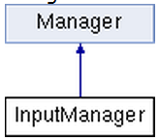
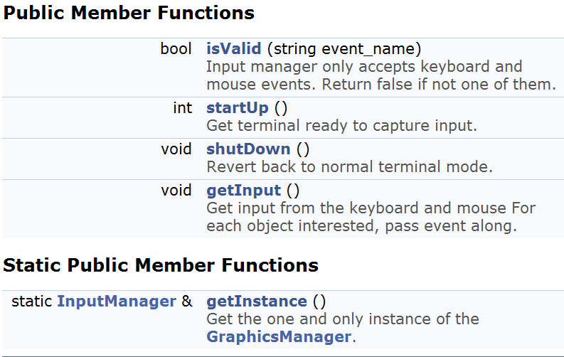
InputManager

Slide 134
InputManager::startUp
Check that GraphicsManager is started
  If not, exit
Enable keypad
Disable line buffering
Turn off newline on output
Disable character echo
Turn off cursor
Set nodelay
Enable mouse events
Set is_started

Slide 135
InputManager:ShutDown
Turn on the cursor
Note: assume shut’s down before GraphicsManager so won’t endwin()
Set is_started to false

Slide 136
InputManager::getInput
Get character (note, not continuous mouse input)
Check if mouse
  If so, check if valid mouse action
    If so, then create EventMouse (x, y and action)
    Send EventMouse to interested objs (onEvent())
  Else ignore
Else
  Create EventKeyboard (character)
  Send EventKeyboard to interested objs (onEvent())

Slide 137
InputManager::isValid
InputManager only handles some events
  GameObject can’t register for, say, user-defined events
  Some InputManagers may not handle mouse events
For return of isValid(string event_name)
  Check if event_name is known (KEYBOARD_EVENT or MOUSE_EVENT)
    → Return true
  Else
    → Return false

Slide 138
Using the InputManager
Modify game loop in GameManger to get input
GameObjects will need to register for interest
  Example:
Need to create Events that can be passed to interested GameObjects
  EventKeyboard
  EventMouse
// Get input
InputManager &input_manager = InputManager::getInstance();
input_manager.getInput();
InputManager &im = InputManager::getInstance();
im.registerInterest(this, KEYBOARD_EVENT);

Slide 139
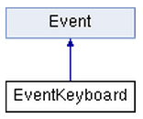
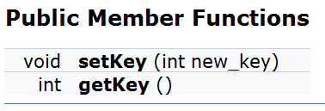
EventKeyboard
Inherited from base Event

Slide 140
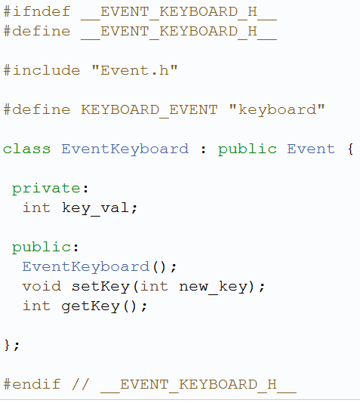
EventKeyboard.h

Slide 141
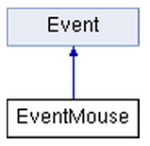
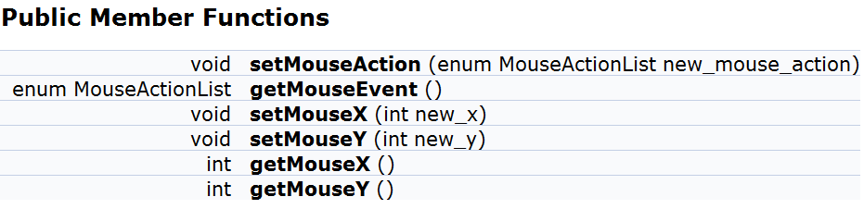
EventMouse
Inherited from base Event
Define mouse actions
enum MouseActionList {
LEFT_BUTTON_CLICK,
LEFT_BUTTON_DOUBLECLICK,
RIGHT_BUTTON_CLICK,
RIGHT_BUTTON_DOUBLECLICK,
UNDEFINED};
}

Slide 142
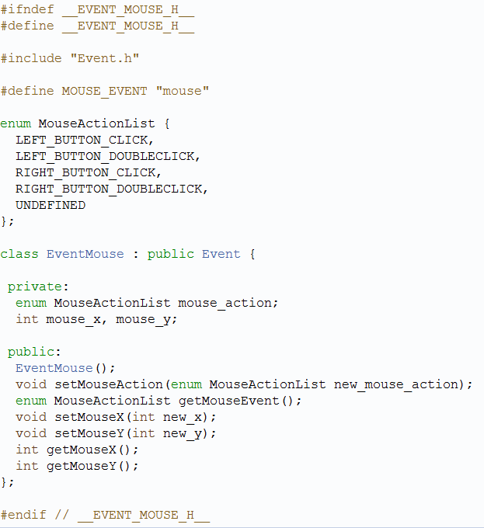
EventMouse.h

Slide 143
Outline – Part III
Filtering Events (done)
Managing Graphics (done)
Managing Input (done)
Moving Objects (next)
  Collisions
  World boundaries
Misc

Slide 144
Collision Detection
Determining objects collide not as easy as it seems
  Geometry can be complex (beyond spheres)
  Objects can move fast
  Can be many objects (say, n)
    Naïve solution O(n²) time complexity → every object potentially collide with every other
Two basic techniques
  Overlap testing
    Detects whether a collision has already occurred
  Intersection testing
    Predicts whether a collision will occur in the future
Notes:
Rabin, Introduction to Game Development, Ch 4.2, 1st edition

Slide 145
Overlap Testing
Most common technique used in games
  Relatively easy
  But may exhibit more error than intersection testing
Concept
  Every step, test every pair of objects to see if overlap
  Easy for simple volumes like spheres, harder for polygonal models
Useful results of detected collision
  Time collision took place
  Collision normal vector (needed for physics actions)

Slide 146
Overlap Testing: Collision Time
Collision time calculated by moving object back in time until right before collision
  Move forward or backward ½ step, called bisection
Get within a delta (close enough)
  With distance moved in first step, can know “how close”
In practice, usually 5 iterations is pretty close

Slide 147
Overlap Testing: Limitations
Fails with objects that move too fast
Possible solutions
  Design constraint on speed of objects (e.g. fastest object moves smaller distance than thinnest object)
    May not be practical for all games
  Reduce game loop step size
    Adds overhead since more computation
    But could have different step size for different objects

Slide 148
Intersection Testing
Predict collisions
Extrude geometry in direction of movement
  E.g. swept sphere turns into a “capsule” shape
Then, see if overlap
When predicted:
  Move simulation to time of collision
  Resolve collision
  Simulate remaining time step

Slide 149
Dealing with Complexity
Complex geometry must be simplified
  Complex 3D object can have 100’s or 1000’s of polygons
  Testing intersection of each costly
Reduce number of object pair tests
  There can be 100’s or 1000’s of objects
  Remember, if test all, O(n²) time complexity

Slide 150
Complex Geometry: Bounding Volume
(1 of 3)
Bounding volume is simple geometric shape that approximates object
  E.g. approximate spikey object with ellipsoid
Note, does not need to encompass, but might mean some contact not detected
  May be ok for some games

Slide 151
Complex Geometry: Bounding Volume
(2 of 3)
Testing cheaper
  If no collision with bounding volume, no more testing required
  If is collision, then could be collision → more refined testing next
Commonly used bounding volumes
  Sphere – if distance between centers less than sum of Radii then no collision
  Box – axis-aligned (lose fit) or oriented (tighter fit)

Slide 152
Complex Geometry: Bounding Volume
(3 of 3)
For complex object, can fit several bounding volumes around unique parts
  E.g. For avatar, boxes around torso and limbs, sphere around head
Can use hierarchical bounding volume
  E.g. large sphere around whole avatar
    If collide, refine with more refined bounding boxes

Slide 153



Complex Geometry: Minkowski Sum
(1 of 2)
Take sum of two convex volumes to create new volume
  Sweep origin (center) of X all over Y
+
=

Slide 154
Complex Geometry: Minkowski Sum
(2 of 2)
Test if single point in X in new volume, then collide
  Take center of sphere at t₀ to center at t₁
  If line intersects new volume, then collision

Slide 155
Reduced Collision Tests: Partitioning
Partition space so only test objects in same cell
  If N objects, then sqrt(N) x sqrt(N) cells to get linear complexity
But what if objects don’t align nicely?
  What if all objects in same cell? (same as no cells)

Slide 156
Reduced Collision Tests: Plane Sweep
Objects tend to stay in same place
  So, don’t need to test all pairs
Record bounds of objects along axes
Any objects with overlap on all axes should be tested further
Time consuming part is sorting bounds
  Quicksort O(nlog(n))
  But, since objects don’t move, can do better if use Bubblesort to repair – nearly O(n)

Slide 157
Collision Resolution (1 of 2)
Once detected, must take action to resolve
  But effects on trajectories and objects can differ
E.g. Two billiard balls collide
  Calculate ball positions at time of impact
  Impart new velocities on balls
  Play “clinking” sound effect
E.g. Rocket slams into wall
  Rocket disappears
  Explosion spawned and explosion sound effect
  Wall charred and area damage inflicted on nearby characters
E.g. Character walks through invisible wall
  Magical sound effect triggered
  No trajectories or velocities affected

Slide 158
Collision Resolution (2 of 2)
Prologue
  Collision known to have occurred
  Check if collision should be ignored
  Other events might be triggered
    Send collision notification messages
Collision
  Place objects at point of impact
  Assign new velocities
    Using physics or some other decision logic
Epilog
  Propagate post-collision effects
  Possible effects
    Destroy one or both objects
    Play sound effect
    Inflict damage
Many effects (e.g. sound) can be either in prologue or epilogue

Slide 159
Collision Detection Summary
Test via overlap or intersection (prediction)
Control complexity
  Shape with bounding volume
  Number with cells or sweeping
When collision: prolog, collision, epilog

Slide 160

Collisions in Dragonfly
Detection
Resolution
Overlap testing
Dragonfly Naiad has single “point” objects
  Collision between objects means they occupy the same space
Dragonfly simplifies geometry with bounding box
  Collision means boxes overlap, no refinement
Detection only when moving object
  Note: alternative could have objects move themselves, then would test all objects
Disallow move
  Object stays in original location
  Extend GameObjects
  is_solid attribute
  Create EventCollision
  Extend WorldManager
  isCollision() method
  moveObj() method

Slide 161
Collidable Entities
Not all objects are collidable entities
  E.g. User menus, scores
  E.g. Stars, in Project 1
Add notion of “solidness”
  Collisions only occur between solid objects
An object that is solid automatically is “interested” in collisions
  Alternative design would have objects register for interest in collisions
Extend GameObject to support solidness

Slide 162


Extend GameObject
Set to true in constructor (default)
Next, create a collision event → EventCollision

Slide 163



EventCollision

Slide 164

Collision.h

Slide 165
Extend WorldManager
New Methods
positionIntersect – see if two positions intersect
  Can replace with boxesIntersect later
isCollision – detect collision at a position
moveObj – if no collision, move an object

Slide 166
WorldManager::positionIntersect
bool positionIntersec(
Position p1,
Position p2)
if p1.getX() == p2.getX() and
p1.getY() == p2.getY() then
return true
else
return false
end if

Slide 167
WorldManager::isCollision
GameObjectListIterator i over all GameObjects
while not i.done()
GameObject *p_temp_go = i.currentObj()
if (p_temp_go != p_go) then // not self
if (positionIntersect(
p_temp_go -> getPos() and where) then
if (p_temp_go -> isSolid())
return temp_go
end if
end if
end if
i.next()
end while
return NULL // if here, no collision

Slide 168

WorldManager::moveObj
Psuedo-code
if p_go->isSolid() then // need to be solid for collisions
GameObject *p_temp_go;
p_temp_go = isCollision(p_go, where) // collide? Null if not
if p_temp_go then
EventCollision c (p_go, p_temp_go, where) // create event
p_go -> eventHandler(&c) // send to obj
p_temp_go -> eventHanlder (&c) // send to other
return -1
end if
end if // isSolid()
p_go -> setPos(where) // if here, no collision so allow move
return 0

Slide 169
Outline – Part III
Filtering Events (done)
Managing Graphics (done)
Managing Input (done)
Moving Objects (next)
  Collisions
  World boundaries
Misc

Slide 170
World Boundaries
Generally, game objects expected to stay within world
  May be “off screen” but still within game world
Object that was inside game world boundary that moves out receives “outofbounds” event
  Move still allowed
  Objects can ignore event
Create “out of bounds” event → EventOut

Slide 171



EventOut
Inherit from base Event class

Slide 172
Generating “Out of Bounds” Events
Get boundary of screen with queries
  Note: in Part 3, will have View and Boundary in WorldManager. For Part 2, use GraphicsManager:
  GraphicsManager::getHorizontal()
  GraphicsManager::getVertical()
Modify WorldManager::moveObj
  Put after move is allowed
  If object inside boundary then moves outside → send “out of bounds” event
EventOut ov;
p_go -> eventHanlder(&ov);
Note, only want to send once!
  If stays outside and moves, no additional events

Slide 173
Outline – Part III
Filtering Events (done)
Managing Graphics (done)
Managing Input (done)
Moving Objects (done)
Misc (next)
  Layers
  Deferred deletion

Slide 174
Drawing in Layers
Up to now, no easy way to make sure one object drawn before another
  e.g. If did Project 1, Star may be on top of Hero
Provide means to control levels of objects display order → Altitude
Draw “low altitude” objects before higher altitude objects
  Higher altitude objects in same location will overwrite lower ones before screen refresh
Note, not really a third dimension since all in same plane for collisions

Slide 175


Implementing Altitude
Provide “altitude” attribute for GameObject
  Default to 0
Provide MAX_ALITITUDE 2 in WorldManager.h
In WorldManager::draw, add outer loop around drawing all objects
for alt = -MAX_ALTITUDE to MAX_ALTITUDE
// normal iteration through all objects
if (p_temp_go -> getAltitude() == alt)
// draw
(What is the “cost” of doing altitude?)

Slide 176
Outline – Part III
Filtering Events (done)
Managing Graphics (done)
Managing Input (done)
Moving Objects (done)
Misc (next)
  Layers
  Deferred deletion

Slide 177
Need for Deferred Deletion
Each step of game loop, iterate over all objects → send “step” event
An object may be tempted to delete itself or another
  E.g. during a collision
  E.g. after a fixed amount of time
But may be in the middle of iteration! Other object may act.
  E.g. eventHandler() for both objects called, even if one “deletes” another
Implement deferred deletion → WorldManager::markForDelete

Slide 178


WorldManager::markForDelete
// object might already have been marked, so only add once
create GameObjectListIterator i(&del)
i.first()
while not i.isDone()
if i.currentObj() == p_go // object already in list
return 0
i.next()
end while
del.insert(p_go)
And modify WorldManager::update()

Slide 179
WorldManager::update()
// Send “step” event
create EventStep s
onEvent (&s)
// Delete all marked objects
create GameObjectListIterator i(&del)
while not i.isDone()
delete i.currentObj()
i.next()
end while
del.clear() // clear list for next step

Slide 180
Ready for Dragonfly Naiad!
Objects register for interest in events (e.g. “step”)
Objects can draw themselves
  2D graphics in color
Interested objects can get input from keyboard, mouse
Objects that move out of bounds get event
Objects that collide get collision event
  Can react accordingly
  Non-solid objects don’t get
Safe removal of objects at end of world update
Objects can appear higher/lower than others
  5 layers
Can be used to make a game!
E.g. Consider Saucer Shoot without sprites

Slide 181
Mid-Term Exam Topic List
Overview of Game Engine
  Purpose
  Typical components
  Structures
Managers
  Concept
  Features/methods
Logfile Management
  Features/methods
Game Management
  Game loop
Game World
  Game objects
  Storing and updating
Events
  Notifying objects
  User-defined
  Game object interest
Graphics Management
  Concept
  Features/methods
Input Management
  Concept
  Features/methods
Collisions
  Detection
  Resolution
Resource Management
  Concept
  Features/methods

Slide 182
Outline – Part IV
Resource Management (next)
  Offline (tool chain)
  Online (runtime)
  ResourceManager
Using Sprites
Bounding Boxes
Camera Control
Misc

Slide 183
Managing Resources
Games have a wide variety of resources
  Often called assets or media
  E.g. meshes, textures, shader programs, animations, audio clips, level layouts …
Offline – tools to create, store and archive during game creation
Online – loading, unloading, manipulation when game is running
→ Resource Manager
Sometimes, single subsystem that handles all formats
Other times, disparate collection of subsystems
  Different authors, time periods
  Different developers, functionality
Notes:
Gregory, Game Engine Architecture, Chapter 6

Slide 184


Off-line Resource Management
Revision control for assets
  Small project → simple files stored and shared
  But larger, 3D project needs structure
Tools help control → Resource Database (e.g. Perforce)
  May have customized wrappers/plugins to remove burden from artists

Slide 185
Resource Database
Need: create, delete and inspect resources
Move from one location to another (e.g. to different artists/developers as needed)
Cross-reference other resource (e.g. mesh/animations used by a level)
Retain integrity (add/delete) and revisions (who made change, why)
Searching and querying

Slide 186

Dealing with Data Size
C++ code small, relative to impact size
Art assets can large
  Copies to/from server can be expensive (delay)
Deal with it (inefficient), or only have access to assets of need (limited vision)
Art-specific tools (e.g. Alienbrain)

Slide 187
Asset Conditioning (Tool Chain)
Most assets need to be modified/conditioned to get into game engine
Means to do that varies across game dev projects
  E.g. could embed format conversion notes in header files, versus stand-alone script for each file
Exporters – take out of native format (e.g. Maya) via plugin (often custom)
Resource compilers – re-arrange format (e.g. “massage” mesh triangles into strips, or compress bitmap)
Resource linkers – compile into single, large source (e.g. mesh files with skeleton and animations)
Dependencies may matter (e.g. build skeleton before process animation) , so tool needs to support

Slide 188
Runtime Resource Management
One copy of each resource in memory
  Manage memory resources
Manage lifetime (remove if not needed)
Handle composite resources
  E.g. 3d model with mesh, skeleton, animations…
Custom processing after loading (if needed)
Provide aingle, unified interface which other engine aspects can access
Handles streaming (asynchronous loading) if engine supports

Slide 189
Runtime Resource Management
“Understands” format of data
  E.g. PNG or Text-sprite file
Globally-unique identifier
  So assets can be accessed by objects
Usually load when needed (but sometimes in advance)
Removing hard (when done?) E.g. some models used in multiple levels → Can use reference count
  E.g. load level and all models with count for each. As level exits, decrease reference count. When 0, remove

Slide 190
Resource Management in Dragonfly
Only assets are sprites
  Text-based files
No offline management tools
  Such a tool could help build, then save in right format
Runtime, must understand format and load
Need data structures (classes) for
  Frames (dimensions and data)
  Sprites (identifiers and frames)
Then, ResourceManager

Slide 191
Frames
____
/__o_\
Text
Variable sizes
  Rectangular
Note, in Dragonfly, frames don’t have color (nor do individual characters)
  But could be extended to support
.**
**.**
*.*
_____ _____ __ __
/ ___/____ ___ __________ _____ / ___// /_ ____ ____ / /_
\__ \/ __ `/ / / / ___/ _ \/ ___/ \__ \/ __ \/ __ \/ __ \/ __/
___/ / /_/ / /_/ / /__/ __/ / ___/ / / / / /_/ / /_/ / /_
/____/\__,_/\__,_/\___/\___/_/ /____/_/ /_/\____/\____/\__/
Arrow keys to move, Spacebar to fire, Enter for one nuke
\
~==-
/

Slide 192


Frame

Slide 193

Frame.h

Slide 194
Sprite
____
/____\
____
/___o\
____
/__o_\
____
/_o__\
____
/o___\
Sequence of Frames
In Dragonfly, Sprites have color
Note, Sprites are just repository for data
  Don’t know how to “draw” themselves
  Nor even what the display rate is
  (That functionality with GameObjects)
Need dimensions, number of frames, and ability to add/retrieve frames
\
~==-
/
\
==-
/

Slide 195



Sprite Class

Slide 196

Sprite.h
Need to understand Frames

Slide 197
Sprite: Constructor
Sprite::Sprite(int max_frames)
(No default constructor)
Initialize
  frame_count, width, height all 0
Create (using new) array of max_frames
  Make sure to delete in destructor
Set max_frame_count to be max_frames
Set color to be COLOR_DEFAULT (defined in GraphicsManager)
Want to define sprite delimiters in header file

Slide 198
Sprite::addFrame
(Frame new_frame) as parameter
Check if full (frame_count = max_frame_count)
  If so, return error
frame[frame_count] = new_frame
Increment frame_count
(Note, frames are numbered from 0)

Slide 199
Sprite:getFrame
(int frame_number) as parameter
Make sure frame_number in bounds (not negative, not equal to frame count)
  If so, return “empty” Frame
Return frame[frame_number]

Slide 200



ResourceManager
Inherit from Manager
  startUp, shutDown
Singleton

Slide 201
Reading Sprite from File
frames 5
width 6
height 2
color green
____
/____\
end
____
/___o\
end
____
/__o_\
end
____
/_o__\
end
____
/o___\
end
eof
Typical that image file has specific format
  Header
  Body
  Closing
Parse in pieces

Slide 202

ResourceManager::loadSprite
Open file
Read header
Make new Sprite (since know frame count)
Read frames, 1 by 1
  Add to Sprite
Close file
Add label
Note, error check throughout (file format, length of line, frame count
  Report line number error in log
  Clean up resources (delete Sprite, close file) as appropriate
Write “helper functions”

Slide 203

Basic File Reading in C++
ifstream
getline() to read line at a time
  Removes ‘\n’ delimiter
good() if still data

Slide 204
ResourceManager::loadSprite –
Helper Function
// Read a single line, expect “tag num” → return num
int readLineInt(ifstream *p_file,
int *p_line_number, const char *tag)
string line
getline() into line // error check: p_file->good()
if not line.compare(line, tag) // right tag?
  return error
atoi() on line.substr() to get number
return number
(Can also make readLineStr for color)

Slide 205
ResourceManager::loadSprite –
Helper Function
// Read frame (up until “end”) → return frame
Frame readFrame(ifstream *p_file,
int *p_line_number, int width, int height)
string line, frame_str
For j from 1 to height
getline() into line // error check
If line width > width, return error (empty frame)
frame_str += line
End for
getline() into line, check if “end” else return error
Create Frame (width, height, frame_str)
Return frame

Slide 206
ResourceManager::loadSprite –
Helper Function
getline() removes newline delimiter (‘\n’)
Text file on Windows will still have carriage return (‘\r’)
  Will always be at the end
void discardCR(string &str)
If str[str.size() – 1] is ‘\r’
str.erase(str.size() - 1)
Call this with every line since will ignore if not there

Slide 207

ResourceManager::getSprite
for i from 0 to sprite_count
if label == sprite[i] -> getLabel() // pointers
return sprite[i]
end if
end for
return NULL
Example game code:
ResourceManager &resource_manager = ResourceManager::getInstance();
resource_manager.loadSprite("sprites/saucer-spr.txt", "saucer");

Slide 208
Outline – Part IV
Resource Management (done)
Using Sprites (next)
Bounding Boxes
Camera Control
Misc

Slide 209




Extend GameObject with Sprites
Add pointer to Sprite object, get() and set()
Typically center sprite at object (x,y)

Slide 210



GameObject: Drawing Sprites (1 of 4)
Base class assumes Sprite for each object
  Extend draw() to draw frame, advance to next
Note, derived class can still define
  Make draw() virtual
  Can call parent draw() explicitly (GameObject::draw())
Since draw only 1 frame, keep track of latest

Slide 211

Extend GraphicsManager
If frame is empty → return
If centered, y_offset = frame.getHeight / 2 // else 0
x_offset = frame.getWidth / 2 // else 0
string str = frame.getString // get frame data
For y = 1 to frame.getHeight // draw character by character
For x = 1 to frame.getWidth
Position temp_pos(world_pos.getX – x_offset + x,
world_pos.getY – y_offset + y)
drawCh(temp_pos, str[y * frame.getWidth + x], color)
End for x
End for y

Slide 212
GameObject: Drawing Sprites (2 of 4)
If !p_sprite then do nothing // sprite not defined
graphics_manager.drawFrame(
pos,
p_sprite->getframe(getSpriteIndex(), p_sprite->getColor())
int next = p_sprite -> getSpriteIndex() + 1
if next == p_sprite -> getFrameCount() → next = 0
setSpriteIndex(next)

Slide 213


GameObject: Drawing Sprites (3 of 4)
Convenient for game to slow down animation
  Alternative is to make a lot of “still” frames
  Still would be called to draw(), so expensive
Since draw() is called every game game loop (step), make slowdown in units of frame time

Slide 214
GameObject: Drawing Sprites (4 of 4)
Add to draw()
// advance sprite index, if appropriate
if getSpriteSlowdown() is 0 // 0 means no animtn
→ return
int count = getSpriteSlowdownCount()+1
if count == getSpriteSlowdown()
setSpriteSlowdownCount(0)
else
setSpriteSlowdownCount(count)

Slide 215
Outline – Part IV
Resource Management (done)
Using Sprites (done)
Bounding Boxes (next)
Camera Control
Misc

Slide 216
Boxes
Can use boxes for several features
  Determine bounds of game object for collisions
  World boundaries
  Screen boundaries (for camera control)
Create 2d box class

Slide 217


Box

Slide 218

Box.h
Uses position

Slide 219


Extend GameObject “Size” to Box
Protected Attribute
Box box
Default to Sprite size
(Centered)

Slide 220

Boxes for Collisions
In WorldManager,
replace positionIntersect
x-overlap
  Left of A in B? → B_{x1} <= A_{x1} <= B_{x2}
  Left of B in A? → A_{x1} <= B_{x1} <= A_{x2}
y-overlap
  Left of A in B? → B_{y1} <= A_{y1} <= B_{y2}
  Left of B in A? → A_{y1} <= B_{y1} <= A_{y2}
If (x-overlap) && (y-overlap) --> return true
Otherwise, return false
Remember! In curses, we have "cells" on screen, so “width 1” would look like 2 here. So subtract 1 from horizontal and vertical

Slide 221
Outline – Part IV
Resource Management (done)
Using Sprites (done)
Bounding Boxes (done)
Camera Control (next)
Misc

Slide 222
Boxes for Boundaries
World Boundary
View Boundary
Translating world coordinates to view coordinates

Slide 223


Extend/Modify WorldManager
Add world boundary limits with Box
  Used to only get screen size from GraphicsManager
Add additional Box for camera view
Methods
Attributes

Slide 224
Modify GameManager::startUp
Default world as large as window, player has a view of whole world
Position world_corner(0,0)
Box boundary(world_corner,
graphics_manager.getHorizontal()-1,
graphics_manager.getVertical()-1)
world_manager.setBoundary(boundary)
world_manager.setView(boundary)

Slide 225
Views
GameObjects have world (x,y) → need to translate to view/screen (x,y)
  In GraphicsManager before drawing on screen
(0,0)
World boundary
(10,3)
To get screen (x,y) → compute distance from origin
A → (5,7) and draw
B → (-2, 2) don’t draw
(x value too small)
C → (15, -1) don’t draw
(x value too large,
y value too small)
View boundary
C(25,2)
B(8,5)
A(15,10)

Slide 226
GraphicsManager::worldToScreen
Input → Position world_pos
int view_x =
game_world.getView().getCorner().getX()
int view_y =
game_world.getView().getCorner().getY()
Position screen_pos(
world_pos.getX() - view_x, world_pos.getY() - view_y);
return screen_pos;

Slide 227
Modify GraphicsManager::drawCh
Get screen position from world position
Position screen_pos = worldToScreen(world_pos)
Then, mvwaddch() normally but with screen_pos instead of world_pos
Next → add condition in WorldManager to call draw() only when bounding box of object intersects view (next slide)

Slide 228
Modify WorldManager::draw
Inside “altitude” loop
// bounding box is relative to obj, so convert to world
Box box = p_temp_go->getBox();
Position corner = box.getCorner();
corner.setX(corner.getX() + p_temp_go->getPosition().getX())
corner.setY(corner.getY() + p_temp_go->getPosition().getY())
box.setCorner(corner)
// only draw if the object would be visible
if (boxesIntersect(box, view)
p_temp_go -> draw()

Slide 229

Extend WorldManager
GameObject *p_view_following;
Allow game code to center view at specific point
Indicate object to follow (centered)

Slide 230

WorldManager::setViewPosition
// make sure horizontal not out of world boundaries
int x = view_pos.getX() – view.getHorizontal()/2;
if (x + view.getHorizontal() > boundary.Horizontal())
x = boundary.getHorizontal()–view.getHorizontal();
if (x < 0) // limit range to stay within world boundary
x = 0;
// make sure vertical not out of world boundaries
…
// set view
Position new_corner(x, y);
view.setCorner(new_corner);

Slide 231

WorldManager::setViewFollowing
if p_new_view_following == NULL then
p_view_following = NULL
return 0
end if
// Iterate over all objects, make sure new one legitimate
(if not found, return -1)
p_view_following = p_new_view_following
setViewPosition(p_view_following -> getPosition())
return 0

Slide 232
Modify WorldManager::moveObject
If successfully move (no collision) …
// if view is following this object,
// adjust view
if (p_view_following == p_go)
setViewPosition(p_go->getPosition())

Slide 233
Using Views –
An Example of Game-Code control
// Always keep the Hero centered in screen
void Hero::move(int dy) {
// move hero
Position new_pos(pos.getX(), pos.getY() + dy);
world_manager.moveObj(this, new_pos);
// adjust view
Box new_view = world_manager.getView();
Position corner = new_view.getCorner();
corner.setY(corner.getY() + dy);
new_view.setCorner(corner);
world_manager.setView(new_view);
}

Slide 234
Using Views –
An Example of Engine Control
In game.cpp, make world larger
// set world boundaries
Position corner(0,0);
Box boundary(corner, 80, 50);
world_manager.setBoundary(boundary);
In Hero.cpp constructor, set to follow Hero
world_manager.setViewFollowing(this);

Slide 235
Outline – Part IV
Resource Management (done)
Using Sprites (done)
Bounding Boxes (done)
Camera Control (done)
Misc (next)
  Velocity
  Catching ctrl-C
  Random numbers

Slide 236
Velocity
Remember this?
→ Needed to do
game code every
step
Instead, have Engine do the work → Automatically update object positions based on direction and speed
In Saucer::move():
…
move_countdown--;
if (move_countdown > 0)
return;
move_countdown = move_slowdown;
…

Slide 237


Extend GameObject
Protected Attributes
Methods

Slide 238
GameObject::getXVelocityStep
// see if there is an x-velocity
if (!x_velocity)
return 0
// see if time to move
x_velocity_countdown--
if (x_velocity_countdown > 0)
return 0
// ok, time to move, so figure out how far
int step = 0
do {
x_velocity_countdown += fabs(1/x_velocity)
(x_velocity < 0) ? step-- : step++
} while (x_velocity_countdown <= 0)
return step
(And do same for y-velocity)

Slide 239
Update WorldManager::update
After onEvent(“step”)
// Update object positions based on their velocities
GameObjectListIterator vi
vi.first()
while not vi.isDone()
GameObject *p_go = vi.currentObj()
x = p_go->getXVelocityStep() // see how far moved x
y = p_go->getYVelocityStep() // see how far moved y
if did move → Position new_pos(
p_go->getPosition().getX() + x,
p_go->getPosition().getY() + y)
moveObj() to new_pos
vi.next()

Slide 240
Using Velocity - Example
In Saucer.cpp:
// set speed in vertical direction
x_velocity = -0.25; // 1 space left every 4 frames
No need to handle “step” event
No need for move_slowdown, move_countdown
(Can modify Bullet and Stars, too)
(Future work could extend to acceleration)

Slide 241
Outline – Part IV
Resource Management (done)
Using Sprites (done)
Bounding Boxes (done)
Camera Control (done)
Misc (next)
  Velocity
  Catching ctrl-C
  Random numbers

Slide 242
The Need for Signal Handling
Control-C causes termination without notice
  Logfiles open (data not flushed), windows in uncertain state (e.g. cursor off)
Control-C → Gracefully shutdown
  Shutdown curses
  Close logfile
Linux/Unix (Cygwin) use sigaction()
Windows use SetConsoleCtrlHandler()
Semantics: interrupt current execution and go to function
  When function done, return (but can exit())

Slide 243
Modify GameManager::startUp – Unix (Cygwin, too)
#include <signal.h>
// Catch ctrl-C (SIGINT) and shutdown
struct sigaction action;
action.sa_handler = (void(*)(int)) doShutDown;
sigemptyset (&action.sa_mask);
action.sa_flags = 0; // SA_RESTART
sigaction (SIGINT, &action, NULL)
______________________
void doShutDown(void) → GameManager.shutdown()

Slide 244
Modify GameManager::startUp - Windows
#include <windows.h>
// Catch ctrl-C (SIGINT) and shutdown
SetConsoleCtrlHandler(doShutDown, TRUE);
_________________________________
BOOL WINAPI doShutDown(DWORD ctrl_type) {
if (ctrl_type == CTRL_C_EVENT) {
game_manager.shutDown();
return TRUE;
}
}
Also: CTRL_CLOSE_EVENT (program being closed), CTRL_LOGOFF_EVENT (user is logging off), CTRL_SHUTDOWN_EVENT (system shutdown)

Slide 245
Outline – Part IV
Resource Management (done)
Using Sprites (done)
Bounding Boxes (done)
Camera Control (done)
Misc (next)
  Velocity
  Catching ctrl-C
  Random numbers

Slide 246
Random Numbers and Games
Many games make heavy use of random numbers
  Adds non-determinism to opponent choices, starting locations, etc.
True randomness difficult for computers (can’t “roll dice”)
  Instead, psuedo-random – deterministic but “looks” random to external tests
Want function that produces psuedo-random sequence
E.g. x_{n} = 5x_{n-1} + 1 mod 16
Say, x₀ = 5 → x₁ = 5(5) + 1 mod 16 = 26 mod 16 = 10
Sequence: 10, 3, 0, 1, 6, 15, 12, 13, 2, 11, 8, 9, 14 …
Hard to figure out what is next → Looks pretty random!
  And could start with different x₀ (or “seed”)

Slide 247
(Old) Random Number Functions
static unsigned long next = 1; // state
// Generate “random” number
int myrand(void) {
next = next * 1103515245 + 12345;
return((unsigned)(next/65536) % 32768);
}
// Seed to get different starting point
void mysrand(unsigned seed) {
next = seed;
}
_________________________________________
Note: with same seed will get same sequence! Useful for reproducing
Note: New are random() and srandom()
(Use mod/% to size )

Slide 248

Modify GameManager::startUp
Game code uses random()
Dragonfly only need to seed srandom()
  Provide option for game-code seed
Seed with system time (seconds since 1970)
srandom(time(NULL))
Includes needed: <time.h>, <stdlib.h>

Slide 249
Ready for Dragonfly!
Game objects have Sprites
  Animation
Game objects have bounding boxes
  Sprite sized
Collisions for boxes
Have camera control for world
  Subset of world
  Move camera, display objects relative to world
Game objects have velocity
  Automatic updating

