Slide 1
Iterative Development
Notes:
Much from Robert Lindeman, IMGD 3000, C-term 2011

Slide 2
Motivation
Last thing you want to do is write critical code near end of a project
Induces huge stress on team
Introduces all kinds of “interesting” bugs that break working code
Testing always gets cut in crunch
Makes problem even worse!
Planning can help avoid writing critical code in alpha or beta phases

Slide 3
Wishes versus Reality
Most games you make are smaller/less than you originally envisioned
Design was bigger than implementation
Or, tested/working implementation bigger than what made it into game
That’s ok → expect it
So, how do we know when a game is “done”?

Slide 4
How Do We Estimate Progress?
Example:
Jo is a programmer
She estimates it will take 10 days to implement Smart Trap
She is 4 days into implementation
Is Smart Trap 40% complete? … maybe
We may not see it "snap shut" until day 9
She’s good, → finishes in 8 days total
Yay, we are ahead!
Later, decide to add functionality to Smart Trap (e.g., trap large bad guys, too)
Takes 4 days
Boo, now we’re behind!

Slide 5
What’s the Point?
Most things get revisited multiple times during development
Fix bugs, modify functionality, etc.
“Refactoring” your code
Note, refactoring easier with clear, easy-to-understand code!
Expect this! Despite your careful planning …
So, the "40% done" estimate looks pretty sketchy…
Need way to account for time without driving project into trouble (and into panic)

Slide 6
Incremental Delivery
Milestones are good things!
They let us get things “done”
Milestones can have downside
If you miss one, people notice, action taken
Especially management people
Developer’s view
Milestones (or plans, in general) are just best guesses for how implementation will evolve
Management’s view
Schedules are contracts with developers
Promising certain things at certain times
Different views cause problems
Developers: panic, pressure, long hours
Managers: justification for financial pressure

Slide 7
Milestones (1 of 2)
Despite problems, necessary
Without milestones, unlikely to get done
Unrealistic milestones mean work not done on time, no matter financial importance
Remember, are best guesses
Managers need to know estimates of developers and key makers along the way
Plan financial/time links accordingly
External milestones coarser
Tie to publishers, marketers, etc.
Internal milestones have finer granularity
Used by team members

Slide 8
Milestones (2 of 2)
Think of development plan as black box
Managers have specific “interface” to box
“Give me the latest build”
“Give me the latest (high-level) schedule”
Clearly, this is too simplistic/wishful thinking
Managers just want to know more (and need to, to do their jobs better)
But view as development plan as “black box” helps separate job roles better

Slide 9
There is More than Meets the Eye
For many, “if I can’t see it, it is not important”
AI takes time to build (and you don’t see it)
Network code to balance players is an optimization (and you don’t see it)
Developers receive less “credit” for unseen code than for things that can be seen
Good managers will probe deeper to see what is really going on
Requires technical ability (knowledge)
This is one reason Game Designer needs technical knowledge!

Slide 10
Iteration
Make frequent working builds
“We don’t go home Friday until a working build checked in.”
Frequency (daily or weekly) depends upon project
If management asks for latest build, give one from last week
Resist desire to show latest-and-greatest
Won’t always be bug free, ready to show
People will always expect it and leads to unrealistic expectations

Slide 11
Internal Scheduling
Give detailed design document
Make list of all objects (e.g. players, items, NPCs…) that need to be built
Mark each as one of:
Core – base, fundamental functionality
Required – needed for working, playable game
Desired – icing on the cake, make game special but not required
End result:
List of features sorted by importance
Note, doing this planning gets easier the more you do!

Slide 12
Internal Scheduling Structure
Could start from top of milestone list → Work down and when time runs out, then done
Produces whole lot of “complete” pieces, but no whole that works together
Makes management (and others) nervous since cannot see it “coming together”
Better way → since list made in Object-Oriented (OO) fashion, start building objects!

Slide 13
OO Iterative Development – Object Versions (1 of 2)
Create a Stub version of each object
Complete, but empty
Perhaps just print out message
Basic version
Placeholder with some properties present
Set attributes, minimal functionality
Nominal version
Commercial viable implementation
Most functionality in place
Tested
Optimal version
State of the art
All polish present
Thoroughly tested
Stub
// Player.h
class Player {
public:
Player();
~Player();
};
// Player.cpp
#include "Player.h"
Player::Player(){ }
Player::~Player(){ }
Nice feature about above development plan? Game will “build” even after Basic version!

Slide 14
OO Iterative Development – Object Versions (2 of 2)
Some objects (classes) will be simpler
Fewer iterations (e.g. Position class)
Some will be more complex
More iterations (e.g. WorldManager class)
Can say have shippable game when every object at least in Nominal version
Working definition of “Good Enough”
A complete game is one where all objects are at Optimal level

Slide 15
OO Iterative Development – Overall
But, seems like need to write 3 versions of every object!
Yes, but would probably do that anyway with revisions
Approach
Starting with core, then required, then desired, implement Stub versions of all objects
Starting with core, then required, implement Nominal versions
Code is now releasable
Only now start to work on desired
This is breadth-first approach
Better than "let's do the cool bits first!"
Always have build-able game
Near-continuous growth
Can easily show refinement
Throughout, better handle on how "complete" game is

Slide 16
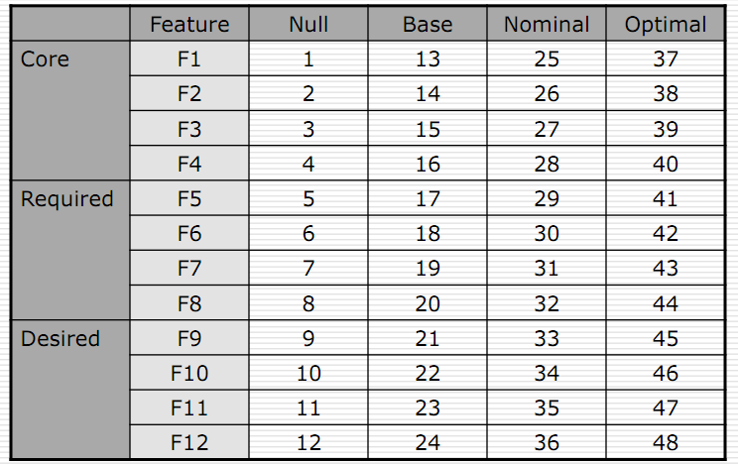
Scheduling - Naive

Slide 17
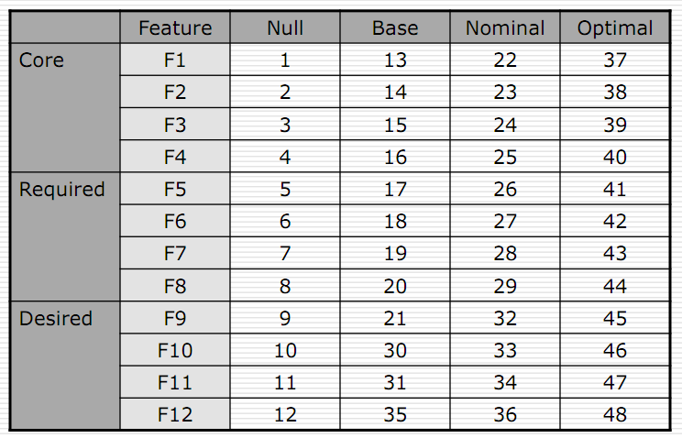
Scheduling – Better (single programmer)
Note! This is just one example → Alternate could be to finish Core Nominal before Base Required
Point is to “zig-zag” to bottom corner, with optimal last

Slide 18
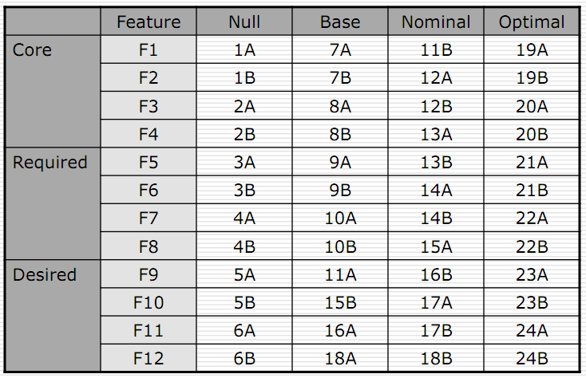
Scheduling – Better (multiple programmers)

Slide 19
Team Work
Make sure to use skills of each team member well
Keep everyone busy
No waiting, if possible
Communication vital!
Every programmer should be aware of what others are doing
Code reviews (for sharing implementation details as much as writing solid code)
Joint status meetings (Daily! Even if brief)
Documentation (documented code, documented milestones and status, documented bug list)

Slide 20
Scheduling with Iteration
Shift:
FROM: When will it be finished?
TO: When will it be good enough?
"Finished" is meaningless, anyway
Have definition of “good enough" now!
Bad estimation often comes from top-down dissection
No accounting for learning curve, code revision, or integration
Iterative development
Total time equals sum of the Stub, Base, Nominal, and Optimal levels

Slide 21
Consider Saucer Shoot
\
~==-
/
____
/__o_\
Core
Ability for player to move ship, fire bullets
Saucers move
Required
Bullets destroy saucers
Saucers respawn
Explosions
Animated Sprites
Game difficulty progresses and game ends
Desired
Stars
Game start screen, game end screen
Score

Slide 22
Consider Dragonfly
(Note, your development did separate 2a, 2b, 2c “mini-projects”)
Core
Log file management
Game loop with timing
Game objects with updates
Required
User-input
User-defined events
Graphics support
Collisions
Desired
Animated Sprites
Efficient scene management (e.g. for collision detection)
Multi-colored Sprites
Camera control
Is “optimal” done for any classes?
Probably not – would need all Desired done first!
But have Nominal version of classes for all

Slide 23
Group Exercise
Split into Project 3 Teams
Make list for your game, with one feature in each list
Core
Required
Desired
Provide high-level class name(s) associated with each

