Slide 1
Artificial Intelligence

Slide 2
Introduction to Artificial Intelligence (AI)
Many applications for AI
  Computer vision, natural language processing, speech recognition, search …
But games are some of the more interesting
Opponents that are challenging, or allies that are helpful
  Unit that is credited with acting on own
Human-level intelligence too hard
  But under narrow circumstances can do pretty well (ex: chess and Deep Blue)
  For many games, often constrained (by game rules)
Artificial Intelligence (around in CS for some time)

Slide 3
AI for CS different than AI for Games
Must be smart, but purposely flawed
  Loose in a fun, challenging way
No unintended weaknesses
  No “golden path” to defeat
  Must not look dumb
Must perform in real time
Often, configurable by designers
  Not hard coded by programmer
“Amount” and type of AI for game can vary
  RTS needs global strategy, FPS needs modeling of individual units at “footstep” level
  RTS most demanding: 3 full-time AI programmers
  Puzzle, street fighting: 1 part-time AI programmer

Slide 4
Where to Learn AI at WPI?
IMGD 3000
  Introduction to idea
  Whirlwind view of techniques
  Finite State Machines
  Basic Pathfinding (A*)
IMGD 4000
  Details on basic game AI commonly used in almost all games
    Decision trees
    Hierarchical state machines
  Advanced game AI used, but only in more sophisticated games
    Advanced pathfinding
    Behavior trees
IMGD 4100 in 2014 “AI for Interactive Media and Games”
  Fuzzy logic
  Goal-driven agent behavior
CS 4341 “Artificial Intelligence”
  Machine learning
  Planning

Slide 5
Outline
Introduction (done)
Common AI Techniques (next)
Promising AI Techniques
Pathfinding (A*)
Finite State Machines
Summary

Slide 6
Common Game AI Techniques (1 of 4)
Whirlwind tour of common techniques
  For each, provide idea and example (where appropriate)
Movement
  Flocking
    Move groups of creatures in natural manner
    Each creature follows three simple rules
      Separation – steer to avoid crowding flock mates
      Alignment – steer to average flock heading
      Cohesion – steer to average position
    Example – use for background creatures such as birds or fish. Modification can use for swarming enemy
  Formations
    Like flocking, but units keep position relative to others
    Example – military formation (archers in the back)

Slide 7
Common Game AI Techniques (2 of 4)
Movement (continued)
  A* pathfinding
    Cheapest path through environment
    Directed search exploit knowledge about destination to intelligently guide search
    Fastest, widely used
    Can provide information (ie- virtual breadcrumbs) so can follow without recompute
  Obstacle avoidance
    A* good for static terrain, but dynamic such as other players, choke points, etc.
    Example – same path for 4 units, but can predict collisions so furthest back slow down, avoid narrow bridge, etc.

Slide 8
Common Game AI Techniques (3 of 4)
Behavior organization
  Emergent behavior
    Create simple rules result in complex interactions
    Example: game of life, flocking
  Command hierarchy
    Deal with AI decisions at different levels
    Modeled after military hierarchy (ie- General does strategy to Foot Soldier does fighting)
    Example: Real-time or turn based strategy games -- overall strategy, squad tactics, individual fighters
  Manager task assignment
    When individual units act individually, can perform poorly
    Instead, have manager make tasks, prioritize, assign to units
    Example: baseball – 1st priority to field ball, 2nd cover first base, 3rd to backup fielder, 4th cover second base. All players try, then disaster. Manager determines best person for each. If hit towards 1st and 2nd, first baseman field ball, pitcher cover first base, second basemen cover first

Slide 9
Common Game AI Techniques (4 of 4)
Influence map
  2d representation of power in game
  Break into cells, where units in each cell are summed up
  Units have influence on neighbor cells (typically, decrease with range)
  Insight into location and influence of forces
  Example – can be used to plan attacks to see where enemy is weak or to fortify defenses. SimCity used to show fire coverage, etc.
Level of Detail AI
  In graphics, polygonal detail less if object far away
  Same idea in AI – computation less if won’t be seen
  Example – vary update frequency of NPC based on position from player

Slide 10
Outline
Introduction (done)
Common AI Techniques (done)
Promising AI Techniques (next)
Pathfinding (A*)
Finite State Machines
Summary

Slide 11
Promising AI Techniques (1 of 3)
Bayesian network
  A probabilistic graphical model with variables and probable influences
  Example - calculate probability of patient having a specific disease given symptoms
  Example – AI can infer if player has warplanes, etc. based on what it sees in production so far
  Can be good to give “human-like” intelligence without cheating or being too dumb
Decision tree learning
  Series of inputs (usually game state) mapped to output (usually thing want to predict)
  Example – health and ammo → predict bot survival
  Modify probabilities based on past behavior
  Example – Black and White could stroke or slap creature. Creature learned what was good and bad.

Slide 12
Promising AI Techniques (2 of 3)
Filtered randomness
  Want randomness to provide unpredictability to AI
  But even random can look odd (e.g.- if 4 heads in a row, player think something wrong. And, if flip coin 100 times, will be streak of 8)
    E.g.– spawn at same point 5 times in a row, then bad
  Compare random result to past history and avoid
Fuzzy logic
  Traditional set, object belongs or not.
  In fuzzy, can have relative membership (e.g.- hungry, not hungry. Or “in-kitchen” or “in-hall” but what if on edge?)
  Cannot be resolved by coin-flip
  Can be used in games – e.g.- assess relative threat

Slide 13
Promising AI Techniques (3 of 3)
Genetic algorithms
  Search and optimize based on evolutionary principles
  Good when “right” answer not well-understood
  E.g. – may not know best combination of AI settings. Use GA to try out
  Often expensive, so do offline
N-Gram statistical prediction
  Predict next value in sequence (e.g.- 1818180181 … next will probably be 8)
  Search backward n values (usually 2 or 3)
  Example
    Street fighting (punch, kick, low punch…)
    Player does low kick and then low punch. What is next?
    Uppercut 10 times (50%), low punch (7 times, 35%), sideswipe (3 times, 15%)
    Can predict uppercut or, proportionally pick next (e.g.- roll dice)

Slide 14
Outline
Introduction (done)
Common AI Techniques (done)
Promising AI Techniques (done)
Pathfinding (A*) (next)
Finite State Machines
Summary

Slide 15
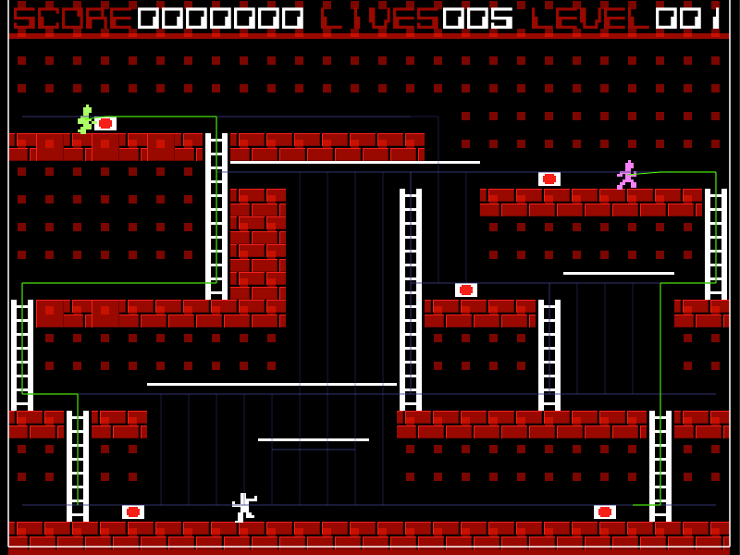
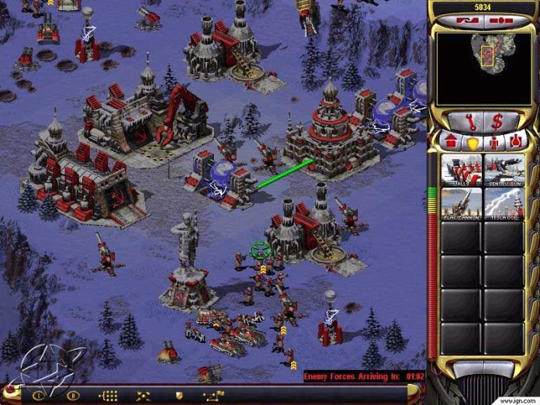
Pathfinding
Often seems obvious and natural in real life
  E.g. Get from point A to B → go around lake
For a computer controlled player, may be difficult
  E.g. Going from A to B go through enemy base
Want to pick “best” path
Need to do it in real-time
Why can’t we just figure it out ahead of time (i.e. before the game starts)?

Slide 16
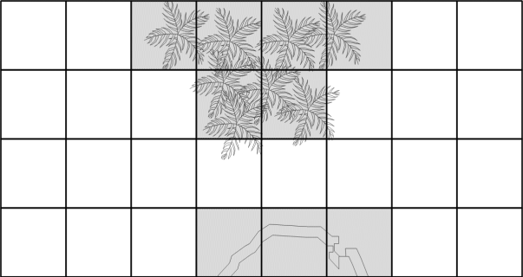
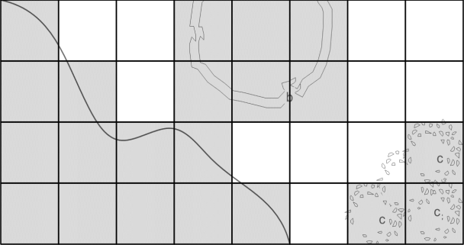
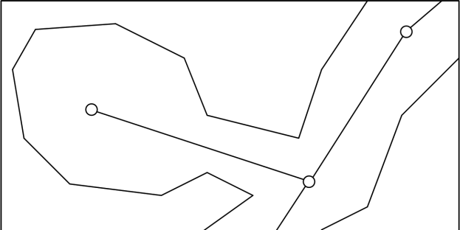
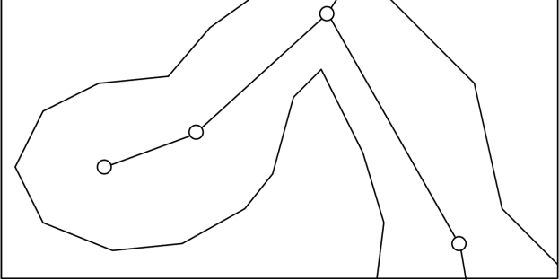
Representing the Space
System needs to understand the level
  But not full information, only relevant information (e.g. is it passable, not water vs. lava vs. tar…)
Common representations
  2d Grid
    Each cell passable or impassible
    Neighbors automatic via indices (8)
  Waypoint graph
    Connect passable points
    Neighbors flexible (but needs to be stored)
    Good for arbitrary terrain (e.g. 3d)

Slide 17
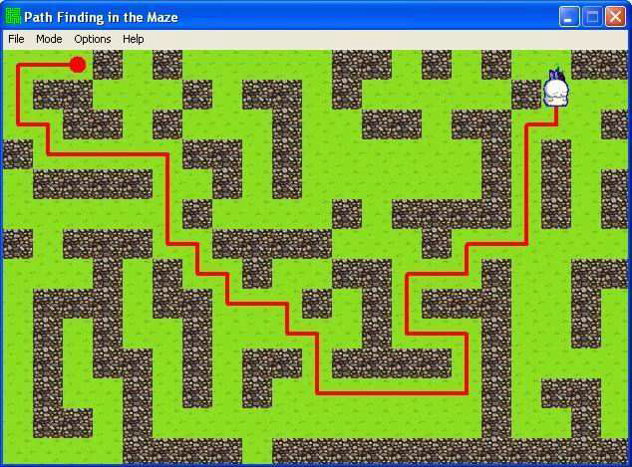
Finding a Path
Path – a list of cells, points or nodes that agent must traverse to get to from start to goal
  Some are better than others
  → measure of quality
Algorithms that guarantee path called complete
Some algorithms guarantee optimal path
Others find no path (under some situations)

Slide 18
Random Trace (Simple Algorithm)
Agent moves towards goal
If goal reached, then done
If obstacle
  Trace around obstacle clockwise or counterclockwise (pick randomly) until free path towards goal
Repeat procedure until goal reached
(Humans often do this in mazes)

Slide 19
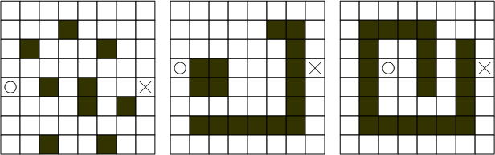
Random Trace (continued)
How will Random Trace do on the following maps?
Not a complete algorithm
Found paths are unlikely to be optimal
Consumes very little memory

Slide 20
Understanding A*
To understand A*
– Combines breadth-first, best-first, and Dijkstra
These algorithms use nodes to represent candidate paths
m_pParent used to chain nodes sequentially together to represent path
  List of absolute coordinates, instead of relative directions
class PlannerNode {
public:
PlannerNode *m_pParent;
int m_cellX, m_cellY;
...
};

Slide 21
Breadth-First (1 of 2)
Overview
Overall Structure
Use two lists: open and closed
Open list keeps track of promising nodes
Closed list keeps nodes that are visited, but don’t correspond to goal
When node examined from open list
  Take off
  Check to see if reached goal
If not reach goal
  Create additional nodes
  Place on closed list
Create start point node – push onto open list
While open list is not empty
  A. Pop node from open list (call it currentNode)
  B. If currentNode corresponds to goal done
  C. Create new nodes (successors nodes) for cells around currentNode and push them onto open list
  D. Put currentNode onto closed list

Slide 22
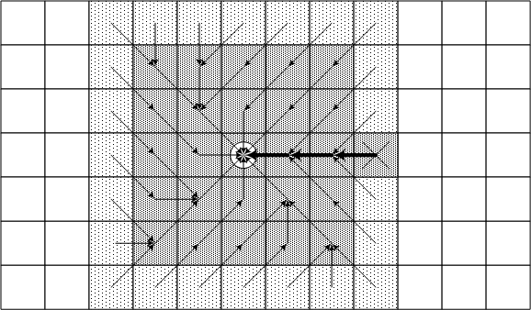
Breadth-First (2 of 2)
Search from center
Goal was ‘X’
Open list → light grey
  Have not been processed
Closed list → dark grey
  Not goal and have been processed
Arrows represent parent pointers
Path appears in bold

Slide 23
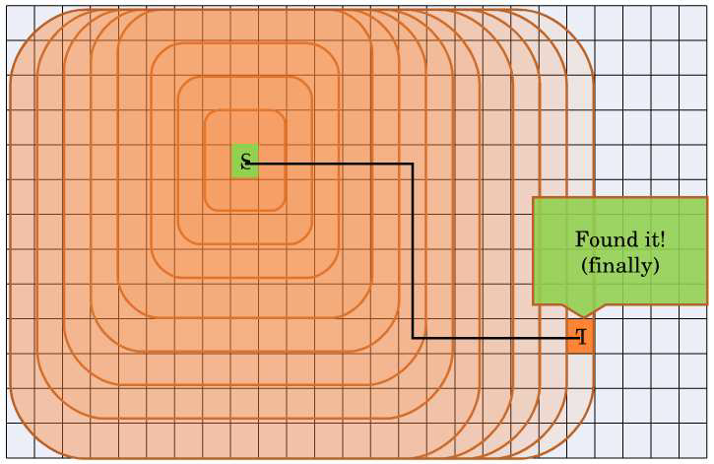
Breadth-First in Action

Slide 24
Breadth-First Characteristics
Exhaustive search
– Systematic, but not clever
Consumes substantial amount of CPU and memory
Guarantees to find paths that have fewest number of nodes in them
  Complete algorithm
  But not necessarily shortest distance!

Slide 25
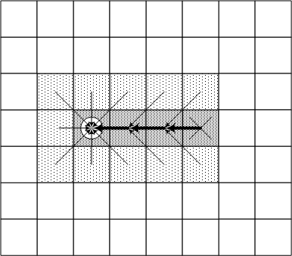
Best-First (1 of 2)
Uses problem specific knowledge to speed up search process
  Not an exhaustive search, but a heuristic search
Head straight for goal
Computes distance of every node to goal
Algorithm same as breadth first
  But use distance as priority value
  Use distance to pick next node from open list

Slide 26
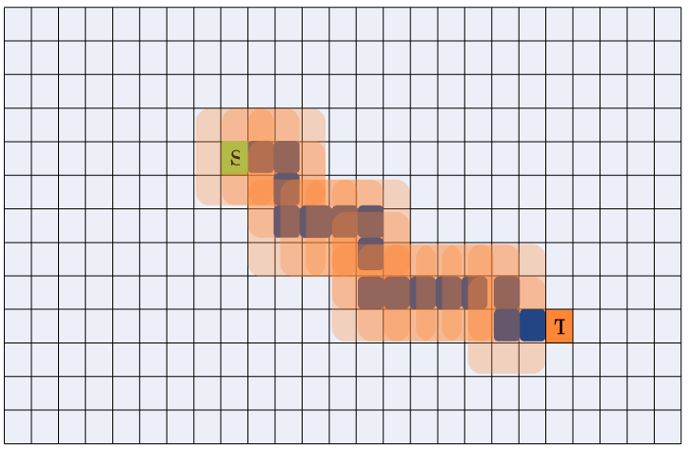
Best-First in Action
Looks pretty good! But perfect?

Slide 27
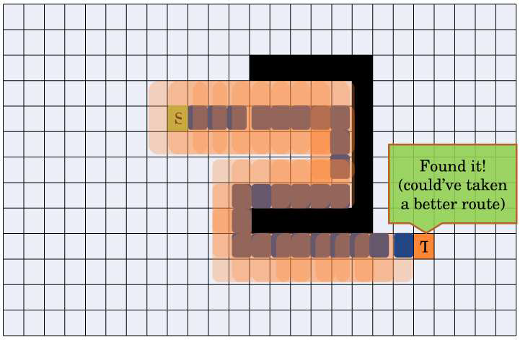
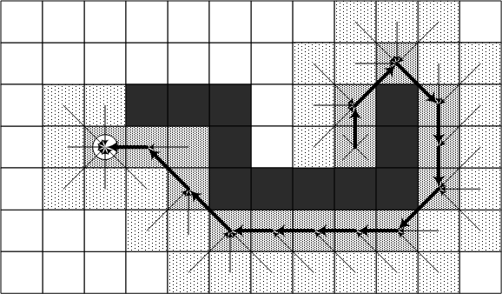
Best-First (2 of 2)
(Sub-optimal paths)

Slide 28
Best-First Characteristics
Heuristic search
Uses fewer resources than breadth-first
On average, much faster than breadth-first search
Tends to find good paths
  No guarantee to find most optimal path
Complete algorithm

Slide 29
Dijkstra’s Algorithm
Disregards distance to goal
  Keeps track of cost of every path
  Unlike best-first, no heuristic guessing
Computes accumulated cost paid to reach a node from start
  Uses cost (called “given cost”) as priority value to determine next node in open list
Use of cost allows it to handle other terrain
  E.g. mud that “slows” or “downhill”

Slide 30
Dijkstra Characteristics
Exhaustive search
At least as resource intensive as Breadth-First
Always finds the optimal path
  No algorithm can do better
Complete algorithm

Slide 31
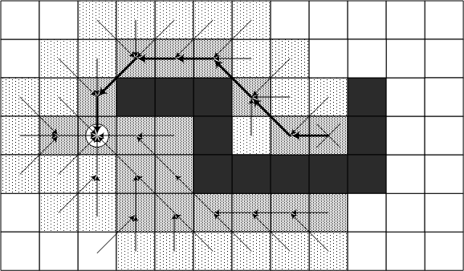
A*
Use best of Djikstra and Best-First
Both heuristic cost (estimate) and given cost (actual) to pick next node from open list
Final Cost = Given Cost + (Heuristic Cost * Heuristic Weight)
(Avoids Best-First trap!)

Slide 32
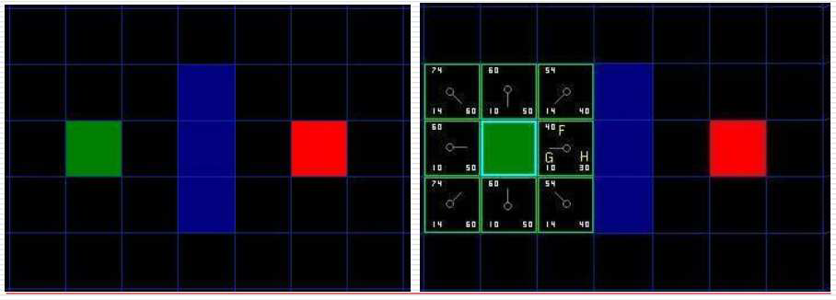
A* Internals (1 of 3)
Green: start
Red: goal
Blue: barrier
G: 10 for ver/horiz, 14 for diagonal
H: distance * 10

Slide 33
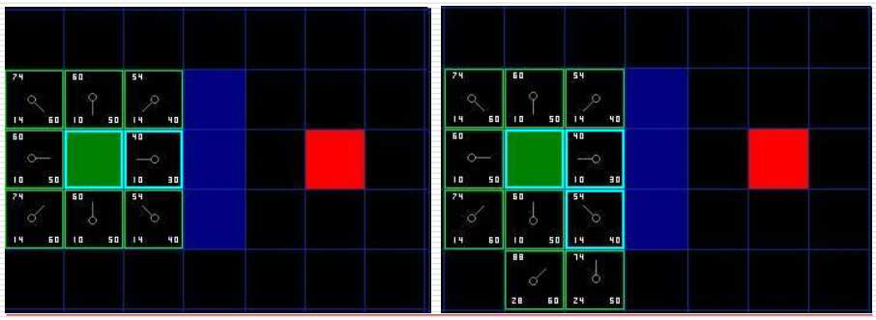
A* Internals (2 of 3)
Now check for the low F value in OPEN
  In this case NE = SE = 54, so choose SE
Going directly to SE is cheaper than E->SE
  Leave start as the parent of SE, and iterate

Slide 34
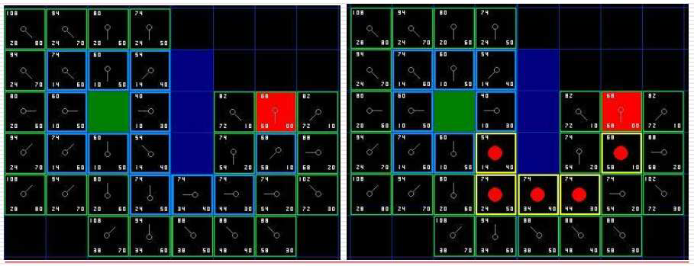
A* Internals (3 of 3)
Keep iterating until reach goal and OPEN is empty
Follow parent links to get short path

Slide 35
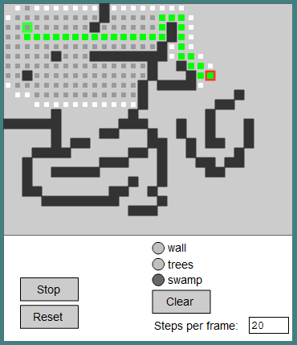
A* Demo
http://www.antimodal.com/astar/

Slide 36
A* Characterisitics
Heuristic search
  Weight can control 0 then like Dijkstra, large then like best-first
On average, uses fewer resources than Dijkstra and Breadth-First
“Good” heuristic guarantees it will find the most optimal path
  “Good” as long as doesn’t overestimate actual cost
  For maps, good is “as a bird flies” distance (best-case)
Complete algorithm

Slide 37
Outline
Introduction (done)
Common AI Techniques (done)
Promising AI Techniques (done)
Pathfinding (A*) (done)
Finite State Machines (next)
Summary

Slide 38
Finite State Machines
Often AI as agents: sense, think, then act
But many different rules for agents
  Ex: sensing, thinking and acting when fighting, running, exploring…
  Can be difficult to keep rules consistent!
Try Finite State Machine
  Probably most common game AI software pattern
  Natural correspondence between states and behaviors
  Easy: to diagram, program, debug
  General to any problem
  See AI Depot - FSM
For each situation, choose appropriate state
  Number of rules for each state is small

Slide 39
Finite State Machines
(Detailed
example next
slide)
Abstract model of computation
Formally:
  Set of states
  A starting state
  An input vocabulary
  A transition function that maps inputs and current state to next state

Slide 40
Finite State Machines – Example (1 of 2)
Game where raid Egyptian Tomb
Mummies! Behavior
  Spend all of eternity wandering in tomb
  When player is close, search
  When see player, chase
Make separate states
  Define behavior in each state
    Wander – move slowly, randomly
    Search – move faster, in lines
    Chasing – direct to player
Define transitions
  Close is 100 meters (smell/sense)
  Visible is line of sight
Wandering
Close by
Far away
Searching
Visible
Hidden
Chasing

Slide 41
Finite State Machines – Example (2 of 2)
Can be extended easily
Ex: Add magical scarab (amulet)
When player gets scarab, Mummy is afraid. Runs.
Behavior
  Move away from player fast
Transition
  When player gets scarab
  When timer expires
Can have sub-states
  Same transitions, but different actions
    ie- range attack versus melee attack
Wandering
Timer
Expires
Scarab
Close by
Far away
Searching
Afraid
Scarab
Visible
Hidden
Chasing
Scarab

Slide 42
Finite State Machines Summary
Pros
Cons
Simplicity → low entry level
Predictability → allows for easy testing
Simplicity → quick to design, implement and execute
Well-proven technique with lots of examples
Flexible → many ways to implement
Easy to transfer from abstract representation to coded implementation
Low processor overhead → only the code for the current state needs to run, well suited to games
Easy to tell reachability of state
Predictability → can make for easy-to-exploit opponent
Large FSMs difficult to manage and maintain ("spaghettifactor“)
All states, transitions and conditions need to be known up front and be well defined
Inflexible → conditions for transitions are ridged

Slide 43
Summary
AI for games different than other fields
  Intelligent opponents, allies and neutral’s but fun (lose in challenging way)
  Still, can draw upon broader AI techniques
Finite State Machines flexible, popular
  But don’t scale to complicated AI
Dozens of techniques to choose from, with promising techniques on the horizon
  AI is the next great “frontier” in games
Two key aspects of pathfinding:
  Representing the search space
  Searching for a path

