Slide 1
Project 2
Dragonfly

Slide 2
Overview
Goal is to build your own Dragonfly
2D (text-based graphics) game engine
Objectives
Learn how game engine works from ground up
Provide in-depth understanding of your engine to enable development of a game (Project 3)
Become better programmer

Slide 3
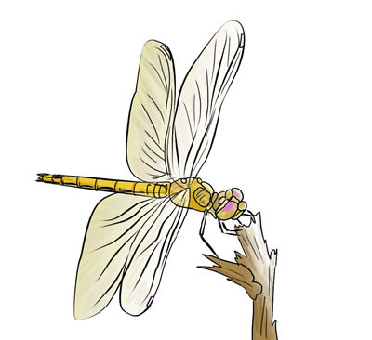
Dragonfly Parts (1 of 2)
A: Dragonfly Egg: February 1st, 11:59pm
B: Dragonfly Naiad: February 10th, 11:59pm
C: Dragonfly: February 10th, 11:49pm
All build to fully working, full-featured game engine
Part A is foundational
Part B is fully working
Part C is full-featured

Slide 4
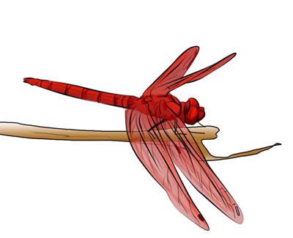
Dragonfly Parts (2 of 2)
Completing through Part B will enable Project 3
Earn a “B” grade for Project 2
Completing through Part C will enable additional game engine features (e.g. animated sprites)
Potential for “A” grade for project 2
Important! Tested, trusted robust code that implements A and B much better than buggy, unreliable code that attempts part C
Work alone (Project 3 in teams)
Can collaborate for debugging, discussion but all coding done separately (do not send/swap code!)

Slide 5
Part A – Dragonfly Egg
Start and stop gracefully
Log time-stamped messages to file
Adding and removing of game objects
Objects have 2d game world positions
Running a game loop with:
A fixed rate (e.g. 30 Hz)
Updates sent to all objects each tick
Note! No visual depiction needed for Part A!

Slide 6
Part A Classes
LogManager
singleton
startup and shutdown
time
flexible means of data entry (integers, strings, ...)
Clock
milliseconds of resolution for timing
Position
(x,y) location
GameManger
singleton
startup and shutdown
game loop
GameObject
position
event handler
GameObjectList
store 1+ GameObjects
add, remove GameObject
GameObjectListIterator
iterate through GameObjectList
WorldManager
store all game programmer GameObjects
add, remove GameObjects
can send an event to all GameObjects
Event
getting/setting type
(Note, not necessarily in order of implementation!)

Slide 7
Part A – Grading
LogManager 10%
Clock 10%
Position 5%
GameManager 10%
Game Object 10%
GameObjectList 10%
Iterator 10%
WorldManager 10%
Event 5%

Slide 8
Part B – Dragonfly Naiad
Output
Support 2d (ascii) characters
Clean refresh each game loop
Support color
Input
Accept non-blocking keyboard and mouse input
Send in event to interested game objects
Collisions
Detect between solid objects (note, need "solid" attribute for game objects)
Send as event to both objects
Misc
Deferred, batch removal of game objects (markForDelete)
Support event filtering, where game objects register when interested
Provide "altitude" attribute for game objects for layered drawing
Send "outofbounds" event when objects off screen

Slide 9
Part B – Classes
Manager (base class)
Support event filt (register, unregister, onEvent)
GameManager
Modify game loop
Get input (InputManager)
Have objects draw themselves (WorldManager)
Refresh screen (GraphicsManager)
GraphicsManager
Singleton
Startup and shutdown
Draw character at (x,y) with optional color
Detect and store horiz and vert screen size
SwapBuffers to refresh display to latest world
InputManager
Singleton
Startup and shutdown
Allow registration for only valid events
Support keyboard and mouse input
EventKeyboard
Getting/setting type
Getting/setting key pressed
WorldManager
Batched removal in update (markForDelete)
Support boundary limits (equal to screen limits)
Detect collisions
Move objects
If out of bounds, provide event
If solid, provide collisions (detection and events)
Draw method, where all objects draw themselves
Altitude , where lowest objects drawn first
GameObject
Solidness
Altitude
EventOut
Getting/setting type
EventCollision
Getting/setting type
Getting/setting both objects in collision
Getting/setting collision position
EventMouse
Getting/setting type
Getting/setting mouse action (button)
Getting/setting (x,y) location on screen
(Note, not necessarily in order of implementation!)

Slide 10
Part B – Grading
Manager 10%
GameManager 5%
GraphicsManager 25%
InputManager 25%
WorldManager 25%
GameObject and Events 10%

Slide 11
Part C - Dragonfly
Sprites
Provide multi-character frame
Associate 1+ frames one object
Play frames in sequence to achieve animation
Resource Management
Read sprite data from file
Bounding boxes
Game objects larger than single character (movement and collisions)
Bounding box associated with Sprite
Camera Control
Game world larger than screen (viewport)
View port movement around game world
Object Control
Support "velocity" for game objects with automatic updates
Misc
Gracefully handle kill signal
Random number seeding

Slide 12
Part C – Classes
ResourceManager
Singleton
Startup and shutdown
Load Sprites from file
Find Sprites with given labels
Sprite
Width, height
Label
Color
Frame count and frame
Frame
Width, height
Data
Box
Corner, position
GameObject
Support Sprites
Centered
Animation rate (slowdown)
Gettting/setting bounding box
Centered based on Sprite
Getting/setting x-velocity, y-velocity
WorldManager
Modify collision detection for box intersection
Add camera (viewport) control
Get/set view
Translate world (x,y) to view (x,y)
Modify update to support velocities

Slide 13
Part C - Grading
ResourceManager 25%
Sprite 15%
Game Object 25%
WorldManager 20%
Frame 8%
Box 7%

Slide 14
Development
Must be C++
Can be Linux or Windows with Cygwin
Certain to support curses (project 2b, project 2c)
Consider Eclipse if want IDE
Where?
FL222 → install Cygwin, 64-bit
CCC → login to ccc.wpi.edu, Linux 64-bit
Or, setup your own environment (e.g. Visual Studio)
Must have curses support (consider pdcurses, cygwin)
TA needs to grade
If in doubt, ask!

Slide 15
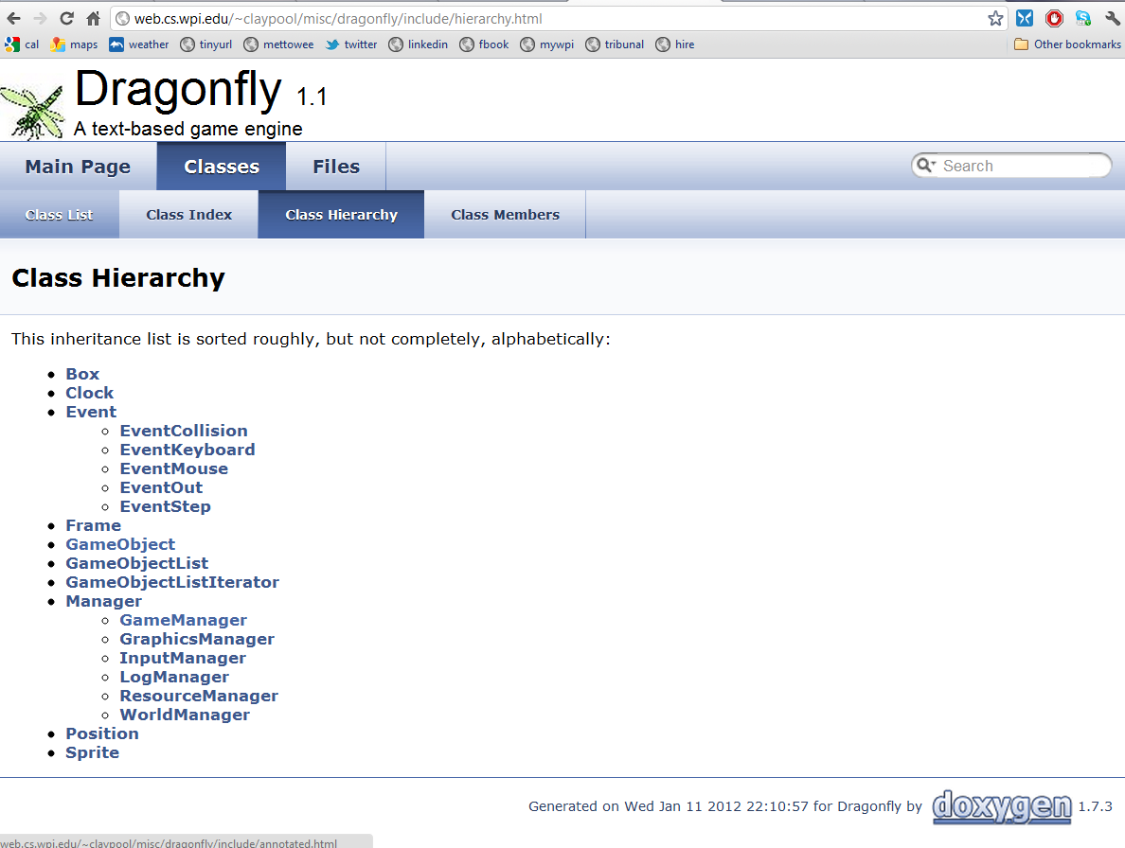
Resources
Slides

Slide 16
Hand In (1 of 2)
Source code package
All code necessary to build your game (well-structured, commented)
Any other support files, including .h files.
A Makefile or project for building your utilities.
Game program(s)
Game code illustrating functionality
Should be accompanied by what to see in log files
README file explaining:
Platform
Files
Code structure
How to compile
Anything else needed to understand (and grade) your game

Slide 17
Hand In (2 of 2)
When ready, upload (WinSCP) to CCC machine
mkdir lastname-proj2a
cp * lastname-proj2a
tar czvf proj1-lastname.tgz lastname-proj2a
Submit your assignment (proj1-lastname.tgz):
/cs/bin/turnin submit imgd3000 project2a proj2a-lastname.tgz
Verify
/cs/bin/turnin verify imgd3000 project2a
Help at
http://www.cs.wpi.edu/Resources/turnin.html
Due at midnight (11:59pm)

