Slide 1

Project 1
To Catch a Dragonfly

Slide 2

Overview
Goal is to get used to Dragonfly
  2D (text-based graphics) game engine
Work through tutorial making a game
  Saucer Shoot
Objectives
  Learn how to develop a game using an engine
  Provide foundational knowledge for your engine (Project 2)
  Provide ideas of scope for your game (Project 3)

Slide 3
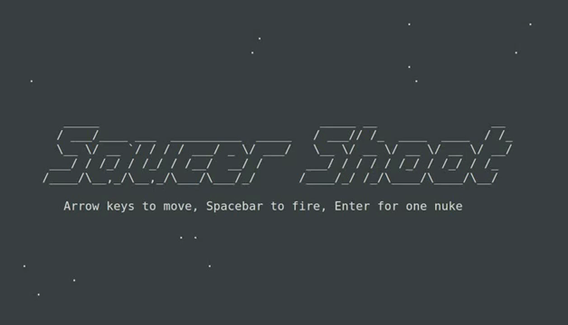
What Does “Text-based” Look Like?

Slide 4

Setup
Project 1 Web page has link to Dragonfly Web page
  Dragonfly Web page is password protected
  Login is your CCC username, plus password
Download the Dragonfly game engine (dragonfly-v1.0.zip)
  Linux (32-bit and 64-bit)
  Cygwin (64-bit)

Slide 5

Setup
Setup environment
  Path to Dragonfly pre-compiled library (e.g. libdragonfly.a)
  Path to Dragonfly header files (*.h)
Where?
  FL222 → install Cygwin, 64-bit
  CCC → login to ccc.wpi.edu, Linux 64-bit
  Setup your own environment
    Compiler (e.g. g++ or MinGW)
    For Makefile → make and makedepend
    Libncurses development environment
    If Cygwin, -DCYGWIN needed

Slide 6

Tutorial
Saucer Shoot, on Dragonfly Web page
Work through start to finish
  “Cook-book” like, but with some explanations
Note: Sprite package (sprites.zip)
Note: Source code if stuck (gameX.zip)
Internal understanding not necessarily needed
  That will come during the term
Basic external understanding expected
  Needed for extending the game

Slide 7

A 10,000-Foot View of Game Code
Startup Game Engine
  Initialize graphics, input devices, file logging
Populate World with Objects
  Player object (Hero), Saucers
Run Game
  Move objects, get input, send events to objects (e.g. collisions), draw screen (objects draw themselves)
Shutdown

Slide 8

Core Attributes of Engine in Tutorial
Startup
  Managers
Resource loading (sprites)
Objects
  Static (Hero, Stars)
  Dynamic (Saucers, Bullets)
Events
  Built-in: Keyboard, Collision
  Custom: Nuke
Not explicit, but also: Debugging (own code), logfiles

Slide 9

Extending the Game
Add additional code (sprites, if needed)
An extra “10%” functionality
  Additional weapons (e.g. Missile with explosion)
  Additional bad-guys (e.g. UFO that zig-zags)
  Lives or Health for Hero (with status)
  Score
See end of Tutorial for suggestions

Slide 10
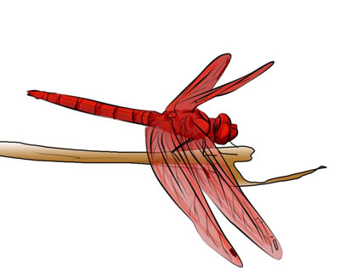
Why ASCII?
Conceptually easy
  (x,y) location, all cells
Platform independent (mostly)
  Curses (Ncurses) ported nearly everywhere
  All modern terminal windows support
Reduce temptation of spending time on art
  “Programmer art” is ok!

Slide 11

ASCII Graphics
How do you animate?
Update display, making changes often enough
  Full-motion video about 30fps
  Dragonfly does 30 updates/second
Taking a Walk
0
|
|
Taking a Walk
0
|
/ \
Taking a Walk
0
|
|

Slide 12

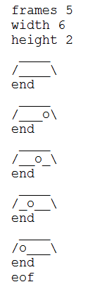
ASCII Graphics
Sprite file with fixed format
  Note, must be exact (spaces)
Included sprites (sprites.zip) all work
If cut-and-paste or create own and doesn’t load, see “dragonfly.log”

Slide 13


Only ASCII? Check out Star Wars
,-'//__\\`-.
,' ____ `.
/ / ,-.-. \
(/# /__`-'_| || || )
||# []/()] O || || |
__`------------------'__
|--| |<=={_______}=|| |--|
| | |-------------|| | |
| | |={_______}==>|| | |
| | | |: _ :| || | |
> _| |___|:===:| || |__<
:| | __| |: - :| || | |:
:| | ==| |: _ :| || | |:
:| | ==|_|:===:|___||_| |:
:| |___|_|:___:|___||_| |:
:| ||| ||/_\|| ||| -| |:
;I_|||[]_||\_/|| ||| -|_I;
|_ |__________________| _|
| `\\\___|____|____/_//' |
J : | \____/ | : L
_|_: | |__| | :_|_
-/ _-_.' -/ \- `.-_- \-
/______\ /______\ /______\
http://www.asciimation.co.nz/

Slide 14


Note “Pixels” of Resolution
Don’t have to limit yourself to 80x24!
(Above, about 200x60. My screen, 600x400 → nearly VGA)

Slide 15
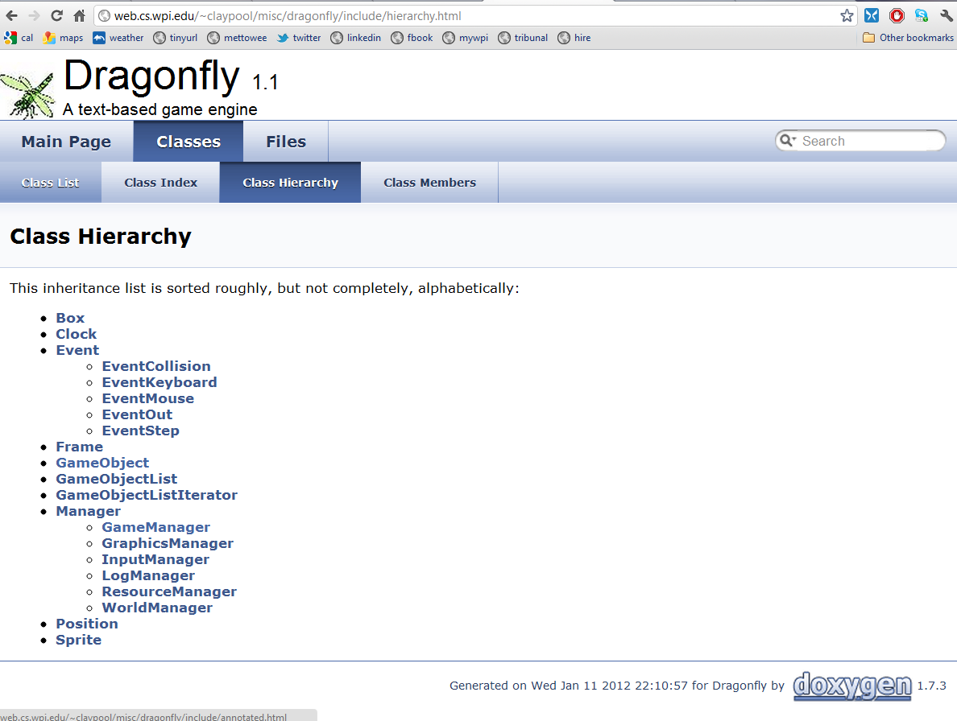
Document Browser

Slide 16
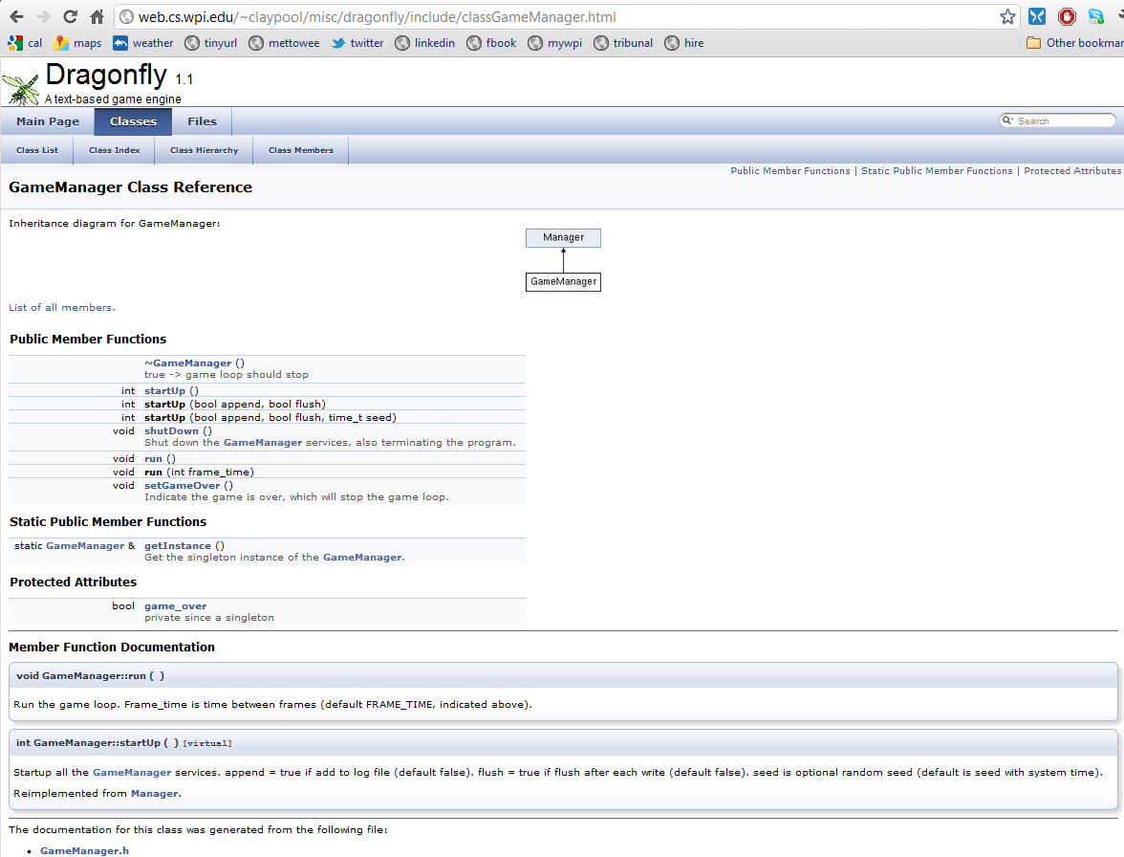

Slide 17

Hand In (1 of 2)
Source code package
  All code necessary to build your game (well-structured, commented)
  Any other support files, including .h files.
  Any sprites that may be needed.
  A Makefile or project for building your utilities.
  You do NOT need to turn in any Dragonfly headers or libraries
README file explaining:
  Platform
  Files
  Code structure
  How to compile
  Anything else needed to understand (and grade) your game
GAME file providing:
  Short description of additional 10% extension
  Detail functionality added from player's prospective
  Briefly indicate code written

Slide 18

Hand In (2 of 2)
When ready, upload (WinSCP) to CCC machine
  mkdir lastname-proj1
  cp * lastname-proj1
  tar czvf proj1-lastname.tgz lastname-proj1
Submit your assignment (proj1-lastname.tgz):
  /cs/bin/turnin submit imgd3000 proj1 proj1-lastname.tgz
Verify
  /cs/bin/turnin verify imgd3000 project1
Help at
  http://www.cs.wpi.edu/Resources/turnin.html
Due at mid-night (11:59pm)

Slide 19

Grading
Tutorial 40%
Customization 50%
Documentation 10%

