Slide 1
The M.S. Degree in Robotics Engineering
A multidisciplinary degree spanning Computer Science, Electrical and Computer Engineering, and Mechanical Engineering

Slide 2
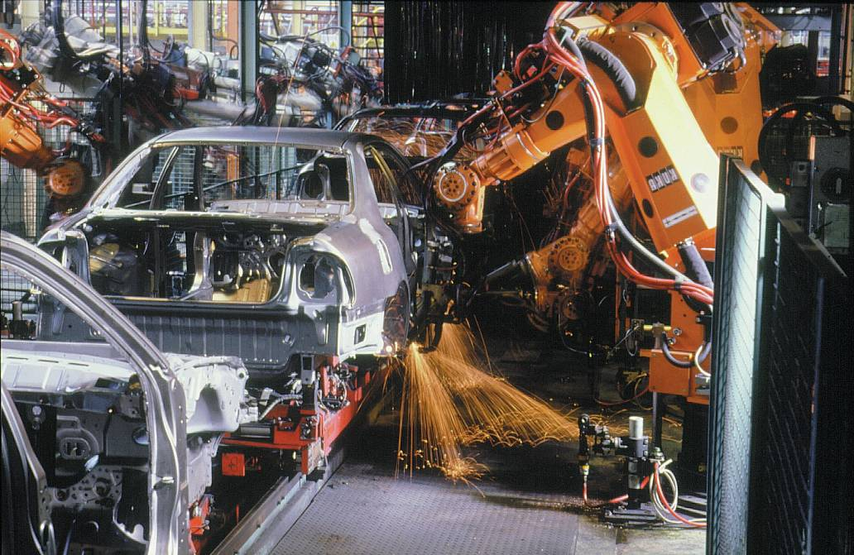
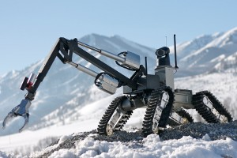
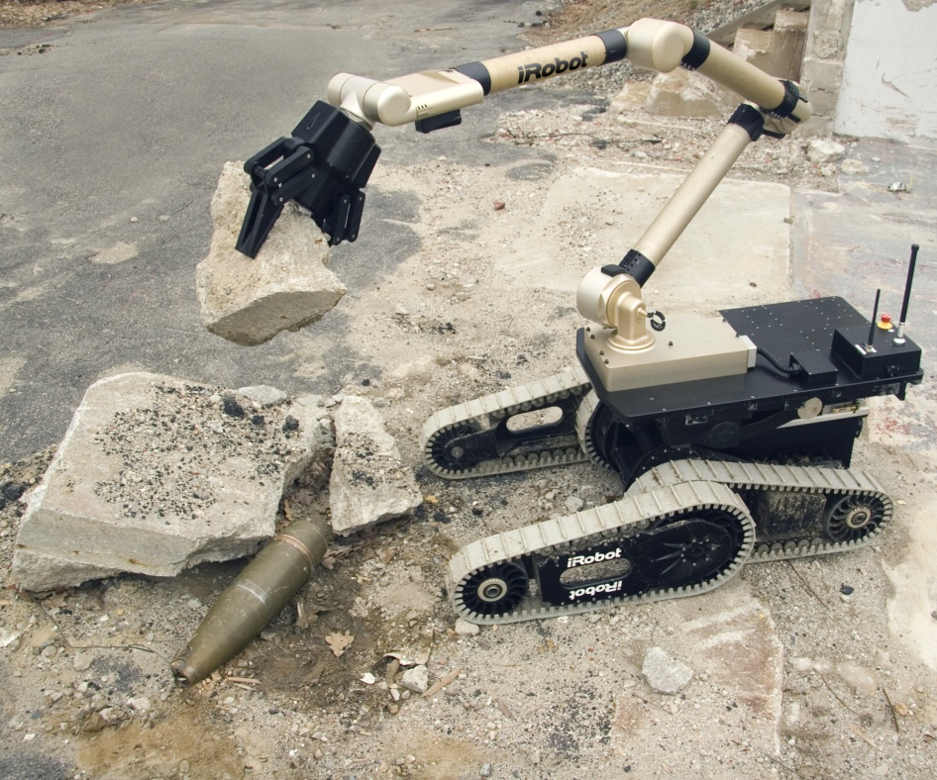
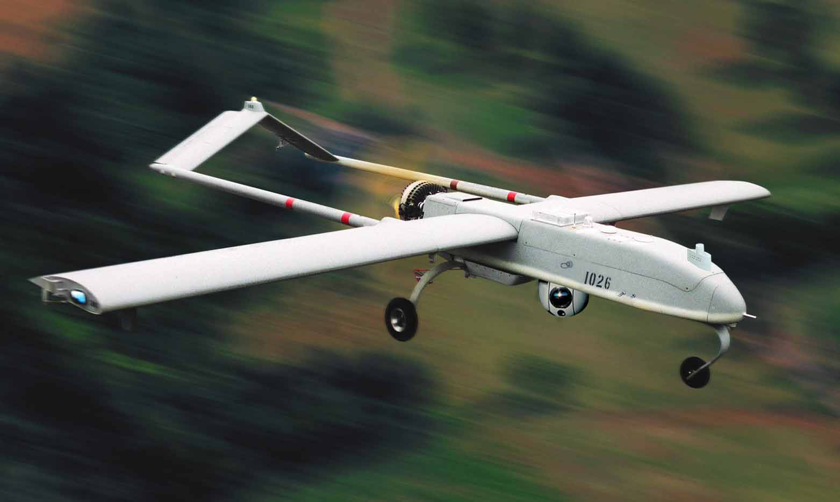
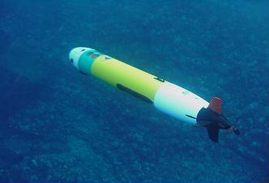
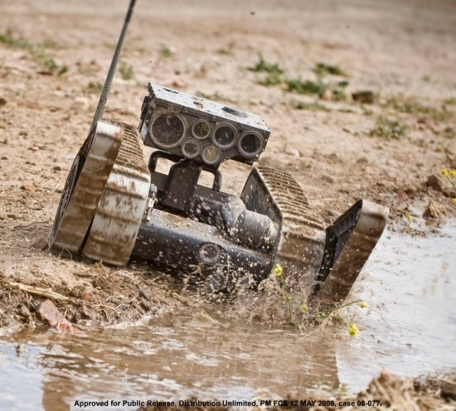
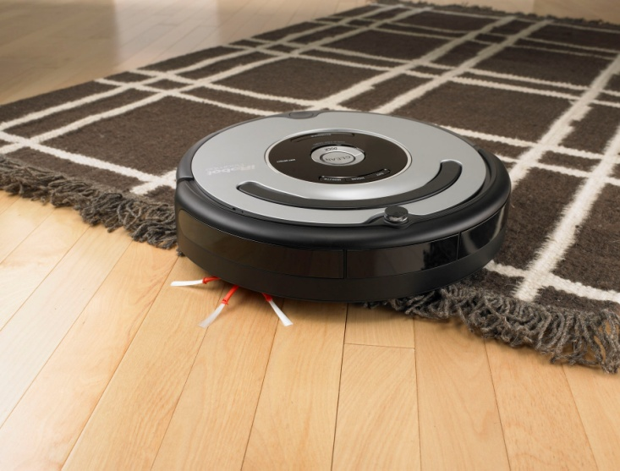
Robotics
B.S. in Robotics Engineering
Approved by the WPI Faculty in fall 2006.
M.S. in Robotics Engineering
Approved by the WPI Faculty in spring 2009.
The first RBE B.S. program in the United States.
The first institution offering both B.S. and M.S. Robotics Engineering programs in the United States.
New century,
New technology,
New program,
New courses,
New approach…

Slide 3
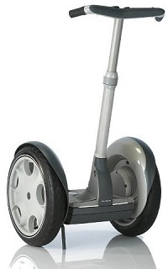
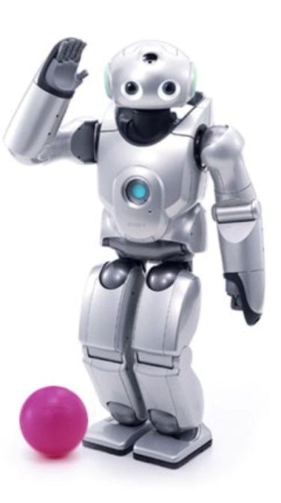
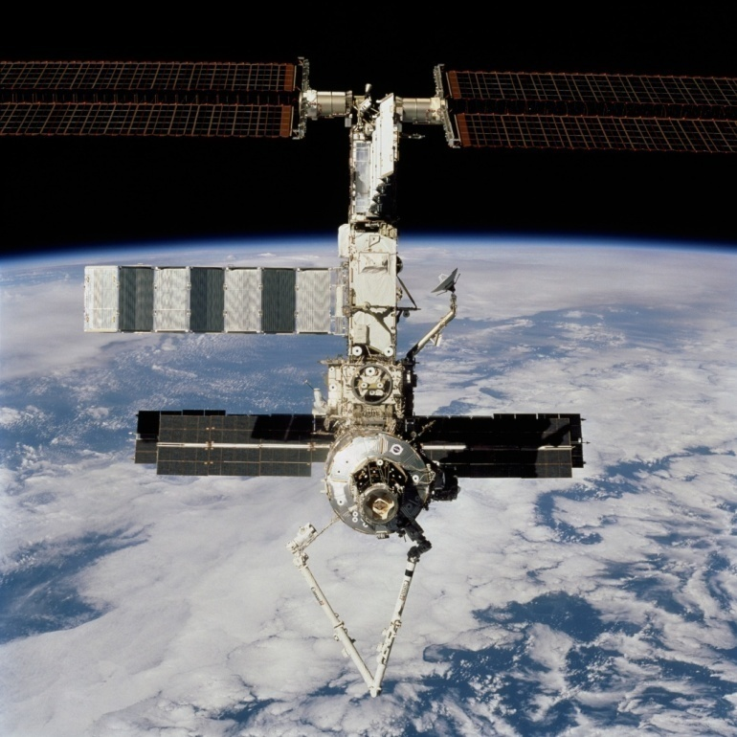
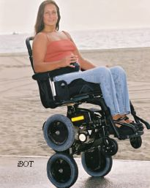
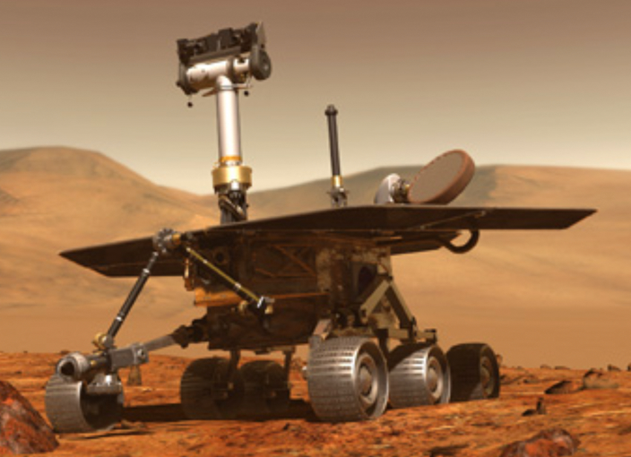
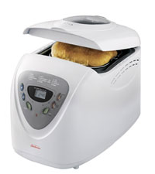
Robots take many forms!

Slide 4
WPI and Robotics Engineering (RBE)
RBE is fundamentally multi-disciplinary
Innovative and immersive approach to intermingle CS, ECE and ME while maintaining a strong traditional-core engineering education
RBE is rooted in practice as strongly as in theory
Project experience and industry research relationships are essential for an effective RBE graduate
WPI with its history of innovation, emphasis on project-oriented education, flexible curriculum, and industrial ties, is the perfect university to undertake the education of future roboticists.

Slide 5
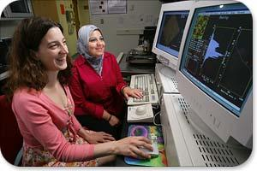
Computer Science
Software engineering and systems (not just "programming")
Human interfaces, graphics and animation
Computer networks
Database and knowledge systems
Artificial intelligence
…Robotics

Slide 6
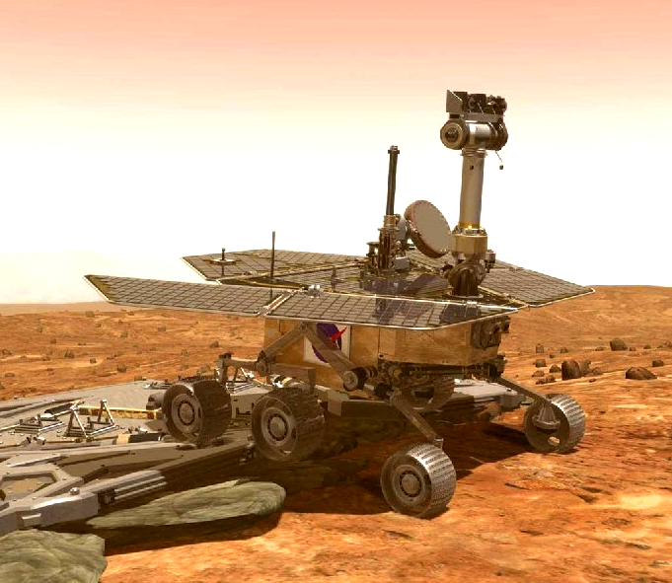
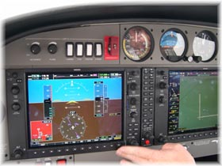
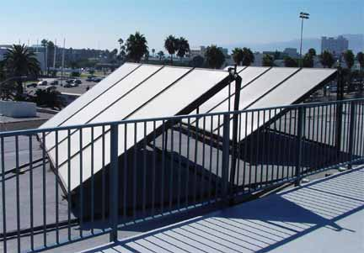
Electrical & Computer Engineering
Electric Power
Information
Computers
Networking and Communications
Video, Audio… any entertainment
Cryptography
Sensors and Systems
Aerospace and Navigation
Radar, Sonar, Inertial
Environmental
Computer Engineering
Circuits and Systems
Micro and Nano-electronics and photonics
…Robotics

Slide 7
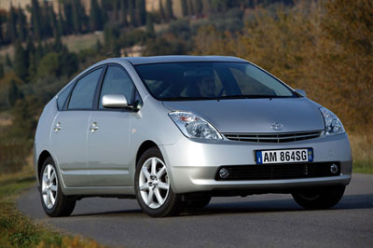
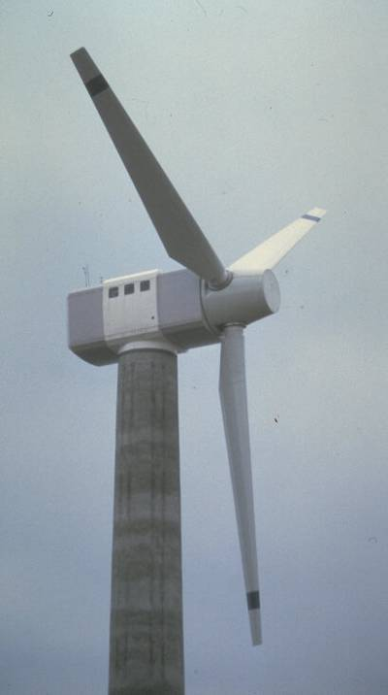
Mechanical Engineering
Energy
Energy transformation
Renewable sources
Materials
Biomaterials, structural materials, smart materials
Machines
Air, space, land, water vehicles
…Robotics

Slide 8
The Robotics Industry
“The epicenter of Robotics is in New England.”
--Helen Greiner Co-founder, iRobot Founder and CEO, The Droidworks
New England, and Massachusetts in particular, houses a strong and growing Robotics industry.
Sales exceed $942 million
Employ 2,500 in Massachusetts
40% companies are startups or less than 6 years old
Average annual growth rate 47%
90% of all hires are local hires
70% plan to hire in next 1–2 years

Slide 9
Robotics Engineering Advisory Board
David Kelly, President, Bluefin Robotics
Helen Greiner, Founder and CEO, The Droidworks
Brian Hart, President, Black-I Robotics
Dean Kamen, Founder and President, DEKA Research and Development Corp.
Dan Kara, President, RoboticsTrends
Etc…

Slide 10
Goals & Objectives
Goal
Prepare men and women for technical leadership in the robotics industry and research in robotics.
Objectives
Solid understanding of the fundamentals of Computer Science, Electrical and Computer Engineering, Mathematics, and Mechanical Engineering
Awareness of management and systems contexts
Advanced knowledge in selected areas of robotics, culminating in a capstone research or design experience.

Slide 11
Credit Requirements
 | MS Thesis | MS Non-Thesis | BS/MS
Robotics Core | 15 | 15 | 15
Engineering Context | 6 | 6 | 6
Electives | 6 | 9 | 9
Thesis | 9 | – | –
Capstone Design / Practicum | – | 6 | 6
Double Count | – | – | (12)
Total | 36 | 36 | 24

Slide 12
Detailed Requirements
Robotics Core (15 credits)
Foundations: RBE 500 Foundations of Robotics & RBE 501 Robot Dynamics
CS: 1 from {CS 509 Design of Software Systems, CS 534 AI, CS 546 HCI}
ECE: 1 from {ECE 502 Analysis of Probabilistic Signals and Systems, ECE 503 Digital Signal Processing, ECE 504 Analysis of Deterministic Systems}
ME: 1 from {ME523 Applied Linear Control, ME527 Dynamics, ME623 Applied Nonlinear Control}
Engineering Context (6 credits)
Management: 1 from {ETR 592 New Venture Management And Entrepreneurship, MIS 576 Project Management, MKT 563 Marketing of Emerging Technologies, OBC 511 Interpersonal and Leadership Skills for Technological Managers, OIE 546 Managing Technological Innovation}
Systems Engineering: 1 course
Capstone Design / Practicum (6 credits) or Thesis (9 credits)
Electives (6-9 credits)

Slide 13
Courses
RBE 500. Foundations of Robotics
Mathematical foundations and principles of processing sensor information in robotic systems.
ME/RBE 501. Robot Dynamics
Foundations and principles of robotic manipulation.
RBE 595. Special Topics
Arranged by individual faculty with special expertise
RBE 596. Robotics Engineering Practicum
RBE 597. Independent Study
RBE 598. Directed Research
RBE 599. Thesis Research

Slide 14
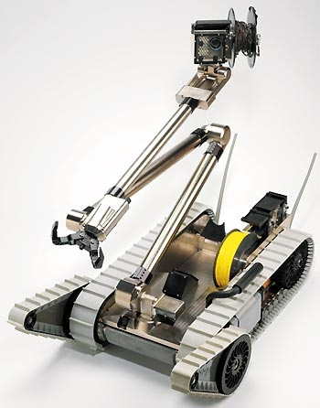
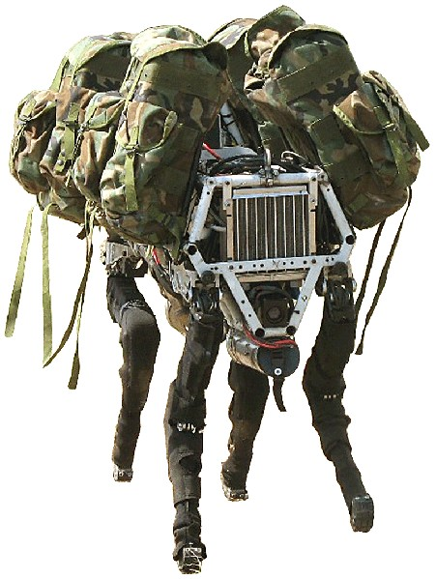
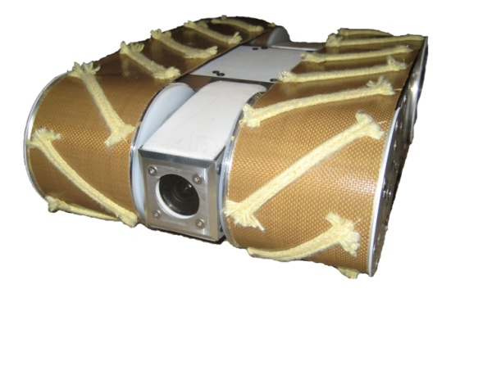
Internship Opportunities

Slide 15
Robotics Honor Society

Slide 16
Faculty & Research I
David Brown, CS
The Application of AI to Design;
Human-Computer Interaction & Interface Design;
Design Theory & Methodology;
Artificial Intelligence
Michael J. Ciaraldi, CS
Robotics Education;
Software Engineering;
Real-Time and Embedded Systems;
Eben C. Cobb, ME
Computer Aided Design and Kinematics;
Smart Structures;
Vibration Control;
Design of High-Speed Precision Equipment
David Cyganski, ECE
Machine Vision;
Automatic Target Recognition;
Image Fusion; Network Computing;
Multimedia;
Computers In Education
Michael A. Demetriou, ME
Control of Mobile Sensor and Actuator Networks;
Intelligent Control of Robotic Manipulators;
Model-Based Intrusion and Biochemical Source
Detection Using Mobile Sensors
Gregory Fischer, ME
Medical Robotics;
Computer Assisted Interventional Systems;
MRI-Compatible Mechatronics;
Modeling And Control Of Robotic Systems;
Kinematics And Mechanism Design
Michael A. Gennert, CS
Robotics Education;
Computer Vision;
Image Processing;
Programming Languages
Islam Hussein, ME
Cooperative Control of Intelligent Multiple Vehicle
Sensor Network Systems;
Geometric Mechanics; Optimal Control Theory

Slide 17
Faculty & Research II
Robert W. Lindeman, CS & IMGD
Human-Computer Interaction;
Human-Robot Interaction for Teleoperation
Fred J. Looft III, ECE
Instrumentation;
Digital and Analog systems;
Signal Processing;
Biomedical Engineering;
Microprocessor Systems and Architectures;
Space-Flight Systems
William Michalson, ECE & CS
Communications and Navigation Systems;
Embedded Computing / Real-Time Systems;
Networking and IT Infrastructure
Robert L. Norton, ME
Mechanical Design and Analysis;
Dynamic Signal Analysis;
Computer Aided Engineering and Design;
Vibration Analysis
Taskin Padir, ECE
Modeling and Control of Robotic Systems;
Kinematics and Dynamics of Robot Manipulators;
Redundancy Resolution and Trajectory Planning;
Machine Vision
Gary Pollice, CS
Software Engineering;
Quality and Testing;
Collaborative Development and Processes
Charles Rich, CS &IMGD
Human-Robot Interaction
Gretar Tryggvason, ME
Robotics Education;
Computing;
Entrepreneurship
James D. Van de Ven, ME
Propulsion Systems,;
Energy Storage;
Kinematics Including Manipulator Design;

Slide 18
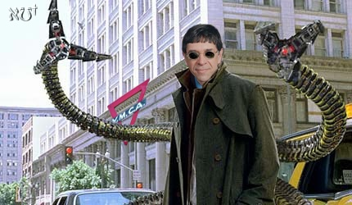
The Future
“Within 25 years there will be no activity, legal or illegal, that we will undertake without the assistance of a robot.”
Now planning PhD in Robotics!

Slide 19
For more information: http://robotics.wpi.edu Watch this site regularly for updates and announcements!

Slide 20
Questions?

