Slide 1
Tasker
A serious game for procrastination
Zihui Wu
Jonathan Yang
Thompson Lee
Sam Wallach

Slide 2
Introduction
Tasker is a serious game designed to help the player overcome procrastination.
Summary of the game:
  Study for an upcoming exam
  Face certain procrastination factors
  Manage the energy and time for the character
  Goal for character - Get his tasks done, increase his intelligence level, perform better on the final exam

Slide 3
Needs Analysis
Procrastination is detrimental for one’s life and health
Time must be used wisely
Helping players to understand and solve the problems as following:
  Lack of focus
  fatigue
  Helplessness in the face of complexity, not knowing where or how to start
  Fear of the outcome
  Rebellion and laziness
  Lack of motivation
  Perfectionism

Slide 4
Learning Objectives – Task Analysis
Understanding some of the factors that cause procrastination
Understanding how to overcome certain factors which contribute to procrastination
  Lack of focus - Avoiding spending too much time on distractions, such as games, TV, and comics, and focusing on their work.
  Fatigue - Taking breaks
  Complexity – Breaking the work down

Slide 5
Target Audience & Platform
Target Audience
  College students who might have procrastination issues
Platform
  PC – Windows/Mac

Slide 6
Game Mechanics
Scheduler
Studying
Distractions
Time & Stamina
Scoring
Real-life tasks
Inputs
Notes:
Scheduler is a calendar where the player can organize the tasks and choose to break down the more complex tasks.
For studying, the player is given articles to read and the game provides quizzes for the player to make sure they are actually reading them. We also added mystery boxes that can pop up and give distractions to the player. If the player chooses to open the box, it will use up time but there will be a chance that the player will gain stamina.
For distractions, we have for example, players can choose to have their main character play minigames, read comic books, or take a nap.
For each in game day, there is a set amount of time and stamina the main character has. As the player complete their tasks, they lose both time and stamina. If they run out of time, the day ends. If they run out of stamina, they cannot do tasks unless the player completely replenishes the stamina. Distractions uses up time, but restores a bit of stamina. So, the player must balance studying and engaging in distractions as breaks.
how well the main character does in the exam is determined by the score. The player’s score is based on how many tasks they complete.
At the end of each day, the game asks the player for their schedules and if they are following through their plans.
Inputs –> Mouse (point and click) Keyboard (typing)

Slide 7
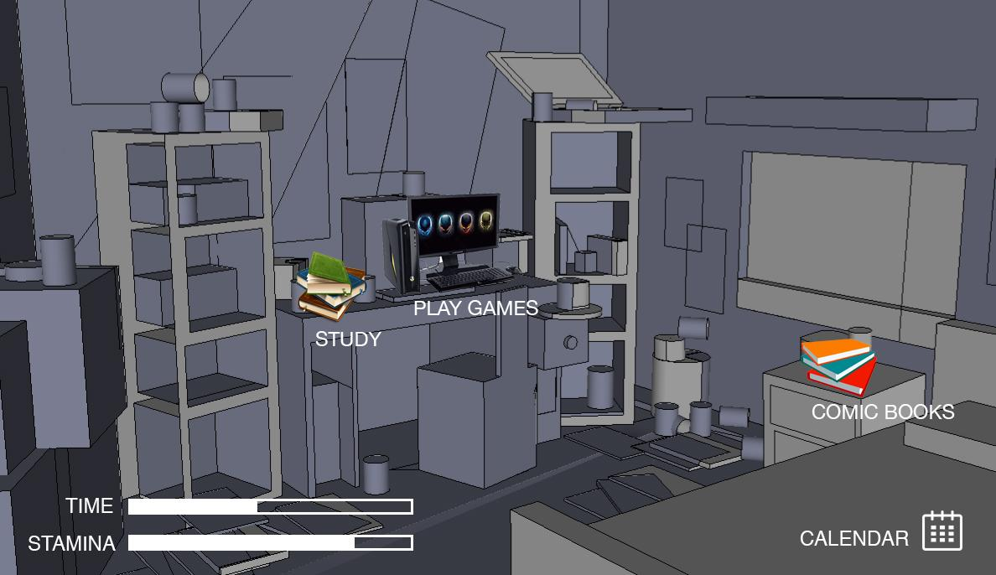
Concept Art
Main Interface

Slide 8
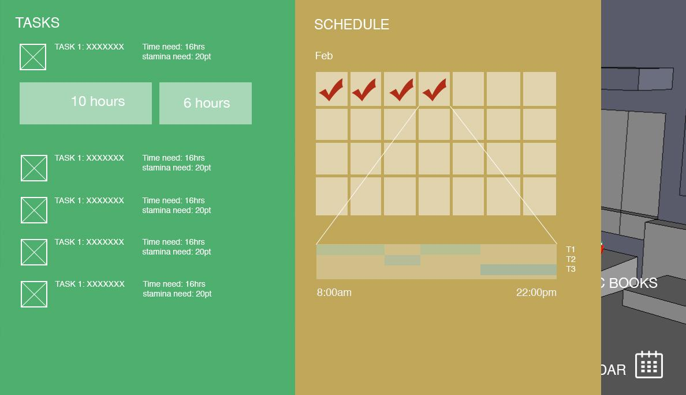
Concept Art
Schedule Module

Slide 9
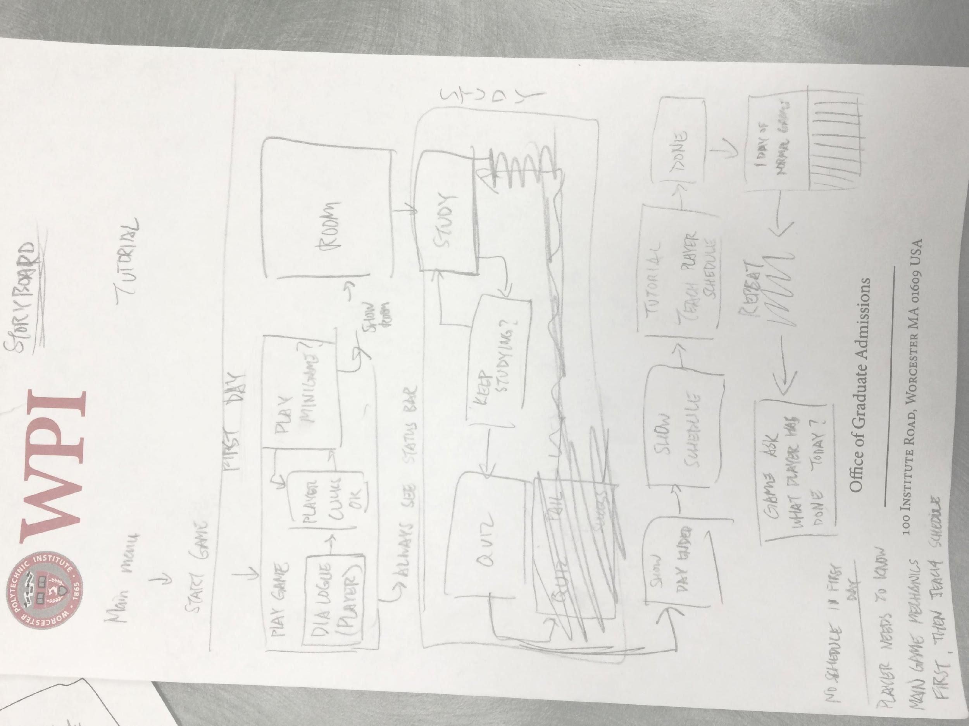
Storyboard & Game Process

Slide 10
Storyboard & Game Process
mini-games (distraction)
day 1
stop playing
dialog
play
mini-games
room (the
main interface)
stop studying and
do some other things
study
(next section)
quiz
study
pass
keep
studying
fall
task (study)
day end
schedule module

Slide 11
Storyboard & Game Process
suggestions
schedule
tutorial:
show how to
scheduling
show dialog
scheduling
real life tasks module
day 2

Slide 12
Assessment
After each day’s play session, the game asks the players to update a schedule of their real-life tasks and give them feedback how efficiently they have done
At the very end of the game, the player find out how the character do in the game

Slide 13
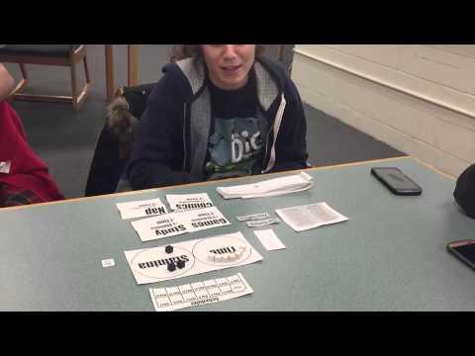
Paper prototype
Notes:
Jonathan Facilitor
Sam AI
Rae camera
Thompson notetaking
Videos:
Part 1: http://youtu.be/-_qu5XfDkU8
Part 2: http://youtu.be/KeA6vHJtO60
Part 3: http://youtu.be/NewSkq4OIvs
Part 4: http://youtu.be/U1xXoaAQzbk
Choose whatever video you want to play.

Slide 14
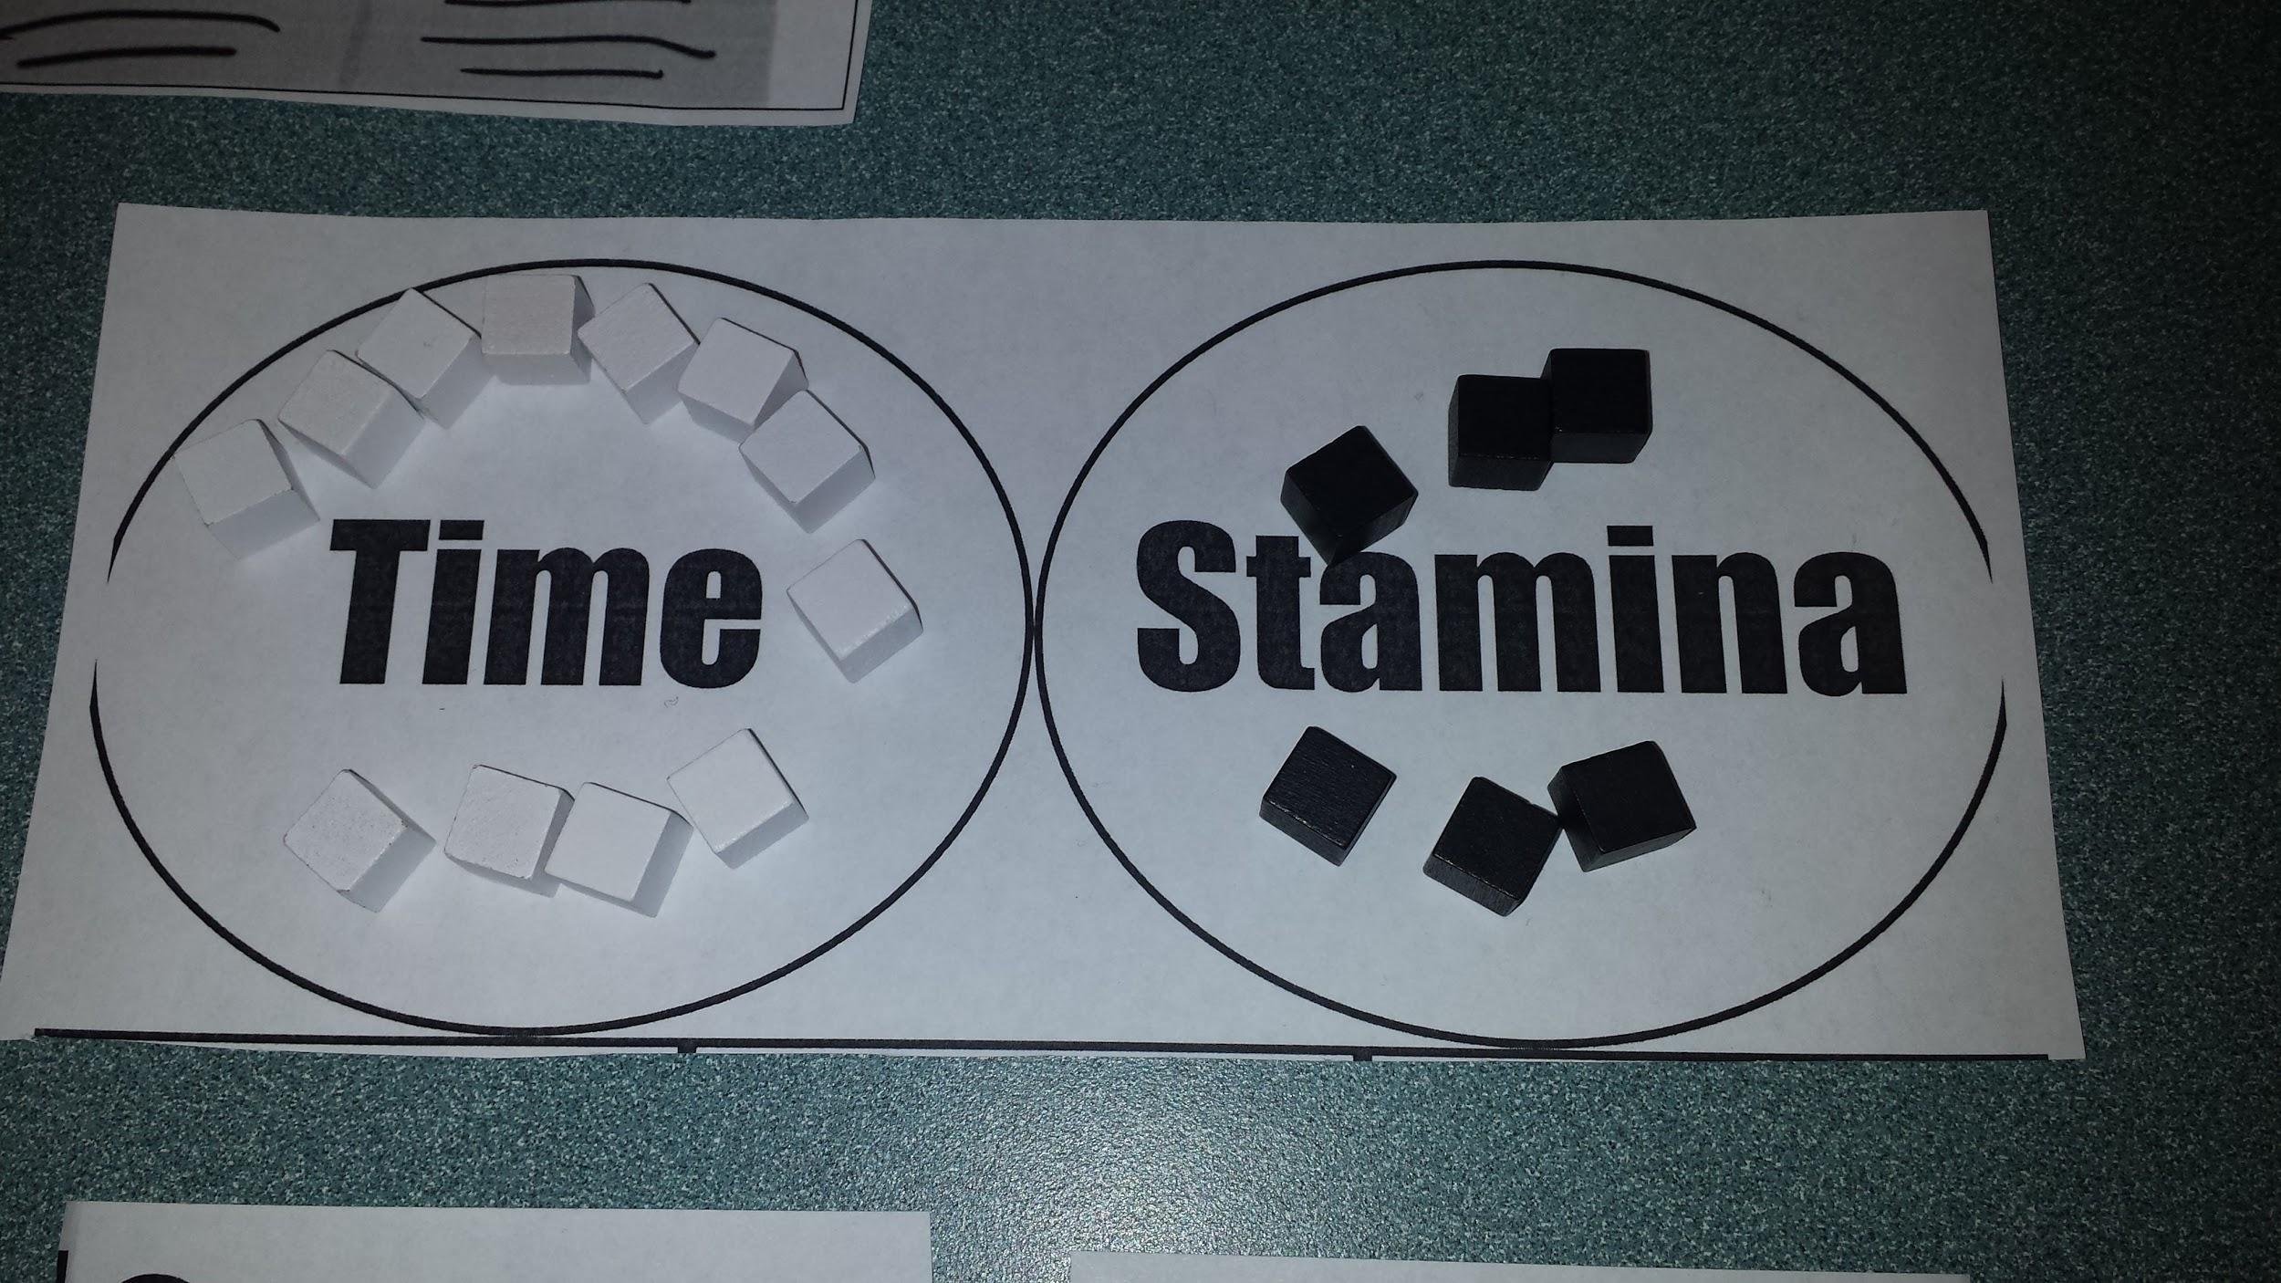
Stamina and Time
Notes:
pools instead of meters for paper

Slide 15
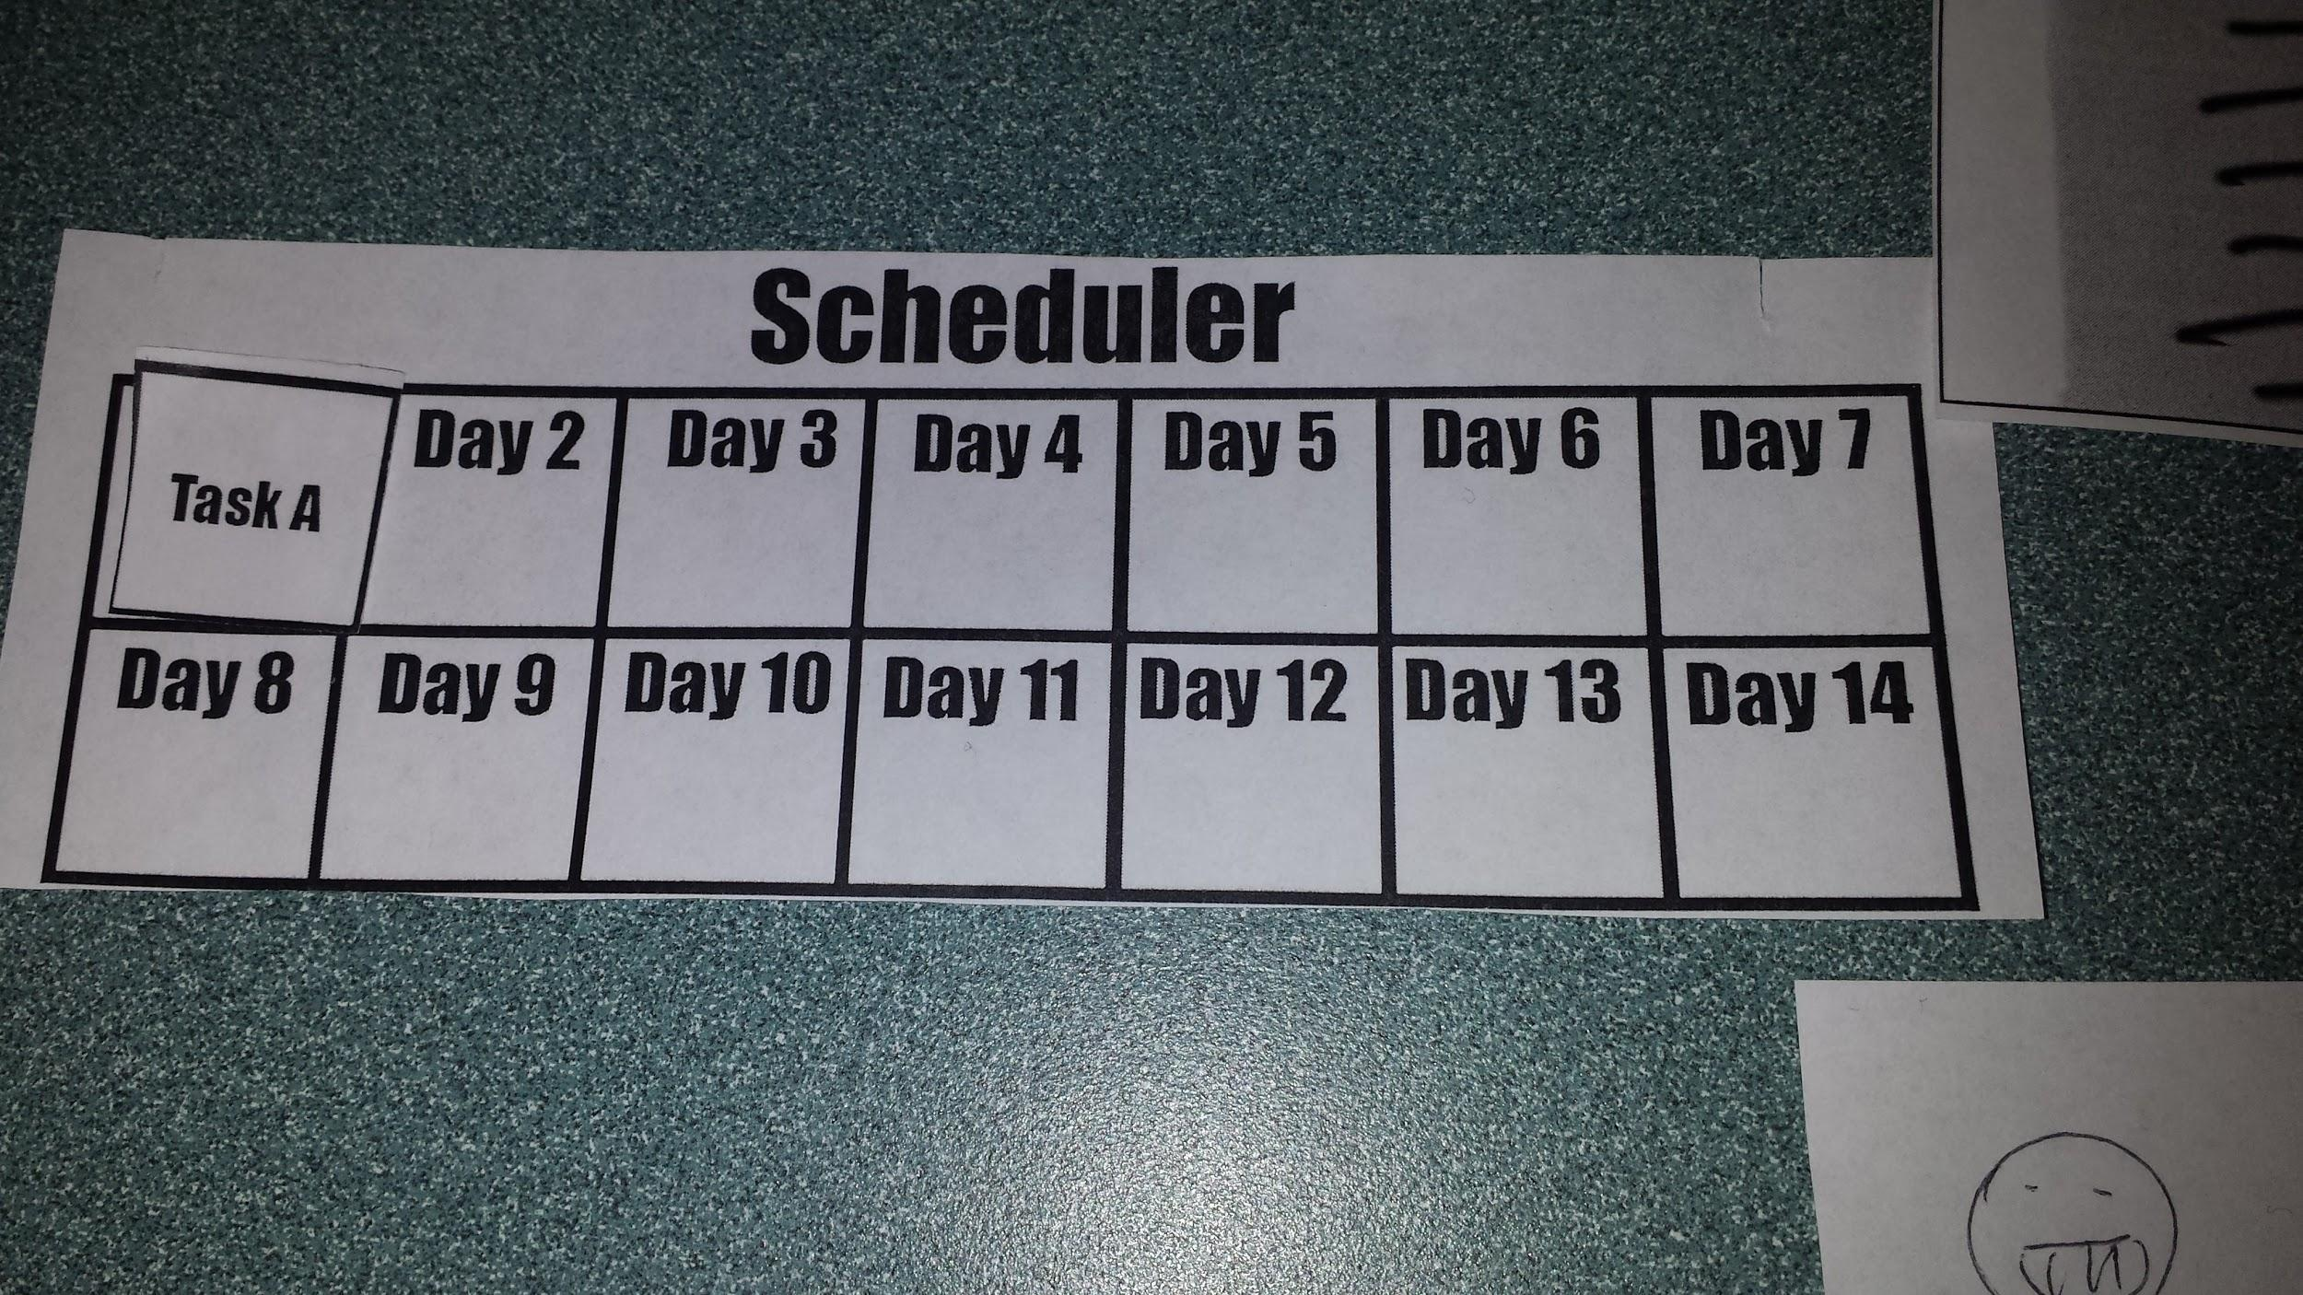
Scheduler
Notes:
Very similar to actual in-game scheduler

Slide 16
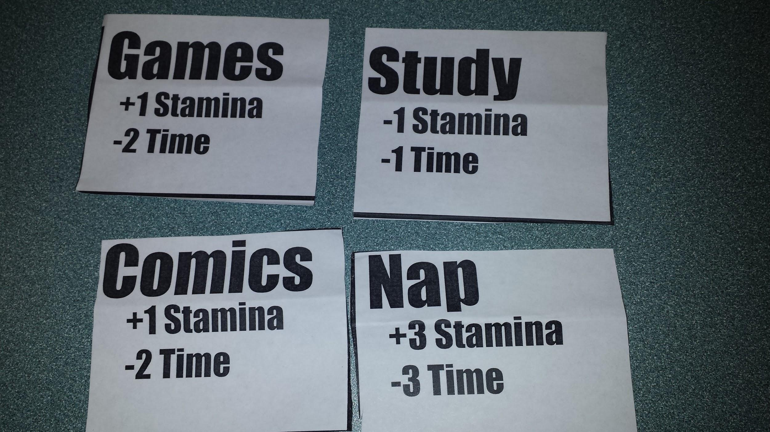
Room Interface
Notes:
‘click’ on options
Stamina and Time effects always visible

Slide 17
Study
Simple readings about procrastination
Each page takes one “Study” action
Quizzes every few pages to make sure the reading is done

Slide 18
Games
Simple mazes and reflex games
Played one after another until the player chooses to stop, using time for each one

Slide 19
Comics
Read some of a comic
Each page turn uses another action

Slide 20
Nap
Simply pay 3 time for 3 Stamina

Slide 21
Feedback
Player doesn’t know if stamina stacks (carry over) to the next day.
Not much usage of naps in first playtest.
It may not be possible to finish Task A after opening mystery box.
Player felt unfair/confused about the game after opening mystery box or playing mini-game.
Rewards in first playtest felt unrewarding.
Post gameplay assessment may be required.

Slide 22
Feedback (continued)
Player asked what other objects can be in the mystery box; Might need to explain about the contents beforehand.
Player suggests that the more quizzes gotten right, the more unlockables can be unlocked (extra minigames, etc.)
We asked ourselves if we need to add more attributes to the protagonist. Player suggested afterwards that attributes added can be for multiplayer experience or single-player with sharable social media info.
Need more playtests to assess the action attributes (stamina and time) for game balancing.

Slide 23
Postmortem
Games for behavioral changes is definitely hard
Research before designing is helpful
A lo-fi prototype can keep the player focus on the game flow and mechanics instead of graphics
It was sometimes difficult to get everyone in the right place at the right time to get work done
For future testing, the rules must be made much more clear to the playtesters
The game needs to be much better balanced, as it felt unfair during playtests
Notes:
Doing research before designing the game helps to identify the problems, and it is important for instructional design.
Lo-fi: We keep it lo-fi so the player is not distracted by the aesthetics of the game.
Last point: The final game needs to be balanced, instead of the prototype.

Slide 24
Thanks!

