Slide 1
The Rising Tides
A Waterfront Safety Game
Samm Conley
Yahel Nachum
Jonathan Decelle

Slide 2
Needs Analysis
About 10 people die every day from unintentional drowning
Reasons being most people:
  Do not understand how dangerous the ocean is
  Are not properly trained to swim in an ocean or open body of water
Learning objectives:
  How open bodies of water differ from pools and other controlled aquatic areas
  Reasons for the frequency of drownings in open bodies of water
  How can swimmers prevent accidents in the water

Slide 3
Target Audience
The Center for Disease Control and Prevention states “nearly 80% of those who die from drowning are male”
Because of this, the game will be targeted towards men and young adults

Slide 4
Task Analysis
Objectives:
  Impress upon the target audience how dangerous the ocean is
    Teach what dangers to look out for when entering bodies of water
    Teach how to handle life-threatening situations
    Teach what to do if others are in dangerous situations
Steps to take
  Present information about ocean-related dangers
    Show that there is a problem (accidents, deaths, saves)
    Oceans pose different dangers than other bodies of water
      Rip currents, getting hit/pushed under a huger wave, debris on beach

Slide 5

Gameflow/Narrative
Starts off with a calm beach with beach-goers enjoying themselves
  Lifeguard instructor presents facts about ocean and its dangers
Instructor spots a swimmer in a dangerous situation
  Instructor demonstrates how to identify beach dangers and how to assist the imperiled beach-goer

Slide 6

Gameflow/Narrative (Continued)
Game turns over control to the player
  Player looks over the beach identifying the dangerous situations
    Once player has spotted a beach-goer in danger, player must run down the beach avoiding debris
    As the player is swimming towards the victim, they must time diving under the waves
At this point, the perspective shifts to the victim
  The player must now swim the victim out of the dangerous situation
    This will be either a rip current or a jetty

Slide 7

User Experience
The Rising Tides consists of two distinct perspectives
  The first being that of the lifeguard with the intent of identifying dangerous situations
  The second being that of the victim with the intent of navigating the given dangerous situation
The entire game is from a top-down style of view
  Focusing on separate portions of the beach depending on the current mini-game
This game relies heavily on Scaffolding
  Early on, distressed swimmers will be highlighted to assist players
  Also arrows will be used to indicate the direction the player should go to escape a rip current
  Later on, these hints will gradually removed as the player becomes more experienced

Slide 8
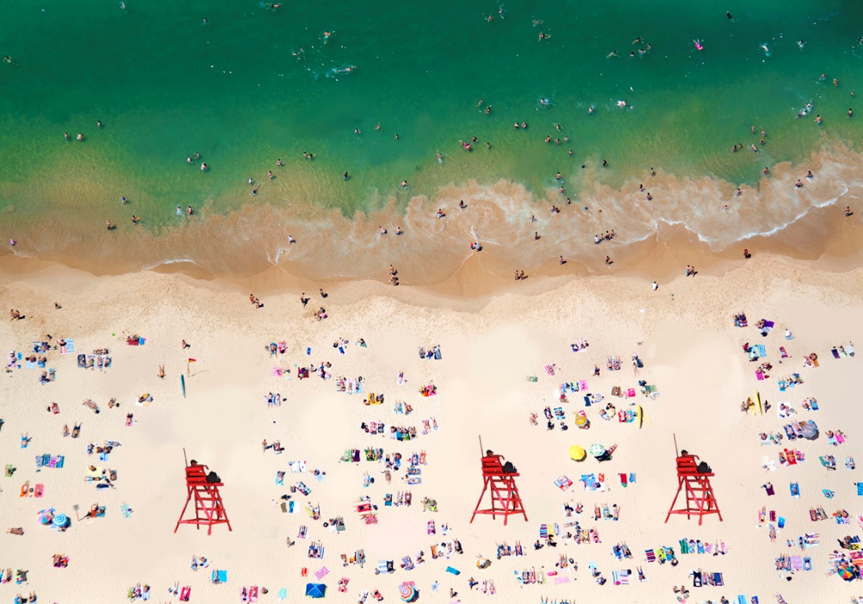
Gameplay
Beach lifeguarding level
  Player identifies and clicks on distressed swimmers
Beach navigation level
  Player avoids debris on the beach to get to the water as quickly as possible
Rip current level
  Player is given a set amount of energy which drains as they attempt to escape the rip current.
  Player succeeds if they correctly swim to the side out of the current

Slide 9
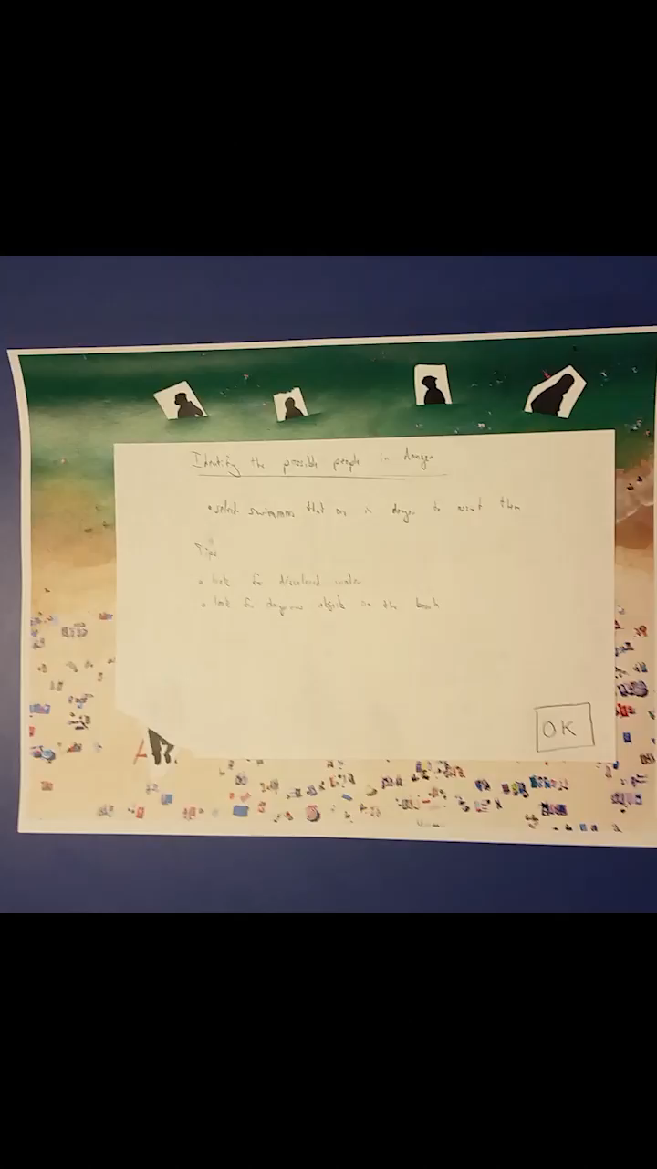
Demo

Slide 10
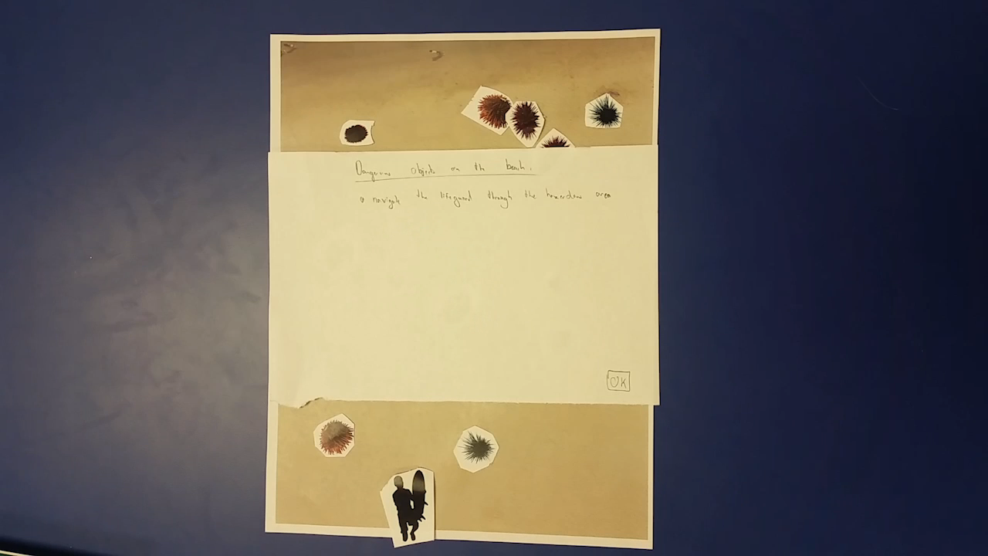
Demo

Slide 11
Assessment
Pre-tests be administered in two parts
  First will be a survey to ascertain how much the user visits the beach and their usual activity while there
  The second will be a multiple choice questionnaire to quizzing the user’s knowledge of waterfront safety
Post-tests will consist of only the multiple choice questionnaire
  The results of the two will be compared to determine if any information had been retained

Slide 12
Post Mortem
Text is too small to read in the video.
Mechanics do not translate well into paper.
Need to add info section to inform players about the ocean.
Some of the tasks might not hold player’s attention very well.
  Play tester complained about this.
Will need more levels with different dangerous situations.
Good potential to expand upon and make game goals more complex.
Might be a possibility to transform game into a way to train lifeguards.

Slide 13
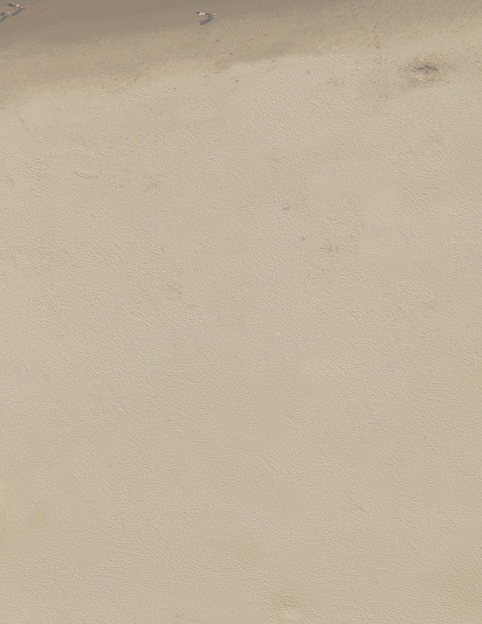
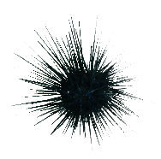




Conclusion
It is our hope that The Rising Tides will at the very least lead to more informed decisions and preparedness of beach-goers
We feel as though our play-tester walked away from the game with a deeper understanding of the danger of beaches
  As well as how to navigate these dangerous situations

Slide 14
Questions?

