Slide 1

Designed By
Nicholas Mollica
Evan Polekoff
Thomas Hunt
Richard Hayes

Slide 2
Target Audience and Goals
Target Audience: Teenage Drivers
Goals:
Educate about the dangers of texting and driving
Transfer responsible driving behaviors

Slide 3
Needs Analysis
Teens are unaware of the dangers of texting while driving.
Teens feel that it is important to respond to texts immediately.
Bored teen drivers use texting as a form of entertainment.

Slide 4
Task Analysis
Encourage driving with a passenger
Discourage driving while tired
Remind teens that they can:
  Take breaks from driving when bored
  Have a passenger read/respond to messages
  Pull over instead of reading texts at red lights
Inform teens that:
  Sending and reading texts while driving are equally bad
  Listening to text-to-speech is only marginally better
  Holding phone lower to avoid police is very dangerous

Slide 5
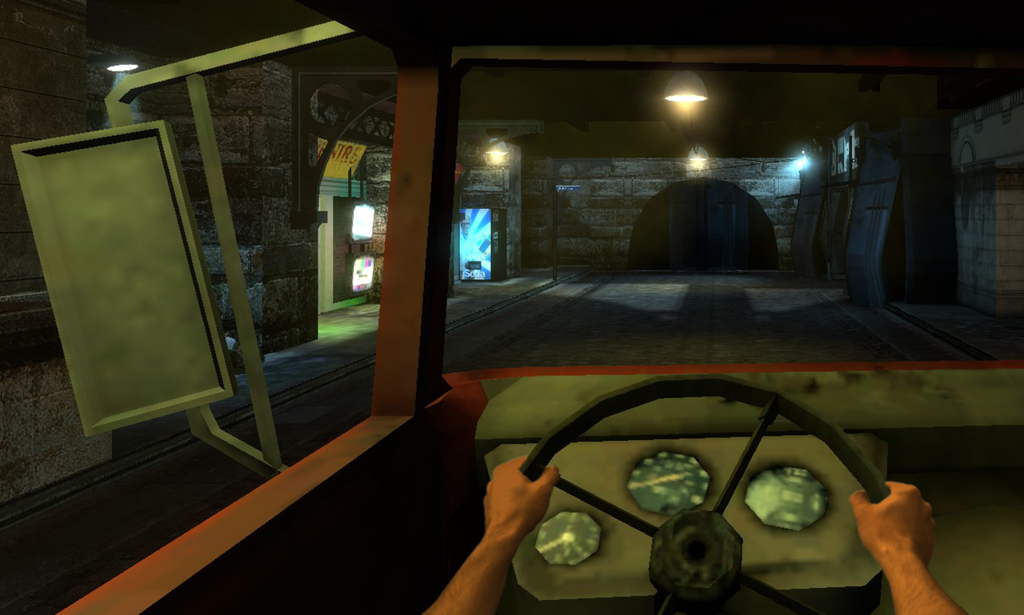
Narrative
Futuristic Noir-style Detective Narrative
Independent Detective working with a friend in the police department
Psychotic Criminal that texts cryptic hints

Slide 6
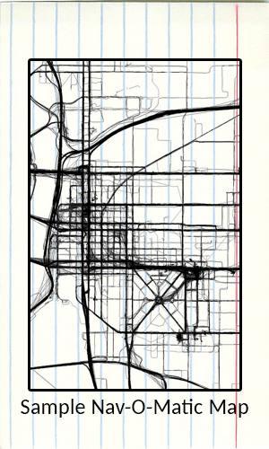
Gameflow
Must communicate with NPCs while rushing to the crime scene
Use Nav-O-Matic Phone GPS
Checking phone while driving prohibitively increases difficulty
Level progression introduces alternatives to bad texting and driving behaviors

Slide 7
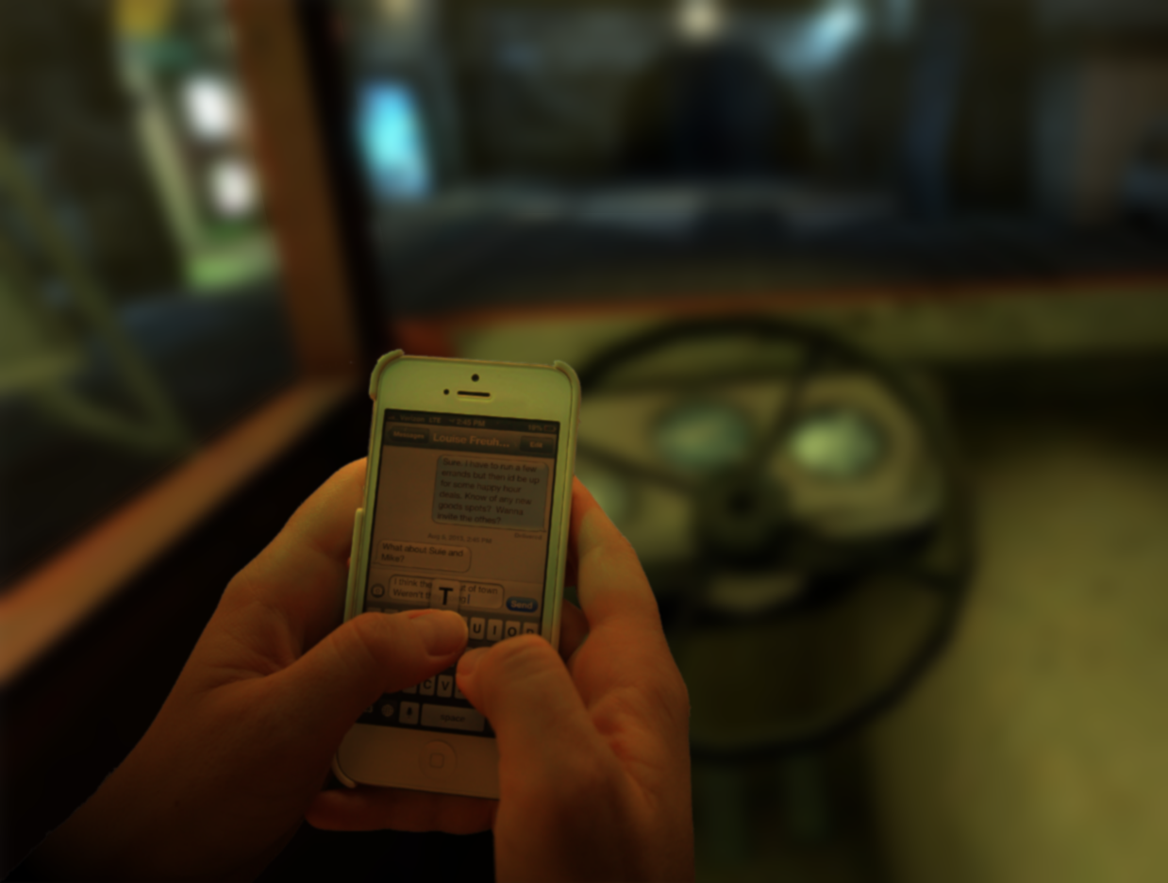
Technology and Interactivity
Oculus Rift for PC
Pedal and Wheel peripherals
Razer Hydra
Screen Blurs While Texting

Slide 8
Assessment
Pre/Post-Test Surveys to test Knowledge Transfer
To test Behavioral Change:
  Better behavior in-game
  Compare driver’s accident rates before/after game
  Phone companion app
  Consensual video monitoring on driver’s vehicle

Slide 9

Paper Prototype - Video

Slide 10
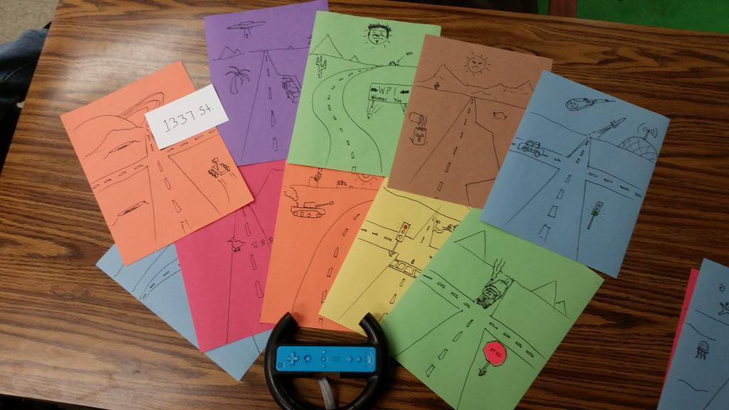
Paper Prototype - Materials
Scenery drawings
Note cards
Drum pedal
Wii wheel
Cell phone

Slide 11
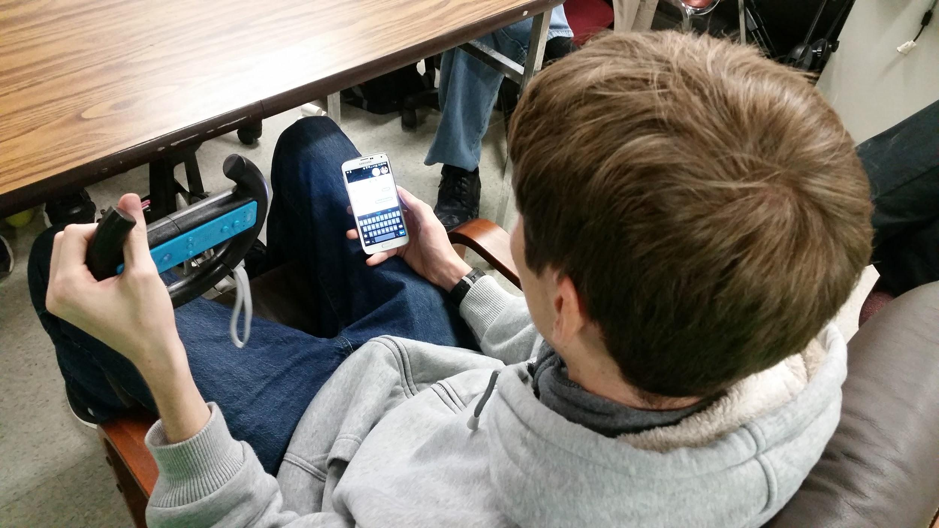
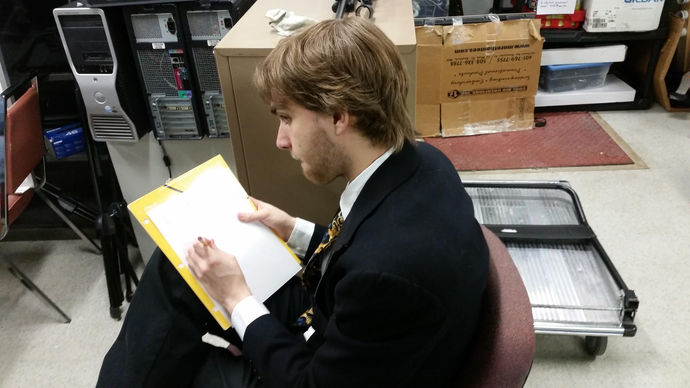
Post Mortem
What worked:
Good indication of player actions

Slide 12
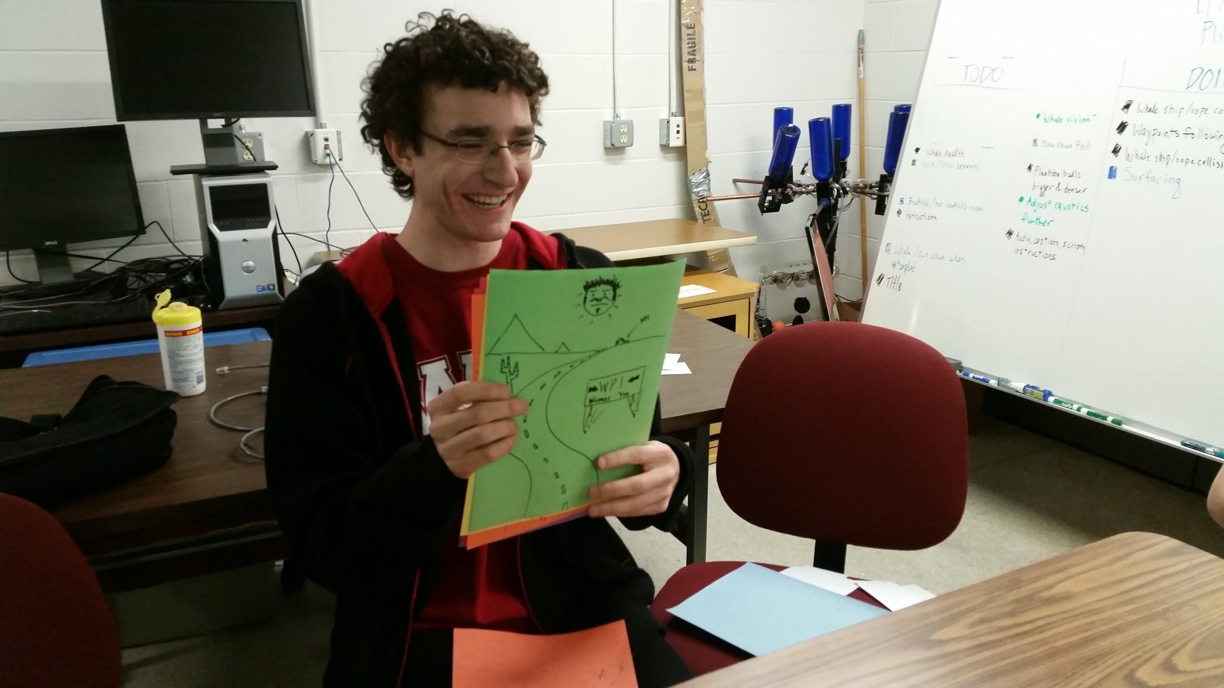
Post Mortem
Flaws:
Too Easy
  Never pulled over
Too Slow
  Paper flip obvious

Slide 13
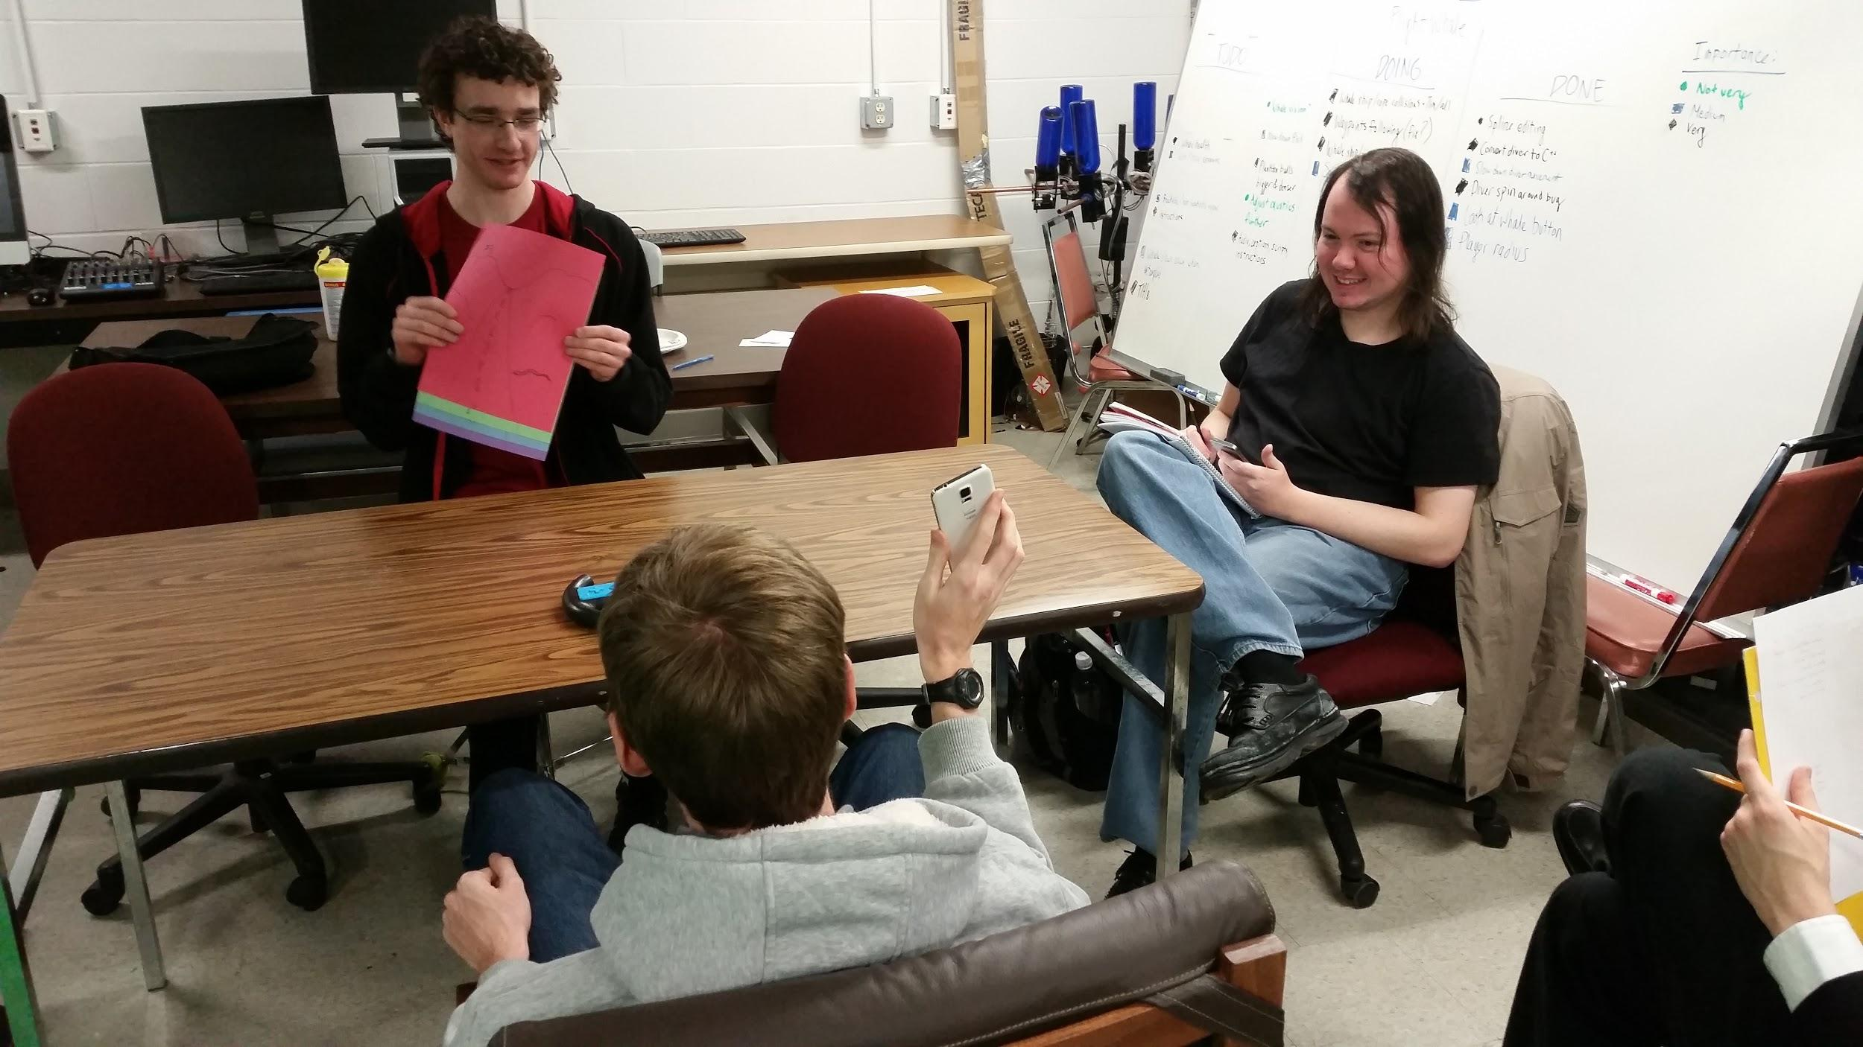
Improvements
Build a device to swap papers
Use powerpoint

Slide 14
Questions?

