Slide 1
Ethernet
Advanced Computer Networks
D12

Slide 2
Ethernet Outline
Ethernet
  Binary Exponential Backoff
Ethernet versus IEEE 802.3
Ethernet Evolution
  10BASE5, 1OBASE2, 1BASE5, 10BASE-T
Switched Ethernet
Switching Hub

Slide 3
Ethernet [DEC, Intel, Xerox]
1-persistent, CSMA-CD with Binary Exponential Backoff.
Manchester encoding.

Slide 4
Ethernet [operational in 1974]
Initially 3 Mbps baseband coaxial cable (thick Ethernet).
Operational Description
Ethernet stations sense the channel (CS).
When the channel is free, the station transmits a frame (1-persistent).
The stations monitor the ‘ether’ during the transmission (MA).
If a collision is detected by any station (CD), the transmission is terminated immediately and a jam signal is sent.
Upon collision, transmitting stations backoff using a local counter and then retransmit (BEB).

Slide 5
Worst Case Collision Scenario
Distance d meters
A transmits at t = 0
A
B
B transmits before t = t_{prop} and detects
collision shortly
thereafter
A
B
A detects
collision at
t = 2 t_{prop}
A
B
t_{prop} = d / ν seconds
Leon-Garcia & Widjaja:
Communication Networks

Slide 6
Ethernet
frame
contention
frame
A frame seizes the channel after 2 t_{prop}
On 1 km Ethernet, t_{prop} is approximately 5 microseconds.
Contention interval = 2 t_{prop}
Interframe gap = 9.6 microseconds
Modeled as slotted scheme with
slot = 2 t_{prop}

Slide 7
Model (slotted Bernoulli Trial)
frame
frame
contention
Probability of 1 successful transmission:
P^{max}
P_{success} is maximized at p =1/n :
n
Tanenbaum

Slide 8
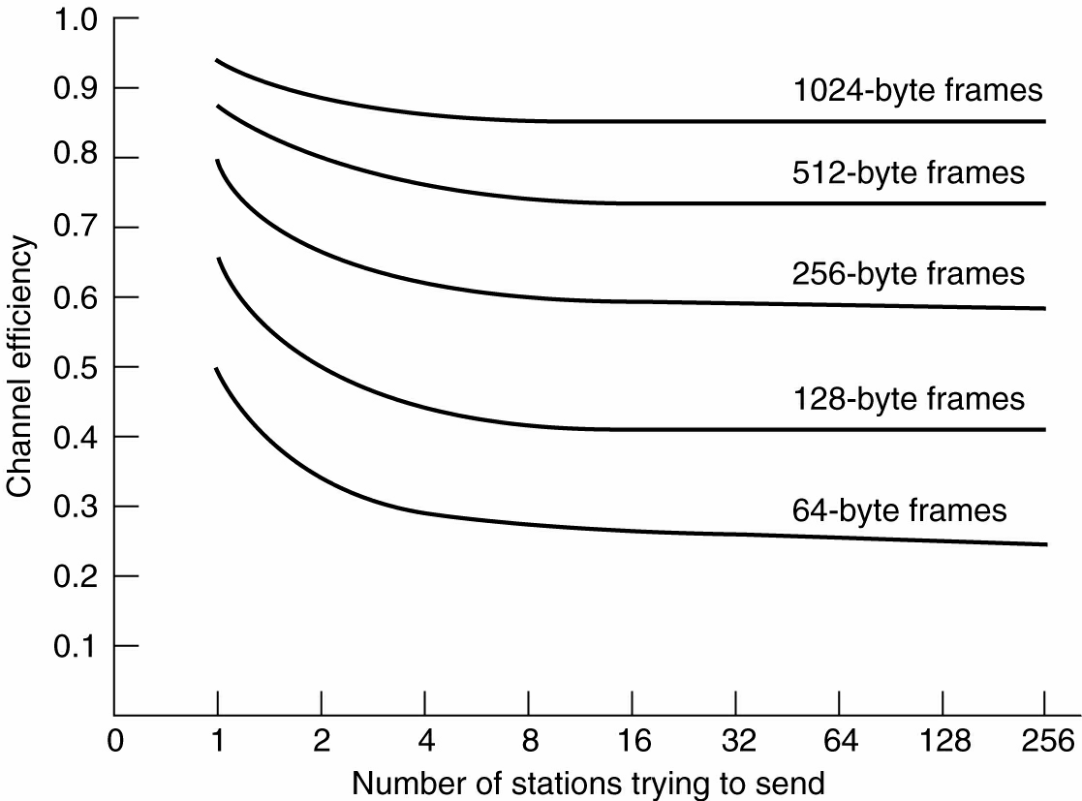
Ethernet Performance
Efficiency of Ethernet at 10 Mbps with 512-bit slot times.
Tanenbaum

Slide 9
Binary Exponental Backoff (BEB)
Upon a collision, the sending stations increment a local counter K. The backoff interval is randomly selected using a uniform distribution over the
L = 2^{K} slots.
K is initially set to 0.
Thus upon collision, the value of L is doubled locally for each sending station.

Slide 10
Binary Exponental Backoff (BEB)
Slotted ALOHA has been shown to be unstable when
p > 1/n
Since Ethernet permits up to 1024 stations, backoff continues until K = 10, L = 2¹⁰, and p = 1/2¹⁰
Normally K is incremented up to 10, but BEB is set for 16 retries. After 16 retries, MAC gives up trying to send the frame.
{The IP packet is now considered lost}.

Slide 11
IEEE 802.3 Frame Format
802.3 MAC Frame
7
1
2 or 6
2 or 6
2
4
Preamble
Destination
Address
Source
Address
Length
Information
Pad
FCS
SD
Synch
Start
frame
64 to 1518 bytes
0
Single address
Destination address is either single address
or group address (broadcast = 111...111)
Addresses are defined on local or universal basis
2⁴⁶ possible global addresses
1
Group address
0
Local address
1
Global address
Leon-Garcia & Widjaja:
Communication Networks

Slide 12
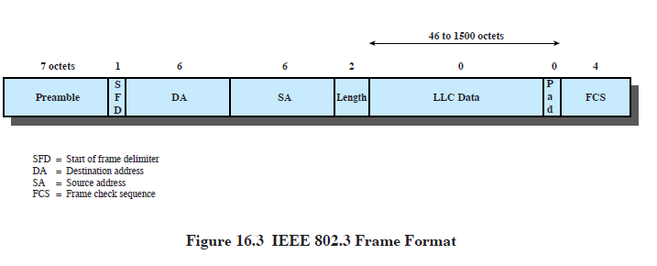
Ethernet Frame Format
Ethernet Frame
7
1
2 or 6
2 or 6
2
4
Preamble
Destination
Address
Source
Address
Type
Information
Pad
FCS
SD
Synch
Start
frame
64 to 1518 bytes
Note – a minimum
Leon-Garcia & Widjaja:
Communication Networks
DCC 6th Ed.
Stallings

Slide 13
Ethernet Encapsulation
ORG
Type
Leon-Garcia & Widjaja:
Communication Networks
3
2
SNAP PDU
SNAP Header
Information
LLC PDU
AA AA 03
1
1
1
802.3 Frame
MAC Header
FCS

Slide 14
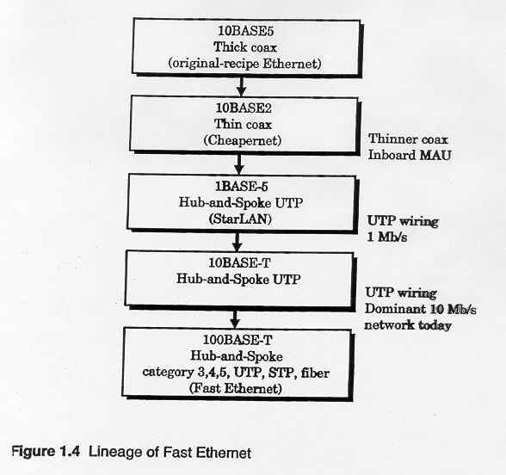

Slide 15
Ethernet Evolution
10BASE5 {1983}
10 Mbps
500 meter segment length
Signal-regenerating repeaters
Thick Coax
  Advantages: Low attenuation, excellent noise immunity, superior mechanical strength
  Disadvantages: Bulky, difficult to pull, transceiver boxes too expensive
Wiring represented a significant part of total installed cost.

Slide 16
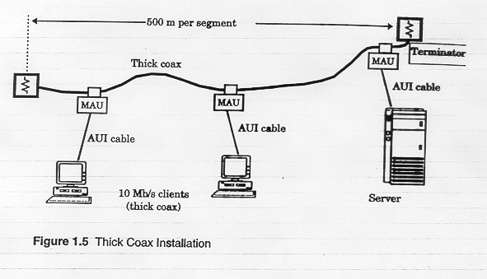
10BASE5
MAU device is physically hooked on main cable.
50 meter AUI cable from MAU to station.

Slide 17
Ethernet Evolution
10BASE2 ‘Cheapernet’ {1985}
10 Mbps
185 meter segment length
Signal-regenerating repeaters
Transceiver was integrated onto the adapter
Thin Coax (coax thinner and lighter)
  Advantages: Easier to install, reduced hardware cost, BNC connectors widely deployed ➔ lower installation costs.
  Disadvantages: Higher attenuation and could not support as many stations due to signal reflection caused by BNC Tee Connector.

Slide 18
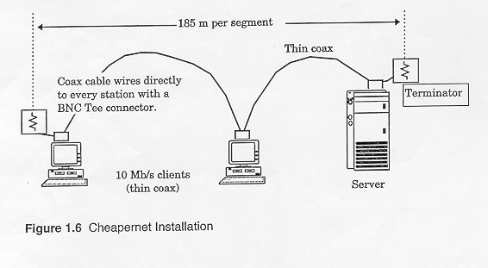
10Base2 Cheapernet

Slide 19
Thick Ethernet Cable
(a)
transceivers
(b)
Thin Ethernet Cable
Leon-Garcia & Widjaja:
Communication Networks

Slide 20
Ethernet Evolution
1BASE5 StarLAN {1987}
1 Mbps
250 meter segment length
Signal-regenerating repeaters
Transceiver integrated onto the adapter
Hub-and-Spoke topology (star topology)
Two pairs of unshielded twisted pair
  Advantages: Since four or more UTP are ubiquitous in buildings, it is easier to use installed wiring in the walls. Telephone wiring is hierarchical ➔ can use wiring closets.

Slide 21
Ethernet Evolution
10BASE-T {1990} **Most popular
10 Mbps
100 meter segment length
Signal-regenerating repeaters
Transceiver integrated onto adapter
Two pairs of UTP
Hub-and-spoke topology {Hub in the closet}
  Advantages: could be done without pulling new wires. Each hub is a repeater – recovering the incoming signal, amplifying the signal and broadcasting it on all outgoing lines.

Slide 22
The Hub Concept
Separate transmit and receive pair of wires.
The repeater in the hub retransmits the signal received from any input pair onto ALL output pairs.
Essentially, the hub emulates a broadcast channel with collisions detected by receiving nodes.

Slide 23
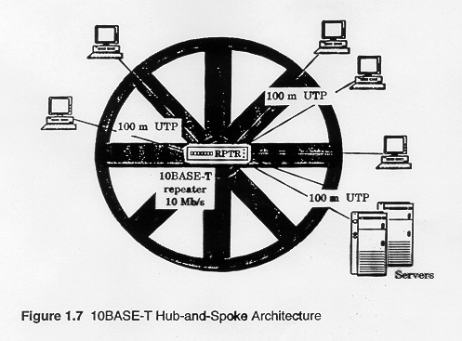
10Base-T Hub Concept

Slide 24
Twisted Pair Ethernet
(a)
hub
Single collision domain
●     
switch
High-Speed Backplane or Interconnection fabric
(b)
●   
Leon-Garcia & Widjaja:
Communication Networks

Slide 25
10Mbps Specification (Ethernet)
DCC 9th Ed.
Stallings
Notes:
The IEEE 802.3 committee has defined a number of alternative physical configurations. This is both good and bad. On the good side, the standard has been responsive to evolving technology. On the bad side, the customer, not to mention the potential vendor, is faced with a bewildering array of options. However, the committee has been at pains to ensure that the various options can be easily integrated into a configuration that satisfies a variety of needs. Thus, the user that has a complex set of requirements may find the flexibility and variety of the 802.3 standard to be an asset.
To distinguish the various implementations that are available, the committee has developed a concise notation:
<data rate in Mbps> <signaling method><maximum segment length in hundreds of meters>
The defined alternatives for 10-Mbps are:
10BASE5: Specifies the use of 50-ohm coaxial cable and Manchester digital signaling. The maximum length of a cable segment is set at 500 meters. The length of the network can be extended by the use of repeaters. A repeater is transparent to the MAC level; as it does no buffering, it does not isolate one segment from another. So, for example, if two stations on different segments attempt to transmit at the same time, their transmissions will collide. To avoid looping, only one path of segments and repeaters is allowed between any two stations. The standard allows a maximum of four repeaters in the path between any two stations, extending the effective length of the medium to 2.5 kilometers.
10BASE2: Similar to 10BASE5 but uses a thinner cable, which supports fewer taps over a shorter distance than the 10BASE5 cable. This is a lower-cost alternative to 10BASE5.
10BASE-T: Uses unshielded twisted pair in a star-shaped topology. Because of the high data rate and the poor transmission qualities of unshielded twisted pair, the length of a link is limited to 100 meters. As an alternative, an optical fiber link may be used. In this case, the maximum length is 500 m.
10BASE-F: Contains three specifications: a passive-star topology for interconnecting stations and repeaters with up to 1 km per segment; a point-to-point link that can be used to connect stations or repeaters at up to 2 km; a point-to-point link that can be used to connect repeaters at up to 2 km.

Slide 26
Switched Ethernet
*Basic idea: improve on the Hub concept
The switch learns destination locations by remembering the ports of the associated source address in a table.
The switch may not have to broadcast to all output ports. It may be able to send the frame only to the destination port.
➔ a big performance advantage over a hub, if more than one frame transfer can go through the switch concurrently.

Slide 27
Switches
link-layer devices: smarter than hubs, take active role
  Store and forward Ethernet frames.
  Examine incoming frame’s MAC address, selectively forward frame to one-or-more outgoing links when frame is to be forwarded on segment, uses CSMA/CD to access segment.
transparent
  hosts are unaware of presence of switches.
plug-and-play, self-learning
  switches do not need to be configured.
K & R

Slide 28
Switches allows multiple simultaneous transmissions
Hosts have dedicated, direct connection to switch.
Switches buffer packets.
Ethernet protocol used on each incoming link, but no collisions due to full duplex.
  each link is its own collision domain.
switching: A-to-A’ and B-to-B’ simultaneously, without collisions.
  not possible with dumb hub!!
A
C’
B
1
2
6
3
5
4
C
B’
A’
switch with six interfaces
(1,2,3,4,5,6)
K & R

Slide 29
Switch Table
Q: How does switch know that A’ is reachable via interface 4, B’ is reachable via interface 5?
A: Switch has a switch table, each entry:
  (MAC address of host, interface to reach host, time stamp)
looks like a routing table!
Q: How are entries created, maintained in switch table?
  something like a routing protocol?
A
C’
B
1
2
6
3
5
4
C
B’
A’
switch with six interfaces
(1,2,3,4,5,6)
K & R

Slide 30
Switch: Self-Learning
Source: A
switch learns which hosts can be reached through which interfaces
  when frame received, switch “learns” location of sender: incoming LAN segment.
  records sender/location pair in switch table.
Dest: A’
A
A A’
C’
B
1
2
6
3
5
4
C
MAC addr interface TTL
B’
A’
A
1
60
Switch table
(initially empty)
K & R

Slide 31
Switch: Frame Filtering/Forwarding
When frame received at the switch:
1. Record link associated with sending host.
2. Index switch table using MAC destination address.
3. if entry found for destination then
{
if dest on segment from which frame arrived
then drop the frame
else forward the frame on interface indicated
}
else flood
K & R
forward on all but the interface
on which the frame arrived

Slide 32
Self-learning, Forwarding: Example
Source: A
frame destination unknown:
Dest: A’
flood
A
A A’
destination A location known:
C’
B
selective send
1
2
6
3
A A’
A A’
A A’
A A’
A A’
5
4
C
A’ A
MAC addr interface TTL
B’
A’
A
1
60
A’
4
60
Switch table
(initially empty)
K & R

Slide 33
Interconnecting Switches
Switches can be connected together.
S₄
S₁
S₃
A
S₂
F
I
B
C
D
E
G
H
Q: sending from A to G - how does S₁ know to forward frame destined to G via S₄ and S₃?
A: self learning! (works exactly the same as in single-switch case!)
K & R

Slide 34
Self-learning Multi-Switch
Suppose C sends frame to I, I responds to C
S₄
1
3
S₁
2
S₃
A
S₂
F
I
B
C
D
E
G
H
Q: show switch tables and packet forwarding in S₁, S₂, S₃, S₄
K & R

Slide 35
Switched Ethernet
The advantage comes when the switched Ethernet backplane is able to repeat more than one frame in parallel (a separate backplane bus line for each node).
  The frame is relayed onto the required output port via the port’s own backplane bus line.
Under this scheme collisions are still possible when two concurrently arriving frames are destined for the same station.
Note – each parallel transmission can take place at 10 Mbps!!

Slide 36
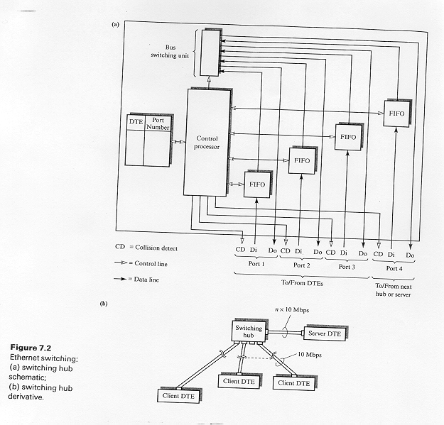
Switched Ethernet
Halsall

Slide 37
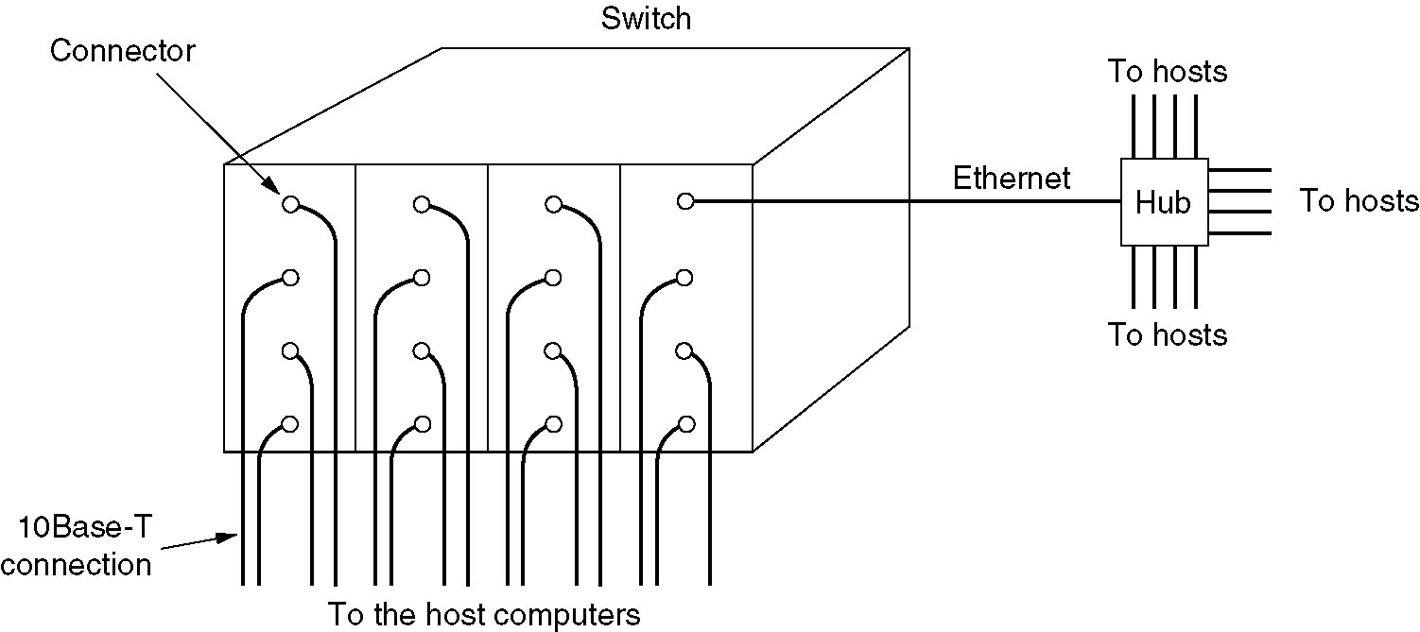
Switched Ethernet
Tanenbaum considers a more
powerful switch that reduces
collisions even further!!
Figure 4-20.A simple example of switched Ethernet.
Tanenbaum

Slide 38
Switched Ethernet Hub
Since servers are often shared by multiple nodes, one can employ a switching hub with one port which operates at a higher rate than the other ports.
This requires extra buffering inside the hub to handle speed mismatches.
Can be further enhanced by higher rated port full-duplex.

Slide 39
Switching Hierarchy
Fast Ethernet
Switch
Ethernet Switch
Server
100 Mbps links
Ethernet Switch
10 Mbps links
Leon-Garcia & Widjaja:
Communication Networks

Slide 40
Ethernet Summary
Ethernet
  Binary Exponential Backoff
Ethernet versus IEEE 802.3
Ethernet Evolution
  10BASE5, 1OBASE2, 1BASE5, 10BASE-T
Switched Ethernet
Switching Hub

