Slide 1
Computer Networks Performance Metrics
Advanced Computer Networks

Slide 2
Computer Networks
T
X
Z
W1
W2
W
Y
Host
L
AP
W3
Host
M
Host
A
2
3
W4
4
Host
B
1
5
nodes
14
16
11
Host
J
Host
C
12
17
15
6
10
13
7
Host
H
Host
D
9
8
Host
G
Host
E
Host
F

Slide 3
Simple Queuing Model
Customer
Arrivals
Queue
Server

Slide 4
Router Node
node 15
packet
packet
17
Incoming Link
Outgoing Link
Server
Router Buffer

Slide 5
Generic Performance Metrics
Utilization ::
the percentage of time a device is busy servicing a “customer”.
Throughput ::
the number of jobs processed by the “system” per unit time.
Response time ::
the time required to receive a response to a request (round-trip time).
Delay ::
the time to traverse from one end to the other of a system.

Slide 6
Network Performance Measures
Channel utilization:: the average fraction of time a channel is busy [e.g. Util = 0.8]
when overhead is taken into account (i.e., excluded from useful bits), channel utilization is often referred to as channel efficiency.
Throughput:: bits/sec.successfully sent
[e.g. Tput = 10 Mbps]

Slide 7
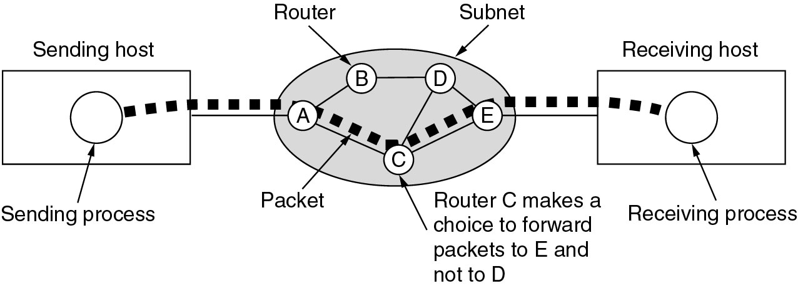
End-to-End Packet Delay
End-to-end delay includes multiple hop link delays.
Tanenbaum

Slide 8
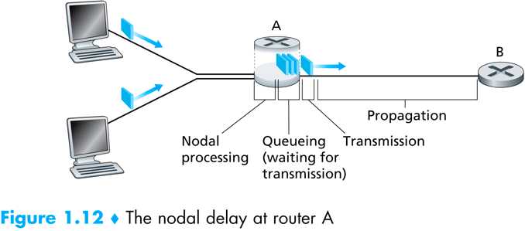
Hop Delay Components

Slide 9
End-to-end Packet Delay
End-to-end packet delay :: the time to deliver a packet from source to destination.
{Most often, we are interested in the packet delay within the communications subnet.} This delay is the sum of the delays on each subnet link traversed by the packet.
Each link delay consists of four components[B&G Bertsekas and Gallager]:

Slide 10
Link Packet Delay
1. The processing delay [PROC] between the time the packet is correctly received at the head node of the incoming link and the time the packet is assigned to an outgoing link queue for transmission.
2. The queuing delay [QD] between the time the packet is assigned to a queue for transmission and the time it starts being transmitted. During this time, the packet waits while other packets in the transmission queue are transmitted.

Slide 11
Link Packet Delay
3. The transmission delay [TRANS] between the times that the first and last bits of the packet are transmitted.
4. The propagation delay [PROP] between the time the last bit is transmitted at the head node of the link queue and the time the last bit is received at the next router. This is proportional to the physical distance between transmitter and receiver.

Slide 12
End-to-End Packet Delay
Link packet delay = PROC + QD
+ TRANS + PROP
end-to-end packet delay = sum of ALL link packet delays.
Be Careful !!
end-to-end can be defined either:
from Host-to-Host
or only from end-to-end nodes within the subnetwork.

Slide 13
End-to-End Packet Delay
End-to-end delay includes multiple hop link delays.
Tanenbaum

Slide 14
Network Performance Measures
Latency ::
usually implies the minimum possible delay. Latency assumes no queuing and no contention encountered along the path.
Goodput ::
{measured at the receiver} the rate in bits per second of useful traffic received. Goodput excludes duplicate packets and packets dropped along the path.
Fairness ::
either Jain’s fairness or max-min fairness are used to measure fair treatment among competing flows.
Quality of Service (QoS) ::
a QoS measure accounts for importance of specific metric to one type of application [e.g. jitter and playable frame rate for streaming media].

Slide 15
Wireless Performance Metrics
WLANs and WSNs are concerned with
packet loss and employ additional metrics:
Delivery ratio::
the ratio of packets received to packets sent {excluding duplicates and retransmissions}.
Packet loss rate::
the percentage of packets lost or dropped.
Link layer retransmission rates::
the percentage of DL layer frames that are retransmitted.

Slide 16
Performance Metrics Summary
The three most general performance measures are : utilization, throughput and response time.
In computer networks, end-to-end delay is an important performance metric.
Queuing models are used to analyze and estimate computer network performance.

Slide 17
Performance Metrics Summary
Other useful metrics include: latency, goodput, fairness and QoS metrics such as jitter or playable frame rate.
In wireless networks, delivery ratio, packet loss rate and link layer retransmission rates are valuable network measures.

