Slide 1
Performance of New Variants of TCP
Presenter – Bob Kinicki

Slide 2
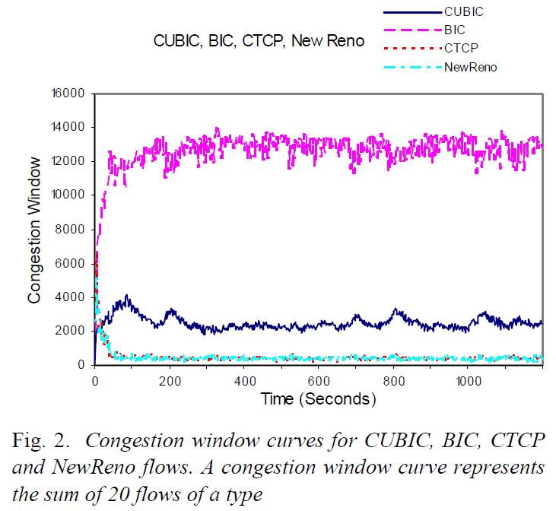
Fairness in TCP Variants
ns-2 dumbbell simulations
C = 1 Gbps
Min RTT = 104 ms.
Drop tail routers
1500 byte packets
Buffer size = BDP
20 flows of each TCP variant
1200 sec. simulated
BIC too aggressive!
Cubic fairer
NewReno and
Compound get beat up!
[Munif 2007]

Slide 3
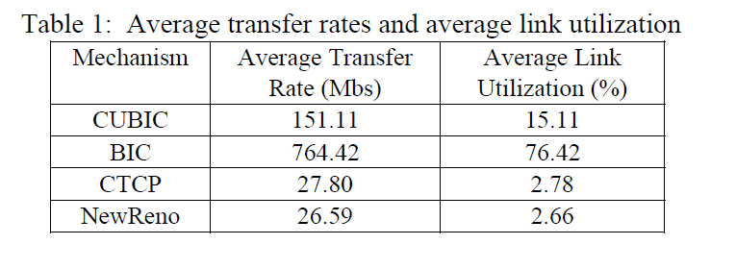
Fairness in TCP Variants
Too Aggressive
[Munif 2007]

Slide 4
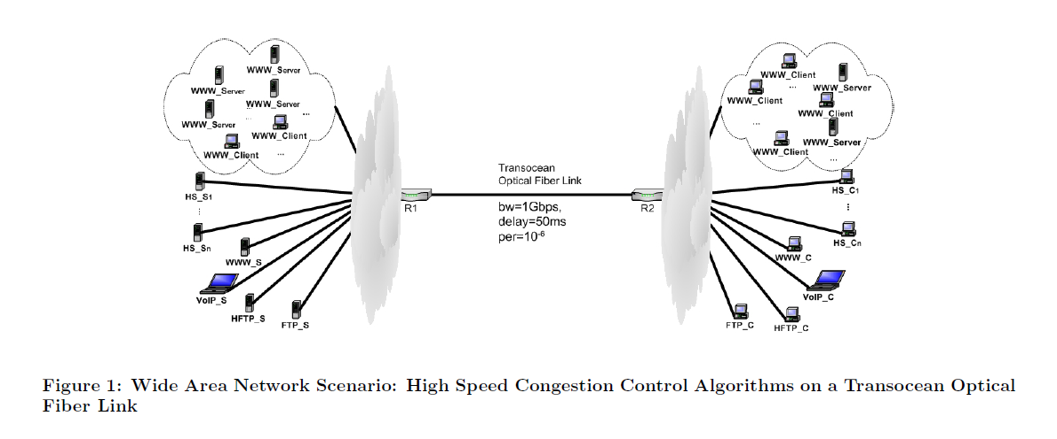
High Speed Simulations
[Wu 2008a]

Slide 5
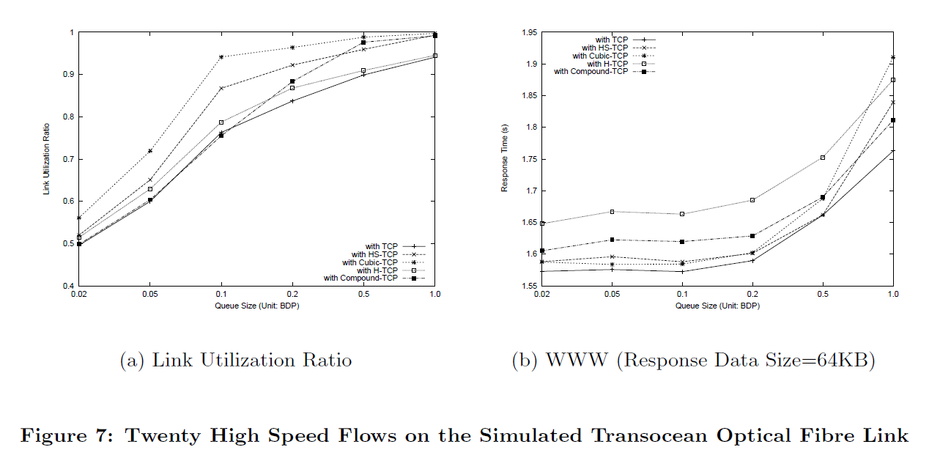
Utilization and Response Time
Cubic
HS-TCP
[Wu 2008a]

Slide 6
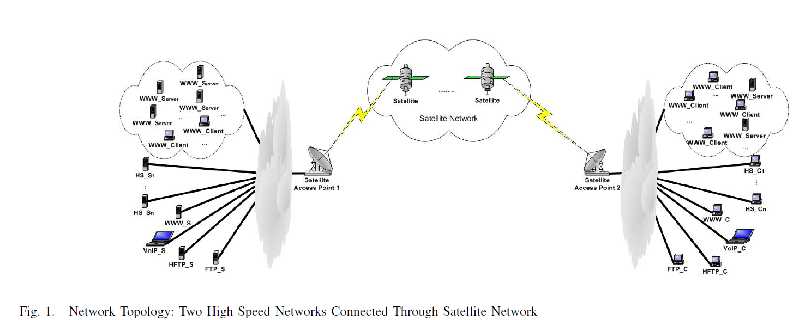
Simulated Satellite Network
[Wu 2008b]

Slide 7
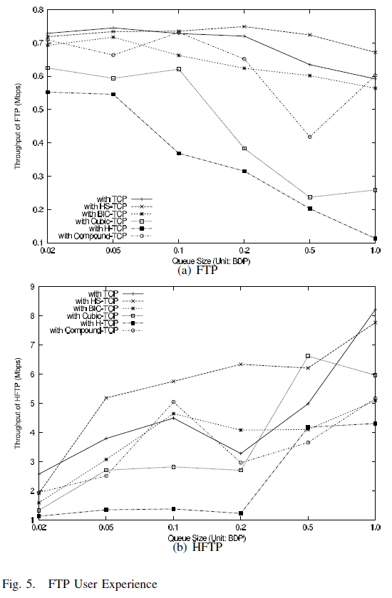
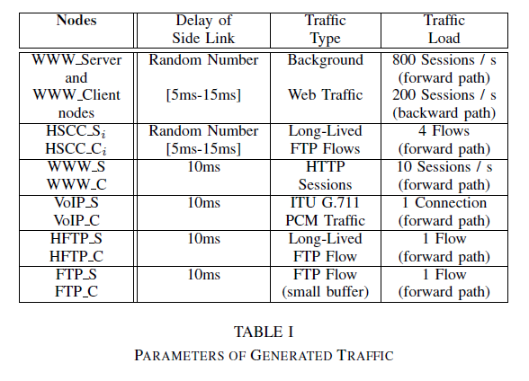
Satellite Simulations
HS-TCP
HS-TCP
HFTP flows: 100000 packet window
FTP flows: 64 packet window
[Wu 2008b]

Slide 8
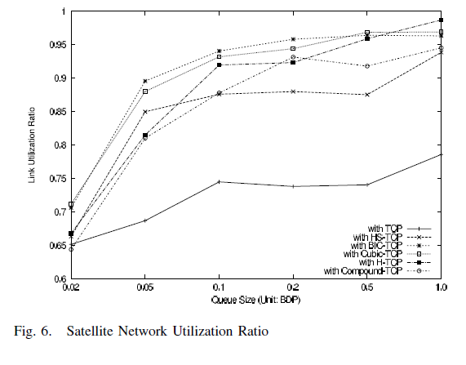
TCP Variant Utilization
[Wu 2008b]

Slide 9
References
[Munif 2007] K. Munir, M. Welzl, D. Damianovic, “Linux beats Windows! – or the Worrying Evolution of TCP in Common Operating Systems” Fifth International Workshop on Protocols for FAST Long-Distance Networks (PFLDnet-07), February 2007, pp. 43-48.
[Wu 2008a] X. Wu, “Effects of Applying High Speed Congestion Control Algorithms in the Internet”, National University of Singapore Tech Report 2008.
[Wu 2008b] Xiuchao Wu, M. C. Chan and A. L. Ananda, "Effects of Applying High-Speed Congestion Control Algorithms in Satellite Network", IEEE International Conference on Communcations, Beijing, May 2008, pp. 1925-1929 .

