Slide 1
Introduction
Computer Networks
Spring 2012

Slide 2
Introduction Outline
Preliminary Definitions
Internet Components
Network Application Paradigms
Classifying Networks
  by transmission technology
  by size/scale
  by topology
Summary

Slide 3
Definitions
computer network ::
[Tan] a collection of autonomous computers interconnected by a single technology.
[LG&W] communications network ::a set of equipment and facilities that provide a service.
[P&D] a network provides connectivity among a set of computers.
Initially, computers were directly connected over a physical medium such as copper, coaxial cable or optical fiber.
Selecting the set of computers involves security and scalability issues.

Slide 4
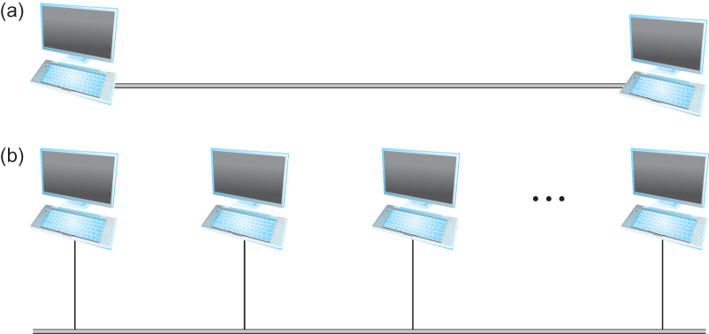
Physical Connectivity
Figure 1.2 Direct links:
(a) point-to-point
(b) multiple access (MA)

Slide 5
Other Forms of Connectivity
Indirect connectivity through a set of cooperating nodes.
Wireless connectivity:
  WiFi (IEEE802.11)
  Cellular
  Bluetooth
  Zigbee (part of IEEE802.15.4)
  WiMAX

Slide 6
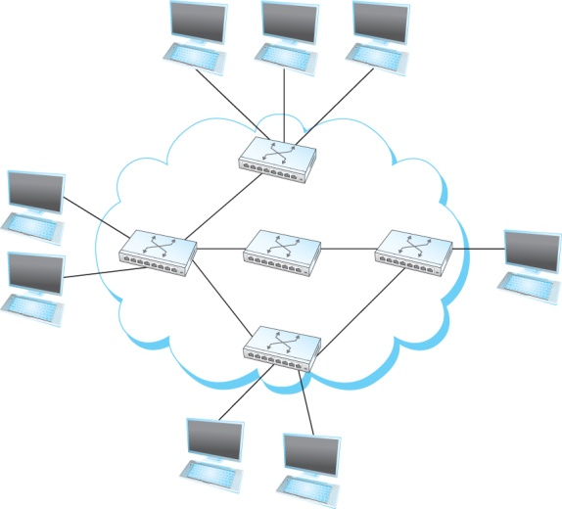
Switched Network
Figure 1.3 Switched network

Slide 7
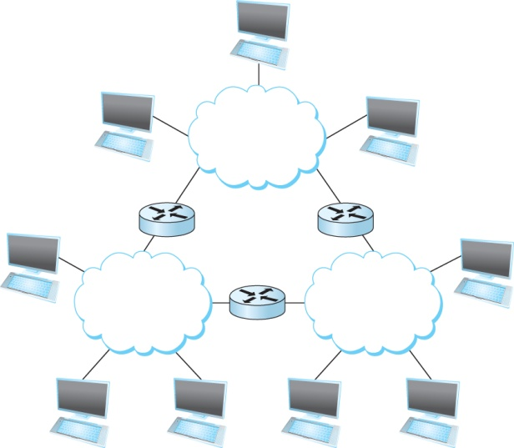
An internet
Figure 1.4 Interconnection of Networks

Slide 8
Definitions
In a distributed system:: the collection of independent computers appears to its users as a single coherent system.
Namely, the distinction between a computer network and a distribution system lies in the transparency in assigning tasks to computers.
Example:
NFS is a distributed files system.
Computer networks provide host-to-host connectivity by assigning an address to each node.

Slide 9
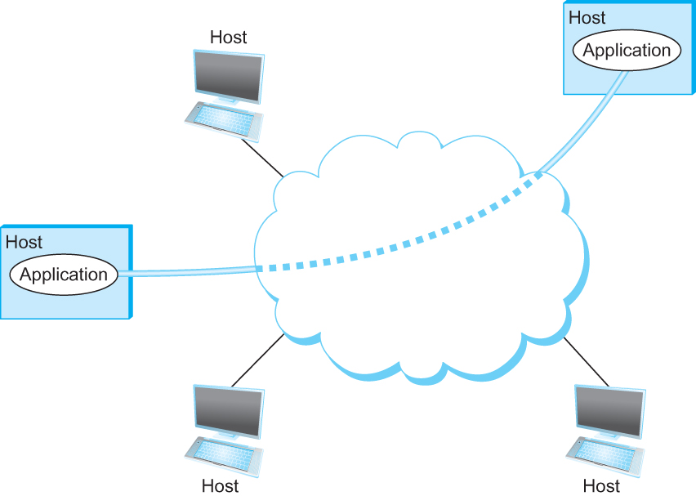
Application Communication
Figure 1.7 Processes communicating over
an abstract channel

Slide 10
Internet Access and Flows
T
X
Z
W1
W2
W
Y
Host
L
AP
W3
Host
M
Host
A
2
3
W4
4
Host
B
1
5
nodes
14
16
11
Host
J
Host
C
12
17
15
6
10
13
7
Host
H
Host
D
9
8
Host
G
Host
E
Host
F

Slide 11

The Internet: “nuts and bolts” view
PC
billions of connected computing devices: hosts = end systems
  running network apps
Mobile network
server
Global ISP
wireless
laptop
cellular
handheld
Home network
communication links
  fiber, copper, radio, satellite
  transmission rate = capacity
Regional ISP
access
points
Institutional network
wired
links
routers*: forward packets (chunks of data)
router
* Also referred to as switches or gateways.
K & R

Slide 12
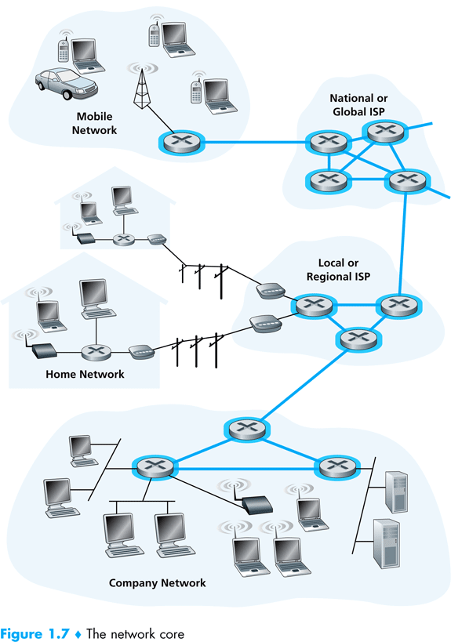
K & R

Slide 13
Student Perspectives
Application Programmer
  List the services that an application needs with QoS (Quality of Service) delivery targets.
Network Designer
  Design a cost-effective network with fair resource sharing.
Network Provider/Operator
  List the characteristics of a system that is easy to administer and manage. Concerns include: quick fault diagnosis, correct configurability, and easy growth.

Slide 14
Networking Application
Paradigms
Introduction

Slide 15
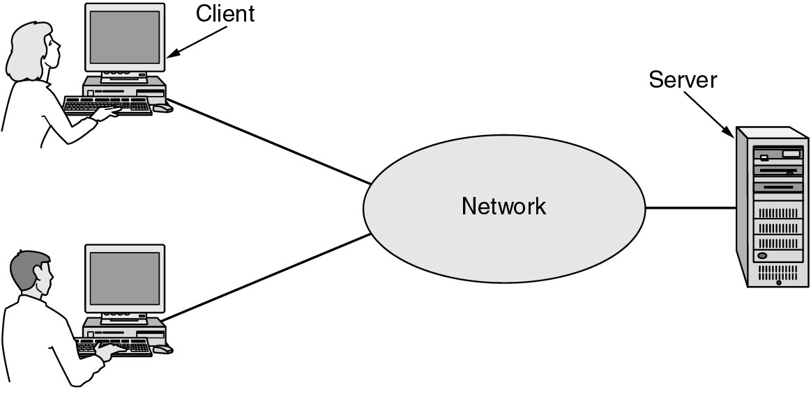
Client-Server Applications
Figure 1.1 A network with two clients and one server.
Tanenbaum

Slide 16
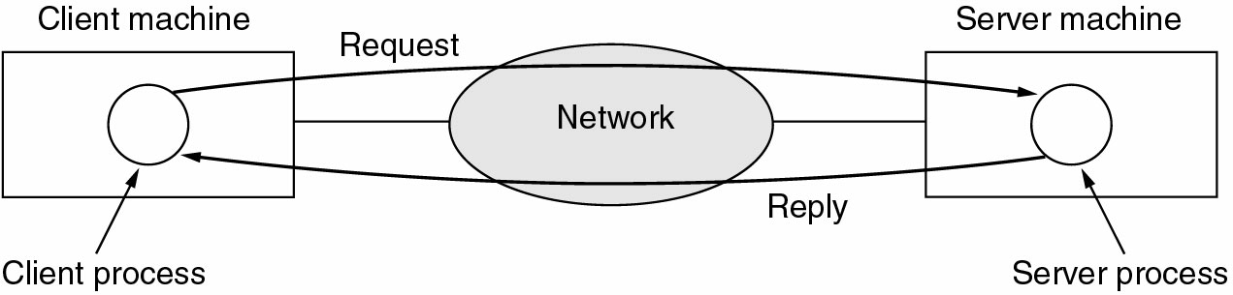
Client-Server Model
Figure 1-2. The client-server model involves requests and replies.
Tanenbaum

Slide 17
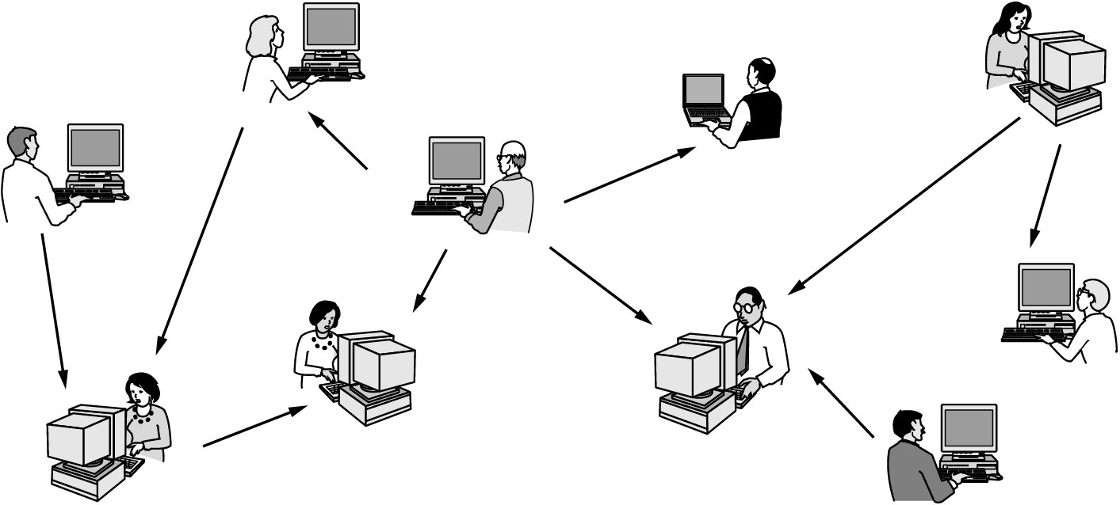
Peer-to-Peer Applications
Figure 1.3 In a peer-to-peer system there are no fixed clients and servers.
Tanenbaum

Slide 18
A Closer Look at Network Structure
network edge: applications and hosts
access networks, physical media: wired, wireless communication links
network core:
  interconnected routers
  network of networks
K & R

Slide 19
The Network Edge
end systems (hosts):
  run application programs
  e.g. Web, email
  at “edge of network”
peer-peer
client/server model
  client host requests, receives service from always-on server
  e.g. Web browser/server; email client/server
client/server
peer-peer model:
  minimal (or no) use of dedicated servers
  e.g. Skype, BitTorrent
K & R

Slide 20
Wireless versus Mobile Applications
Wireless involves transmissions through the air (type depends on frequency).
  Residential access networks
    Residential access points
  Institutional access networks
    Institutional and corporate access points or mesh networks
  Public access networks
    e.g., Cities, towns, libraries and coffee shops
  Cellular networks
    2.5G, 3G and 4G

Slide 21
Wireless versus Mobile Applications
Mobile can refer to the Hosts.
  Laptops can be moveable and wired.
  Laptops can be moveable and wireless.
  Cell phones, smart phones, PDAs and devices in vehicles are mobile and wireless.
Mobile Ad Hoc NETworks (MANETs)::
  wireless devices are both Hosts and subnet nodes (routers).
  The distinction is that MANET nodes may relay traffic intended for other nodes (multi-hop traffic).

Slide 22
Network
Classifications
Introduction

Slide 23
Classifying by Transmission Technology
broadcast :: a single communications channel shared
by all machines (addresses) on the network.
Broadcast can be both a logical or a physical concept
(e.g. Media Access Control (MAC) sublayer ).
multicast :: communications to a specified group.
This requires a group address (e.g. – multimedia multicast).
unicast :: a communication involving a single sender and a single receiver.
point-to-point :: connections made via links between pairs of nodes.

Slide 24
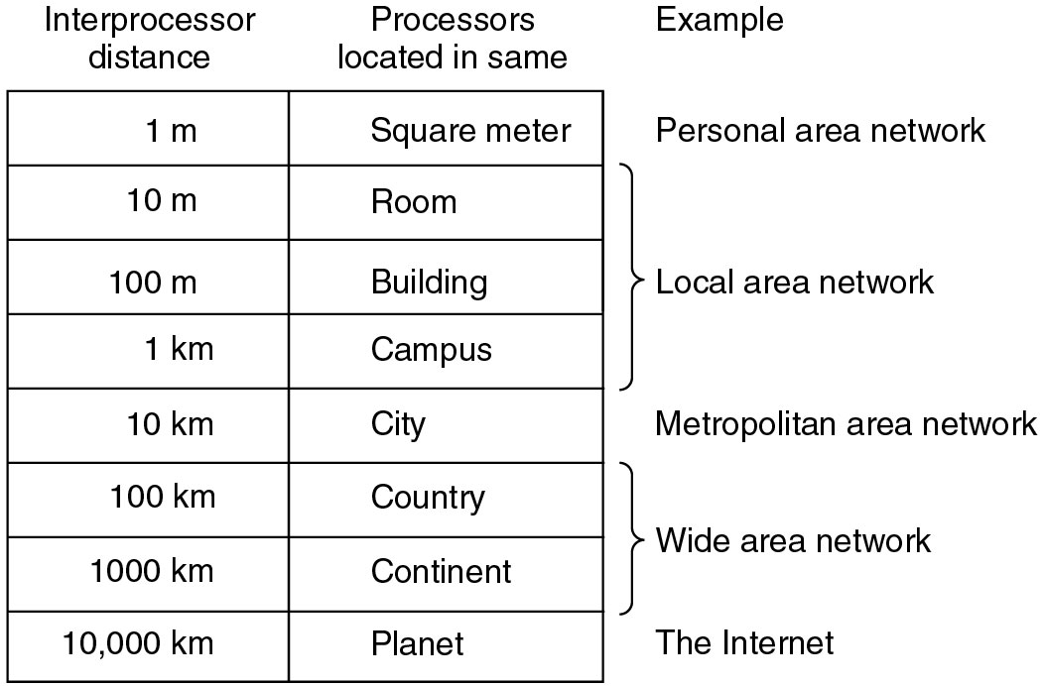
Classification by Size
(PAN)
(LAN)
(MAN)
(WAN)
Figure 1-6. Classification of interconnected processors by scale.
Tanenbaum

Slide 25
Classification by Size
PANS {Personal Area Networks}
  Used for communication among computer devices, including smart phones and PDA’s in proximity to an individual's body. [Wikipedia].
  Reach up to meters.
  Includes ‘wearable’ devices and protocols such as Bluetooth, Zigbee and UWB (Ultra Wide Band) and BANs (Body Area Networks).
  IEEE 802.15 Working Group for Wireless PANs (WPANs).

Slide 26
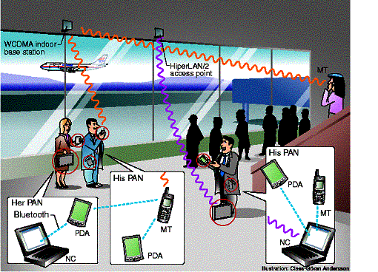
PANs
[Brunell University West London]

Slide 27
Classification by Size
LANs {Local Area Networks}
  Wired LANs: typically physically broadcast at the MAC layer (e.g., Ethernet, Token Ring)
  Wireless LANs (WLANs)
  Wireless Sensor Networks (WSNs)
MANs {Metropolitan Area Networks}
  campus networks connecting LANs logically or physically.
  often have a backbone (e.g., FDDI, ATM or a mesh) to connect campus networks.

Slide 28
Wired LANs
transceivers
●     
Ethernet bus
Ethernet hub
Leon-Garcia & Widjaja:
Communication Networks

Slide 29
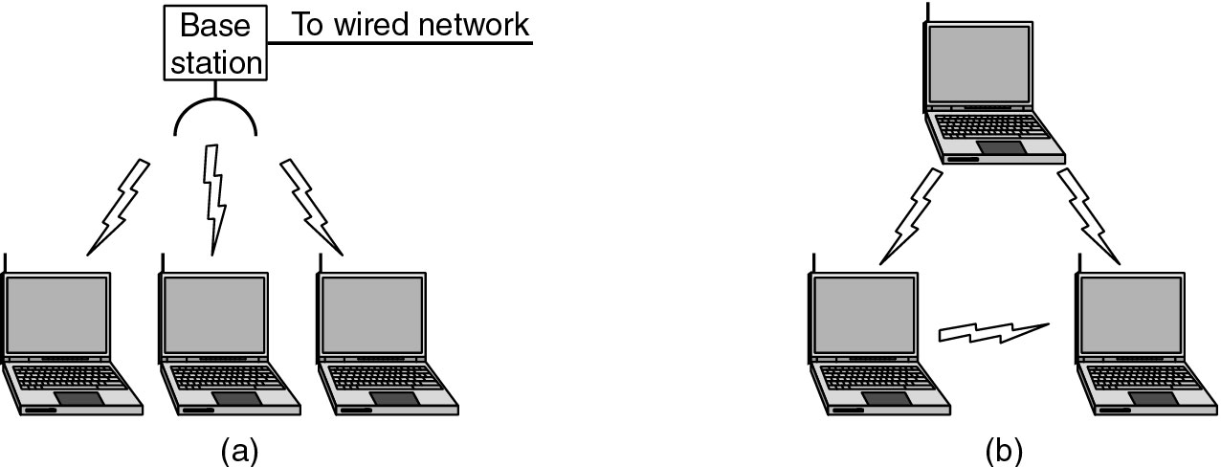
Wireless LANs (WLANs)
Figure 1-35. (a) Wireless networking with a base station. (b) Ad hoc networking.
Tanenbaum

Slide 30
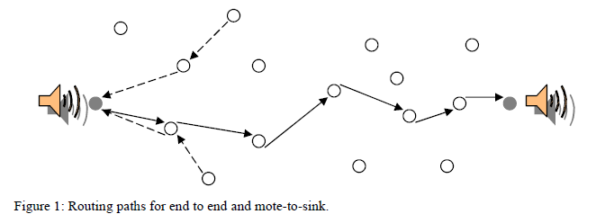
Wireless Sensor Networks (WSNs)
N. Chohan
WSNs can have mobile or fixed nodes but require a routing algorithm and normally have power concerns.

Slide 31
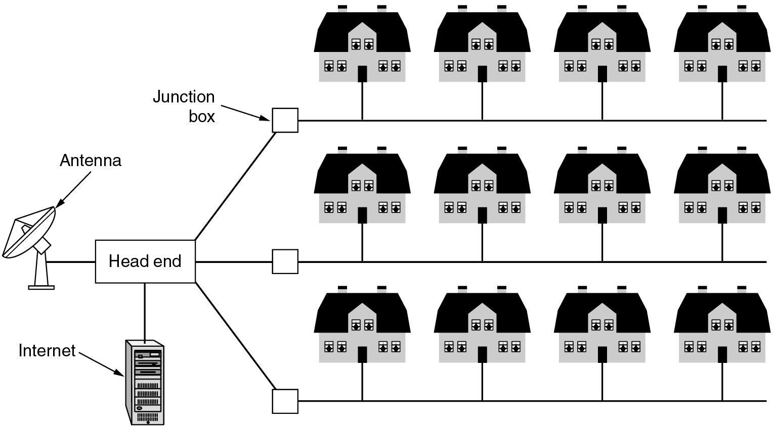
Metropolitan Area Networks (MANs)
Figure 1-8. A metropolitan area network based on cable TV.
Tanenbaum

Slide 32
MANs within a Hierarchical Topology
1*
a
b
2
Metropolitan network A consists of access subnetworks: a, b, c, d.
4
3
A
c
d
Hierarchical Network Topology
National network consists of regional subnetworks: α, β, γ.
Metropolitan network A is part of regional subnetwork α.
A
α
β
γ
Leon-Garcia & Widjaja:
Communication Networks

Slide 33
Network Classification by Size
WANs {Wide Area Networks}
  also referred to as “point-to-point” networks.
  ARPANET → Internet
  usually hierarchical with a backbone.
  Enterprise Networks, Autonomous Systems (ASs)
  VPNs (Virtual Private Networks).

Slide 34
ARPAnet circa 1972
AMES
McCLELLAN
UTAH
BOULDER
GWC
CASE
RADC
ILL
LINC
CARN
AMES
USC
MIT
UCSB
MITRE
STAN
SCD
ETAC
UCLA
RAND
TINKER
BBN
HARV
NBS
A point-to-point network
Leon-Garcia & Widjaja:
Communication Networks

Slide 35
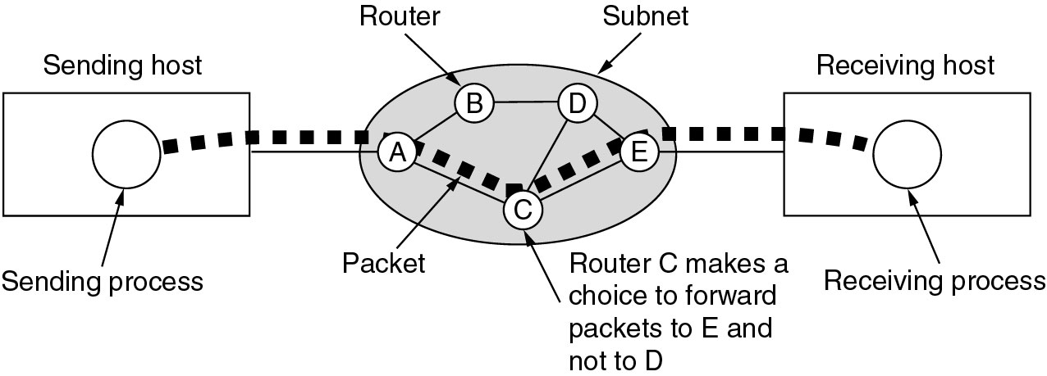
Wide Area Networks (WANs)
Figure 1-10.A stream of packets from sender to receiver.
Tanenbaum

Slide 36
internet
net 3
G
net 1
G
G
G = gateway
G
net 5
net 2
G
net 4
G
A network of networks
Leon-Garcia & Widjaja:
Communication Networks

Slide 37
Network Classification by Topology
flow of data
Bidirectional flow
Default is baseband
cabling
Repeater
Bus Topology

Slide 38
Network Classification by Topology
Note - A ring implies unidirectional flow.
Repeater
Repeater
Ring Topology

Slide 39
Network Classification by Topology
Headend
Tree Topology
Computer Networks Introduction

Slide 40
Tree Topology
N. Chohan
WSN end-to-end routing often employs a spanning tree for routing.

Slide 41
Network Classification by Topology
hub, switch
or repeater
Star Topology

Slide 42
Network Classification by Topology
Wireless Infrastructure
W2
W1
AP
W3
W4
Star Topology

Slide 43
Introduction Summary
Define: network, distributed system, subnet, host, node, flow, channel and link.
Paradigms: Client-Server, Peer-to-Peer, Wireless and Mobile.
Classifications and Acronyms:
  Broadcast, multicast, unicast
  PAN, LAN, MAN, WAN, WLAN, WSN
  The Internet versus an internet
  Hierarchical, bus, ring,tree, and star topology

