Slide 1
Data Link Layer
Computer Networks
Spring 2012

Slide 2
Data Link Layer Outline
Parallelism between Transport and Data Link Layer
Tanenbaum’s Treatment/Model of Data Link Layer
Protocol 1: Utopia
Protocol 2: Stop-and-Wait
Protocol 3: Positive Acknowledgment with Retransmission [PAR]
Old ‘flawed’ version
Newer version

Slide 3
DL Layer Outline (cont)
Pipelining and Sliding Windows
Protocol 4: One Bit Sliding Window
Protocol 5: Go Back N
Protocol 6: Selective Repeat
Further Details and Decisions

Slide 4
Reliable Protocols at Two Layers
ACK/NAK
Transport Layer
End to End
1
2
3
4
5
Data
Data
Data
Data
Leon-Garcia & Widjaja:
Communication Networks
Hop by Hop
Data Link Layer
Data
Data
Data
Data
1
2
3
4
5
ACK/NAK
ACK/NAK
ACK/NAK
ACK/NAK

Slide 5
Data Link Layer Protocols
To achieve control when sending data, a layer of logic, the Data Link Layer protocol
is added above the Physical layer.
To manage data exchange over a link, DL layer protocol needs:
frame synchronization
flow control
error control
addressing
control and data
link management
DCC 9th Ed.
Stallings
Notes:
In this chapter, we shift our emphasis to that of sending data over a data communications link. To achieve the necessary control, a layer of logic is added above the physical layer, referred to as data link control or a data link control protocol. Some of the requirements and objectives for effective data communication between two directly connected transmitting-receiving stations:
• Frame synchronization: Data are sent in blocks called frames. The beginning and end of each frame must be recognizable.
• Flow control: The sending station must not send frames at a rate faster than the receiving station can absorb them.
• Error control: Bit errors introduced by the transmission system should be corrected.
• Addressing: On a shared link, such as a local area network (LAN), the identity of the two stations involved in a transmission must be specified.
• Control and data on same link: the receiver must be able to distinguish control information from the data being transmitted.
• Link management: Procedures for the management of initiation, maintenance, and termination of a sustained data exchange over a link.

Slide 6
Data Link Layer
Provides a well-defined service interface to the network layer.
Determines how the bits of the physical layer are grouped into frames (framing).
Deals with transmission errors (CRC and ARQ).
Regulates the flow of frames.
Performs general link layer management.

Slide 7
Tanenbaum’s DL Layer Treatment
Concerned with communication between two adjacent nodes in the subnet (node to node).
Assumptions:
The bits are delivered in the order sent.
A rigid interface between the Host and the node ➔ the communications policy and the Host protocol (with OS effects) can evolve separately.
He uses a simplified model.

Slide 8
Tanenbaum’s ‘Simplified’ Model
Host
A
Layer 4
Host
B
Layer 2
Node
1
Node
2
frame
Tanenbaum’s Data Link Layer Model
Assume the sending Host has infinite supply of messages.
A node constructs a frame from a single packet message.
The CRC is automatically appended in the hardware.
The protocols are developed in increasing complexity to help
students understand the data link layer issues.

Slide 9
Basic Elements of ARQ
Information
frames
Error-free
packet
sequence
Packet
sequence
Transmitter
Receiver
Station A
Control frames
Station B
CRC
Header
CRC
Information
packet
Header
Control frame
Information Frame
Leon-Garcia & Widjaja:
Communication Networks

Slide 10
Tanenbaum’s Protocol Definitions
Continued →
Figure 3-9. Some definitions needed in the protocols to follow. These are located in the file protocol.h.

Slide 11
Packet and Frame Definitions
packet
network layer
buffer
frame
info
ack
seq
kind
data link layer
postamble
CRC
preamble
physical layer

Slide 12
Protocol Definitions (continued)
Figure 3-9. Some definitions needed in the protocols to follow. These are located in the file protocol.h.

Slide 13
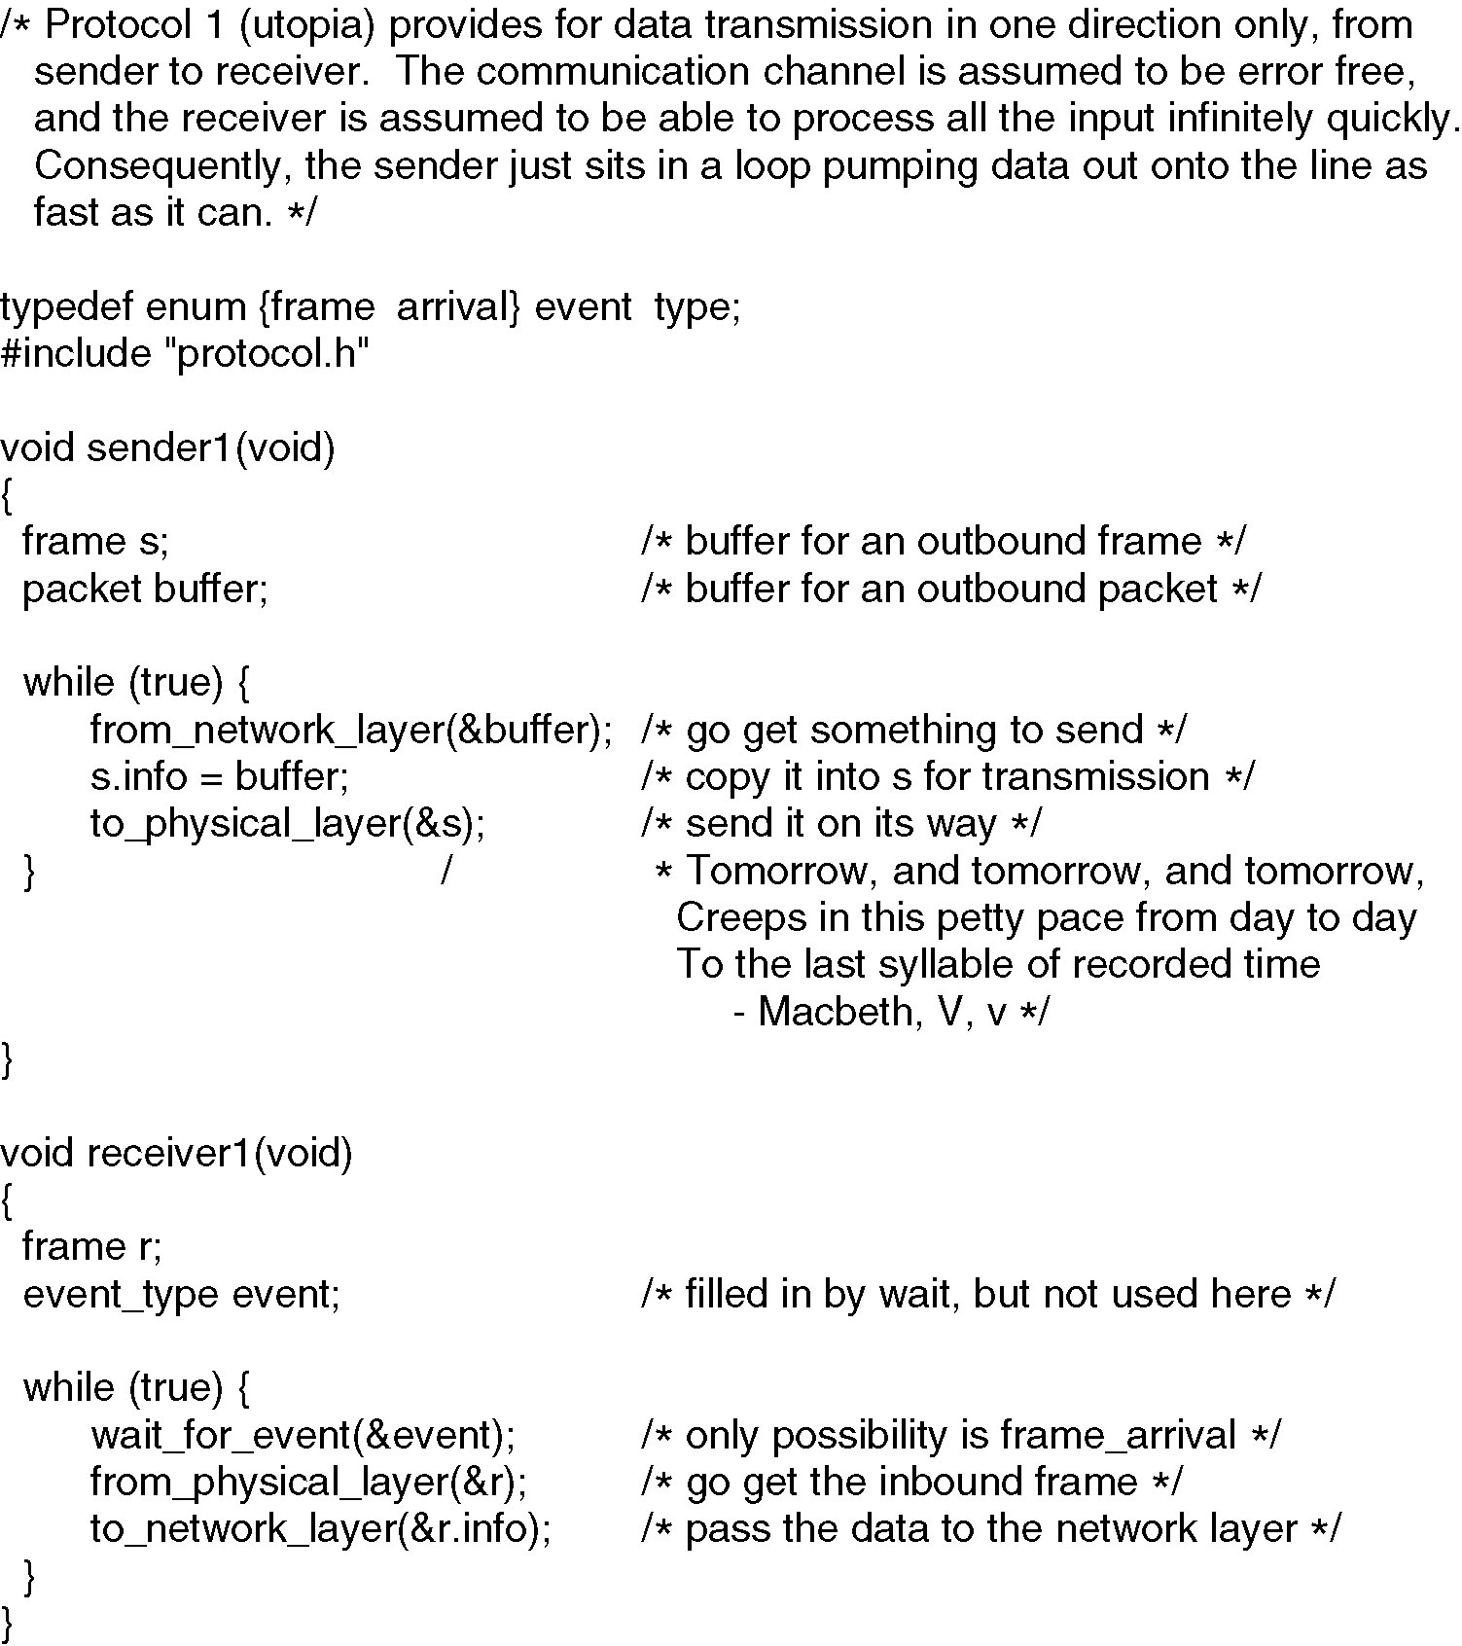
Figure 3-10 Unrestricted Simplex Protocol

Slide 14
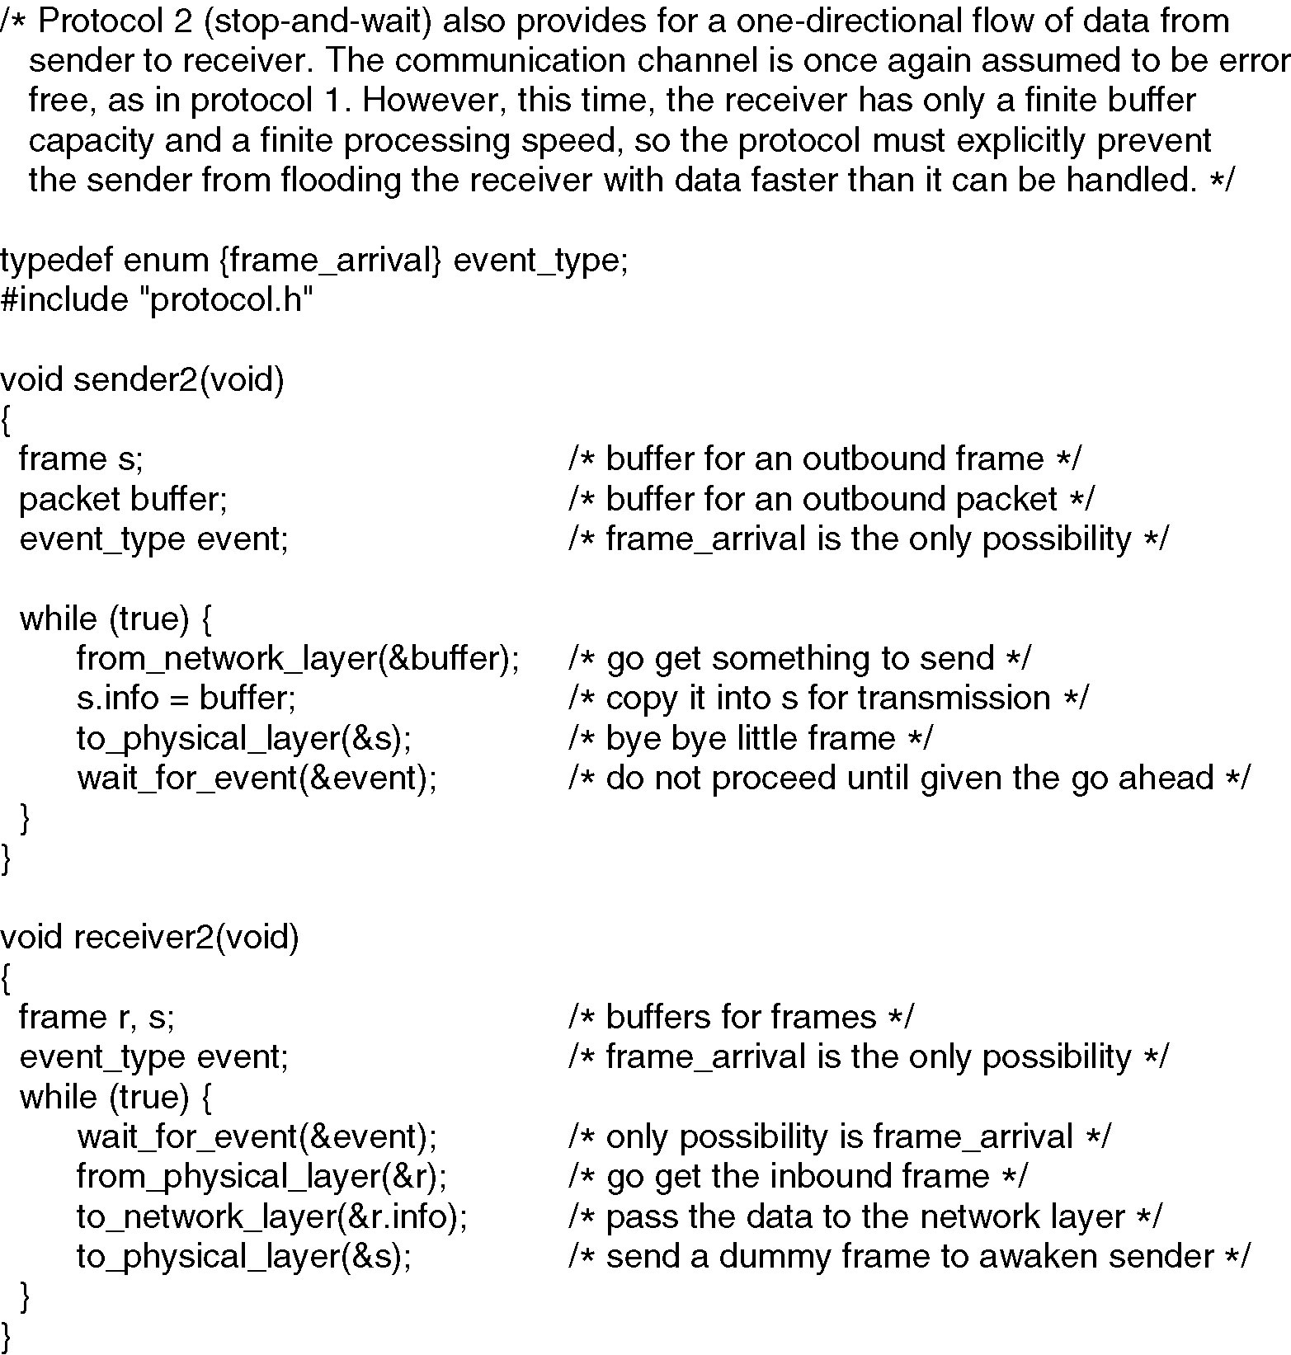
Figure 3-11 Simplex Stop-and-Wait Protocol

Slide 15
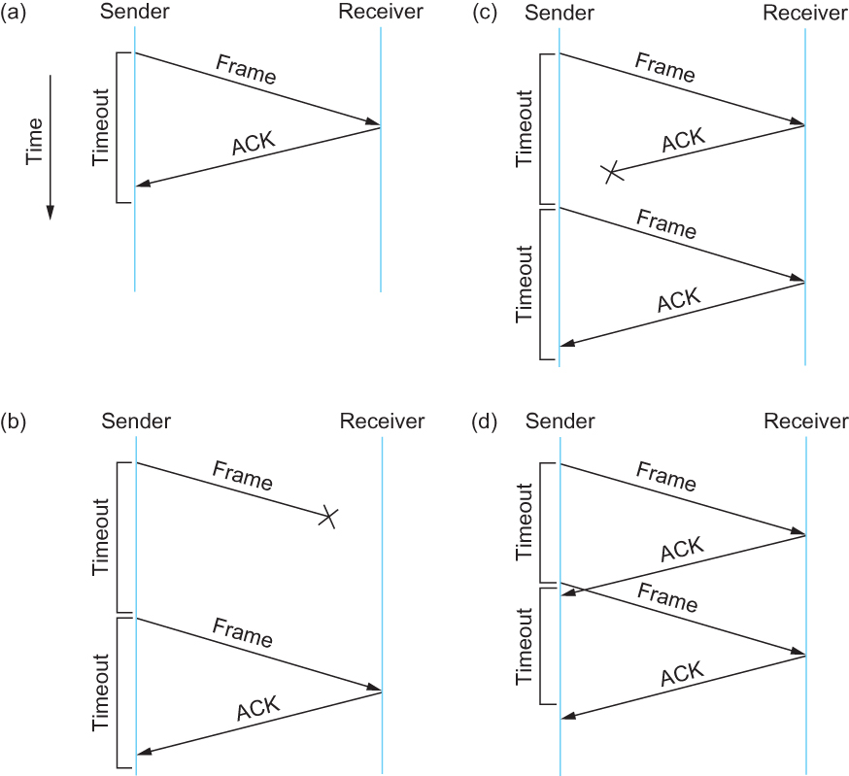
Stop-and-Wait Scenarios
Now we introduce
a noisy channel
into our world!
Figure 2.17 Timeline showing four different scenarios for the stop-and-wait algorithm.
(a) The ACK is received before the timer expires; (b) the original frame is lost; (c) the
ACK is lost; (d) the timeout fires too soon {premature timeout}

Slide 16
Protocol 3: Positive Acknowledgement with Retransmissions [PAR]
Introduce Noisy Channels
This produces:
Damaged and lost frames
Damaged and lost ACKs
PAR Protocol
Tools and issues:
Timers
Sequence numbers
Duplicate frames

Slide 17
Stop-and-Wait [with errors]
(a) Frame 1 lost
Time-out
time
A
frame
0
frame
1
frame
1
frame
2
B
ACK
ACK
without sequence numbers
ambiguous results !!
(b) ACK lost
Time-out
time
A
frame
0
frame
1
frame
1
frame
2
ACK
ACK
ACK
B
In parts (a) and (b) transmitting station A acts the same way, but part (b) receiving station B accepts frame 1 twice.

Slide 18
Protocol 3 Positive ACK with Retransmission (PAR) [Old Tanenbaum Version]
#define MAX_SEQ 1
typedef enum {frame_arrival, cksum_err, timeout} event_type;
include “protocol.h”
void sender_par (void)
{
seq_nr next_frame_to_send;
frame s;
packet buffer;
event_type event;
next_frame_to_send = 0;
from_network_layer (&buffer);
while (true)
{ s.info = buffer;
s.seq = next_frame_to_send;
to_physical_layer (&s);
start_timer (s.seq);
wait_for_event (&event);
if (event == frame_arrival) {
from_network_layer (&buffer);
inc (next_frame_to_send); }
}
}

Slide 19
Protocol 3 Positive ACK with Retransmission (PAR) [Old Tanenbaum Version]
void receiver_par (void)
{
seq_nr next_frame_to_send;
frame r, s;
event_type event;
frame_expected = 0;
while (true)
{ wait_for_event (&event);
if (event == frame_arrival)
{ from_physical_layer (&r);
if (r.seq == frame_expected) {
to_network_layer(&r.info);
inc (frame_expected);
}
to_physical_layer (&s);
}
}
}
/* Note – no sequence number on ACK */

Slide 20
PAR [OLD] problem
Ambiguities occur when ACKs
are not numbered.
premature
time-out
time
A
frame
0
frame
0
frame
1
frame
2
ACK
ACK
B
Transmitting station A misinterprets duplicate ACKs
Leon-Garcia & Widjaja:
Communication Networks

Slide 21
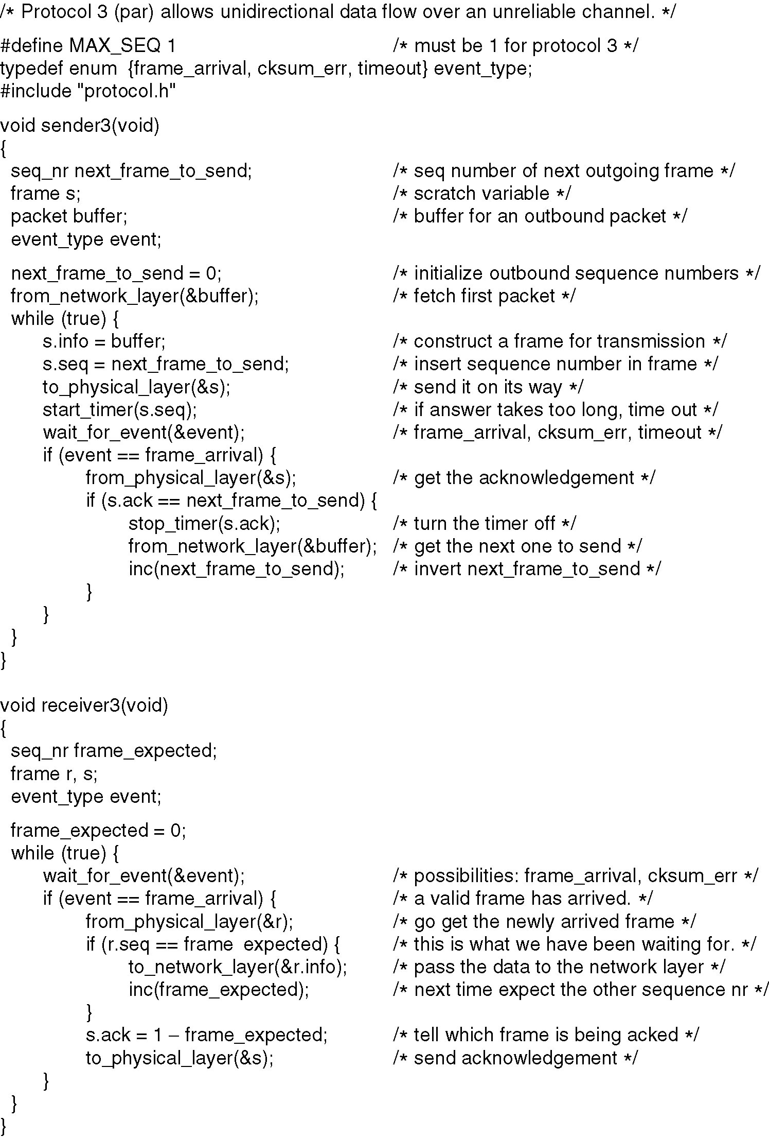
PAR Simplex Protocol for a Noisy Channel
Code added
Figure 3-12.A Positive Acknowledgement with Retransmission protocol.
Continued →

Slide 22
A Simplex Protocol for a Noisy Channel
Code added
Figure 3-12.A Positive Acknowledgement with Retransmission protocol.

Slide 23
State Machine for Stop-and-Wait
0 1
0 1
0 1
0 1
0 1
0 1
0 1
0 1
S_{last}
R_{next}
Timer
S_{last}
Transmitter
Receiver
Station A
R_{next}
Station B
(0,0)
Error-free frame 0
arrives at receiver
(0,1)
Global State:
(S_{last}, R_{next})
ACK for
frame 0
arrives at
transmitter
ACK for
frame 1
arrives at
transmitter
Error-free frame 1
arrives at receiver
(1,0)
(1,1)

Slide 24
Sliding Window Protocols [Tanen]
Must be able to transmit data in both directions.
Choices for utilization of the reverse channel:
mix DATA frames with ACK frames.
Piggyback the ACK
Receiver waits for DATA traffic in the opposite direction.
Use the ACK field in the frame header to send the sequence number of frame being ACKed.
➔ better use of the channel capacity.

Slide 25
Sliding Window Protocols
ACKs introduce a new issue – how long does receiver wait before sending ONLY an ACK frame?
Now we need an ACKTimer !!
The sender timeout period needs to be set longer.
The protocol must deal with the premature timeout problem and be “robust” under pathological conditions.

Slide 26
Sliding Window Protocols
Each outbound frame must contain a sequence number. With n bits for the sequence number field,
maxseq = 2^{n} – 1
and the numbers range from 0 to maxseq.
Sliding window:: the sender has a window of frames and maintains a list of consecutive sequence numbers for frames that it is permitted to send without waiting for ACKs.

Slide 27
Sliding Window Protocols
The receiver has a window of frames that has space for frames whose sequence numbers are in the range of frame sequence numbers it is permitted to accept.
Note – sending and receiving windows do NOT have to be the same size.
The windows can be fixed size or dynamically growing and shrinking
(e.g., TCP uses dynamic cwnd).

Slide 28
Sliding Window Protocols
The Host is oblivious to sliding windows and the message order at the transport layer is maintained.
sender’s DL window :: holds frames sent but not yet ACKed.
new packets from the Host cause the upper edge inside the sender’s window to be incremented.
acknowledged frames from the receiver cause the lower edge inside the sender’s window to be incremented.

Slide 29
Sliding Window Protocols
All frames in the sender’s window must be saved for possible retransmission and we need one timer per frame in the window.
If the maximum sender window size is B, the sender needs at least B buffers.
If the sender’s window gets full (i.e., it reaches the maximum window size, the protocol must shut off the Host (the network layer) until buffers become available.

Slide 30
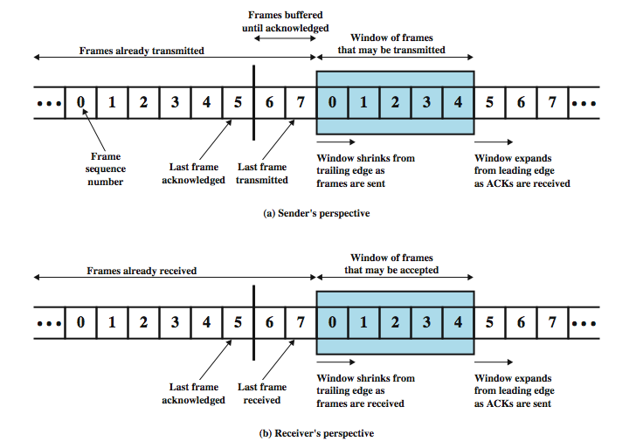
Sliding Window Diagram
DCC 9th Ed.
Stallings
Notes:
Stallings DCC9e Figure 7.3 depicts the sliding-window process. It assumes the use of a 3-bit sequence number, so that frames are numbered sequentially from 0 through 7, and then the same numbers are reused for subsequent frames. The shaded rectangle indicates the frames that may be sent; in this figure, the sender may transmit five frames, beginning with frame 0. Each time a frame is sent, the shaded window shrinks; each time an acknowledgment is received, the shaded window grows. Frames between the vertical bar and the shaded window have been sent but not yet acknowledged. As we shall see, the sender must buffer these frames in case they need to be retransmitted.
Sliding-window flow control is potentially much more efficient than stop-and-wait flow control. The reason is that, with sliding-window flow control, the transmission link is treated as a pipeline that may be filled with frames in transit. In contrast, with stop-and-wait flow control, only one frame may be in the pipe at a time.

Slide 31
Sliding Window Protocols
receiver’s DL window
Frames received with sequence numbers outside the receiver’s window are not accepted.
The receiver’s window size is normally static.
The set of acceptable sequence numbers is rotated as “acceptable” frames arrive.
If a receiver’s window size = 1, then the protocol only accepts frames in order.
This scheme is referred to as
Go Back N.

Slide 32
Sliding Window Protocols
Selective Repeat :: receiver’s window size > 1.
The receiver stores all correct frames within the acceptable window range.
Either the sender times out and resends the missing frame, or
Selective repeat receiver sends a NACK frame back the sender.

Slide 33
Choices in ACK Mechanisms
The ACK sequence number indicates the last frame successfully received.
- OR -
2. ACK sequence number indicates the next frame the receiver expects to receive.
Both schemes can be strictly individual ACKs or represent cumulative ACKs.
Cumulative ACKs is the most common technique used.

Slide 34
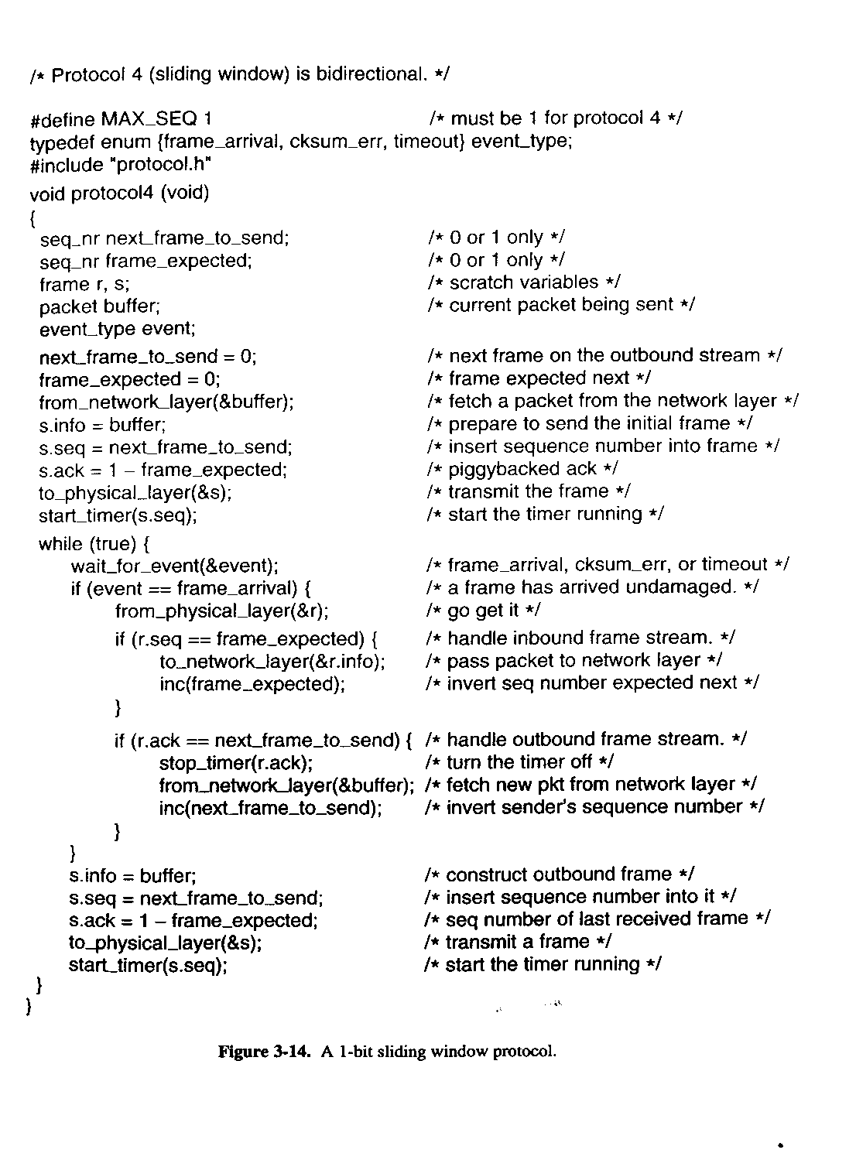
One-Bit Sliding Window Protocol

Slide 35
Go Back N
Timeout Occurs for frame 3 !!
4 outstanding frames
so go back 4
Go-Back-4:
fr
0
fr
1
fr
2
fr
3
fr
4
fr
5
fr
6
fr
3
fr
4
fr
5
fr
6
fr
7
fr
8
fr
9
time
A
B
ACK1
ACK2
ACK3
Out-of-sequence frames
ACK4
ACK5
ACK6
ACK7
ACK8
ACK9
error
ACKing next frame expected
Leon-Garcia & Widjaja:
Communication Networks

Slide 36
Go Back N
with NAK error recovery
Transmitter goes back to frame 1
Go-Back-7:
fr
0
fr
1
fr
2
fr
3
fr
4
fr
5
fr
1
fr
2
fr
3
fr
4
fr
5
fr
6
fr
7
fr
0
time
A
B
ACK1
NAK1
Out-of-sequence
frames
ACK2
ACK3
ACK4
ACK5
ACK6
ACK7
error
Leon-Garcia & Widjaja:
Communication Networks

Slide 37
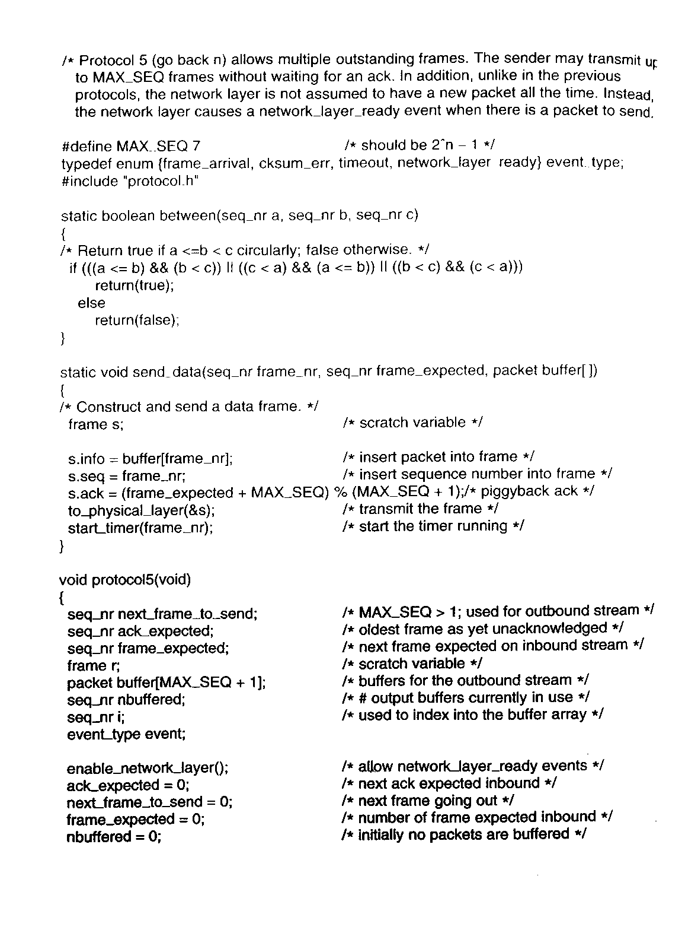

Slide 38
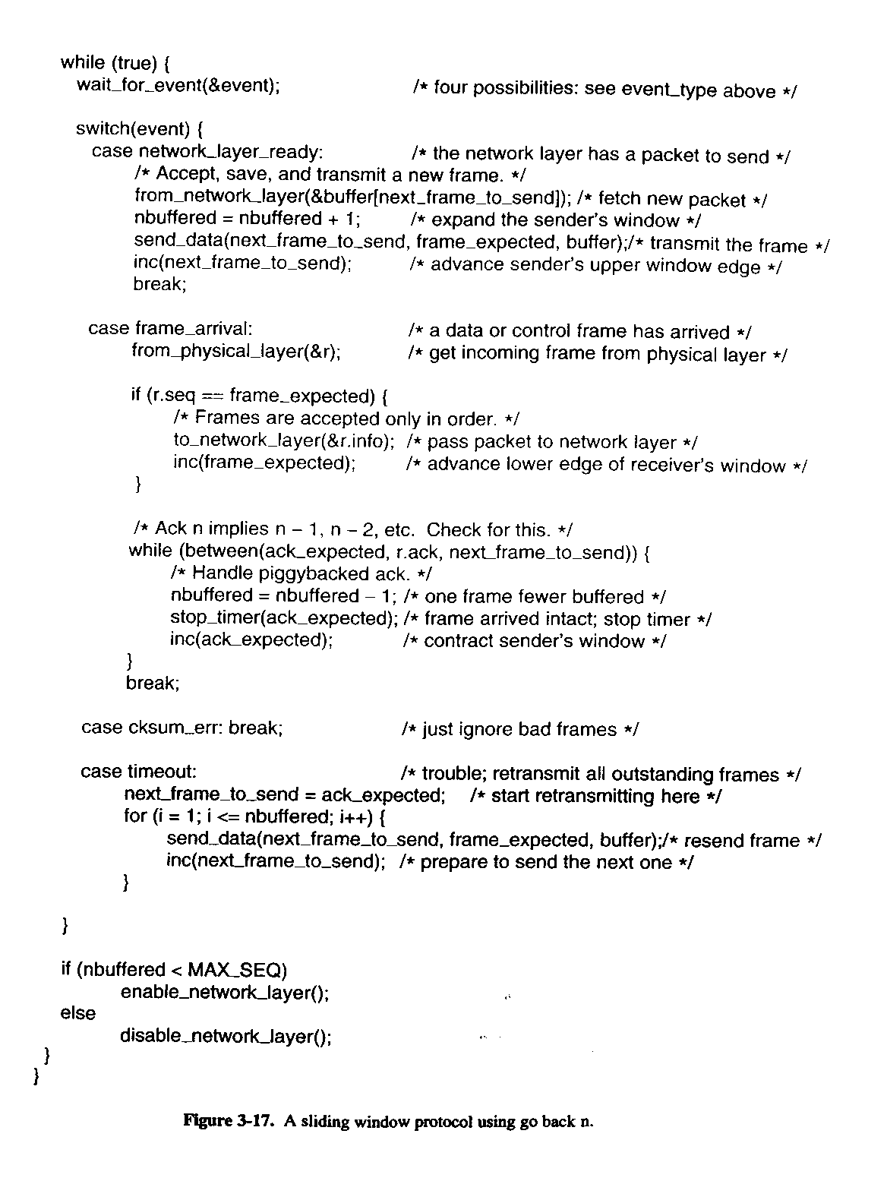

Slide 39
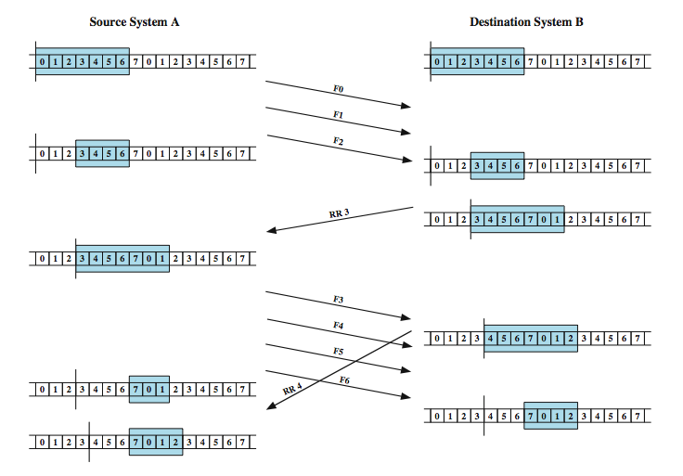
Sliding Window Example
DCC 9th Ed.
Stallings
Notes:
An example is shown in Stallings DCC9e Figure 7.4. The example assumes a 3-bit sequence number field and a maximum window size of seven frames. Initially, A and B have windows indicating that A may transmit seven frames, beginning with frame 0 (F0). After transmitting three frames (F0, F1, F2) without acknowledgment, A has shrunk its window to four frames and maintains a copy of the three transmitted frames. The window indicates that A may transmit four frames, beginning with frame number 3. B then transmits an RR (receive ready) 3, which means "I have received all frames up through frame number 2 and am ready to receive frame number 3; in fact, I am prepared to receive seven frames, beginning with frame number 3." With this acknowledgment, A is back up to permission to transmit seven frames, still beginning with frame 3; also A may discard the buffered frames that have now been acknowledged. A proceeds to transmit frames 3, 4, 5, and 6. B returns RR 4, which acknowledges F3, and allows transmission of F4 through the next instance of F2. By the time this RR reaches A, it has already transmitted F4, F5, and F6, and therefore A may only open its window to permit sending four frames beginning with F7.

Slide 40
Selective Repeat
with NAK error recovery
Retransmit only frame 2
fr
0
fr
1
fr
2
fr
3
fr
4
fr
5
fr
6
fr
2
fr
7
fr
8
fr
9
fr
10
fr
11
fr
12
time
A
B
ACK1
ACK2
NAK2
ACK2
ACK2
ACK2
ACK7
ACK8
ACK9
ACK10
ACK11
ACK12
error
Cumulative ACK

Slide 41
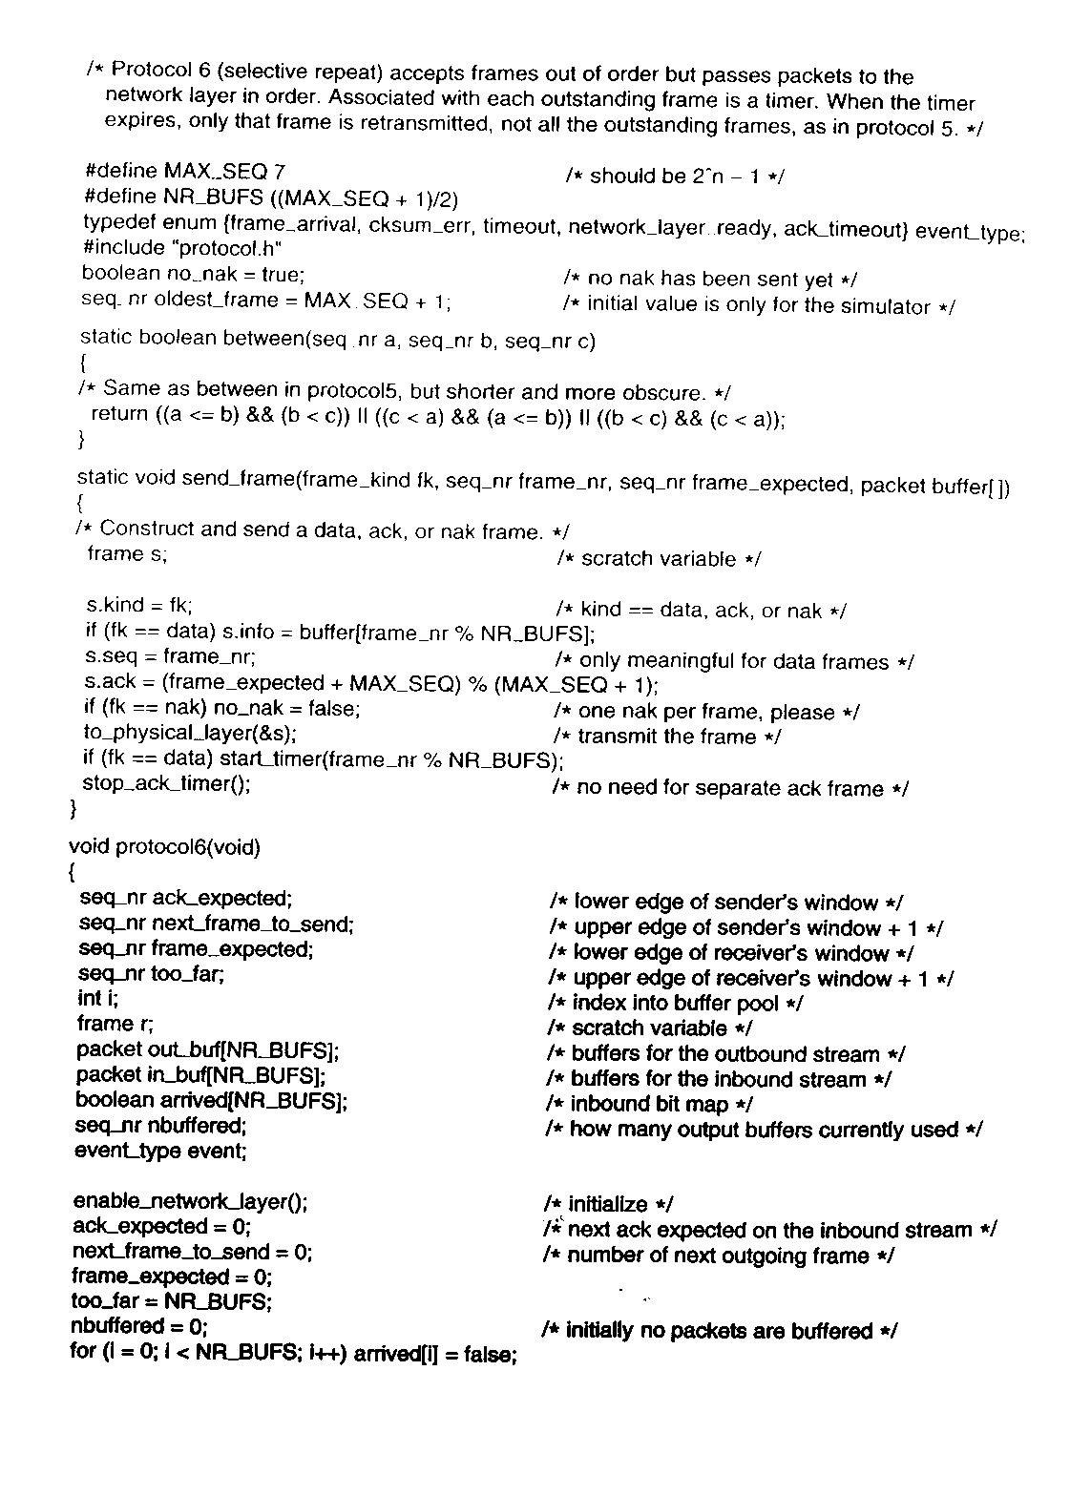

Slide 42
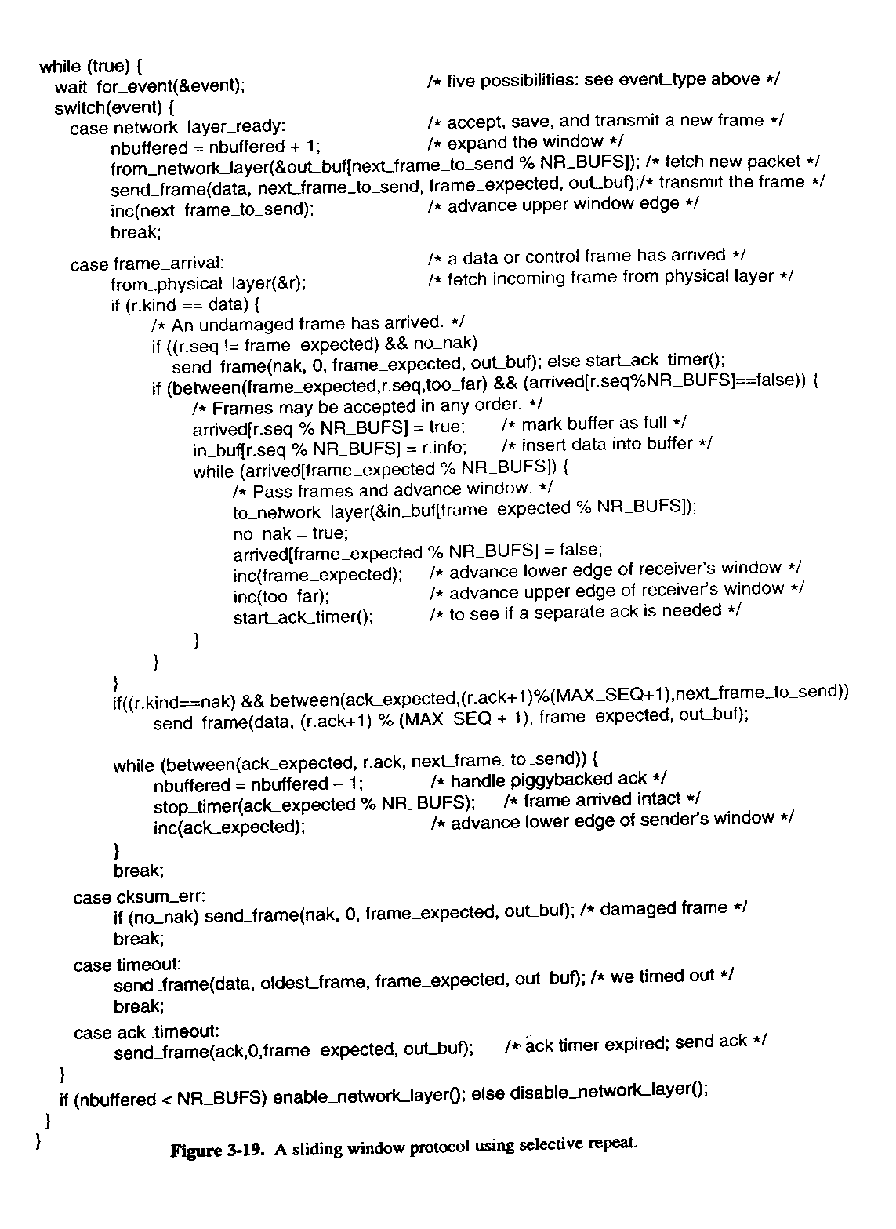

Slide 43
Data Link Layer Summary
Parallelism between Transport and Data Link Layer
Tanenbaum’s Treatment/Model of Data Link Layer
Protocol 1: Utopia
Protocol 2: Stop-and-Wait
Protocol 3: Positive Acknowledgment with Retransmission [PAR]
Old ‘flawed version
Newer version

Slide 44
DL Layer Summary (cont)
Pipelining and Sliding Windows
Protocol 4: One Bit Sliding Window
Protocol 5: Go Back N
Protocol 6: Selective Repeat
Further Details and Decisions

