Slide 1
XORs in the Air: Practical Wireless Network Coding
Sachin Katti
HariharanRahul, WenjunHu, Dina Katabi,
Muriel Medard, Jon Crowcroft
Presented by Lianmu Chen

Slide 2
Outline
Introduction
Cope Overview
Cope Gains
Making it work
Implementation details
Experimental results
Conclusions

Slide 3
Introduction

Slide 4
Problem
Current wireless implementation suffer from a severe throughput limitation and do not scale to dense large networks.
New architecture: COPE.

Slide 9
Cope Overview

Slide 10
Cope Overview
Cope incorporates three main techniques:
Opportunistic Listening
Opportunistic Coding
Learning Neighbor State

Slide 11
Opportunistic Listening
(a)sets the nodes in promiscuous mode
(b) snoop on all communications, store the overheard packets for a limited period T
(c) each node broadcasts reception reports

Slide 12
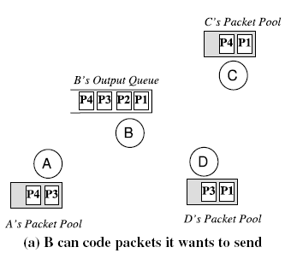
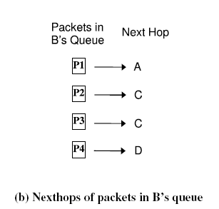
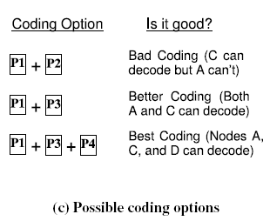
Opportunistic Coding
Rule:
“A node should aim to maximize the number of native packets delivered in a single transmission, while ensuring that each intended next-hop has enough information to decode it’s native packet.”

Slide 13
Opportunistic Coding
Issues:
Unneeded data should not be forwarded to areas where there is no interested receiver, wasting capacity.
The coding algorithm should ensure that all next-hops of an encoded packet can decode their corresponding native packets.
Rule: To transmit n packets p₁ … p_{n} to n next-hops r₁ … r_{n}, a node can XOR the n packets together only if each next-hop r_{i} has all n - 1 packets p_{j} for j ≠ i

Slide 14
Learning Neighbor State
(a)Reception report
(b)guess whether a neighbor has a particular packet.
COPE estimates the probability that a particular neighbor has a packet, as the delivery probability of the link between the packet’s previous hop and the neighbor.
incorrect guess ：relevant native packet is retransmitted, encoded with a new set of native packets.

Slide 15
Cope’s Gains

Slide 16
Understanding COPE’s Gains
Coding Gain
Definition： the ratio of no. of transmissions required without COPE to the no. of transmissions used by COPE to deliver the same set of packets.
Theorem: In the absence of opportunistic listening, COPE’s maximum coding gain is 2, and it is achievable.
Obviously, this number is greater than 1
And 4/3 for Alice-Bob Example

Slide 17
Coding Gain
Coding gain of the chain tends to 2 as the number of intermediate nodes increases.
The complete proof is in Appendix A.

Slide 18
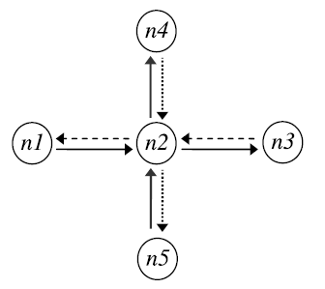
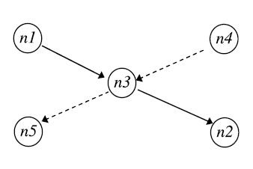
Coding Gain
Obviously, the coding gain in Alice and Bob example is 4/3.
Coding gain = 4/3 = 1.33
Coding gain = 8/5 = 1.6
In the presence of opportunistic listening

Slide 19
Understanding COPE’s Gains
Coding+MAC Gain
Definition： the ratio of the
bottleneck’s draining rate with COPE to its draining rate without COPE.
Theorem 2: In the absence of opportunistic listening, COPE’s maximum Coding+MAC gain is 2, and it is achievable.

Slide 20
COPE+MAC Gains
Theorem 3: In the presence of opportunistic listening, COPE’s maximum Coding+MAC gain is unbounded.
Table 2—Theoretical gains for a few basic topologies

Slide 21
Making it work

Slide 22
Making it work
Packet Coding Algorithm
Packet Decoding
Pseudo-broadcast
Hop-by-hop ACKs and Retransmissions
Preventing TCP packet reordering

Slide 23
Packet Coding Algorithm
Never delaying packets
Does not wait for additional codable packets to arrive
Preference to XOR packets of similar lengths
Distinguish between small and large packets
Never code together packets headed to the same next-hop
maintains two virtual queues per neighbor; one for small packets and another for large packets, an entry is added to the appropriate virtual queue based on the packet’s nexthop and size
Dequeue the packet at the head of the FIFO
Look only at the head of the virtual queues, determine if it is a small or a large packet
Each neighbor has a high probability of decoding the packet – Threshold probability

Slide 24
Packet Decoding
Each node maintains a packet pool
When a node receives an XORed collection of packets, it searches for the corresponding native node from it’s pool
It ultimately XORs the n - 1 packets with the received encoded packet to retrieve it’s own native packet.

Slide 25
Pseudo-broadcast
802.11 MAC modes: unicast and broadcast
Unicast:
packets are immediately acked by next-hops
back-off if an ack is not received
Broadcast: Since COPE broadcasts encoded packets to their next hops, the natural approach would be to use broadcast
Low reliability (In the absence of the acks, the broadcast mode offers no retransmissions)
cannot detect collisions, does not back off
high collision rates, poor throughput
Solution: Pseudo-broadcast

Slide 26
Pseudo-broadcast
Pseudo-Broadcast
Piggybacks on 802.11 Unicast
it Unicasts packets meant for Broadcast.
Link-layer dest field is sent to the MAC address of one of the intended recipients, with an XOR-header added afterward, listing all the next-hops. (All nodes hear this packet)
If the recipient receives a packet with a MAC address different from it’s own and if it is a next-hop, it processes it further. Else, it stores it in a buffer.
Since this is essentially Unicast, collisions are detected, and back-off is possible as well.

Slide 27
Hop-by-hop ACKs and Retransmissions
Encoded packets require all next hops to ack the receipt of the associated native packet
Only one node ACKs (pseudo-broadcast)
There is still a probability of loss to other next hops
Hence, each node ACKs the reception of native packet
If not-acked, retransmitted, potentially encoded with other packets
Overhead - highly inefficient

Slide 28
Hop-by-hop ACKs and Retransmissions
Asynchronous ACKs and Retransmissions
Cumulatively ACK every T_{a} seconds
If a packet is not ACKed in T_{a} seconds, retransmitted
Piggy-back ACKs in COPE header of data packets
If no data packets, send periodic control packets (same packets as reception reports)

Slide 29
Preventing TCP Packet Reordering
Asynchronous ACKs can cause packet reordering
TCP can take this as a sign of congestion
Ordering agent
Ensures TCP packets are delivered in order
Maintains packet buffer

Slide 30
Implementation

Slide 31
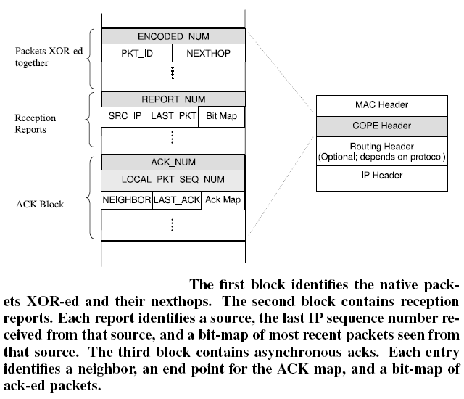
Implementation Details
Packet Format:

Slide 32
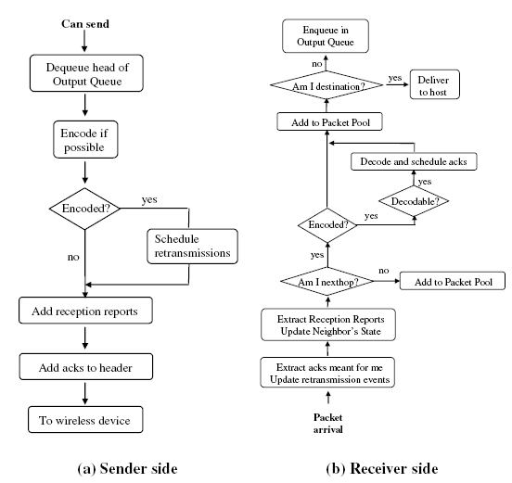
Implementation Details
Control Flow :

Slide 33
Experimental
Result

Slide 34
Testbed
20 nodes
Path between nodes are 1 to 6 hops in length
802.11a with a bit-rate of 6Mb/s
Software
Linux and click toolkit
User daemon and exposes a new interface
Applications use this interface
No modification to application is necessary
Traffic model
udpgen to generate UDP traffic
ttcp to generate TCP traffic
Poisson arrivals, Pareto file size distribution

Slide 35
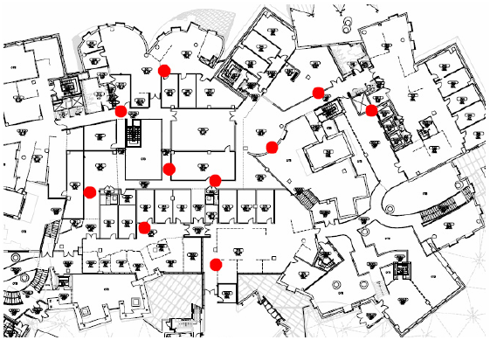
Experimental Results

Slide 36
Metrics
Network throughput
Total end-to-end throughput (sum of throughput of all flows in a network)
Throughput gain
The ratio of measured throughput with and without COPE
Calculate from two consecutive experiments, with coding turned on and off

Slide 37
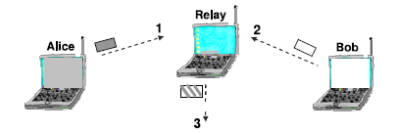
COPE in gadget topologies: Long-lived TCP flows
Close to 1.33
Close to 1.33
Close to 1.6
Throughput gain corresponds to coding gain，rather than Coding+MAC gain
TCP backs-off due to congestion control
To match the draining rate at the bottleneck

Slide 38
Long-lived UDP flows
1.7
1.65
3.5
Close to Coding + MAC gain
XOR headers add small overhead (5-8%)
The difference is also due to imperfect overhearing , flow asymmetry

Slide 39
COPE in an Ad Hoc Network
TCP:
TCP flows arrive according to a Poisson process, pick sender and receiver randomly, and the traffic models the Internet.
TCP does not show significant improvement ( average gain is 2-3%)
Why ?
Collision- related losses:
Nodes are not within carrier sense of each other, resulting in hidden terminal problems

Slide 40
COPE in an Ad Hoc Network
15 MAC retries , the TCP flows experience 14% loss
TCP flows suffer timeouts and excessive back-off, unable to ramp up and utilize the medium efficiently.
Most of time: no packets in their queues or just a single packet.
No enough traffic to make use of coding;
Few coding opportunities arise
Hence, the performance is the same with and without coding

Slide 41
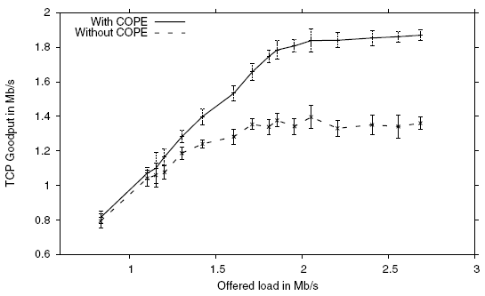
COPE in an Ad Hoc Network
TCP in a collision-free environment
Bring the nodes closer together, within carrier sense range, hence avoid collisions.
COPE performs well without hidden terminals!

Slide 42
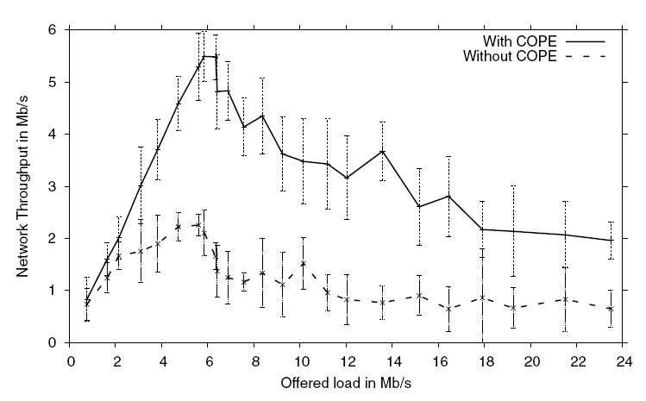
COPE in an Ad Hoc Network
UDP:
Aggregate end-to-end throughput as a function of the demands
Performance: COPE greatly improves the throughput
of these wireless networks

Slide 43
COPE in a Mesh Access Network
Internet accessing using Multi-hop Wireless Networks that connect to the rest of the Internet via one or more gateways/access points ( Traffic flow to and from the closest gateway)
Settings:
UDP flows;
Four sets of nodes;
Each set communicates with the Internet via a specific node that plays the
role of a gateway;

Slide 44
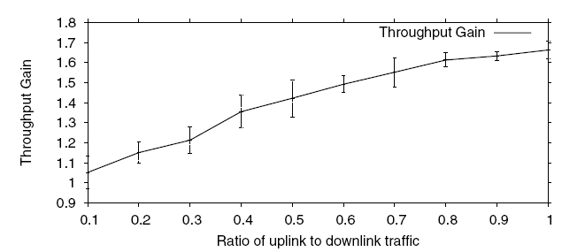
COPE in a Mesh Access Network
Throughput gains as a function of this ratio of upload traffic to download traffic:
COPE’s throughput gain relies on coding opportunities, which depend on the diversity of the packets in the queue of the bottleneck node.

Slide 45
Conclusions

Slide 46
Conclusion
Findings:
Network Coding does have practical benefits
When wireless medium is congested and traffic consists of many random UDP flows, COPE increases throughput by 3 – 4 times.
For UDP, COPE’s gain exceeds theoretical coding gain.
For a mesh access network, throughput improvement with COPE ranges from 5% - 70%
COPE does not work well with hidden terminals. Without hidden terminals, TCP’s throughput increases by an average of 38%
Network Coding is useful for throughput improvement, but COPE introduces coding as a practical tool that can be integrated with forwarding, routing and reliable delivery.

Slide 47
Conclusion
COPE: a new architecture to wireless networks
Large throughput increase
First implement network coding to wireless networks
Simple and practical

Slide 48
Problems
No experiments with mixed flows (Briefly mentioned)
Other routing protocols?
Almost no gain due to hidden terminal

Slide 49
Thank You Questions?

