Slide 1
An Implementation and Experimental Study of the eXplicit Control Protocol (XCP)
Yongguang Zhang and Tom Henderson INFOCOMM 2005
Presenter - Bob Kinicki

Slide 2
Outline
Overview of XCP Study
XCP Implementation Details
XCP Experimental Evaluation
XCP Sensitivity Study
Conclusions and Critique

Slide 3
Overview
The XCP paper involved control theory laws/proofs and ns-2 simulation results.
This paper involves implementing XCP in Linux and conducting a testbed evaluation.
While initial validation results match reported simulation results, this paper exposes: implementation challenges, precision and range issues for XCP, and environmental factors that adversely affect XCP performance.

Slide 4
Implementation Details
XCP implemented as a TCP option.
The use of XCP negotiated on connection setup.
XCP congestion header encoded as a TCP header option and attached to the outgoing TCP header.

Slide 5
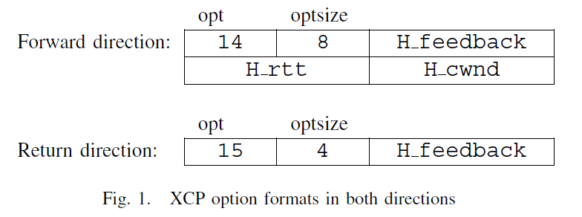
XCP Option Format
Each of the three XCP congestion header fields are 16 bits.
H_cwnd and H_feedback measured in packets and represented as split mantissa-exponent.
H_rtt measured in millisec. and stored as unsigned integer.

Slide 6
XCP functionality from TCP
XCP implementation retained fast retransmit and cwnd reset to one on timeout.
TCP slow start and congestion avoidance disabled.
Advertised window modified to grow by feedback_rcv.
To address wireless packet losses, XCP implemented with two SACK blocks.

Slide 7
XCP Router
XCP Router function divided into:
Kernel support and interface
XCP congestion control (CC) engine
Linux kernel support
XCP Router function implemented as a kernel loadable module.
Linux network device layer includes generic packet queueing and scheduling mechanism Qdisc.
Linux tc command used to manage XCP Qdisc.

Slide 8
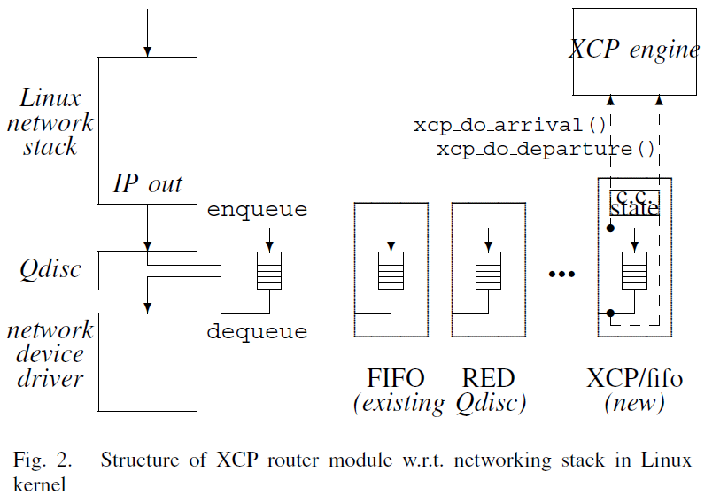
XCP Router

Slide 9
XCP CC Engine
No per-flow state in XCP router.
Per-link congestion control info stored at c.c. state in XCP Qdisc.
xcp_do_arrival updates running traffic statistics.
xcp_do_departure calculates individual packet feedback.
XCP router engine must do per interval (d) processing.

Slide 10
XCP Router

Slide 11
XCP Implementation Challenges
Lack of Linux support for double long and floating point in kernel forced careful scaling analysis of variables and XCP parameters to support high-speed networks.
Changes in bandwidth (capacity) can be fractional ➔ individual packet feedback will be lost to rounding if H_feedback represented as integer number of segments.

Slide 12
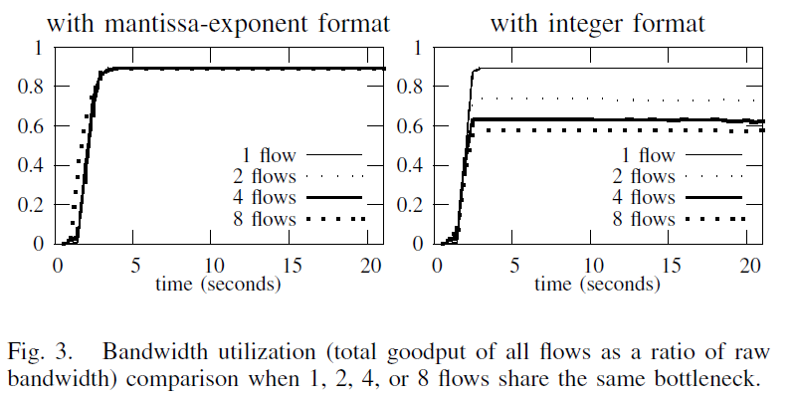
Using Mantissa-Exponent Format
Implementation details can strongly impact performance!!

Slide 13
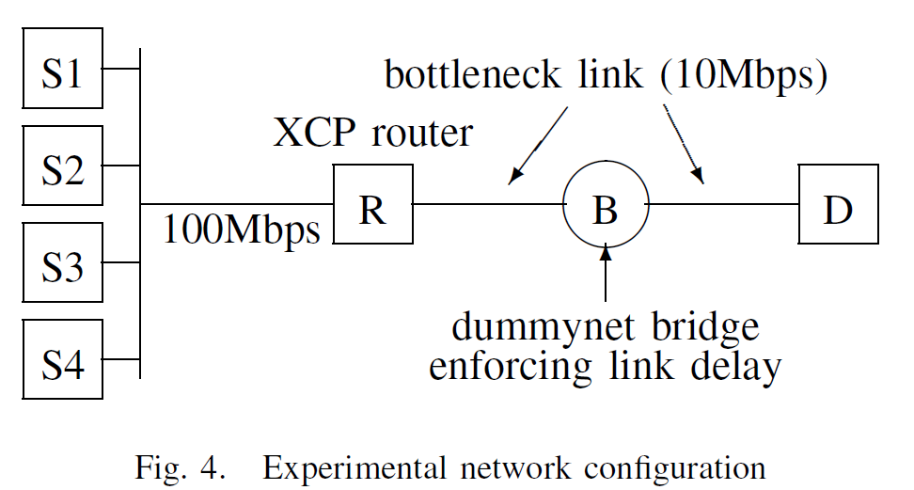
XCP Experimental Network
RTT = 500 ms; router queue size = 2*BDP

Slide 14
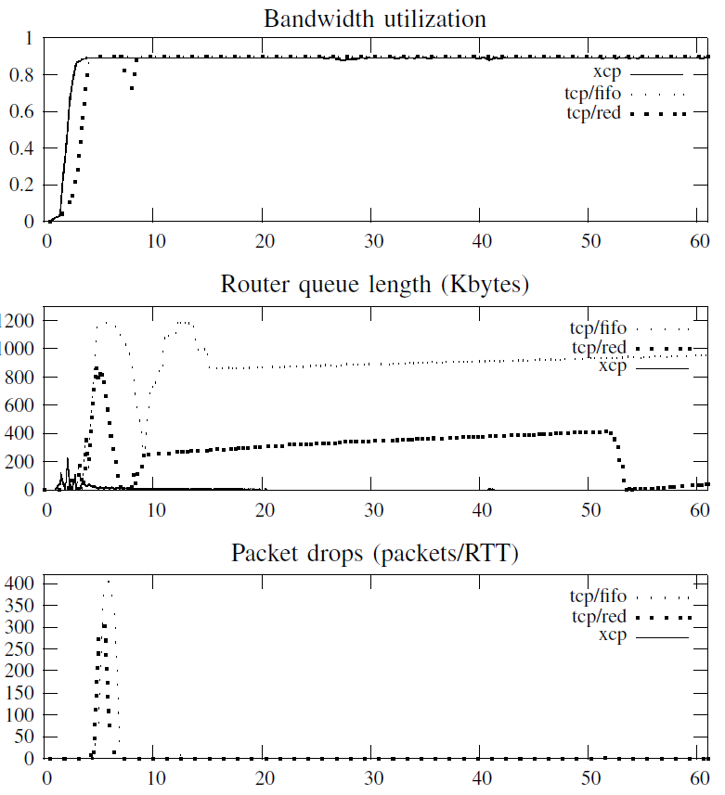
Figure 5 (top three graphs)
Validation Experiments
Run four flows of one type.
Each flow sent from S_{i} .
All flows started at the
same time.

Slide 15
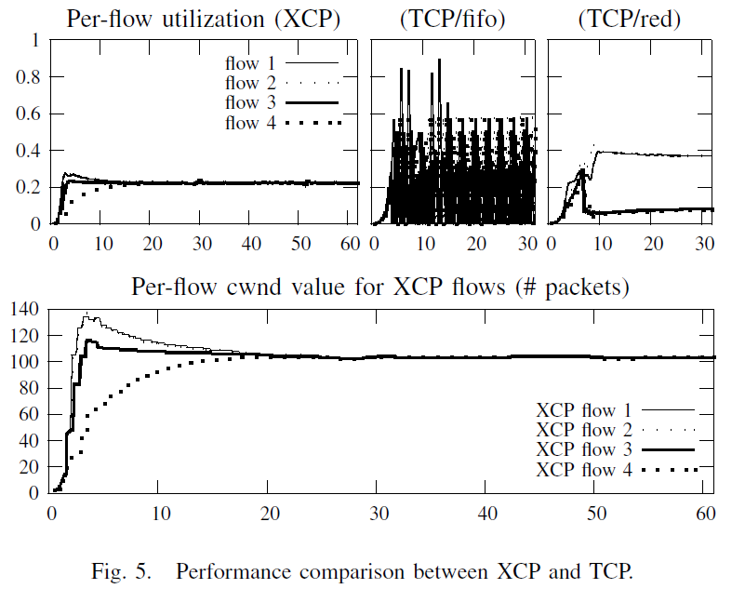
Figure 5 (bottom two graphs)
XCP flows share
capacity equally
and fairly.
TCP flows have
significant
fluctuations.

Slide 16
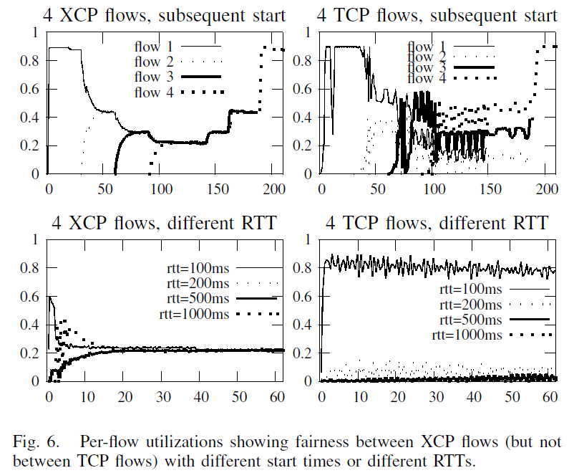
Figure 6: XCP vs TCP
Per-Flow Fairness

Slide 17
XCP Sensitivity Study
XCP sensitive to ‘environmental conditions’, i.e., OS configuration and network conditions.
When receiver buffer too small, difference between actual sent and advertised XCP cwnd treated as spare capacity.
XCP weakness is determining available capacity.
XCP has deployment problems with non-XCP queues.

Slide 18
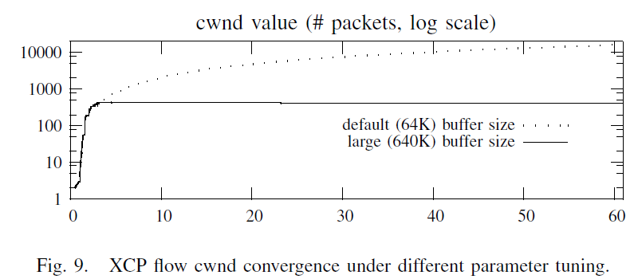
Figure 9

Slide 19
The Efficiency Controller (EC)
persistent queue size
Φ = α * d * S - β * Q
0.226 based on stability analysis
0.4 based on stability analysis
spare capacity (input traffic rate – link capacity)
average RTT (feedback delay)
Link capacity estimates affected by low layer overhead (see
Figure 7), crossing traffic and media access contending traffic (see
Figure 10) and non-congestion wireless packet losses.
Wireless losses are induced ‘pre’ and ‘post’ XCP router and along
reverse ‘ack’ path.

Slide 20
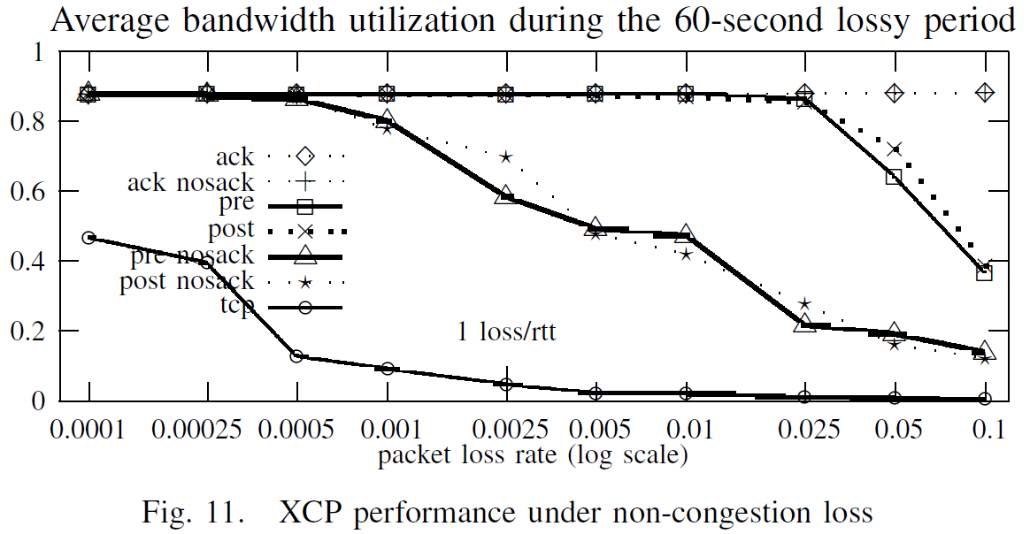
Emulating WLAN Packet Loss

Slide 21
XCP Deployment
If the bottleneck router is non-XCP (e.g. DropTail or RED), XCP has no mechanism to react to this congestion.
Experiments conducted with ‘tighter’ non-XCP router before (case 2) and after (case 1) XCP router.

Slide 22
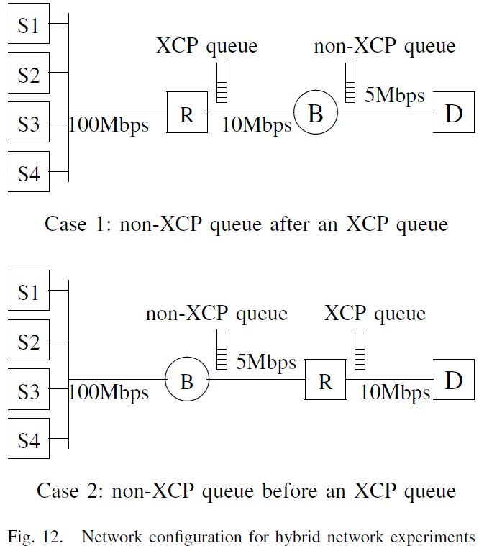
Hybrid Network Cases
Non-XCP router has
FIFO queue with 100
packet buffer and
5 Mbps capacity.
Since XCP assumes all
losses due to link
impairments, XCP does
not respond to FIFO
packet drops.

Slide 23
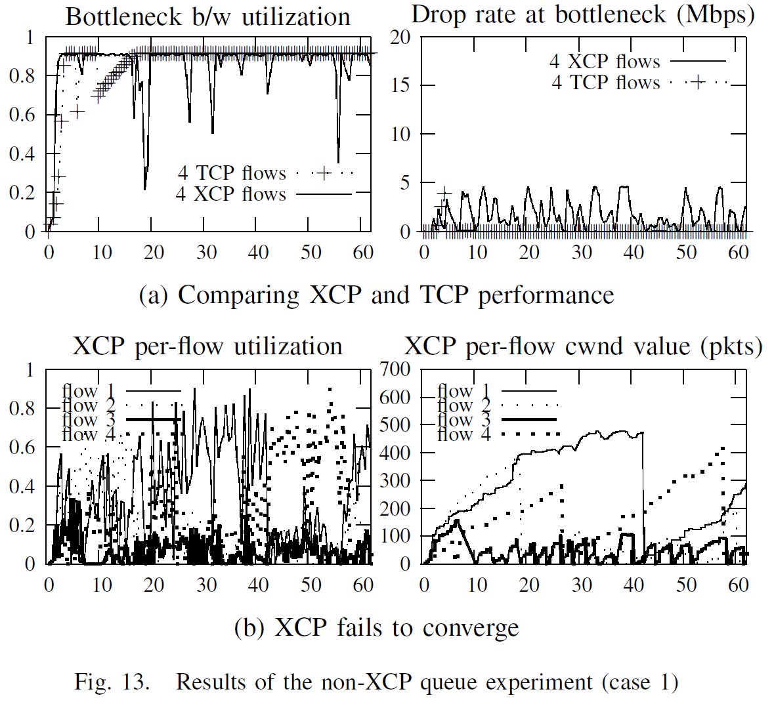
Case 1 Hybrid Network

Slide 24
Control Theory Discussion
Fluid flow model expresses XCP feedback as a set of differential equations:

Slide 25
Control Theory Discussion
Fluid flow model has ‘oversight’ in meaning of c.
c in equation 1 is attainable capacity
c in equation 2 is estimated capacity (a configuration parameter).
Other deficiency is model assumes q(t) has no bound (i.e., assumes no queue limit).

Slide 26
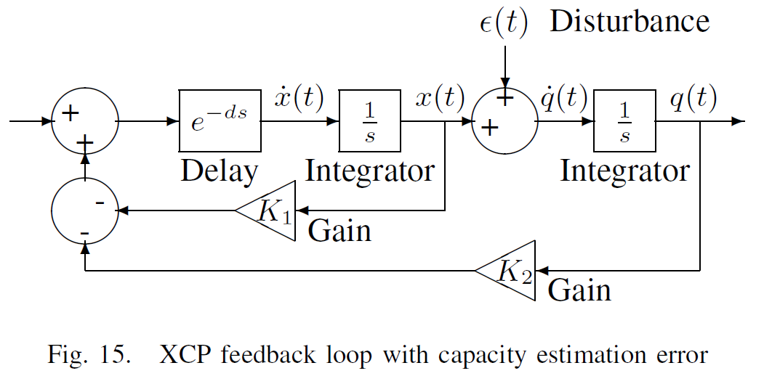
Control Theory Discussion
Non-zero disturbance signal causes this linear system
to fluctuate and be ‘unstable’.

Slide 27
Conclusions and Critique
This research implements XCP as a TCP option and validates XCP simulation results.
Implementation challenges were encountered due to lack of support in Linux kernel for precision arithmetic and floating point data types.
XCP has difficulty when available capacity is not fixed.
With wireless packet losses, XCP performs better with SACK option.

Slide 28
Conclusions and Critique
When deployed in mixed networks, FIFO bottleneck routers can cause XCP to perform poorly.
Paper does not really propose anything new or possible solutions. However, experimental performance studies are often this way.
The value of the research comes from careful experimental methodology that shows clearly performance strengths and weaknesses.

Slide 29
Thanks!
Questions??

