Slide 1
An Overview of WBANs
Presented By
Steve He, Eric Wang
Notes:
This template can be used as a starter file for presenting training materials in a group setting.
Sections
Sections can help to organize your slides or facilitate collaboration between multiple authors. On the Home tab under Slides, click Section, and then click Add Section.
Notes
Use the Notes pane for delivery notes or to provide additional details for the audience. You can see these notes in Presenter View during your presentation.
Keep in mind the font size (important for accessibility, visibility, videotaping, and online production)
Coordinated colors
Pay particular attention to the graphs, charts, and text boxes.
Consider that attendees will print in black and white or grayscale. Run a test print to make sure your colors work when printed in pure black and white and grayscale.
Graphics, tables, and graphs
Keep it simple: If possible, use consistent, non-distracting styles and colors.
Label all graphs and tables.

Slide 2
Outline
Introduction
  Definition
  Difference between WSNs and WBANs
WBAN Routing
  Routing Related Characteristics
  Routing Related Problems
  Routing Strategies
WBAN Security
Notes:
Give a brief overview of the presentation. Describe the major focus of the presentation and why it is important.
Introduce each of the major topics.
To provide a road map for the audience, you can repeat this Overview slide throughout the presentation, highlighting the particular topic you will discuss next.

Slide 3
Introduction
Definition
  Wireless Body Area Network (WBAN) is a collection of low-power, miniaturized, invasive/non-invasive lightweight wireless sensor nodes that monitor the human body functions and the surrounding environment.
Differences between WSNs and WBANs

Slide 4
Differences between WSNs and WBANs
Node Density
Use Frequency
Latency

Slide 5
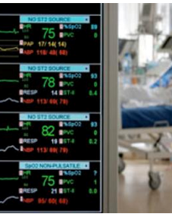
Introduction
WBAN
  Wireless Body Area Network
  Sensor Network
  Health Monitoring
  Fast and accurate
Notes:
Give a brief overview of the presentation. Describe the major focus of the presentation and why it is important.
Introduce each of the major topics.
To provide a road map for the audience, you can repeat this Overview slide throughout the presentation, highlighting the particular topic you will discuss next.

Slide 6
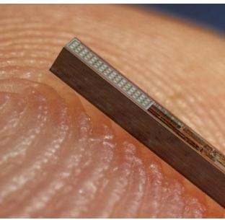
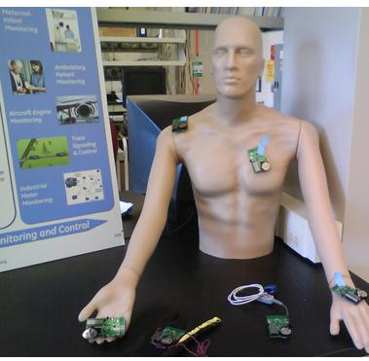
WBAN Sensors
In-Body Sensors
On-Body Sensors
Notes:
Give a brief overview of the presentation. Describe the major focus of the presentation and why it is important.
Introduce each of the major topics.
To provide a road map for the audience, you can repeat this Overview slide throughout the presentation, highlighting the particular topic you will discuss next.

Slide 7
Outline
Introduction
  Definition
  Difference between WSNs and WBANs
WBAN Routing
  Routing Related Characteristics
  Routing Related Problems
  Routing Strategies
WBAN Security
Notes:
Give a brief overview of the presentation. Describe the major focus of the presentation and why it is important.
Introduce each of the major topics.
To provide a road map for the audience, you can repeat this Overview slide throughout the presentation, highlighting the particular topic you will discuss next.

Slide 8
Routing Related Characteristics
Bandwidth
  The available bandwidth is limited, shared and can vary due to fading, noise and interference. As a result, the overhead generated by the protocol should be limited.
Energy Sensitive
  The nodes that form the network can be very heterogeneous in terms of available energy or computing power.
Health Concerns
  An extremely low transmit power per node is needed to minimize interference to cope with health concerns and to avoid tissue heating.
Relative Mobility
  The devices are located on the human body that can be in motion. WBANs should therefore be robust against frequent changes in the network topology.

Slide 9
Routing Related Problems
Network Topology
  Very little research about the most optimal network architectures in WBANs
  Most researchers assume that a single-hop topology
Energy Efficiency
  energy consumption of
    entire network
    individual nodes
  single-hop or multi-hop (body)

Slide 10
Routing Related Problems (cont.)
Reliability
  Earlier, reliability was not considered
  Some researchers experimentally investigated it by measuring the packet delivery ratio
  Multi-hop strategy turns out to be the most reliable
0.10
0.65
0.65
A
B
C
D
0.99
0.99

Slide 11
Routing Strategies in WBANs
Temperature Based Routing
  radiation absorption and heating effects on the human body
Cluster Based Routing
  spread the energy dissipation
Cross Layer Based Routing
  to improve the efficiency of and interaction between the protocols

Slide 12
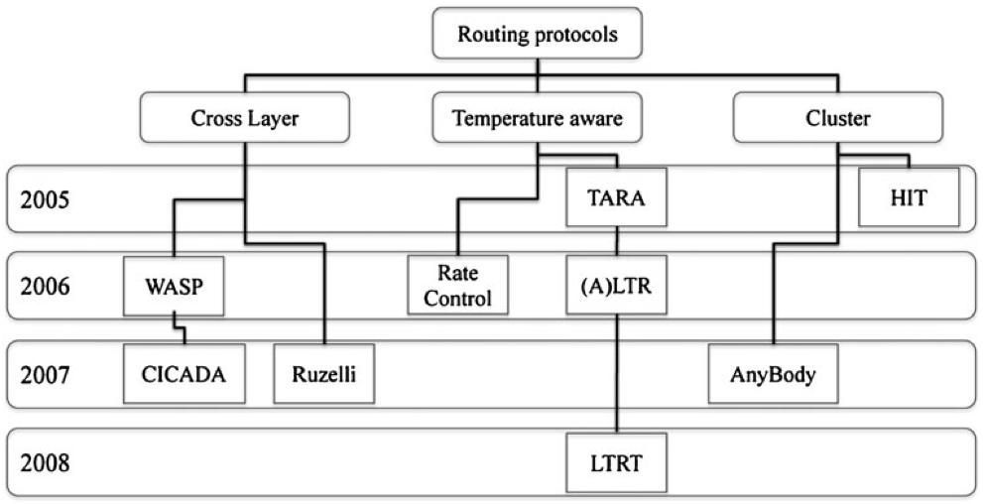
Routing Protocols in WBANs
“A Comprehensive Survey of Wireless Body Area Networks”, Sana Ullah, Henry Higgins, Bart Braem, Benoit Latre, Chris Blondia, Ingrid Moerman, Shahnaz Saleem, Ziaur Rahman, and Kyung Sup Kwak

Slide 13
Temperature Routing
To avoid heat generation
  the radio’s transmission power should be limited
  traffic control algorithms should be used
Bioeffects
  incident power density
  network traffic
  tissue characteristics

Slide 14
Temperature Routing (cont.)
Rate Control
  normalized bioeffect metric or Coefficient of Absorption and Bioeffects (CAB)
  price-based rate allocation algorithm
Thermal Aware Routing Algorithm (TARA), Least Temperature Routing (LTR) and Adaptive LTR (ALTR)
  balance the communication over the sensor nodes

Slide 15
Temperature Routing (cont.)
TARA
  routes data away from high temperature areas
  Each node derive the current temperature of the neighbors by
    Monitoring neighbors packet counts
    Calculating the communication radiation and power consumption
  the temperature of a neighboring node > threshold
    the packets will no longer be forwarded to the node but will be withdrawn and rerouted through alternate paths

Slide 16
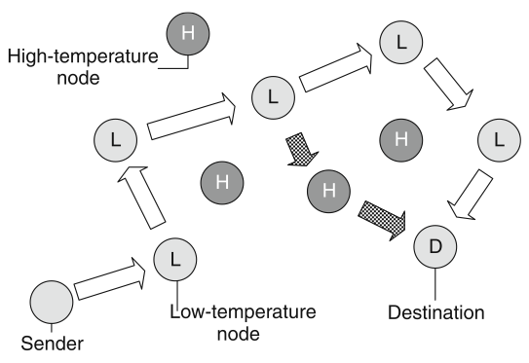
Temperature Routing (cont.)
Improvements of TARA are LTR and ALTR
  choose the neighboring node with the lowest temperature as the next hop for routing
  predefined maximum hop count is used
  Loops are avoided by maintaining a list in the packet with the recently visited nodes.
Improvements of ALTR is Least Total Route Temperature (LTRT)
  selects a least temperature route instead of only considering the next hop
“A Comprehensive Survey of Wireless Body Area Networks”, Sana Ullah, Henry Higgins, Bart Braem, Benoit Latre, Chris Blondia, Ingrid Moerman, Shahnaz Saleem, Ziaur Rahman, and Kyung Sup Kwak

Slide 17
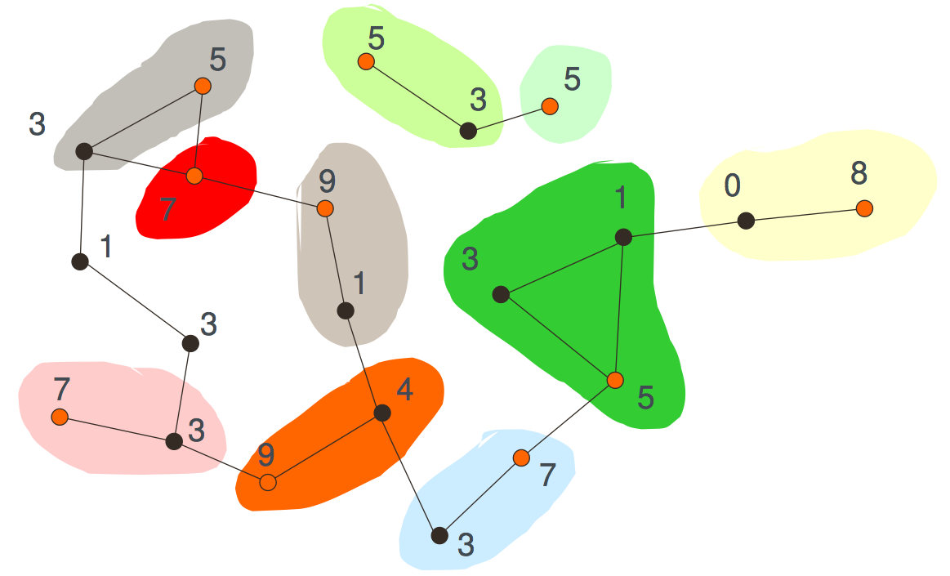
Cluster Based Routing
AnyBody (based on LEACH)
  randomly selects a cluster head at regular time intervals
  cluster head aggregates all data and sends it to the base station
  changes the cluster head selection and constructs a virtual backbone network of the cluster heads (different from LEACH)
“AnyBody: a Self-organization Protocol for Body Area Networks”, Thomas Watteyne, Isabelle Augé-Blum, Mischa Dohler, Dominique Barthel

Slide 18
Cluster Based Routing (cont.)
Improvement of LEACH is Hybrid Indirect Transmissions (HIT)
  combines clustering with forming chains

Slide 19
Cross Layer Based Routing
Cross-layer design is a way to improve the efficiency of and interaction between the protocols in WSNs.
Little research has been done for WBANs
  Ruzelli et al. proposed a cross-layer energy efficient multi-hop protocol built on IEEE 802.15.4

Slide 20
Cross Layer Based Routing (cont.)
Ruzelli
  multi-hop protocol built on IEEE 802.15.4
  The network is divided into timezones where each timezone takes turns in the transmission.
  The nodes in the farthest timezone start the transmission.
  In the next slot, the farthest one sends its data and so on until the sink is reached.

Slide 21
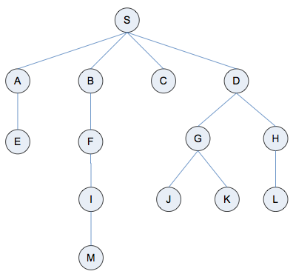
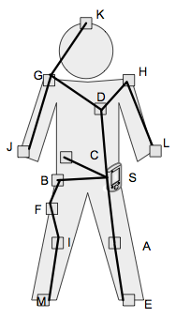
Cross Layer Based Routing (cont.)
Wireless Autonomous Spanning Tree protocol (WASP)
  sets up a spanning tree and divides the time axis in slots
  Every node sends out a proprietary WASP-scheme to its children to inform them of the following level when they are allowed to send.
  Two-way communication is not supported.
"A Low-delay Protocol for Multi-hop Wireless Body Area Networks", Benoıt Latre, Bart Braem, Ingrid Moerman, Chris Blondia, Elisabeth Reusens, Wout Joseph, and Piet Demeester

Slide 22
Cross Layer Based Routing (cont.)
Controlling Access with Distributed slot Assignment protocol (CICADA)
  completely discarding the layered structure and implementing the required functionality in different modules
Advantages
  Duplication of functionality can be avoided
  Heterogeneity is supported as more modules can be added depending on the capabilities of the node
  Cross layer optimizations are possible
  Modules can be easily adapted or replaced

Slide 23
Routing Summary
Temperature Based Routing
  a specific case of weight based routing
  reliability and energy efficiency can be hard to guarantee
Cluster Based Routing
  based on LEACH
Cross-layer Based Routing
  improve the efficiency of and interaction between the protocols

Slide 24
Outline
Introduction
  Definition
  Difference between WSNs and WBANs
WBAN Routing
  Routing Related Characteristics
  Routing Related Problems
  Routing Strategies
WBAN Security
Notes:
Give a brief overview of the presentation. Describe the major focus of the presentation and why it is important.
Introduce each of the major topics.
To provide a road map for the audience, you can repeat this Overview slide throughout the presentation, highlighting the particular topic you will discuss next.

Slide 25
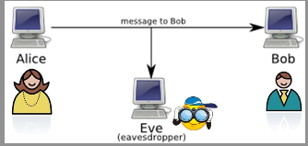
Security in WBAN is CRUCIAL!
“Shared” Nature of wireless Network, insecure channel
Eve could break transmission
More maliciously, Eve modifies the medical data
Can lead to severe medical malpractice
Notes:
Give a brief overview of the presentation. Describe the major focus of the presentation and why it is important.
Introduce each of the major topics.
To provide a road map for the audience, you can repeat this Overview slide throughout the presentation, highlighting the particular topic you will discuss next.

Slide 26
A Comprehensive Security System
Encryption
Authentication
Storage Security
Robustness
Data Integrity
Energy Consumption
Notes:
Give a brief overview of the presentation. Describe the major focus of the presentation and why it is important.
Introduce each of the major topics.
To provide a road map for the audience, you can repeat this Overview slide throughout the presentation, highlighting the particular topic you will discuss next.

Slide 27
Notes:
Give a brief overview of the presentation. Describe the major focus of the presentation and why it is important.
Introduce each of the major topics.
To provide a road map for the audience, you can repeat this Overview slide throughout the presentation, highlighting the particular topic you will discuss next.

Slide 28
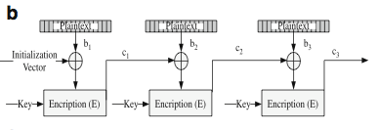
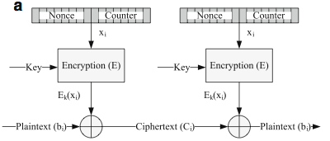
AES-CTR
AES-CBC-MAC
Plaintext is broken into 16-bytes blocks
b₁b₂b₃…b_{n} and computes c_{i} = b_{i} ⊕ E_{k} (x_{i})
Cipher-block Chaining
Message Authentication Code mode.
The plaintext is XORed with he previous
cipher text.
This mode provides authentication and
message integrity by allowing WBAN nodes
to compute 32 bits, 64 bits, 128 bits
MAC.
Notes:
What will the audience be able to do after this training is complete? Briefly describe each objective and how the audience will benefit from this presentation.

Slide 29
AES-CCM
Counter with CBC-MAC mode
Combines CTR and CBC
Apply integrity protection using CBC-MAC
Encrypt Frames using CTR mode
Notes:
Give a brief overview of the presentation. Describe the major focus of the presentation and why it is important.
Introduce each of the major topics.
To provide a road map for the audience, you can repeat this Overview slide throughout the presentation, highlighting the particular topic you will discuss next.

Slide 30
Energy Consumption Overview

Slide 31
Security Summary
Variance of Advanced Encryption Scheme(AES)
AES-CCM most popular
Consumes only about 3% energy
Data Integrity and Authentication should be the direction of future research
Notes:
Summarize presentation content by restating the important points from the lessons.
What do you want the audience to remember when they leave your presentation?

Slide 32
Questions?

Slide 33
Appendix
Notes:
Is your presentation as crisp as possible? Consider moving extra content to the appendix.
Use appendix slides to store content that you might want to refer to during the Question slide or that may be useful for attendees to investigate deeper in the future.

