Slide 1
Ultra-Low Duty Cycle MAC with Scheduled Channel Polling
Wei Ye, Fabio Silva
John Heidemann
Present By: Eric Wang
Notes:
This template can be used as a starter file for presenting training materials in a group setting.
Sections
Sections can help to organize your slides or facilitate collaboration between multiple authors. On the Home tab under Slides, click Section, and then click Add Section.
Notes
Use the Notes pane for delivery notes or to provide additional details for the audience. You can see these notes in Presenter View during your presentation.
Keep in mind the font size (important for accessibility, visibility, videotaping, and online production)
Coordinated colors
Pay particular attention to the graphs, charts, and text boxes.
Consider that attendees will print in black and white or grayscale. Run a test print to make sure your colors work when printed in pure black and white and grayscale.
Graphics, tables, and graphs
Keep it simple: If possible, use consistent, non-distracting styles and colors.
Label all graphs and tables.

Slide 2
Outline
Introduction
Design of SCP-MAC
Lower Bound of Energy Performance with Periodic Traffic
Protocol Implementation
Experimental Evaluation
Related Work
Notes:
Give a brief overview of the presentation. Describe the major focus of the presentation and why it is important.
Introduce each of the major topics.
To provide a road map for the audience, you can repeat this Overview slide throughout the presentation, highlighting the particular topic you will discuss next.

Slide 3
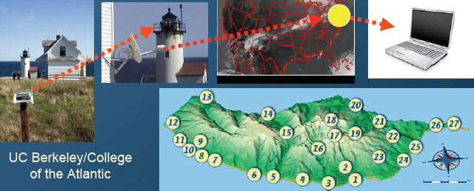
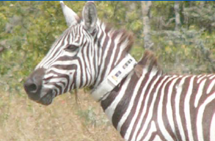
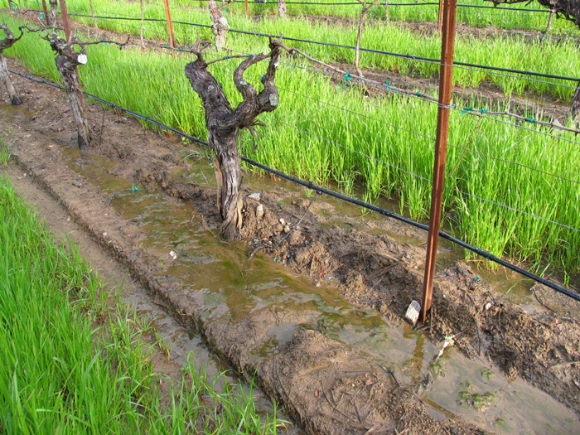
WSN applications
Sensor deployments for months or years
Energy is crucial
Idle listening waste
Notes:
Give a brief overview of the presentation. Describe the major focus of the presentation and why it is important.
Introduce each of the major topics.
To provide a road map for the audience, you can repeat this Overview slide throughout the presentation, highlighting the particular topic you will discuss next.

Slide 4
Channel Polling & Duty Cycle
Channel Polling
  Nodes wake up very briefly to check channel activity without actually receiving data
  Sender sends a long preamble to guarantee intersecting with a polling
Duty Cycle
  Ratio between listen time and a full listen/sleep interval
Notes:
Give a brief overview of the presentation. Describe the major focus of the presentation and why it is important.
Introduce each of the major topics.
To provide a road map for the audience, you can repeat this Overview slide throughout the presentation, highlighting the particular topic you will discuss next.

Slide 5
LPL
Low Power Listening
  WiseMAC, B-MAC
Very Brief channel polling activity
Long Preambles
Save energy particularly during low network utilization
Synchronization cost
  Scheduling
  Long Preambles
  Limit Duty Cycle 1-2%
Notes:
Give a brief overview of the presentation. Describe the major focus of the presentation and why it is important.
Introduce each of the major topics.
To provide a road map for the audience, you can repeat this Overview slide throughout the presentation, highlighting the particular topic you will discuss next.

Slide 6
SCP – Scheduled Channel Polling vs. LPL
Low-power Listening (LPL) | Scheduled Channel Polling (SCP)
Efficiency gained at much big cost for senders | Optimal configurations for synchronizing channel polling, minimized energy cost
Very sensitive to tuning for neighborhood size and traffic rate | Adapt well to variable traffic, broadcast, unicast under bursty traffic rates
Hard to adapt to newer radios like 802.15.4 due to limited preamble size | Can operate effectively on new radios
Notes:
Give a brief overview of the presentation. Describe the major focus of the presentation and why it is important.
Introduce each of the major topics.
To provide a road map for the audience, you can repeat this Overview slide throughout the presentation, highlighting the particular topic you will discuss next.

Slide 7
Outline
Introduction
Design of SCP-MAC
Lower Bound of Energy Performance with Periodic Traffic
Protocol Implementation
Experimental Evaluation
Related Work
Notes:
Give a brief overview of the presentation. Describe the major focus of the presentation and why it is important.
Introduce each of the major topics.
To provide a road map for the audience, you can repeat this Overview slide throughout the presentation, highlighting the particular topic you will discuss next.

Slide 8
Synchronized Channel Polling
Synchronization
  Short wake-up tones
  Reduces overhearing cost
  Effective for broadcast and unicast
Reduce Sync Cost
  Broadcasts Sync schedules to neighbors by SYNC packet
  Piggyback information
Notes:
If there is relevant video content, such as a case study video, demo of a product, or other training materials, include it in the presentation as well.

Slide 9
Adaptive Channel Polling and Multi-hop Streaming
Basic idea: Add additional high-frequency polling slots to nodes on the path.
Short burst: Apply strategy to next node before sending
Long burst: Apply strategy to all nodes on the path before sending
Notes:
If there is relevant video content, such as a case study video, demo of a product, or other training materials, include it in the presentation as well.

Slide 10
Other Optimizations
Two-Phase Contention
Overhearing Avoidance Based on Headers
Carrier sense in CW1
if IDLE: send a tone, enter CW2
else: waits for receiving
if CW2 also IDLE: send data
RTS/CTS enabled:
  Same as S-MAC
RTS/CTS disabled:
  Receiver checks destination after receiving MAC header
  If not to itself, stop receiving and go back to sleep
Notes:
Give a brief overview of the presentation. Describe the major focus of the presentation and why it is important.
Introduce each of the major topics.
To provide a road map for the audience, you can repeat this Overview slide throughout the presentation, highlighting the particular topic you will discuss next.

Slide 11
Outline
Introduction
Design of SCP-MAC
Lower Bound of Energy Performance with Periodic Traffic
Protocol Implementation
Experimental Evaluation
Related Work
Notes:
Give a brief overview of the presentation. Describe the major focus of the presentation and why it is important.
Introduce each of the major topics.
To provide a road map for the audience, you can repeat this Overview slide throughout the presentation, highlighting the particular topic you will discuss next.

Slide 12
Models and Metrics
  Analysis focuses on the energy consumption by the radio, and does not model other components, such as the CPU or sensors.
  Four stable radio states: transmitting, receiving, listening, and sleeping. Ptx, Prx, Plisten and Psleep
  Expected energy consumption, per node:
E = Ecs+Etx+Erx+Epoll+Esleep
= Plistentcs+Ptxttx+Prxtrx+Ppolltpoll+Psleeptsleep
Notes:
Give a brief overview of the presentation. Describe the major focus of the presentation and why it is important.
Introduce each of the major topics.
To provide a road map for the audience, you can repeat this Overview slide throughout the presentation, highlighting the particular topic you will discuss next.

Slide 13
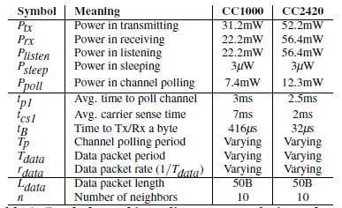
Models and Metrics
Symbols used in radio energy analysis, and typical values for the Mica2 radio (CC1000) and an 802.15.4 radio (CC2420)
Notes:
Give a brief overview of the presentation. Describe the major focus of the presentation and why it is important.
Introduce each of the major topics.
To provide a road map for the audience, you can repeat this Overview slide throughout the presentation, highlighting the particular topic you will discuss next.

Slide 14
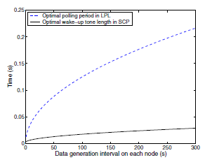
Asynchronous Channel Polling: LPL
Optimal channel polling period in LPL (dotted), and wakeup-tone length in SCP (solid), given neighborhood size of 10
Notes:
Give a brief overview of the presentation. Describe the major focus of the presentation and why it is important.
Introduce each of the major topics.
To provide a road map for the audience, you can repeat this Overview slide throughout the presentation, highlighting the particular topic you will discuss next.

Slide 15

Scheduled Channel Polling: SCP
Additional parameters in SCP-MAC
Notes:
Give a brief overview of the presentation. Describe the major focus of the presentation and why it is important.
Introduce each of the major topics.
To provide a road map for the audience, you can repeat this Overview slide throughout the presentation, highlighting the particular topic you will discuss next.

Slide 16
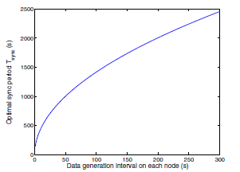
Scheduled Channel Polling: SCP
  Optimal SYNC period for SCP-MAC
Notes:
Give a brief overview of the presentation. Describe the major focus of the presentation and why it is important.
Introduce each of the major topics.
To provide a road map for the audience, you can repeat this Overview slide throughout the presentation, highlighting the particular topic you will discuss next.

Slide 17
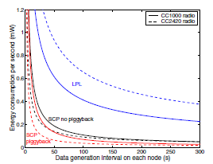
Scheduled Channel Polling: SCP
Analysis of optimal energy consumption for LPL and SCP with and without piggyback for CC1000 (solid lines) and CC2420 (dashed)
Notes:
Give a brief overview of the presentation. Describe the major focus of the presentation and why it is important.
Introduce each of the major topics.
To provide a road map for the audience, you can repeat this Overview slide throughout the presentation, highlighting the particular topic you will discuss next.

Slide 18
Outline
Introduction
Design of SCP-MAC
Lower Bound of Energy Performance with Periodic Traffic
Protocol Implementation
Experimental Evaluation
Related Work
Notes:
Give a brief overview of the presentation. Describe the major focus of the presentation and why it is important.
Introduce each of the major topics.
To provide a road map for the audience, you can repeat this Overview slide throughout the presentation, highlighting the particular topic you will discuss next.

Slide 19
Protocol Implementation
Implement SCP-MAC in TinyOS over the Mica2 motes with the CC1000 radio
Describe the preliminary port to MicaZ motes with the CC2420 radio supporting IEEE802.15.4
Notes:
Give a brief overview of the presentation. Describe the major focus of the presentation and why it is important.
Introduce each of the major topics.
To provide a road map for the audience, you can repeat this Overview slide throughout the presentation, highlighting the particular topic you will discuss next.

Slide 20
Software Architecture
Break MAC functionality into four layers:
  PHY: physical layer
  CSMA layer
  LPL layer
  SCP layer
Several parameters and options at compile time:
  RTS/CTS handling
  Overhearing avoidance
  Adaptive channel polling
Notes:
Give a brief overview of the presentation. Describe the major focus of the presentation and why it is important.
Introduce each of the major topics.
To provide a road map for the audience, you can repeat this Overview slide throughout the presentation, highlighting the particular topic you will discuss next.

Slide 21
Physical Layer
PHY layer (bottom of the stack)
  Handles radio states
  Interacts directly with radio, sending bytes/packets
  Buffers all bytes, pass entire packet to MAC
  Carrier sense, wakeup tone, CRC, time-stamping
  Record time spent in each radio state
  MAC-independent
Notes:
Give a brief overview of the presentation. Describe the major focus of the presentation and why it is important.
Introduce each of the major topics.
To provide a road map for the audience, you can repeat this Overview slide throughout the presentation, highlighting the particular topic you will discuss next.

Slide 22
CSMA layer
Basic CSMA protocol
  Providing common service to LPL and SCP
  Includes preamble length parameter
  Perform carrier sense and random backoff
  For unicast, RTS/CTS disable/enable (compile time)
  Optional retransmission and overhearing avoidance
Notes:
Give a brief overview of the presentation. Describe the major focus of the presentation and why it is important.
Introduce each of the major topics.
To provide a road map for the audience, you can repeat this Overview slide throughout the presentation, highlighting the particular topic you will discuss next.

Slide 23
LPL layer
Major purpose: periodically poll the channel and send radio to sleep when no activity
  Adjust preamble length to ensure intersect with polling frequency
  Coordinates concurrent polling and transmission
  Exports interface to query and adjust channel polling times, to support SCP.
Notes:
Give a brief overview of the presentation. Describe the major focus of the presentation and why it is important.
Introduce each of the major topics.
To provide a road map for the audience, you can repeat this Overview slide throughout the presentation, highlighting the particular topic you will discuss next.

Slide 24
SCP layer
Implement above LPL
Uses basic LPL to bootstrap schedules with SYNC packets
Coordinates packet transmission timing.
Implements the randomized contention widow before wakeup tone transmission
Notes:
Give a brief overview of the presentation. Describe the major focus of the presentation and why it is important.
Introduce each of the major topics.
To provide a road map for the audience, you can repeat this Overview slide throughout the presentation, highlighting the particular topic you will discuss next.

Slide 25
Interaction with TinyOS
Implement a new timer in TinyOS to add support for dynamically adjusting timer values and asynchronous, low-jitter triggers
Timer implementation is based on the 8-bit hardware counter on Mica2
Runs independently from the CPU, allowing the CPU to sleep when no other activity is present
Each timer event is about 0.4% of the cost of a channel poll
Notes:
Give a brief overview of the presentation. Describe the major focus of the presentation and why it is important.
Introduce each of the major topics.
To provide a road map for the audience, you can repeat this Overview slide throughout the presentation, highlighting the particular topic you will discuss next.

Slide 26
Efficient piggybacking of synchronization information
To minimize the cost of synchronizations, we wish to avoid explicit SYNC packet, could piggyback sync information in broadcast packets
  Sender: Reuse the address field to piggyback schedule information
  Receiver: Extract sync information and perform as scheduled.
  It’s for free!! And no affect to upper layer operation
Notes:
Give a brief overview of the presentation. Describe the major focus of the presentation and why it is important.
Introduce each of the major topics.
To provide a road map for the audience, you can repeat this Overview slide throughout the presentation, highlighting the particular topic you will discuss next.

Slide 27
Port to IEEE 802.15.4 Radio
SCP-MAC to run on the 802.15.4 radios found on the MicaZ hardware.
Challenges:
  CC2420 is a packet-level radio, and the microcontroller cannot get byte-level access.
  Potentially affects the accuracy of time synchronization.
  CC2420 limits the preamble length to 16 bytes with a default length of 4 bytes.
Notes:
Give a brief overview of the presentation. Describe the major focus of the presentation and why it is important.
Introduce each of the major topics.
To provide a road map for the audience, you can repeat this Overview slide throughout the presentation, highlighting the particular topic you will discuss next.

Slide 28
Port to IEEE 802.15.4 Radio
To implement long preambles:
Sequentially send multiple wakeup packets back to back.
Ensure that a receiver does not miss the “preamble” even if its channel polling time falls in a gap between the wakeup packets.
To reduce these gaps: pre-load the wakeup packet into the radio buffer before carrier sense, then resend the same packet from the buffer multiple times to make up a long preamble
Notes:
Give a brief overview of the presentation. Describe the major focus of the presentation and why it is important.
Introduce each of the major topics.
To provide a road map for the audience, you can repeat this Overview slide throughout the presentation, highlighting the particular topic you will discuss next.

Slide 29
Outline
Introduction
Design of SCP-MAC
Lower Bound of Energy Performance with Periodic Traffic
Protocol Implementation
Experimental Evaluation
Related Work
Notes:
Give a brief overview of the presentation. Describe the major focus of the presentation and why it is important.
Introduce each of the major topics.
To provide a road map for the audience, you can repeat this Overview slide throughout the presentation, highlighting the particular topic you will discuss next.

Slide 30
Optimal setup with periodic traffic
Comparing the energy performance of SCP and LPL under optimal configuration with completely periodic.
Adaptive channel polling and overhearing avoidance are turned off.
MAC parameters vary based on network size and data rate.
Placing 10 nodes in a single hop network.
Each node periodically generates a 40B message (not including preamble).
Each node’s message generation interval from 50–300s.
Run each experiment for 5 message periods, generating 50 total messages over each experiment.
Notes:
Give a brief overview of the presentation. Describe the major focus of the presentation and why it is important.
Introduce each of the major topics.
To provide a road map for the audience, you can repeat this Overview slide throughout the presentation, highlighting the particular topic you will discuss next.

Slide 31
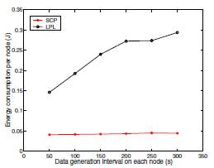
Optimal setup with periodic traffic
Mean energy consumption (J) for each node as traffic rate varies (assuming optimal configuration and periodic traffic)
Notes:
Give a brief overview of the presentation. Describe the major focus of the presentation and why it is important.
Introduce each of the major topics.
To provide a road map for the audience, you can repeat this Overview slide throughout the presentation, highlighting the particular topic you will discuss next.

Slide 32
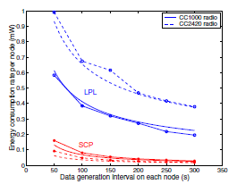
Optimal setup with periodic traffic
Energy consumption of LPL
increases on faster radio,
while SCP decreases energy
Consumption.
Mean energy consumption rate (J/s or W) for each node as traffic rate varies. The radios are the CC1000 (solid lines) and CC2420 (dashed)
Notes:
Give a brief overview of the presentation. Describe the major focus of the presentation and why it is important.
Introduce each of the major topics.
To provide a road map for the audience, you can repeat this Overview slide throughout the presentation, highlighting the particular topic you will discuss next.

Slide 33
Performance with unanticipated traffic
In many applications the traffic load is less predictable (fire detection in forests).
Tuning LPL and SCP for a 0.3% duty cycle, polling every second.
All other parameters match the prior experiment.
Each node generates 20 100B long messages
Notes:
Give a brief overview of the presentation. Describe the major focus of the presentation and why it is important.
Introduce each of the major topics.
To provide a road map for the audience, you can repeat this Overview slide throughout the presentation, highlighting the particular topic you will discuss next.

Slide 34
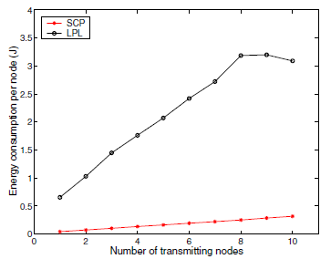
Performance with unanticipated traffic
LPL consumes about 8 times more energy
than SCP to transmit equal amount of data.
This is due to long preambles of LPL.
Energy consumptions on heavy traffic load with very low duty cycle configurations
Notes:
Give a brief overview of the presentation. Describe the major focus of the presentation and why it is important.
Introduce each of the major topics.
To provide a road map for the audience, you can repeat this Overview slide throughout the presentation, highlighting the particular topic you will discuss next.

Slide 35
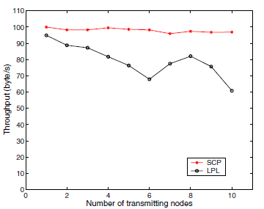
Performance with unanticipated traffic
More effective two-phase contention
Throughput on heavy traffic load with
very low duty cycle configuration
Notes:
Give a brief overview of the presentation. Describe the major focus of the presentation and why it is important.
Introduce each of the major topics.
To provide a road map for the audience, you can repeat this Overview slide throughout the presentation, highlighting the particular topic you will discuss next.

Slide 36
Performance in a Multi-hop Network
9-hop linear network with 10 nodes.
Adaptive channel polling is designed to reduce latency.
All packets are sent as unicast without RTS/CTS.
Acknowledgments with up to three retries.
Notes:
Give a brief overview of the presentation. Describe the major focus of the presentation and why it is important.
Introduce each of the major topics.
To provide a road map for the audience, you can repeat this Overview slide throughout the presentation, highlighting the particular topic you will discuss next.

Slide 37
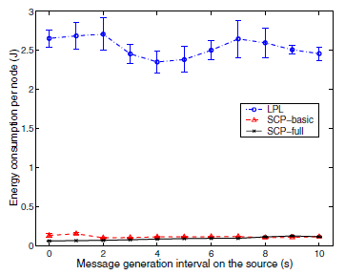
Performance in a Multi-hop Network
SCP-basic: SCP without adaptive
channel polling.
SCP-full: SCP with adaptive channel
polling.
LPL consumes 20-40 times more energy
Than SCP full.
Reason: Long preambles
Mean energy consumption per node for multi-hop experiments (20 packets over 9 hops)
Notes:
Give a brief overview of the presentation. Describe the major focus of the presentation and why it is important.
Introduce each of the major topics.
To provide a road map for the audience, you can repeat this Overview slide throughout the presentation, highlighting the particular topic you will discuss next.

Slide 38
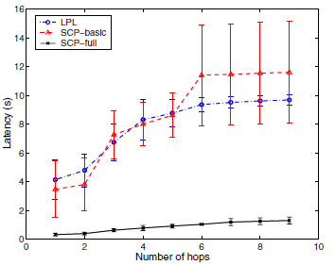
Performance in a Multi-hop Network
SCP-basic and LPL have comparable
latency.
Power of adaptive polling!
Mean packet latency over 9 hops at the heaviest load
Notes:
Give a brief overview of the presentation. Describe the major focus of the presentation and why it is important.
Introduce each of the major topics.
To provide a road map for the audience, you can repeat this Overview slide throughout the presentation, highlighting the particular topic you will discuss next.

Slide 39
Outline
Introduction
Design of SCP-MAC
Lower Bound of Energy Performance with Periodic Traffic
Protocol Implementation
Experimental Evaluation
Related Work
Notes:
Give a brief overview of the presentation. Describe the major focus of the presentation and why it is important.
Introduce each of the major topics.
To provide a road map for the audience, you can repeat this Overview slide throughout the presentation, highlighting the particular topic you will discuss next.

Slide 40
Related Work
Power-save mode in IEEE 802.11 synchronizes wakeup times of nodes in a single-hop network.
S-MAC developed a fully distributed algorithm to synchronize the wakeup schedules of nodes in a multi-hop network.
T-MAC improves S-MAC by reducing the wakeup duration controlled by an adaptive timer.
WiseMAC can reduce the preamble length after an initial unicast packet with a long preamble.
Notes:
Give a brief overview of the presentation. Describe the major focus of the presentation and why it is important.
Introduce each of the major topics.
To provide a road map for the audience, you can repeat this Overview slide throughout the presentation, highlighting the particular topic you will discuss next.

Slide 41
Related Work
TDMA, second class of MAC protocols.
LEACH and BMA.
LMAC and TRAMA.
ZMAC, proposed a hybrid protocol to combine TDMA with CSMA.
Notes:
Give a brief overview of the presentation. Describe the major focus of the presentation and why it is important.
Introduce each of the major topics.
To provide a road map for the audience, you can repeat this Overview slide throughout the presentation, highlighting the particular topic you will discuss next.

Slide 42
Questions?
Notes:
Give a brief overview of the presentation. Describe the major focus of the presentation and why it is important.
Introduce each of the major topics.
To provide a road map for the audience, you can repeat this Overview slide throughout the presentation, highlighting the particular topic you will discuss next.

