Slide 1
Routing Primer
CS 577 Advanced Computer Networks

Slide 2
Routing Outline
Overview of Point-to-Point Routing (WAN)
Routing Classification
Distance Vector Routing
Link State Routing
RIP
OSPF
BGP

Slide 3
Metropolitan Area Network (MAN)
Gateway
Organization Servers
To the Internet or wide area network
s
s
Backbone
R
R
R
S
Departmental Server
S
S
R
R
R
s
s
s
s
s
s
s
s
s
Leon-Garcia & Widjaja:
Communication Networks

Slide 4
Wide Area Network (WAN)
Interdomain level
Border routers
Internet service provider
Autonomous system
or domain
Border routers
LAN level
Intradomain level
Leon-Garcia & Widjaja:
Communication Networks

Slide 5
Modern Internet Backbone
National service provider A
National service provider B
NAP
NAP
National service provider C
Network Access
Point
National Internet Service Providers
Leon-Garcia & Widjaja:
Communication Networks

Slide 6

Network Layer
transport segment from sending to receiving host.
on sending side, encapsulates segments into datagram packets.
on receiving side, delivers segments to transport layer.
network layer protocols in every host, router.
router examines header fields in all IP datagrams passing through it.
application
transport
network
data link
physical
network
data link
physical
network
data link
physical
network
data link
physical
network
data link
physical
network
data link
physical
network
data link
physical
network
data link
physical
network
data link
physical
network
data link
physical
application
transport
network
data link
physical
network
data link
physical
network
data link
physical
K & R

Slide 7
Two Key Network Layer Functions
forwarding: move packets from router’s input to appropriate router output.
routing: determine route taken by packets from source to destination.
analogy:
routing: process of planning trip from source to destination
forwarding: process of getting through single interchange

Slide 8
Interplay between Routing and Forwarding
routing algorithm
local forwarding table
header value
output link
0100
0101
0111
1001
3
2
2
1
value in arriving
packet’s header
0111
1
3
2

Slide 9
The Internet Network Layer
Host, router network layer functions:
Transport Layer: TCP, UDP
Routing protocols
path selection
RIP, OSPF, BGP
IP protocol
addressing conventions
datagram format
packet handling conventions
Network
Layer
forwarding
table
ICMP protocol
error reporting
router “signaling”
Data Link Layer
Physical Layer

Slide 10
Routing
Routing algorithm:: that part of the Network Layer responsible for deciding on which output line to transmit an incoming packet.
Remember: For virtual circuit subnets the routing decision is made ONLY at set up.
Algorithm properties:: correctness, simplicity, robustness, stability, fairness, optimality, and scalability.

Slide 11
Routing Classification
Adaptive Routing
based on current measurements
of traffic and/or topology.
1. centralized
2. isolated
3. distributed
Non-Adaptive Routing
routing computed in advance and off-line
1. flooding
2. static routing using shortest path algorithms

Slide 12
Internetwork Routing [Halsall]
Adaptive Routing
Centralized
Distributed
Isolated
[RCC]
[IGP]
Intradomain routing
Interdomain routing
[EGP]
Interior
Gateway Protocols
[BGP,IDRP]
Exterior
Gateway Protocols
Distance Vector routing
Link State routing
[RIP]
[OSPF,IS-IS,PNNI]

Slide 13
Distance Vector Routing
{Tanenbaum & Perlman version}
Advanced Computer Networks
Distance Vector Routing

Slide 14
Distance Vector Routing
Historically known as the old ARPANET routing algorithm {or known as Bellman-Ford (BF) algorithm}.
BF Basic idea: each router maintains a Distance Vector table containing the distance between itself and ALL possible destination nodes.
Distances,based on a chosen metric, are computed using information from the neighbors’ distance vectors.
Distance Metric: usually hops or delay

Slide 15
Distance Vector Routing
Information kept by DV router
each router has an ID
associated with each link connected to a router, there is a link cost (static or dynamic).
Distance Vector Table Initialization
Distance to itself = 0
Distance to ALL other routers = infinity number

Slide 16
Distance Vector Algorithm [Perlman]
1. A router transmits its distance vector to each of its neighbors in a routing packet.
2. Each router receives and saves the most recently received distance vector from each of its neighbors.
3. A router recalculates its distance vector when:
  It receives a distance vector from a neighbor containing different information than before.
  It discovers that a link to a neighbor has gone down (i.e., a topology change).
The DV calculation is based on minimizing the cost to each destination.

Slide 17
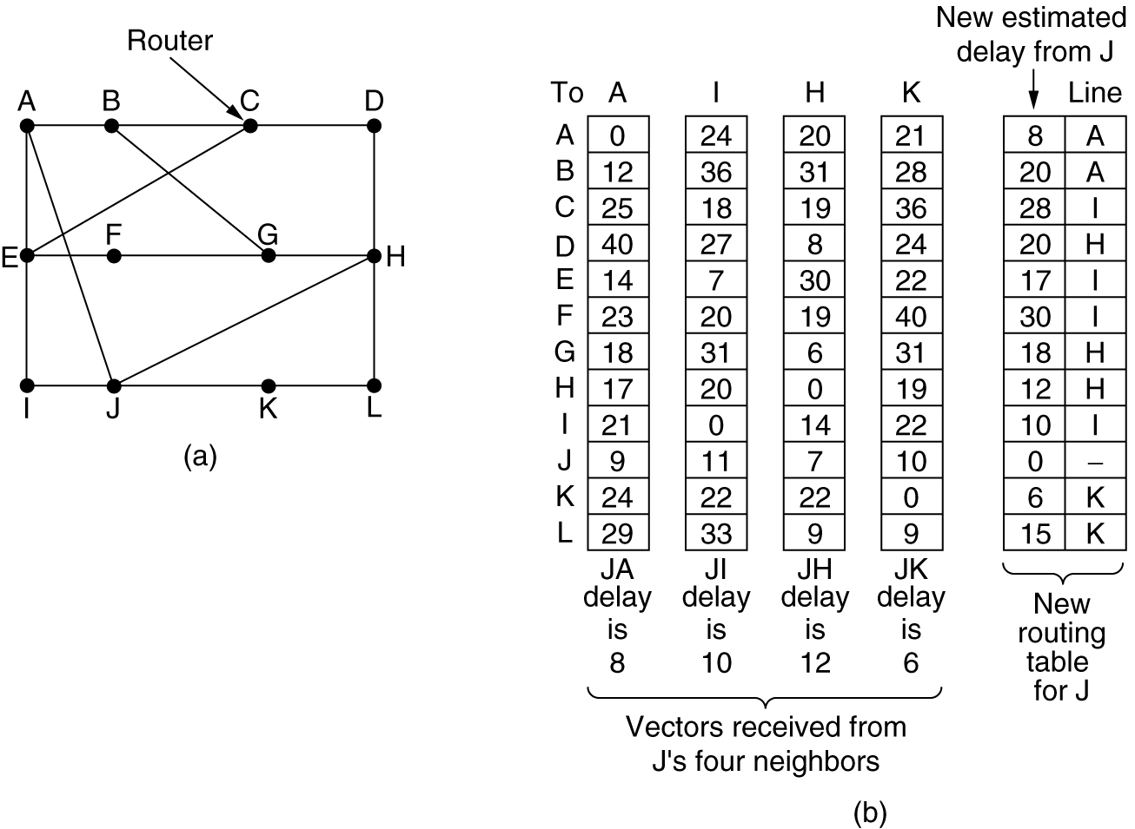
Distance Vector Example
Figure 5-9.(a) A subnet. (b) Input from A, I, H, K, and the new routing table for J.
Tanenbaum

Slide 18
Distance Vector Routing
{Kurose & Ross version}
Advanced Computer Networks
Distance Vector Routing

Slide 19
Distance Vector Algorithm
Bellman-Ford Equation (dynamic programming)
Define
d_{x}(y) := cost of least-cost path from x to y
Then
d_{x}(y) = min {c(x,v) + d_{v} (y)}
where min is taken over all neighbors v of x.
v

Slide 20
Bellman-Ford Example
5
Clearly, d_{v}(z) = 5, d_{x}(z) = 3, d_{w}(z) = 3
v
3
w
2
5
u
z
B-F equation says:
2
1
3
1
2
d_{u}(z) = min { c(u,v) + d_{v}(z),
c(u,x) + d_{x}(z),
c(u,w) + d_{w}(z) }
= min {2 + 5,
1 + 3,
5 + 3} = 4
x
y
1
The node that achieves minimum is next
hop in shortest path ➜ forwarding table.
Namely, packets from u destined for z are
forwarded out link between u and x.

Slide 21
Distance Vector Algorithm
D_{x}(y) = estimate of least cost from x to y
Node x knows cost to each neighbor v: c(x,v)
Node x maintains distance vector
D_{x} = [D_{x}(y): y є N ]
Node x also maintains its neighbors’ distance vectors
  For each neighbor v, x maintains
  D_{v} = [D_{v}(y): y є N ]

Slide 22
Distance Vector Algorithm
DV Basic idea:
From time-to-time, each node sends its own distance vector estimate to neighbors.
Asynchronous
When a node x receives a new DV estimate from any neighbor v, it saves v’s distance vector and it updates its own DV using B-F equation:
D_{x}(y) ← min_{v}{c(x,v) + D_{v}(y)} for each node y ∊ N
Under minor, natural conditions, the estimate D_{x}(y) converges to the actual least cost d_{x}(y).

Slide 23
Distance Vector Algorithm
Iterative, asynchronous: each local iteration caused by:
local link cost change
DV update message from neighbor
Distributed:
each node notifies neighbors only when its DV changes
  neighbors then notify their neighbors if necessary.
Each node:
wait for (change in local link cost or msg from neighbor)
recompute estimates
if DV to any destination has changed, notify neighbors

Slide 24
D_{x}(y) = min{c(x,y) + D_{y}(y), c(x,z) + D_{z}(y)}
= min{2+0 , 7+1} = 2
D_{x}(z) = min{c(x,y) +
D_{y}(z), c(x,z) + D_{z}(z)}
= min{2+1 , 7+0} = 3
node x table
cost to
cost to
x y z
x y z
x
0 2 7
x
0
2
3
y
y
from
∞
∞
∞
from
2 0 1
z
∞
∞
∞
z
7 1 0
node y table
cost to
x y z
y
2
1
x
∞
∞
∞
z
2 0 1
x
y
7
from
z
∞
∞
∞
node z table
cost to
x y z
x
∞ ∞ ∞
y
from
∞
∞
∞
z
7
1
0
time

Slide 25
D_{x}(y) = min{c(x,y) + D_{y}(y), c(x,z) + D_{z}(y)}
= min{2+0 , 7+1} = 2
D_{x}(z) = min{c(x,y) +
D_{y}(z), c(x,z) + D_{z}(z)}
= min{2+1 , 7+0} = 3
node x table
cost to
cost to
cost to
x y z
x y z
x y z
x
0 2 7
x
0 2 3
x
0 2 3
y
y
from
∞
∞
∞
from
2 0 1
y
from
2 0 1
z
∞
∞
∞
z
7 1 0
z
∞
3 1 0
node y table
cost to
cost to
cost to
x y z
x y z
x y z
y
2
1
x
∞
∞
∞
x
0 2 7
z
2 0 1
x
0 2 3
x
y
y
7
from
from
2 0 1
y
from
2 0 1
z
∞
∞
∞
z
7 1 0
z
3 1 0
node z table
cost to
cost to
cost to
x y z
x y z
x y z
x
∞ ∞ ∞
x
0 2 7
x
0 2 3
y
y
2 0 1
y
from
2 0 1
from
from
∞
∞
∞
z
z
3 1 0
z
3 1 0
7
1
0
time

Slide 26
Distance Vector: Link Cost Changes
Link cost changes:
node detects local link cost change.
updates routing info, recalculates
distance vector.
if DV changes, it notifies neighbors .
1
y
4
1
x
z
50
At time t₀, y detects the link-cost change, updates its DV, and informs its neighbors.
“good
news
travels
fast”
At time t₁, z receives the update from y and updates its table.
It computes a new least cost to x and sends its neighbors its DV.
At time t₂, y receives z’s update and updates its distance table.
y’s least costs do not change and hence y does not send any
message to z.

Slide 27
Distance Vector: Link Cost Changes
Link cost changes:
good news travels fast
bad news travels slow - “count to infinity” problem!
44 iterations before algorithm stabilizes: see text!
Poisoned reverse:
If Z routes through Y to get to X :
  Z tells Y its (Z’s) distance to X is infinite (so Y won’t route to X via Z)
will this completely solve count to infinity problem?
60
y
4
1
x
z
50

Slide 28
Link State Algorithm
1. Each router is responsible for meeting its neighbors and learning their names.
2. Each router constructs a link state packet (LSP) which consists of a list of names and cost to reach each of its neighbors.
3. The LSP is transmitted to ALL other routers. Each router stores the most recently generated LSP from each other router.
4. Each router uses complete information on the network topology to compute the shortest path route to each destination node.

Slide 29
Figure 4.18 Reliable LSP Flooding
Reliable Flooding
P&D slide

Slide 30
Reliable Flooding
The process of making sure all the nodes participating in the routing protocol get a copy of the link-state information from all the other nodes.
LSP contains:
  Sending router’s node ID
  List of connected neighbors with the associated link cost to each neighbor
  Sequence number
  Time-to-live (TTL) {an aging mechanism}

Slide 31
Reliable Flooding
First two items enable route calculation.
Last two items make process reliable
  ACKs and checking for duplicates is needed.
Periodic Hello packets used to determine the demise of a neighbor.
The sequence numbers are not expected to wrap around.
  ➔this field needs to be large (64 bits) !!

Slide 32
A Link-State Routing Algorithm
Dijkstra’s algorithm
net topology, link costs known to all nodes
  accomplished via “link state broadcast”.
  all nodes have same info.
computes least cost paths from one node (‘source”) to all other nodes
  gives forwarding table for that node.
iterative: after k iterations, know least cost path to k destinations.
Notation:
c(x,y): link cost from node x to y; = ∞ if not direct neighbors.
D(v): current value of cost of path from source to destination v
p(v): predecessor node along path from source to v
N': set of nodes whose least cost path is definitively known.

Slide 33
Dijsktra’s Shortest Path Algorithm
1 Initialization:
2 N' = {u}
3 for all nodes v
4 if v adjacent to u
5 then D(v) = c(u,v)
6 else D(v) = ∞
7
8 Loop
9 find w not in N' such that D(w) is a minimum
10 add w to N'
11 update D(v) for all v adjacent to w and not in N' :
12 D(v) = min( D(v), D(w) + c(w,v) )
13 /* new cost to v is either old cost to v or known
14 shortest path cost to w plus cost from w to v */
15 until all nodes in N'
[K&R]

Slide 34
Dijkstra’s Algorithm: Example
Step
0
1
2
3
4
5
N'
u
ux
uxy
uxyv
uxyvw
uxyvwz
D(v),p(v)
2,u
2,u
2,u
D(w),p(w)
5,u
4,x
3,y
3,y
D(x),p(x)
1,u
D(y),p(y)
∞
2,x
D(z),p(z)
∞
∞
4,y
4,y
4,y
5
v
3
w
2
5
u
2
1
z
3
1
2
x
y
1

Slide 35
Dijkstra’s Algorithm: Example (2)
Resulting shortest-path tree from u:
v
w
u
z
x
y
Resulting forwarding table in u:
destination
link
v
(u,v)
x
(u,x)
y
(u,x)
w
(u,x)
z
(u,x)

Slide 36
Dijkstra’s Algorithm, Discussion
Algorithm complexity: n nodes
each iteration: need to check all nodes, w, not in N
n(n+1)/2 comparisons: O(n²)
more efficient implementations possible: O(nlogn)
Oscillations possible:
e.g., link cost = amount of carried traffic
1
A
A
A
A
1+e
2+e
0
0
2+e
2+e
0
D
0
0
B
D
B
D
B
D
B
1+e
1
0
0
1+e
1
0
e
0
0
1
1+e
0
e
C
C
C
C
1
1
e
… recompute
routing
… recompute
… recompute
initially

Slide 37
Intra-AS Routing
also known as Interior Gateway Protocols (IGP)
most common Intra-AS routing protocols:
  RIP: Routing Information Protocol
  OSPF: Open Shortest Path First
  IGRP: Interior Gateway Routing Protocol (Cisco proprietary)

Slide 38
Routing Information Protocol (RIP)
RIP had widespread use because it was distributed with BSD Unix in “routed”, a router management daemon in 1982.
RIP - most used Distance Vector protocol.
RFC1058 in June 1988
Runs over UDP.
Metric = hop count
BIG problem is max. hop count =16
➔ RIP limited to running on small networks (or AS’s that have a small diameter)!!

Slide 39
Routing Information Protocol (RIP)
From router A to subnets:
u
v
destination hops
u 1
v 2
w 2
x 3
y 3
z 2
A
B
w
x
z
C
D
y
Sends DV packets every 30 seconds (or faster) as Response Messages (also called advertisements).
each advertisement: list of up to 25 destination subnets within AS.
Upgraded to RIPv2

Slide 40
Figure 4.17 RIP Packet Format
RIP Packets
(network_address,
distance)
pairs
P&D slide

Slide 41
OSPF (Open Shortest Path First)
“open”: publicly available
uses Link State algorithm
  LS packet dissemination {called LSA :: LS Advertisement}
  topology map at each node
  route computation using Dijkstra’s SP algorithm.
OSPF advertisement carries one entry per neighbor router.
advertisements disseminated to entire AS (via flooding)
  carried in OSPF messages directly over IP (rather than TCP or UDP).

Slide 42
OSPF “Advanced” Features (not in RIP)
security: all OSPF messages authenticated (to prevent malicious intrusion).
multiple same-cost paths allowed (only one path in RIP).
For each link, multiple cost metrics for different TOS (e.g., satellite link cost set “low” for best effort; high for real time).
integrated uni- and multicast support:
  Multicast OSPF (MOSPF) uses same topology data base as OSPF.
hierarchical OSPF used in large domains.

Slide 43
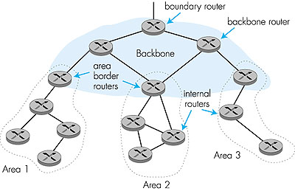
Hierarchical OSPF

Slide 44
Hierarchical OSPF
Two-Level Hierarchy: local area, backbone.
  Link-State Advertisements (LSAs) only in area
  each node has detailed area topology; only knows direction (shortest path) to nets in other areas.
area border routers: “summarize” distances to nets in own area, advertise to other Area Border routers.
backbone routers: run OSPF routing limited to backbone.
boundary routers: connect to other AS’s.

Slide 45
Five OSPF LSA Types
1. Router link advertisement [Hello message]
2. Network link advertisement
3. Network summary link advertisement
4. AS border router’s summary link advertisement
5. AS external link advertisement

Slide 46
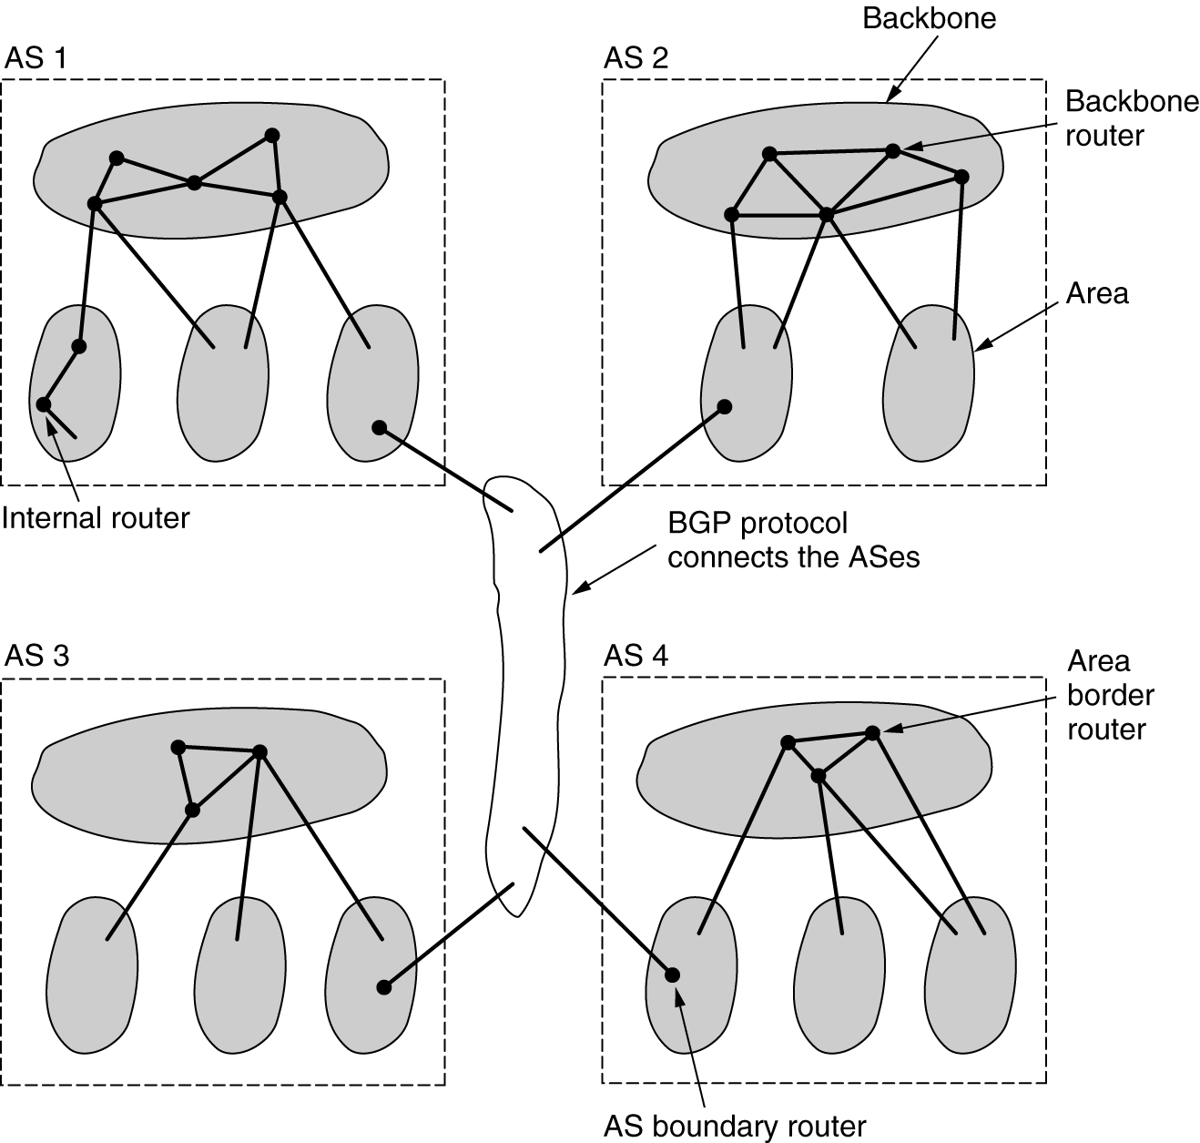
OSPF
Tanenbaum
The relation between ASes, backbones, and areas in OSPF

Slide 47
Internet Inter-AS routing: BGP
BGP (Border Gateway Protocol): the de facto standard
BGP provides each AS a means to:
  Obtain subnet reachability information from neighboring ASs.
  Propagate reachability information to all AS-internal routers.
  Determine “good” routes to subnets based on reachability information and policy.
allows subnet to advertise its existence to rest of Internet: “I am here!”

Slide 48
Routing Primer Summary
Routers forward and route over WANs
  Produce look up tables in routers
Routing Classification:
  Adaptive or non-adaptive
  Interdomain and Intradomain
Distance Vector Routing (DV)
  Perlman version
  Tanenbaum example
  K&R version

Slide 49
Routing Primer Summary
Link State Routing (LS)
  Uses reliable flooding; Dijkstra’s SP algorithm
RIP
  Old ARPA routing; unicast DV routing
OSPF
  Two-Level Hierarchical LS routing
  Five LSA types for router communication
BGP
  Interdomain routing using reachability

