Slide 1
An Empirical Study of UHF RFID Performance
Michael Buettner and David Wetherall
Presented by Qian (Steve) He
CS 577 - Prof. Bob Kinicki

Slide 2
Overview
Introduction
Background Knowledge
Methodology and Tools
Experiment & Result
Enhancement
Conclusion

Slide 3
Overview
Introduction
Background Knowledge
Methodology and Tools
Experiment & Result
Enhancement
Conclusion

Slide 4
Terms
Ultra-High Frequency (UHF)
UHF designates the International Telecommunication Union (ITU) radio frequency range of electromagnetic waves between 300 MHz and 3 GHz.
Radio-Frequency IDentification (RFID)
Electronic Product Code (EPC)
EPCglobal UHF Class 1 Generation 2 in this paper
EPCglobal (a joint venture between GS1 and GS1 US)

Slide 5
Characteristics
Passive Radio Frequency Identification
small, inexpensive computer chip
remotely powered
interrogated for identifiers and other information

Slide 6
Comparison
EPC Gen2 standard
defines readers and passive tags that operate at UHF frequencies
use “backscatter” communication to support read ranges measured in meters
high capability of data storage
Early HF tags
based on inductive coupling that only provide read ranges of centimeters
active tags that require batteries to increase range

Slide 7
* Privacy
Richard Stallman at WSIS 2005 presenting his RFID badge wrapped with aluminum foil as a way of protesting RFID privacy issues.
Logo of the anti-RFID campaign by German privacy group FoeBuD.
http://en.wikipedia.org/wiki/Radio-frequency_identification

Slide 8
Overview
Introduction
Background Knowledge
Methodology and Tools
Experiment & Result
Enhancement
Conclusion

Slide 9
Backscatter
A reader transmits information to a tag by modulating an RF signal
The tag receives both down-link information and the entirety of its operating energy from this RF signal.
The reader transmits a continuous RF wave (CW) which assures that the tag remains powered
The tag then transmits its response by modulating the reflection coefficient of its antenna.
The reader is able to decode the tag response by detecting the variation in the reflected CW,

Slide 10
UHF EPC
Physical Layer
RFID tags communicate by “backscattering” signals that are concurrent with reader transmissions, and use a variety of frequencies and encodings under the control of the reader.
MAC Layer
Readers and tags use a variation on slotted Aloha to solve the multi-access problem in a setting where readers can hear tags but tags cannot hear each other.

Slide 11
Physical Layer
Down-link
Amplitude Shift Keying (ASK)
bits are indicated by brief periods of low amplitude
Pulse Interval Encoding (PIE)
the time between low amplitude periods differentiates a zero or a one
the reader can choose pulse durations
26.7 kbps to 128 kbps.
Up-link
partially determined by
down-link preamble
a bit field set in the Query command
frequency (40 to 640 kHz) & encoding
FM0
Miller-2
Miller-4
Miller-8

Slide 12
MAC Layer
Based on Framed Slotted Aloha
each frame has a number of slots
each tag will reply in one randomly selected slot per frame
the number of slots in the frame is determined by the reader and can be varied on a per frame basis

Slide 13
Query Round & Circle
Query Round
an individual frame
Query Cycle
the series of Query Rounds between power down periods

Slide 14
Query Round: sequence
At the beginning, the reader can optionally transmit a Select command
limits the number of active tags by providing a bit mask
only tags with ID’s (or memory locations) that match this mask will respond in the subsequent round
A Query command is transmitted which contains the fields:
determine the up-link frequency and data encoding, the Q parameter (determines the number of slots in the Query Round), and a Target parameter.
A tag receives a Query command, it chooses a random number in the range (0, 2^{Q} - 1), where 0≤Q≤15, and the value is stored in the slot counter of the tag. The tag changes its Inventoried flag.

Slide 15
Query Round: sequence (cont.)
If a tag stores a 0 in its slot counter, it will transmit a 16 bit random number (RN16) immediately.
The reader will echo the RN16 in an ACK packet after receiving it.
If the tag successful receives the ACK with the correct random number, the tag will backscatter its ID.

Slide 16
Query Round: sequence (cont.)
The reader will send a QueryRepeat command to cause the tag to toggle its Inventoried flag.
If the ID was not successfully received by the reader, a NAK command is sent which resets the tag so that a subsequent QueryRepeat will not result in Inventoried flag being changed.
A QueryRepeat signals the end of the slot.
On receiving the command, the remaining tags will:
decrement their slot counter
respond with a RN16 if their slot counter is set to 0.
The process then repeats, with the number of QueryRepeats being equal to the number of slots set using the Q parameter.

Slide 17
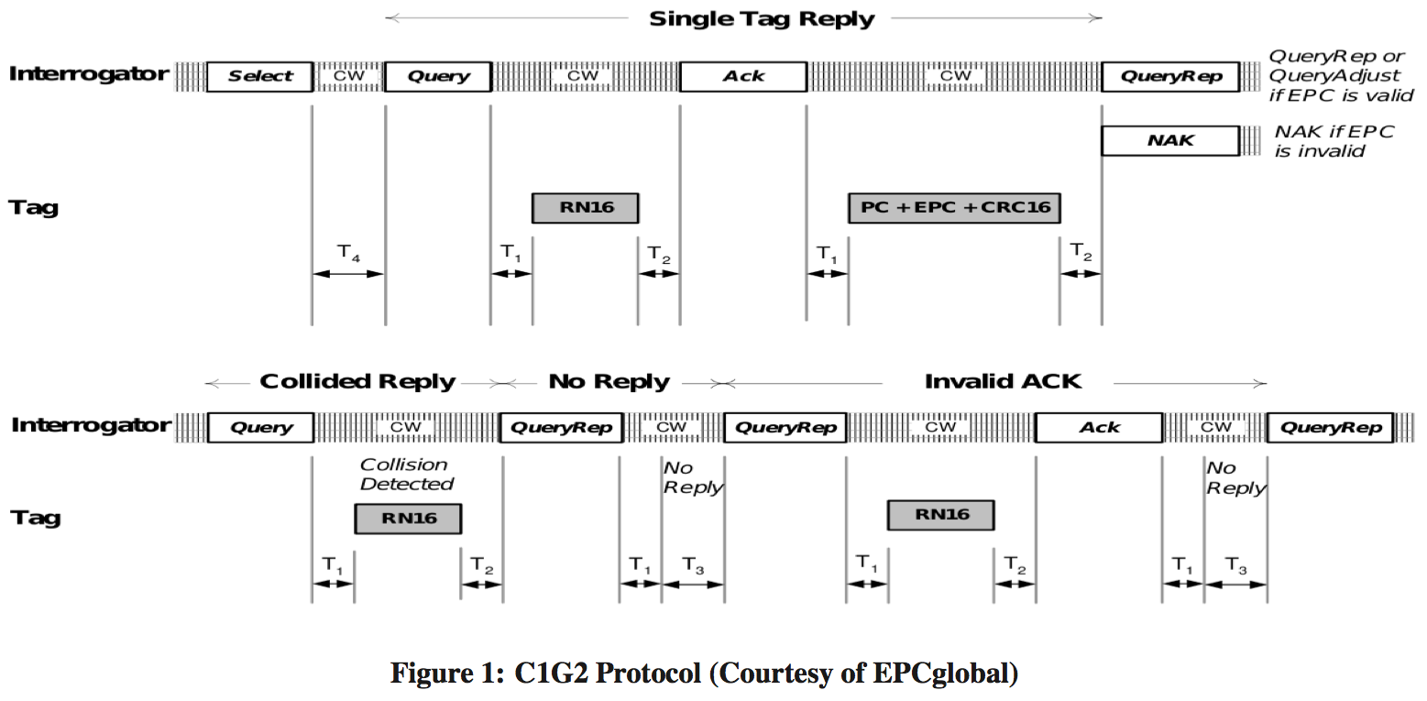
C1G2 Protocol

Slide 18
Overview
Introduction
Background Knowledge
Methodology and Tools
Experiment & Result
Enhancement
Conclusion

Slide 19
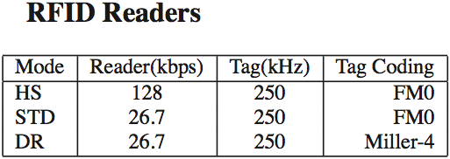
Tools
Hardware
Software
Readers
Alien Technologies ALR-9800
ThingMagic Mercury5e Development kit
Tags
Alien 9460-02 “Omni- Squiggle” tags
Software
Universal Software Radio Peripheral (USRP) platform
GNURadio

Slide 20
Assessment
How well do commercial readers perform?
What protocol factors degrade reader performance?
What causes tags to be missed during a read?
What can be done to improve performance?

Slide 21
Overview
Introduction
Background Knowledge
Methodology and Tools
Experiment & Result
Enhancement
Conclusion

Slide 22
Experiment Settings
A standard office setting with cubicles of 42 inch height
Experiment 1: 30’ x 22’ x 10’
Experiment 2: 40’ x 24’ x 13’
16 tags were adhered to a sheet of poster board in a 4 x 4 grid, with tags spaced approximately 6 inches apart.

Slide 23
Overall Performance Read Rate - Distance

Slide 24
Overall Performance Average Cycle Time – Number of Tags

Slide 25
Overall Performance Read Rate - Coding Scheme
*1 : Experiment 1 *2 : Experiment 2

Slide 26
Cycle Duration

Slide 27
Error Rates

Slide 28
Effects of Errors

Slide 29
Effects of Errors (cont.)

Slide 30
Number of Cycles
the average number of cycles needed to read all tags in the set

Slide 31
Hit Rate of DR Mode for Each Tag

Slide 32
Effects of Frequency Selective Fading
ThingMagic reader in the same location and setup as Experiment1.
15 minute experiment, in which each tag responds on all 50 channels at least once

Slide 33
Effects of Frequency Selective Fading (conts.)

Slide 34
Effects of Frequency Selective Fading (conts.)

Slide 35
Summary
Size of the tag set
affects performance, largely because larger tag sets are more efficient with respect to inter-cycle overhead.
Up-link encoding
Slower but more robust up-link encodings are more effective at greater distances, as the overhead is quickly outweighed by reduced error rates.
Multipath environment
Different multipath environments result in different error rates as distance increases, and these effects are location specific.
Errors
increase both the variance and overall duration of cycles by increasing the number of ACKs and the number of slots.
also result in missed tags when a reader “gives up” during a cycle.

Slide 36
Summary (cont.)
ACKs as well as Query and QueryRepeat commands
account for a significant amount of overall time
the ACKs because they are long and Query* because they are numerous.
Lower down-link rate
result in fewer cycles needed to read the complete tag set, likely because more tags are able to power up.
Frequency selective fading
is a dominant factor in missed reads, particularly at greater distances.

Slide 37
Overview
Introduction
Background Knowledge
Methodology and Tools
Experiment & Result
Enhancement
Conclusion

Slide 38
Physical Layer
Reducing Slot Times
As the Q algorithm results in many empty slots, having the reader truncate the listen time for empty slots would reduce overall cycle times.
Reducing Missed Tags Due to Fading
The variation in frequency response can be smoothed by channel hopping at a more rapid rate.

Slide 39
Reducing Slot Times

Slide 40
Reducing Missed Tags Due to Fading

Slide 41
Physical / MAC Layer Coordination
Reducing ACKs
retrying ACKs even once is likely to have very little benefit when using these modes at larger distances
a more appropriate response would be to not waste time on retries, but instead change the physical layer parameters used in the next round
Hybrid Reader Modes
combining the positive attributes of HS and DR mode has the potential to increase performance significantly

Slide 42
Reducing ACKs

Slide 43
Hybrid Reader Modes

Slide 44
Overview
Introduction
Background Knowledge
Methodology and Tools
Experiment & Result
Enhancement
Conclusion

Slide 45
Conclusion
First detailed, low-level measurement study of EPC C1G2 UHF reader technology in a real world setting.
RFID physical and MAC layers should be considered in conjunction rather than separately as is done at present.
Found physical layer effects are significant factors that degrade the overal(l) performance of commercial readers.
Suggests that better physical layer implementation choices can improve performance while remaining standards compliant.
reducing the listen time for empty slots
increasing the rate of frequency hopping

Slide 46
Thanks
Q & A

