Slide 1

The War Between Mice and Elephants
Liang Guo and Ibrahim Matta
Boston University
ICNP 2001
Presented By
Eric Wang

Slide 2
Outline
Introduction
Analyzing Short TCP Flow Performance
Architecture And Mechanism
Simulation
Discussion
Conclusion and Future Work

Slide 3

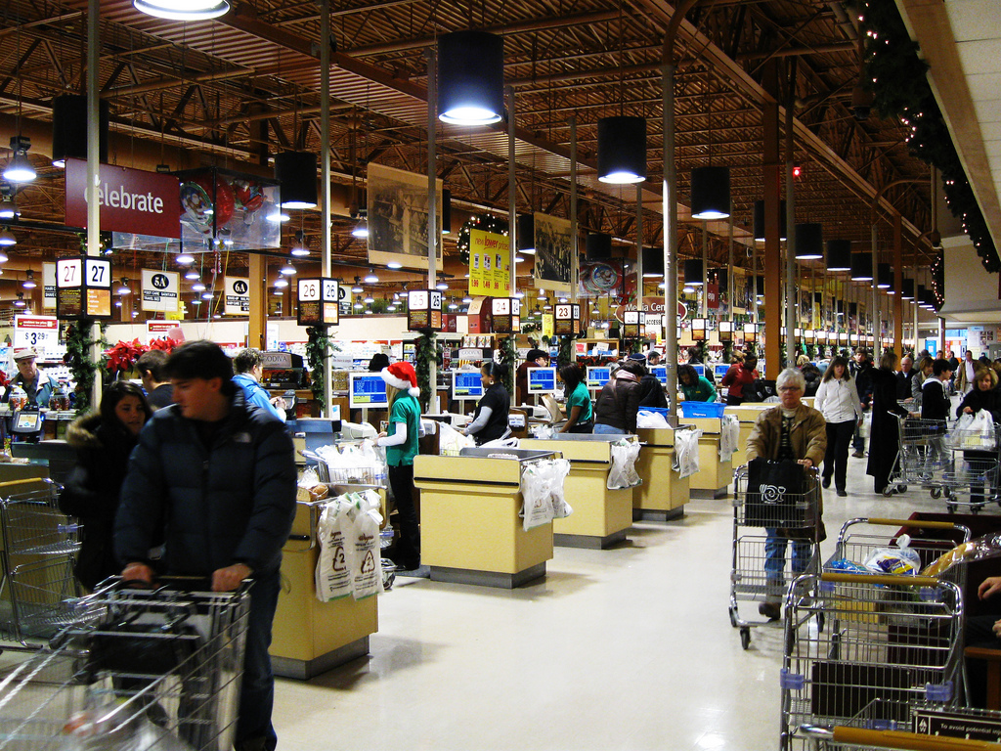
Short TCP Flows vs. Long TCP Flows
A real life example:

Slide 4
Mice and Elephants
Elephants:
Most traffic(80%) is carried out by only a small number of connections.
Mice
The remaining large amount of connections are very small in size or lifetime.
Is this really fair?

Slide 5
Short TCP Flows vs. Long TCP Flows
In a fair network
  Short connections expect relatively fast service compared to long connections
Sometimes this is not the case with Internet
Fast retransmit
3 Dup Acks
Timeout
Fast recovery
Slow start
Slow start

Slide 6
Unfair for Short flows Due to TCP Nature
TCP slow start
Sending window is initiated at minimum value regardless of what is available in the network.
Packet Loss detected by timeout or duplicate ACK
Sending window is initiated at minimum value regardless of what is available in the network.
ITO as initial value for RTO
For the first control packets and first data packets, TCP has to use ITO value as RTO, losing these packets can have disastrous effect on short connection performance.
Proposed solution:
Active Queue Management + Differential Services(Diffserv)
Notes:
Transmission rate increases slowly
Does not get the fair share of the bandwidth
Fast retransmit needs 3 dup ACKs
Small cwnd, not enough packets to activate dup Acks
So timeout happens
Timeout severely degrades the performance of TCP
No sampling data available
Conservative timeout for (SYN, SYN-ACK) and 1st data packet
Disastrous effect on short connection performance if these packets lost

Slide 7
Outline
Introduction
Analyzing Short TCP Flow Performance
Architecture And Mechanism
Simulation
Discussion
Conclusion and Future Work

Slide 8
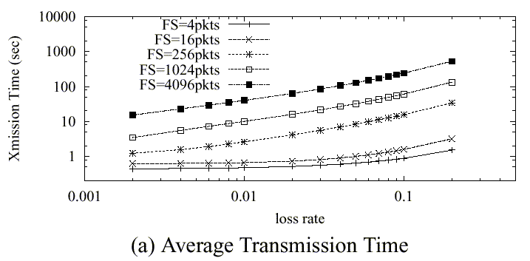
Sensitivity Analysis of TCP flows to Loss Rate
Average transmission time of Short TCP flows are not very sensitive to loss rate
when loss rate is relatively small.
But it increase drastically as loss rate becomes larger ( persistent congestion).

Slide 9
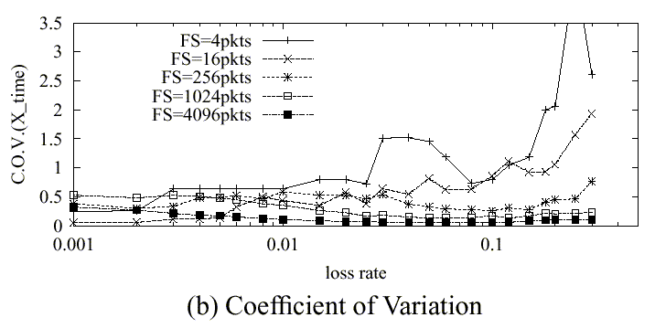
Variance of Transmission Times
COV = Standard deviation/mean
Variability in short flows
Due to 1.
Law of large numbers
Variability in long flows
Due to 2.
Loss in slow start or
congestion avoidance
Less variability in long flows
Loss in both slow start and
congestion avoidance

Slide 10
Conclusions
Short flows are more sensitive to increase of loss rate than long flows.
For short flows, variability of transmission time is more sensitive to increase of loss rate

Slide 11
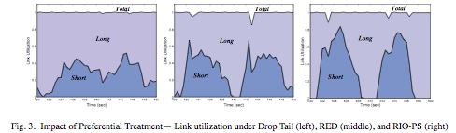
Preferential Treatment to Short flows
Drop Tail fails to give fair treatment to short TCP flows
RED gives almost fair treatment to all flows
RIO favors short flows by giving more than their fair share

Slide 12
Why Using RIO for short flows?
Short flows ends earlier, giving back resources to long flows.
May even enhance long flows since they are less disturbed by short flows.
Faster response time and better fairness for short flows, thus enhance the overall performance.

Slide 13
Outline
Introduction
Analyzing Short TCP Flow Performance
Architecture And Mechanism
Simulation
Discussion
Conclusion and Future Work

Slide 14
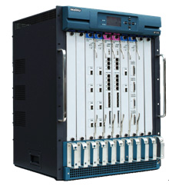
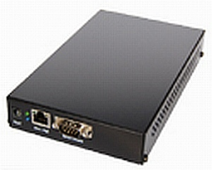
Proposed Architecture
Apply class-based active queue management
Edge Router
Core Router
Mark long flows and short flows

Slide 15
Edge Routers
    Marking packets as from long flow and short flow
    - Setting a counter for each flow and a threshold L_{t}
    - When counter exceeds L_{t} , mark packets as from long flow, otherwise from short flow
    Maintaining per-flow state information
    - A flow hash table is updated every T_{u} time units.
    Dynamically adjusting L_{t} to maintain SLR
    - SLR ( Short-to-long-Ratio )
    - Maintain SLR by doing additive increase/decrease to L_{t}

Slide 16
Core Router – RIO-PS
RIO - RED with In (Short) and Out (Long)
Preferential treatment to short flows
  Short flows
    Packet dropping probability computed based on the average backlog of short packets only (Q_{short})
  Long flows
    Packet dropping probability computed based on the total average queue size (Q_{total})

Slide 17
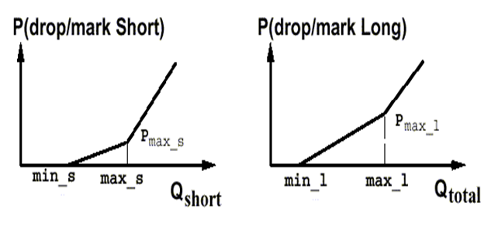
RIO-PS
Two separate sets of RED parameters for each flow class
Gentle RED
Less Packet dropping probability for short flows

Slide 18
Features of RIO-PS
Single FIFO queue is used for all packets
  Packet reordering will not happen
Inherits all properties of RED
  Protection of bursty flows
  Fairness within each class of traffic
  Detection of incipient congestion

Slide 19
Outline
Introduction
Analyzing Short TCP Flow Performance
Architecture And Mechanism
Simulation
Discussion
Conclusion and Future Work

Slide 20
Simulations setup
ns-2 simulations
Web traffic model
  HTTP 1.0
  Exponential inter-page arrival (mean 9.5 sec)
  Exponential inter-object arrival (mean 0.05 sec)
  Uniform distribution of objects per page (min 2 max 7)
  Object size; bounded Pareto distribution (min = 4 bytes, max = 200 KB, shape = 1.2)
  Each object retrieved using a TCP connection

Slide 21
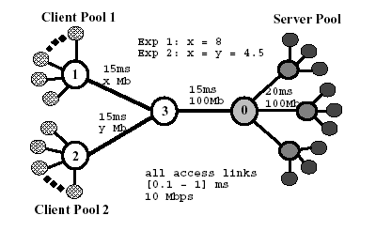
Simulation topology
Request
Response
Core Router
Edge Router

Slide 22
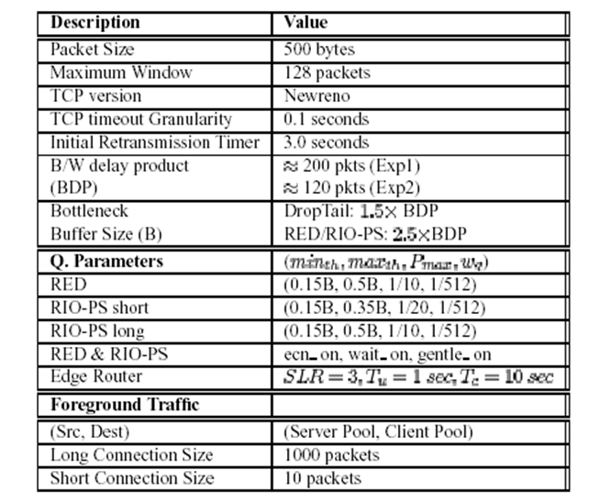
Network configuration

Slide 23
Simulations details
The load is carefully tuned to be close to the bottleneck link capacity
RIO parameters
  Short TCP flows are guaranteed around 75% of the total bandwidth in times of congestion
Experiments run 4000 seconds with a 2000 second warm-up period

Slide 24
Experiment 1: Single Client Set
In this experiment, there is only one set of clients involved (client pool 1).
Therefore, the traffic seen at the core router 1 is the same as that at edge router 0.

Slide 25
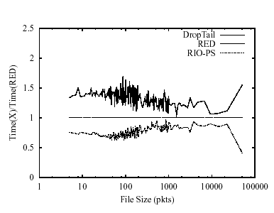
Average Response Time for Different sized objects
ITO = 3 sec
Preferential treatment can cut the average response time for short and
medium sized files significantly (25-30 %)

Slide 26
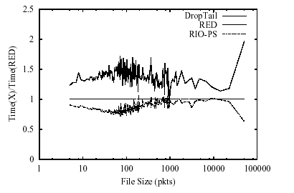
Average Response Time for Different sized objects
ITO = 1 sec
Significantly reducing the gap between RED and proposed scheme
2. Still large improvements with RIO-PS for medium sized connections(15%-25%).

Slide 27
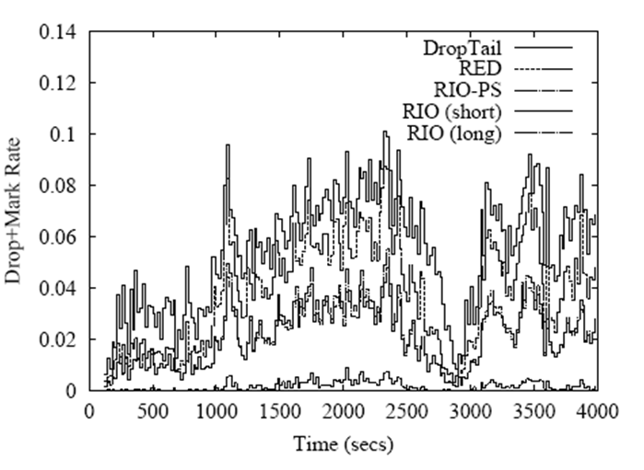
Instantaneous Drop/Mark rate
RIO-PS reduces the overall
drop/mark probability
Comes from the fact that
short flows rarely
experience loss
Also, Short TCP flows are not responsible for controlling congestion
because of the time scale at which they operate.
Preferential treatment to short flows does not hurt the network

Slide 28
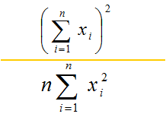
Study of foreground traffic
Periodically inject 10 short flows (every 25 seconds) and 10 long flows (every 125 seconds) as foreground TCP connections and record the response time for i_{th} connection
Fairness index
  For any give set of response times (x₁, .., x_{n}), the fairness index is:

Slide 29
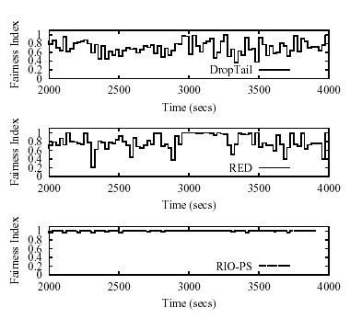
Fairness Index – Short Connections
More fair

Slide 30
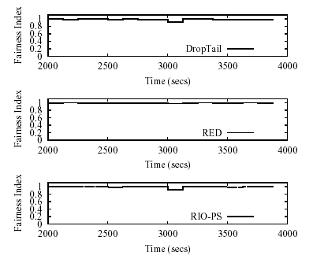
Fairness Index – Long Connections

Slide 31
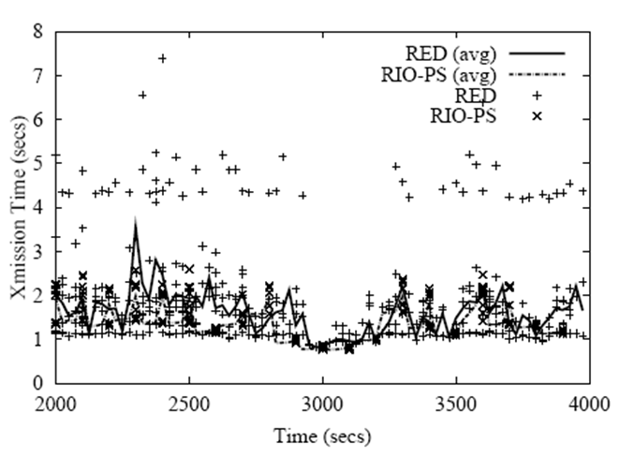
Transmission time – short connections
-Even with RED queues,
many short flows
experience loss
-Some lost first
packet and hence
timeout (3 sec)
RIO-PS
much less drops

Slide 32
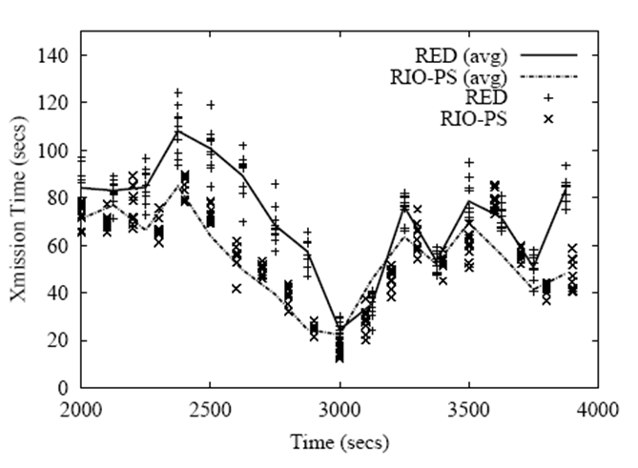
Transmission time – long connections
RIO-PS does not hurt
long flow
performance

Slide 33
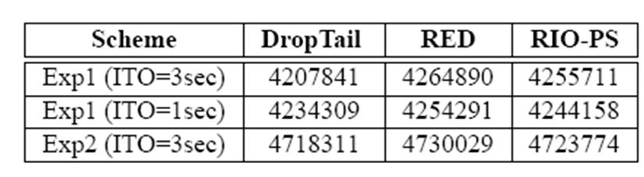
Goodput
RIO-PS does not hurt overall goodput
Slightly improves over DropTail

Slide 34
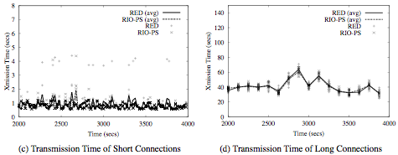
Experiment 2: Unbalanced Request
When router is dominated by one class of flows ( short or long ), the proposed method
reduces to traditional unclassified traffic plus RED queue policy.

Slide 35
Outline
Introduction
Analyzing Short TCP Flow Performance
Architecture And Mechanism
Simulation
Discussion
Conclusion and Future Work

Slide 36
Discussion
Deployment Issues
Flow Classification
Controller Design

Slide 37
Outline
Introduction
Analyzing Short TCP Flow Performance
Architecture And Mechanism
Simulation
Discussion
Conclusion and Future Work

Slide 38
Conclusion
TCP major traffic in the Internet
Proposed Scheme is a Diffserv like architecture
  Edge routers classifies TCP flow as long or short
  Core routers implements RIO-PS
Advantages
  Short flow performance improved in terms of fairness and response time.
  Long flow performance is also improved or minimally affected since short flows are rapidly served.
  System overall goodput is improved
  Flexible Architecture, can be tuned largely at edge routers

