Slide 1
The Mote Revolution: Low Power Wireless Sensor Network Devices
University of California, Berkeley
Joseph Polastre Robert Szewczyk Cory Sharp David Culler
Only a relevant subset of slides

Slide 2
Outline
Trends and Applications
Mote History and Evolution
Design Principles
Telos

Slide 3
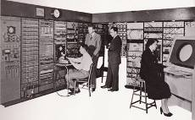
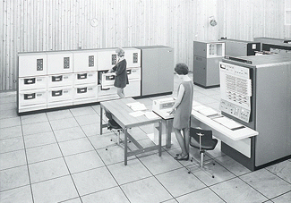
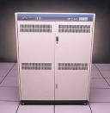
Faster, Smaller, Numerous
Moore’s Law
“Stuff” (transistors, etc) doubling every 1-2 years
Bell’s Law
New computing class every 10 years
Streaming Data to/from the Physical World
log (people per computer)
year

Slide 4
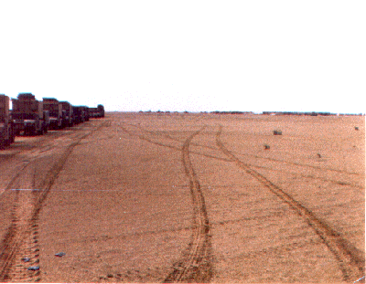
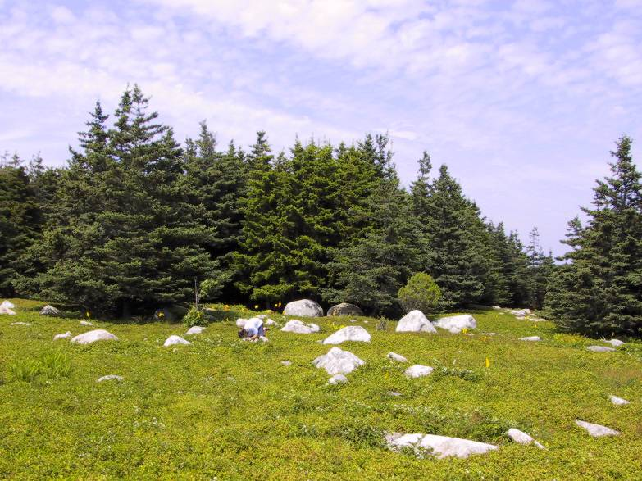
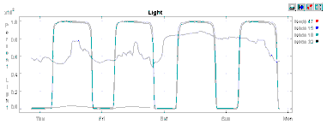
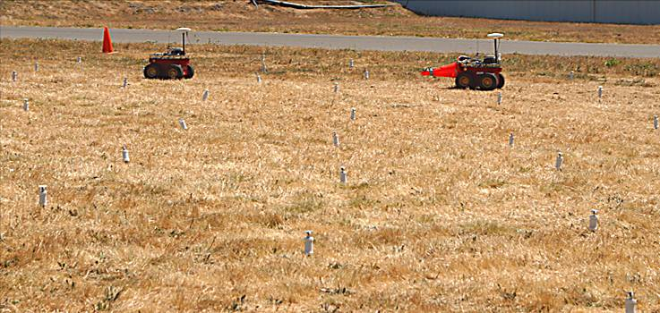
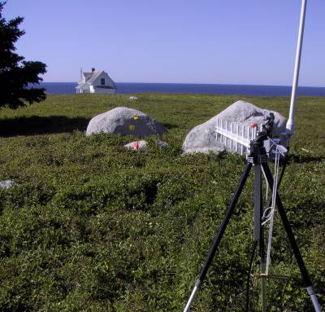
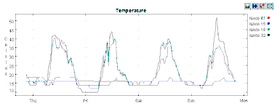
Applications
Disconnection & Lifetime
Sample Rate & Precision
Density & Scale
Mobility
Low Latency
Environmental Monitoring
Habitat Monitoring
Integrated Biology
Structural Monitoring
Interactive and Control
Pursuer-Evader
Intrusion Detection
Automation

Slide 5
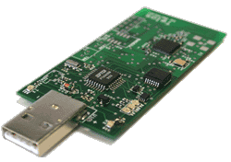
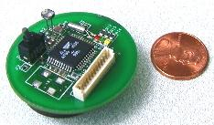
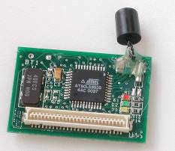
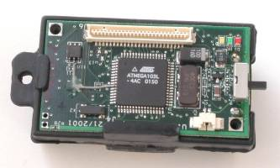
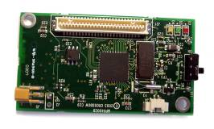
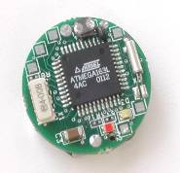
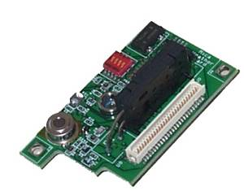
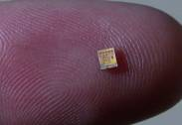
Open Experimental Platform
Telos 4/04
Robust
Low Power
250kbps
Easy to use
Services
Networking
TinyOS
WeC 99
“Smart Rock”
Rene 11/00
Mica 1/02
Dot 9/01
Small microcontroller 8 kB code 512 B data
Simple, low-power radio 10 kbps ASK
EEPROM (32 KB)
Simple sensors
Mica2 12/02
38.4kbps radio FSK
Demonstrate scale
Designed for experimentation
sensor boards
power boards
NEST open exp. Platform 128 kB code, 4 kB data 40kbps OOK/ASK radio 512 kB Flash
Spec 6/03
“Mote on a chip”
Commercial Off The Shelf Components (COTS)
Notes:
Before we jump in to the technical material, I would like to give you one more bit of context.

Slide 6
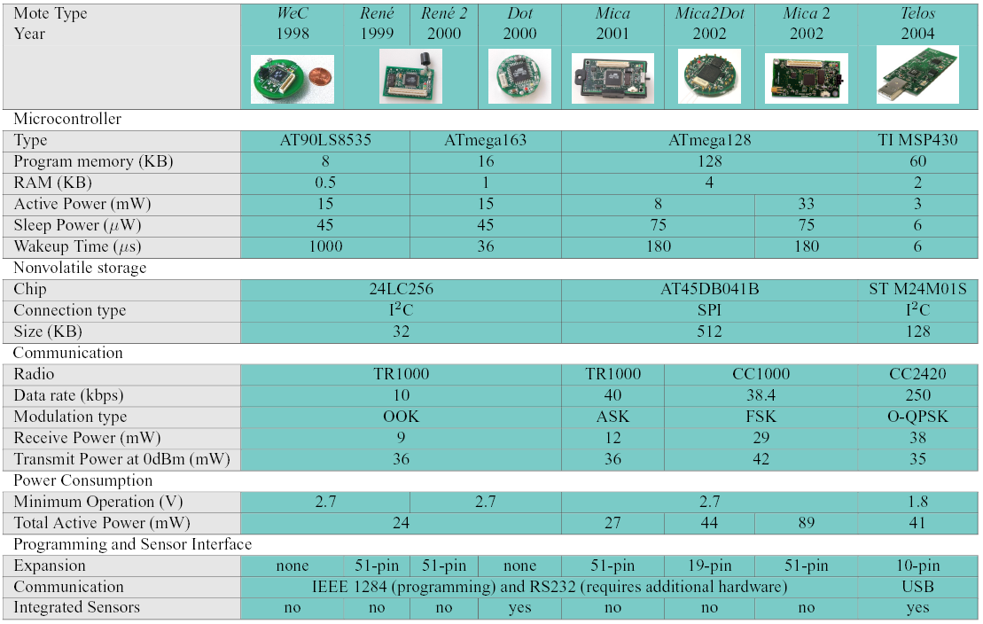
Mote Evolution

Slide 7
Mote
Microcontroller
Sensor
Radio Transceiver
D/A
Analog I/O Ports
A/D
Sensor
External Memory
Digital I/O ports
A very low cost low power computer
Monitors one or more sensors
A Radio Link to the outside world
Are the building blocks of Wireless Sensor Networks (WSN)
Nuwan Gajaweera
Presentation

Slide 8
Low Power Operation
Efficient Hardware
Integration and Isolation
Complementary functionality (DMA, USART, etc)
Selectable Power States (Off, Sleep, Standby)
Operate at low voltages and low current
Run to cut-off voltage of power source
Efficient Software
Fine grained control of hardware
Utilize wireless broadcast medium
Aggregate

Slide 9
Typical WSN Application
processing
data acquisition
communication
Periodic
Data Collection
Network Maintenance
Majority of operation
Triggered Events
Detection/Notification
Infrequently occurs
But… must be reported quickly and reliably
Long Lifetime
Months to Years without changing batteries
Power management is the key to WSN success
Power
wakeup
sleep
Time

Slide 10
Design Principles
Key to Low Duty Cycle Operation:
Sleep – majority of the time
Wakeup – quickly start processing
Active – minimize work & return to sleep

Slide 11
Sleep
Majority of time, node is asleep
>99%
Minimize sleep current through
Isolating and shutting down individual circuits
Using low power hardware
Need RAM retention
Run auxiliary hardware components from low speed oscillators (typically 32kHz)
Perform ADC conversions, DMA transfers, and bus operations while microcontroller core is stopped

Slide 12
Telos Platform
A new platform for low power research
Monitoring applications:
Environmental
Building
Tracking
Long lifetime, low power, low cost
Built from application experiences and low duty cycle design principles
Robustness
Integrated antenna
Integrated sensors
Soldered connections
Standards Based
IEEE 802.15.4
USB
IEEE 802.15.4 ZigBee
CC2420 radio
Frame-based
250kbps
2.4GHz ISM band
TI MSP430
Ultra low power
1.6μA sleep
460μA active
1.8V operation
Open embedded platform with open source tools, operating system (TinyOS), and designs.

Slide 13
Minimize Power Consumption
Compare to MicaZ: a Mica2 mote with AVR mcu and 802.15.4 radio
Sleep
Majority of the time
Telos: 2.4μA
MicaZ: 30μA
Wakeup
As quickly as possible to process and return to sleep
Telos: 290ns typical, 6μs max
MicaZ: 60μs max internal oscillator, 4ms external
Active
Get your work done and get back to sleep
Telos: 4-8MHz 16-bit
MicaZ: 8MHz 8-bit

Slide 14
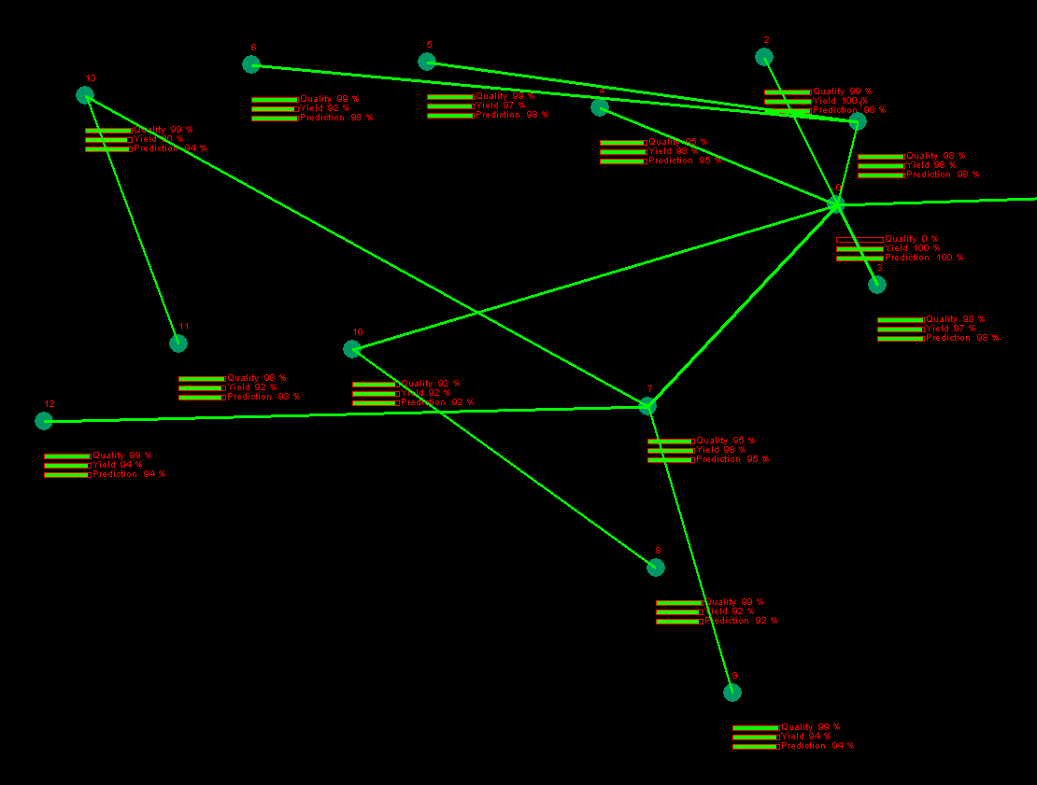
CC2420 Radio IEEE 802.15.4 Compliant
CC2420
Fast data rate, robust signal
250kbps : 2Mchip/s : DSSS
2.4GHz : Offset QPSK : 5MHz
16 channels in 802.15.4
-94dBm sensitivity
Low Voltage Operation
1.8V minimum supply
Software Assistance for Low Power Microcontrollers
128byte TX/RX buffers for full packet support
Automatic address decoding and automatic acknowledgements
Hardware encryption/authentication
Link quality indicator (assist software link estimation)
samples error rate of first 8 chips of packet (8 chips/bit)

Slide 15
Power Calculation Comparison Design for low power
Mica2 (AVR)
0.2 ms wakeup
30 μW sleep
33 mW active
21 mW radio
19 kbps
2.5V min
2/3 of AA capacity
MicaZ (AVR)
0.2 ms wakeup
30 μW sleep
33 mW active
45 mW radio
250 kbps
2.5V min
2/3 of AA capacity
Telos (TI MSP)
0.006 ms wakeup
2 μW sleep
3 mW active
45 mW radio
250 kbps
1.8V min
8/8 of AA capacity
Supporting mesh networking with a pair of AA batteries reporting data once every 3 minutes using synchronization (<1% duty cycle)
453 days
328 days
945 days

Slide 16
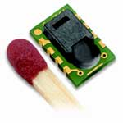
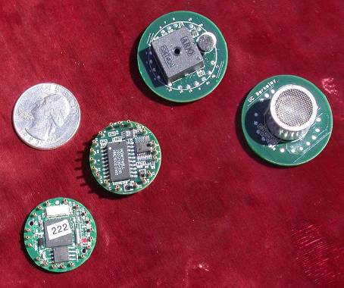
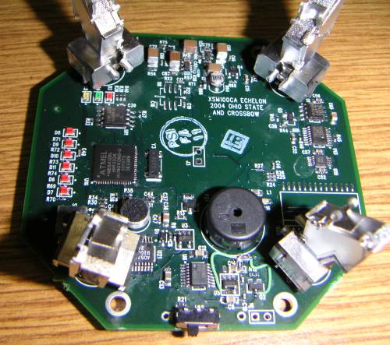
Sensors
Integrated Sensors
Sensirion SHT11
Humidity (3.5%)
Temperature (0.5ºC)
Digital sensor
Hamamatsu S1087
Photosynthetically active light
Silicon diode
Hamamatsu S1337-BQ
Total solar light
Silicon diode
Expansion
6 ADC channels
4 digital I/O
Existing sensor boards
Magnetometer
Ultrasound
Accelerometer
4 PIR sensors
Microphone
Buzzer
acoustic
mag
ultrasound
dot

