Slide 1
DDoS Defense by Offense
Michael Walfish, Mythili Vutukuru,
Hari Balakrishnan, David Karger,
Scott Shenker , SIGCOMM ‘06
Presented by Lianmu Chen

Slide 2
Outline
Introduction
Design
Implementation
Evaluation
Conclusions

Slide 3
Introduction

Slide 4
Introduction
Application level DDoS – It is a noxious attack in which computer criminals mimic legitimate client behavior by sending proper-looking requests, often via compromised and commandeered hosts known as bots.
Attacker sends proper looking requests to waste server’s resources; Overwhelms server, not access links.

Slide 5
Introduction
Far less bandwidth is required: the victim’s computational resources—disks, CPUs, memory, application server licenses, etc.—can often be depleted by proper-looking requests long before its access link is saturated.
The attack traffic is “in-band,” it is harder to identify and thus more potent.

Slide 6
Three categories of Defenses
Overprovision computation resources massively
Detect and block
Resource-based defenses

Slide 7
Speak-up
It’s a Resource-based defense that uses bandwidth as the currency.
Claim: attackers use most of their available bandwidth during attacks, victims do not.
Use encouragement to make victims send more traffic so they are better represented at the server.

Slide 8
Threat Model ???
The attacker can send difficult requests intentionally.
An attacker can repeatedly request service from a site while having different IP addresses.

Slide 9
Two conditions to make it work
Adequate Client Bandwidth: the good clients must have in total roughly the same order of magnitude (or more) bandwidth than the attacking clients.
Adequate Link Bandwidth: The protected service needs enough link bandwidth to handle the incoming request stream.

Slide 10
Three conditions where it wins
No predefined clientele: otherwise the server can install filters to permit traffic only from known clients.
Non-human clientele: ruling out proof-of humanity tests.
Unequal requests or spoofing or smart bots: Currency based approach can charge clients for harder requests.

Slide 11
Design

Slide 12
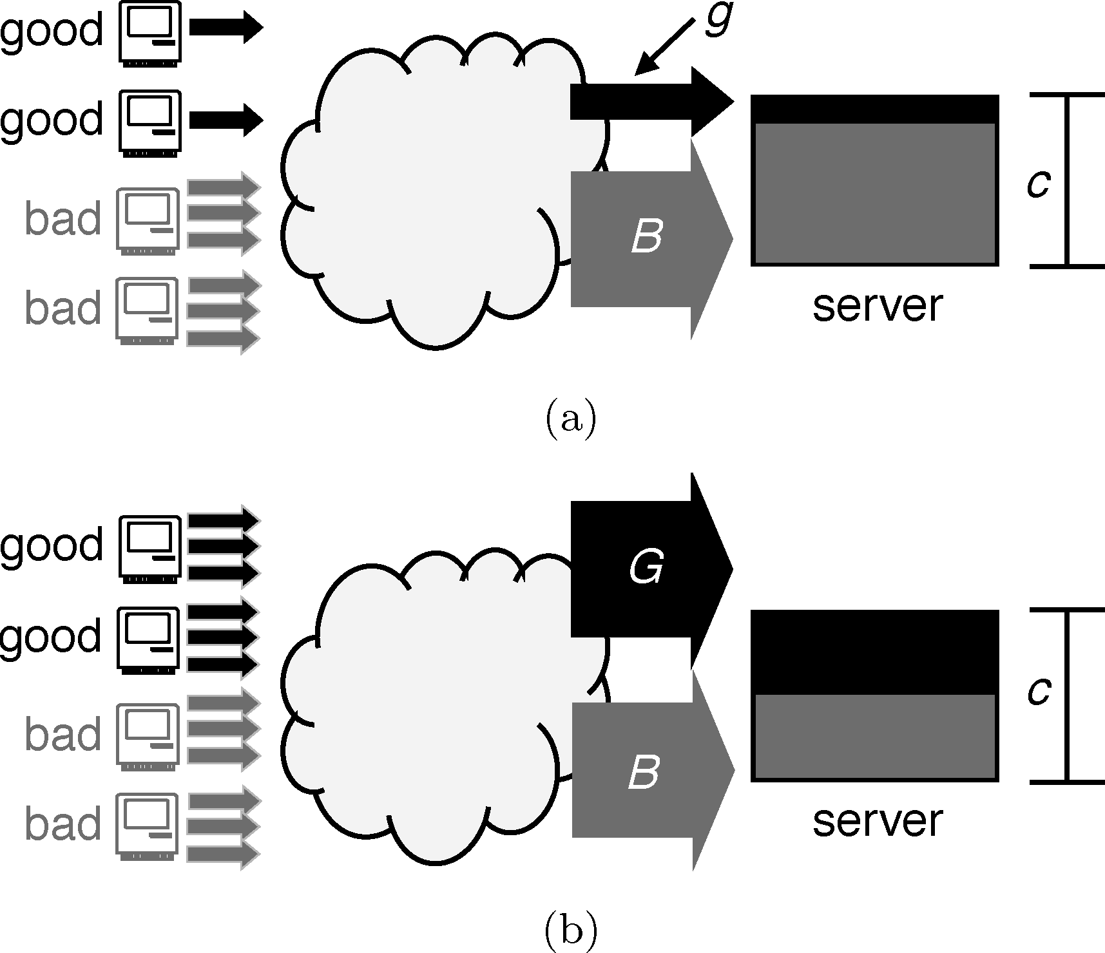
Speak-up
Bad clients exhaust all of their available bandwidth on spurious requests.
Good clients are likely using a only small portion of their available bandwidth.
The key idea of speak-up is to exploit this difference.
Illustration of speak-up
(a) g/g+B (b) G/G+B

Slide 13
Design Goal
Allocate resources to competing clients in proportion to their bandwidth.
- If the good clients make g requests per second and have an aggregate bandwidth of G requests per second to the server and if the bad clients have aggregate bandwidth of B requests per second then the server should process good requests at a rate of min(g,(G/G+B)c) requests per second where c is the servers capacity to process requests.

Slide 14
Required mechanisms
Limit the requests to a server to c per second.
Perform encouragement : cause a client to send more traffic.
Speak-up needs a proportional allocation mechanism to admit client at rates proportional to their delivered bandwidth.
Hence, the thinner appears.

Slide 15
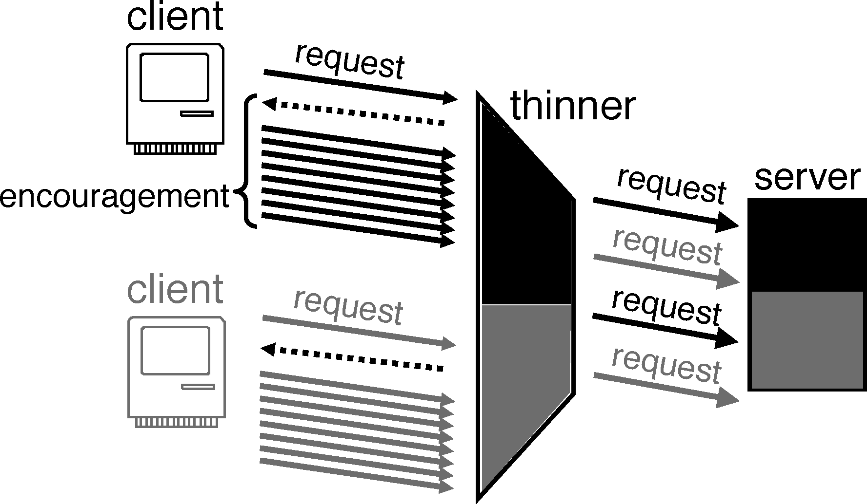
Thinner
Under speak-up, these mechanisms are implemented by a front-end to the server, called the thinner.
Thinner: the thinner implements encouragement and controls which requests the server sees.

Slide 16
Explicit Payment Channel
When server is overloaded, thinner asks clients to open separate payment channels.
Client sends dummy bytes on this channel, becomes a contender.
Thinner tracks how much each contender sends.
When the server notifies the thinner it is ready to fire a new request, thinner admits the client which has sent the most number of padded dummy bytes.

Slide 17
Implementation

Slide 18
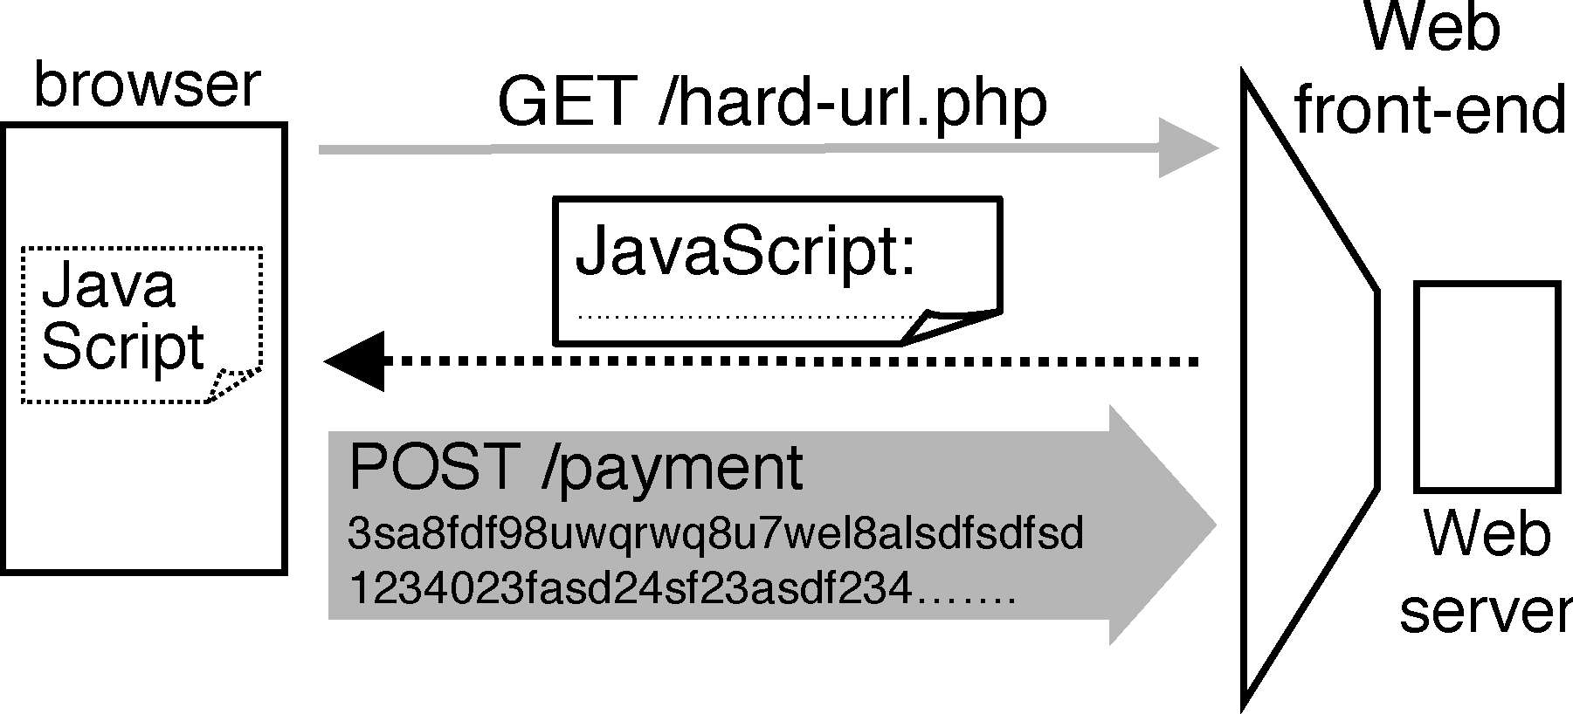
Implementation
A prototype thinner is implemented in C++.
It runs on Linux 2.6 exporting a well know URL.
When a web client requests this URL then thinner decides , if and when to send this request to the server.
When the server responds to that request, the thinner returns HTML to the client with that response.

Slide 19
Implementation
Clients send by Poisson process with limited windows (open requests).
Deterministic service time (all requests equal)
Bad clients send faster, and have bigger windows.
Good client: = 2, w = 1
Bad client: = 40, w = 20
Max. number of clients limited to 50 by testbed.

Slide 20
Configuration parameters
—the capacity of the protected server, expressed in requests per second.
—a list of URLs and regular expressions that correspond to “hard requests.” Each URL and regular expression is associated with a difficulty level.
—the name or address of the server.
—a custom “please wait” screen that humans will see while the server is working and while their browser is paying bits.

Slide 21
Implementation
The Web client requested a “hard” URL(HTTP GET request), the
thinner replies with the “please wait”.
no other connections to the thinner, thinner returns to the client (1) JavaScript that wipes the “please wait” screen (2) the contents of the server’s reply.
other clients are communicating with the client submit, a one-megabyte HTTP POST containing random bytes.
--The client wins an auction, the thinner terminates the POST and submits the client’s request to the server.
--The client does not win, then the thinner returns JavaScript that causes the browser to send another POST, and the process described in the previous paragraph repeats.

Slide 22
Evaluation

Slide 23
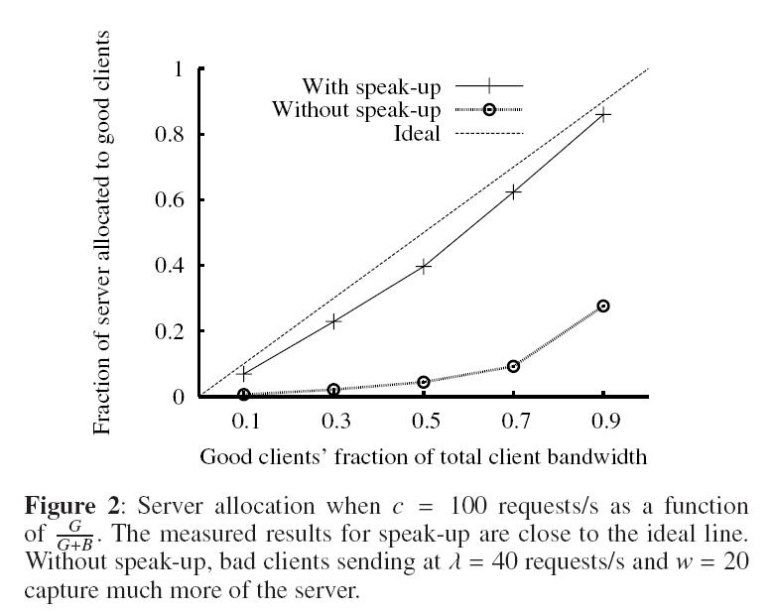
Validating the thinner’s allocation

Slide 24
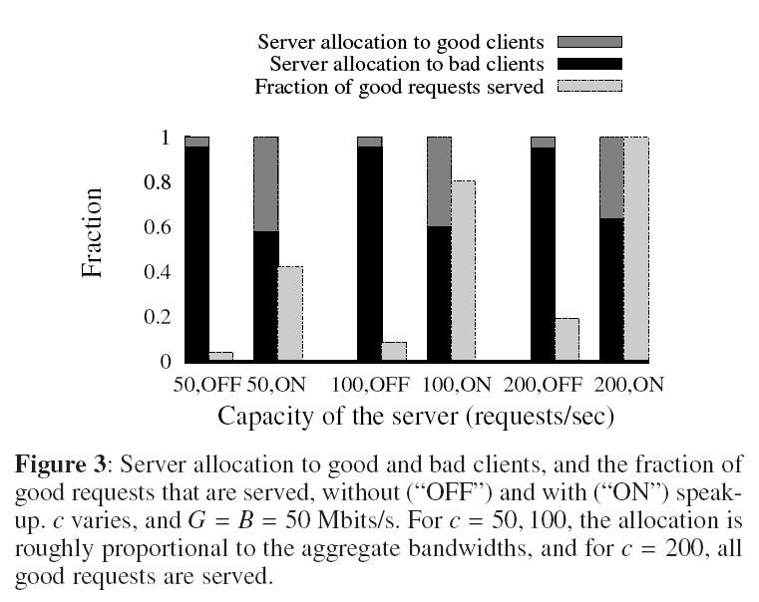
Validating the thinner’s allocation
Setup: 25 good clients, 25 bad clients
Cid = 100 c = 50, 100, 200

Slide 25
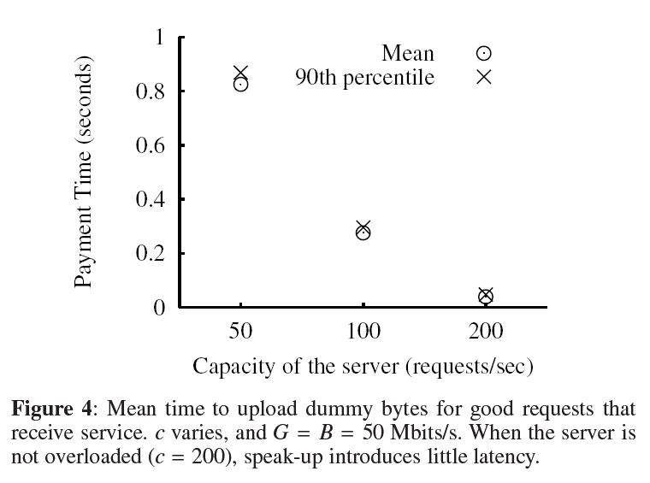
Latency cost

Slide 26
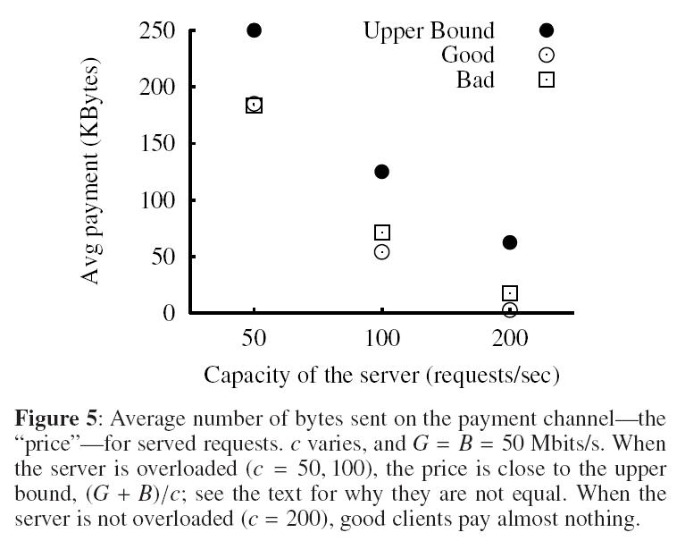
Byte Cost？？？

Slide 27
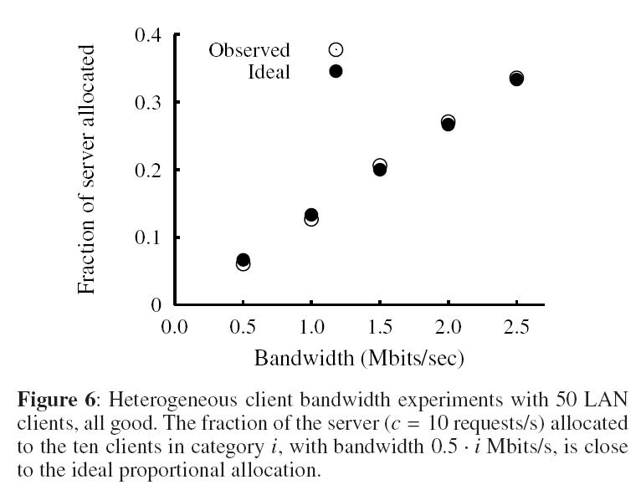
Heterogeneous Network Conditions

Slide 28
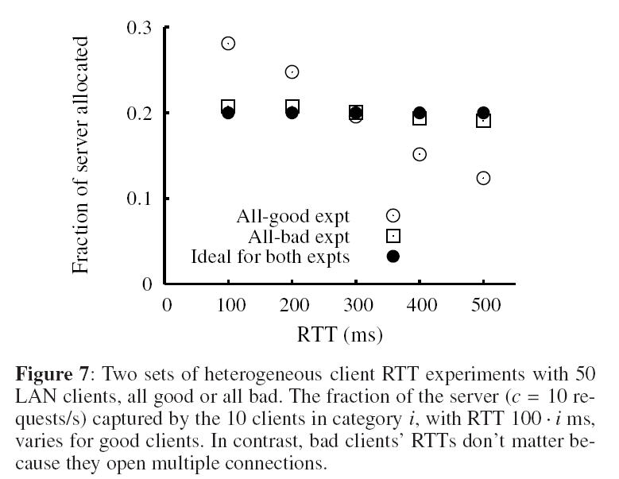
Heterogeneous Network Conditions

Slide 29
Heterogeneous Network Conditions
Good clients with long RTTs do worse than any bad clients
“Effect is limited”
No one gets > 2*ideal
No one gets < 1/2*ideal

Slide 30
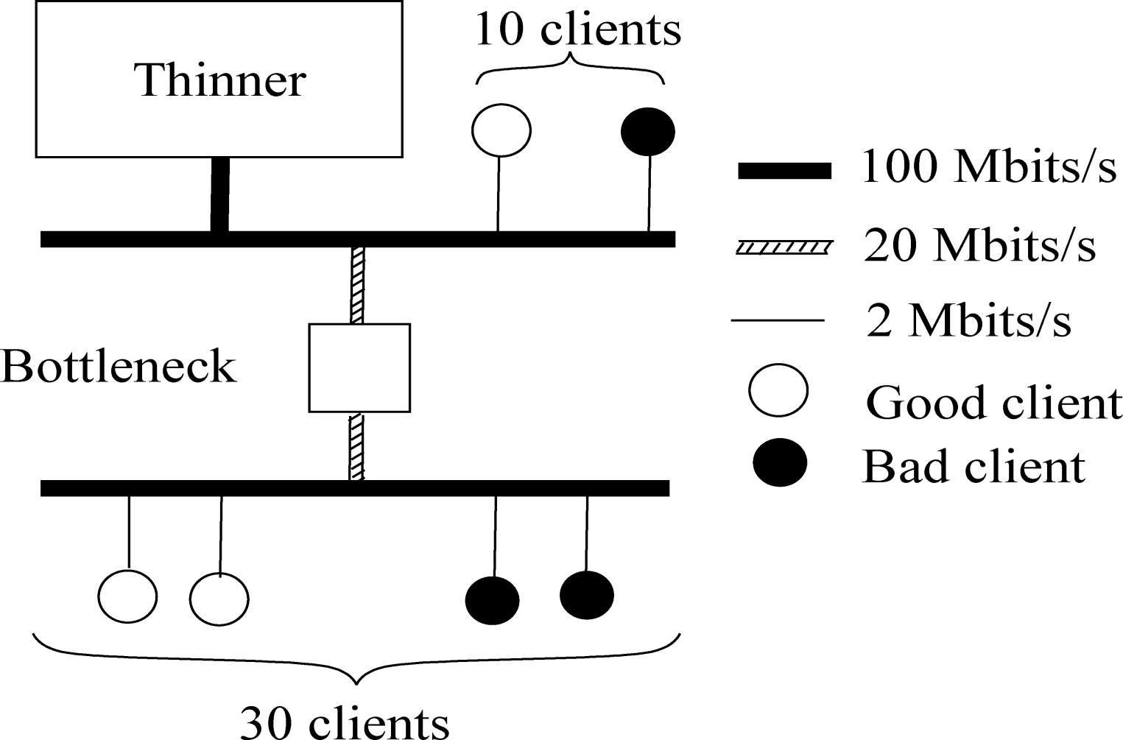
Good and Bad Sharing a Bottleneck

Slide 31
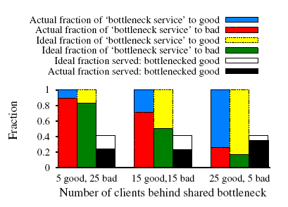
Good and Bad Sharing a Bottleneck

Slide 32
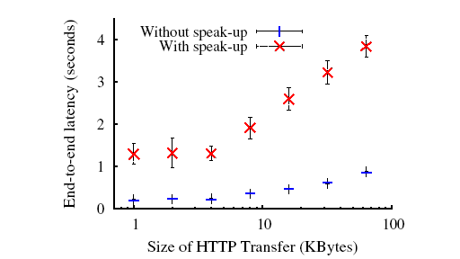
Impact of speak-up on other traffic
Setup:
10 good speak-up clients,
2 Mbits/s;
H, a host that runs the HTTP client wget. 2 Mbits/s;
Bottleneck link, m: 1 Mbit/s;
one-way delay 100 ms;
the thinner and S.
In each experiment,
H downloads a file from S 100 times.

Slide 33
Conclusions

Slide 34
Conclusions
This article presents the design, implementation, analysis, and experimental evaluation of speak-up, a defense against application-level distributed denial-of-service (DDoS).
With speak-up, a victimized server encourages all clients, resources permitting, to automatically send higher volumes of traffic.

Slide 35
Conclusions
Advantages
Network elements don’t need to change.
Only need to modify servers and add thinners.
Disadvantages
Everyone floods, so harder to detect bad clients.
Hurts edge networks.
Rendered useless if access links to thinner are saturated.

Slide 36
Questions?

