Slide 1
Finite State Automata
Code at:
http://files.me.com/jeffpk/9443b3

Slide 2

Definition
A finite state automaton (FSA) is a machine that can be in one and only one of a finite set of states at a time.
Transitions cause the FSA to move to a different state. Each state has a finite set of transitions that define what next states are possible.
Transitions are triggered by events. Every transition has an associated event trigger.
A transition may have one or more side-effects associated with its execution. These side-effects are called actions.
An FSA is also sometimes called a finite state machine (FSM)

Slide 3
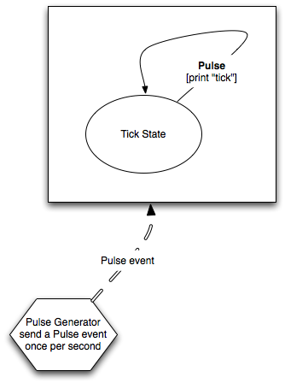
Simple FSA: Tick Clock
What is the output of this FSA?

Slide 4
Tick Clock Output
tick
tick
tick
tick
tick
...

Slide 5
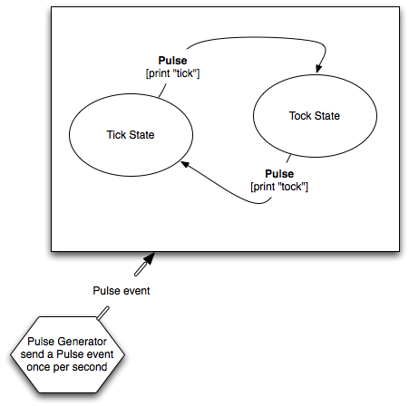
Simple FSA: Tick Tock Clock
What is the output of this FSA?

Slide 6
Output of TickTock Clock FSA
tick
tock
tick
tock
...

Slide 7

State/Transition Tables
An FSA can also be described by a state transition table
State | Event | Action | New State
Tick | Pulse | Print “Tick” | Tock
Tock | Pulse | Print “Tock” | Tick

Slide 8
All common computers are very complex FSAs
Based on something called a “j/k flip-flop.”
j/k flip-flop can be modeled as a fairly simple FSA
j/k flip-flops are combined to create “gates”.
Gates are combined to create computers.
This kind of computer is called a von Neumann architecture machine.

Slide 9
FSAs in Games

Slide 10

In the beginning
There was Zork....
http://files.me.com/jeffpk/d8sb6n
Java Zengine Source: http://sourceforge.net/projects/zpletsourceforge.net/projects/zplet/

Slide 11
Adventure game 101
Adventure games are finite state automata
Your current location is the state of the FSA
Typed input is an event
Transitions define the result of typed text and move you to a new location (state)
Conditions gate some transitions

Slide 12
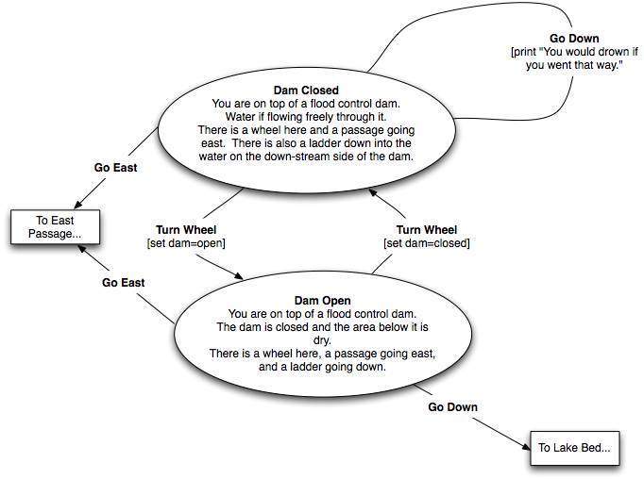
Example: Flood Control Dam #9

Slide 13
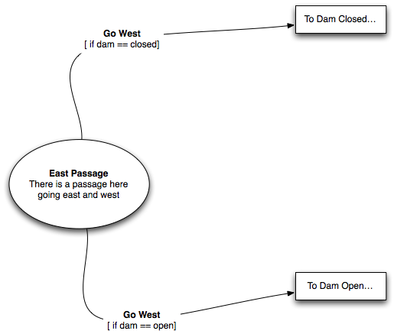
Example: East Passage

Slide 14
State | Event | Condition | Action | New State
Dam Open | look |  | print “You are on top of a flood control dam. Water is flowing freely through it. There is a wheel here and a passage going east. There is also a ladder down into the water on the down-stream side of the dam.“ | Dam Open
Dam Open | go down |  | print “You would drown if you went that way.” | Dam Open
Dam Open | turn wheel |  | print “The water has stopped flowing through the dam.” damOpen=true | Dam Closed
Dam Closed | look |  | print “You are on top of a flood control dam. The dam is closed and the area below it is dry. There is a wheel here and a passage going east. There is also a ladder down to the dry lake bed below.” | Dam Closed
Dam Closed | go down |  | print “You went down the ladder” | Lake Bed
Dam Closed | turn wheel |  | print “The water has started flowing through the dam.” damOpen=false | Dam Open
Lake Bed |  |  | print “You are in a dry lake bed, a tunnel in the wall goes south.” | Lake Bed
Dam Open | go east |  |  | East Passage
Dam Closed | go east |  |  | East Passage
East Passage | go west | if damOpen==true |  | Dam Open
East Passage | go west | if damOpen==false |  | Dam Closed
East Passage | look |  | print “You are in a narrow passage. There is an exit to the west.” | East Passage

Slide 15
Mini-adventure state transition table
State | Event | Condition | Action | New State
Dam Closed | go down |  | print “You would drown if you went that way.” | Dam Closed
Dam Closed | Turn Wheel |  | set dam=open | Dam Open
Dam Open | go down |  |  | Lake Bed
Dam Open | Turn Wheel |  | set dam=closed | Dam Closed
Dam Closed | go east |  |  | East Passage
Dam Open | go east |  |  | East Passage
East Passage | go west | if dam is closed |  | Dam Closed
East Passage | go west | if dam is open |  | Dam Open

Slide 16
What about look?
“look” event should print the description
How might we implement this?

Slide 17
A look event for every state
Explosion of transitions
NxM where N is the number of “global” events and M is the number of states
There should be a better way...

Slide 18
Pervasive Transitions
A transition that is defined for all states.
Can represent with a wildcard in the table...

Slide 19
Mini-adventure state transition table
State | Event | Condition | Action | New State
Dam Closed | go down |  | print “You would drown if you went that way.” | Dam Closed
Dam Closed | Turn Wheel |  | set dam=open | Dam Open
Dam Open | go down |  |  | Lake Bed
Dam Open | Turn Wheel |  | set dam=closed | Dam Closed
Dam Closed | go east |  |  | East Passage
Dam Open | go east |  |  | East Passage
East Passage | go west | if dam is closed |  | Dam Closed
East Passage | go west | if dam is open |  | Dam Open
* | look |  | print description | *

Slide 20
What else might a pervasive transition be used for?

Slide 21
Sub functions
Pop up screens
Chat mode
Option setting
Must return to state it came from
Can be implemented with “push” and “pop” transitions
Called a “Pushdown Finite State Automata” or PFSA

Slide 22
Mini-adventure state transition table
State | Event | Condition | Action | New State
Dam Closed | go down |  | print “You would drown if you went that way.” | Dam Closed
Dam Closed | Turn Wheel |  | set dam=open | Dam Open
Dam Open | go down |  |  | Lake Bed
Dam Open | Turn Wheel |  | set dam=closed | Dam Closed
Dam Closed | go east |  |  | East Passage
Dam Open | go east |  |  | East Passage
East Passage | go west | if dam is closed |  | Dam Closed
East Passage | go west | if dam is open |  | Dam Open
* | look |  | print description | *
* | options |  | push state | Options State
Options State | exit |  |  | (pop state)

Slide 23
FSA for AI

Slide 24
Autonomous Agents
An autonomous agent is a software entity that is capable of taking actions without direct human intervention
In MMORPGs, the most common autonomous agent is the MOB or “Mobile Object”
Autonomous agents use AI to determine what they do”

Slide 25
FSA are Context Sensitive
The result of an event is dependent on the external event and the internal state.
FSA are good for modeling a mental state
Because FSA states can be chained sequentially through events, they are also good for modeling processes.

Slide 26
A simple AI
If you bump me, how I react is dependent on my mood:
If I’m happy, I say “excuse me”
If I’m angry, I shove you back.
I start out happy
If I am bumped, I get angry
Volunteer to draw the state transition diagram?

Slide 27
State Transition table for Bump
State | Event | Condition | Action | New State
Happy | Bump |  | print “Excuse me” | Angry
Angry | Bump |  | print ”**shoves you**” | Angry

Slide 28
What is the eventual result of this AI?

Slide 29
A process: Falling Asleep
Unless I am a Narcoleptic, I don’t go from wide awake to fast asleep
I go from wide awake to sleepy to drifting to full sleep
We can model this process as a set of states in an FSA

Slide 30
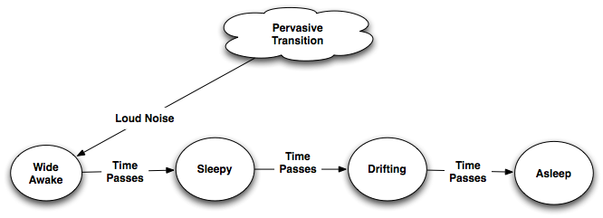
FSA for falling asleep
Note the use of the pervasive transition. A loud noise returns us to Wide Awake from any state

Slide 31
Miner 49er
Miner 49er is a simple textual simulation with an autonomous agent.
The agent is a miner
The miner is modeled with FSA
The simulation plays out in game turns called “ticks”.
The miner takes one action per tick. titickticktick.icktick.referredto as a “tick”

Slide 32
Miner 49er Rules
One action per tick
Mining action adds 1 to gold and 1 to thirst
Travel between mine and town adds 1 thirst
Can carry no more then 10 gold at a time
Cannot work when thirst is 15 or higher

Slide 33
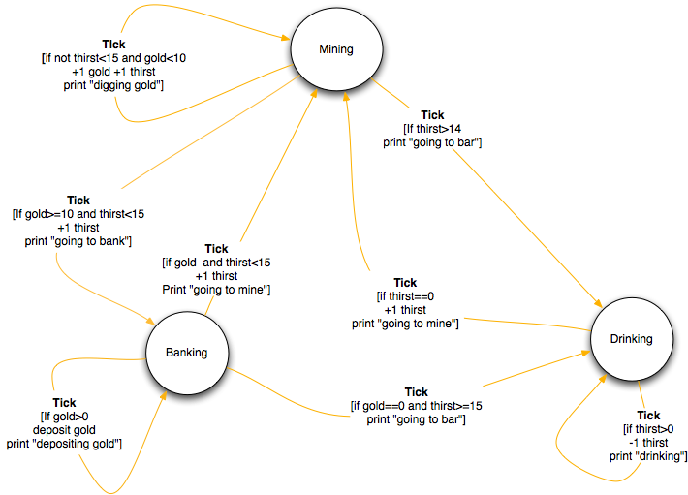
Miner 49er State Transition Diagram

Slide 34
Miner 49er State Transition Table
State | Event | Condition | Action | New State
Mining | Move | thirst<15 gold<10 | Mine | Mining
Mining | Move | gold=10 | Goto Bank | Banking
Mining | Move | thirst=15 | Goto Bar | Drinking
Banking | Move | gold>0 | Deposit | Banking
Banking | Move | gold=0 thirst>=15 | Goto Bar | Drinking
Banking | Move | gold=0 thirst<15 | Goto Mine | Mining
Drinking | Move | thirst>0 | Drink | Drinking
Drinking | Move | thirst=0 | Goto Mine | Mining

Slide 35
`

Slide 36
Homework
Optimize Miner49er
Current strategy is not optimal, final gold owned in 60 ticks is 20.
Study the rules and the state diagram
How can we increase the amount of gold mined without breaking the rules?
Hint: Im going to change the number of turns for the competition

Slide 37
Lecture 2: The FSA Library and More Miner 49er and Beyond

Slide 38
Class 1:
Review
An FSA is a collection of states, one of which is current
A state is a collection of transitions
triggered by events, only one is triggered per event
can have condition and action
set the new current state
Pervasive transitions belong to all states
Push down transitions can remember previous state

Slide 39
Miner 49er State Transition Diagram

Slide 40
Miner 49er State Transition Table
State | Event | Condition | Action | New State
Mining | tick | thirst>14 | +1 thirst Print “going to bar” | Drinking
Mining | tick | gold>=10 | +1 thirst Print “going to bank” | Banking
Mining | tick |  | +1 thirst, +1 gold Print “digging gold” | Mining
Banking | tick | gold>0 | account += gold, gold=0 Print “depositing gold” | Banking
Banking | tick | thirst>=15 | Print “going to bar” | Drinking
Banking | tick |  | Print “going to mine” | Mining
Drinking | tick | thirst>0 | -1 thirst Print “drinking” | Drinking
Drinking | tick |  | +1 thirst Print “going to mine” | Mining

Slide 41
The FSAImpl Class

Slide 42
The FSA Library
Provides Finite State Automata framework
Designed with interfaces
eg FSA is an interface that defines the public calls on an FSA
Implemented with classes called ...Impl
eg the class that implements the FSA interface is called FSAImpl
Good paradigm: Design with interfaces, implement with classes.

Slide 43
FSA Interface
using System; namespace KAI.FSA { /// <summary> /// This interface defines the publicly visible interface to a Finite State Automata /// Author: Jeffrey P. Kesselman /// </summary> /// public interface FSA { /// <summary> /// This call trigger's the first transition in the current state whose /// event is equal to evt (case sensative) and whose conditions all resolve to true. /// </summary> /// <param name="evt"> /// The event to process. <see cref="String"/> /// </param> /// <returns> /// The Transition that fired, or null if none fired /// </returns> /// Transition DoEvent(String evt); /// <summary> /// This sets the current state of the FSA /// </summary> /// <param name="state"> /// The current state <see cref="setCurrentState"/> /// </param> void SetCurrentState(State state); /// <summary> /// Creates a new state that is part of this FSA /// </summary> State MakeNewState(string name=null); /// <summary> /// Creates a new state of the passed type that is part of this FSA /// </summary> T MakeNewState<T>(string name=null) where T : State;
/// <summary> /// Gets the current state of this FSA /// </summary> /// <returns> /// the current state <see cref="State"/> /// </returns> State GetCurrentState(); /// <summary> /// Pushes a state ontoi this FSA's state stack /// </summary> /// <param name="state"> /// the state to push <see cref="State"/> /// </param> void PushState(State state); /// <summary> /// Pops the last pushed state and returns it /// </summary> /// <returns> /// the popped State or null if the stack is empty <see cref="State"/> /// </returns> State PopState(); string GetName(); } }

Slide 44
Using the FSA Library:
FSAImpl
FSAImpl is the key class. To create an FSA, you instance FSAImpl or instance a subclass thereof.
Miner.cs is a sub-class of FSAImpl

Slide 45
The FSA Library:
Creating States
The FSA starts out empty. You create states by calling the factory method FSA.makeNewState()
This returns an object that implements the State interface
This object represents one State of the particular FSA.

Slide 46
The FSAImpl Class
using System; using System.Collections.Generic; namespace KAI.FSA { /// <summary> /// This class implements a fintie state machien that matches the FSA interface. /// It is intended that this class be sub-classed by variosu kinds of machines to /// suit their own needs /// </summary> public class FSAImpl : FSA { private List<State> stateList = new List<State>(); public State currentState; public Stack<State> stateStack = new Stack<State>(); private string name; private Boolean traceStates=false; public FSAImpl (string name) { this.name=name; } /// This call trigger's the first transition in the current state whose /// event is equal to evt (case sensative) and whose conditions all resolve to true. /// </summary> /// <param name="evt"> /// The event to process. <see cref="String"/> /// </param> /// <returns> /// The transition that fire or null if no transition fired /// </returns> public virtual Transition DoEvent(String evt){ if (currentState!=null){ return currentState.doEvent(this,evt); } return null; } public State MakeNewState(string name=null){ return MakeNewState<StateImpl> (name); } public T MakeNewState<T>(string name=null) where T : State{ T newState = (T)Activator.CreateInstance(typeof(T), new object[] { this, name}); stateList.Add(newState); return newState; } public void SetCurrentState(State state){ if (traceStates){ Console.WriteLine("FSA "+name+" set to state "+state.GetName()); } currentState = state; }
protected void AddToStateList(State state){ stateList.Add(state); } /// <summary> /// Gets the current state of this FSA /// </summary> /// <returns> /// the current state <see cref="State"/> /// </returns> public State GetCurrentState(){ return currentState; } /// <summary> /// Pushes a state ontoi this FSA's state stack /// </summary> /// <param name="state"> /// the state to push <see cref="State"/> /// </param> public void PushState(State state){ stateStack.Push(state); } /// <summary> /// Pops the last pushed state and returns it /// </summary> /// <returns> /// the popped State or null if the stack is empty <see cref="State"/> /// </returns> public State PopState(){ if (stateStack.Count==0){ return null; } else { return stateStack.Pop(); } } public string GetName(){ return name; } } }

Slide 47
State Interface
using System; namespace KAI.FSA { /// <summary> /// This interface defines the publicly vidible interface to an FSA state. /// Each object that implements this interface represents a single unique /// state in its owning FiniteStateMachine /// </summary> public interface State { /// <summary> /// This adds a new Standard transition to the end of the state's transition list /// </summary> /// <param name="evt"> /// The event to which the transition repsonds <see cref="String"/> /// </param> /// <param name="conditions"> /// A list of conditiosn that must all evaluate to true to fire this transitions /// <see cref="ConditionDelegate[]"/> /// </param> /// <param name="actions"> /// A list of actions to take when the transition fires<see cref="ActionDelegate[]"/> /// </param> /// <param name="nextState"> /// The new state to which to set this state's owning FSA's current state <see cref="State"/> /// </param> /// <returns> /// An object that represents this transition. <see cref="Transition"/> /// </returns> /// Transition addTransition(String evt, ConditionDelegate[] conditions, ActionDelegate[] actions,State nextState,
String postEvent=null); /// <summary> /// This adds a new push transition to the end of the state's transition list. A push transition is /// like a standard tarnsition except that, when it fires, it pushes the tate's owning FSA's current state /// to that FSA's state stack before executing the actions or transitioning to the new state. /// </summary> /// <param name="evt"> /// The event to which the transition repsonds <see cref="String"/> /// </param> /// <param name="conditions"> /// A list of conditiosn that must all evaluate to true to fire this transitions /// <see cref="ConditionDelegate[]"/> /// </param> /// <param name="actions"> /// A list of actions to take when the transition fires<see cref="ActionDelegate[]"/> /// </param> /// <param name="nextState"> /// The new state to which to set this state's owning FSA's current state <see cref="State"/> /// </param> /// <returns> /// An object that represents this transition. <see cref="Transition"/> /// </returns> Transition addPushTransition(String evt, ConditionDelegate[] conditions, ActionDelegate[] actions,State nextState,
String postEvent=null);
/// <summary> /// This adds a new pop transition to the end of the state's transition list. A pop transition is /// like a standard transition except that it has no defiend new state. Insteadwhen it fires it pops /// the top emember of the state's ownign FSA's state stack off the stack, and sets the FSA's /// current state to that popped state. /// <param name="evt"> /// The event to which the transition repsonds <see cref="String"/> /// </param> /// <param name="conditions"> /// A list of conditiosn that must all evaluate to true to fire this transitions /// <see cref="ConditionDelegate[]"/> /// </param> /// <param name="actions"> /// A list of actions to take when the transition fires<see cref="ActionDelegate[]"/> /// </param> /// <returns> /// An object that represents this transition. <see cref="Transition"/> /// </returns> Transition addPopTransition(String evt, ConditionDelegate[] conditions, ActionDelegate[] actions,
String postEvent=null); /// <summary> /// This method sends an event to the state. The state will execute the /// first transition it finds which matches the event and whose conditions /// all resolve to true. /// </summary> /// <param name="fsa"> /// The fsa that is executing this state <see cref="FSA"/> /// </param> /// <param name="evt"> /// The event represented as a case-sensative string <see cref="String"/> /// </param> /// <returns> /// The transition that fired or null if none fired /// </returns> Transition doEvent(FSA fsa, String evt); string GetName(); } }

Slide 48
The FSA Library:
Adding Transitions
Transitions are created by calling the State.addTransition(...) method
addTransition takes 4 parameters
event string
ConditionDelegate array
ActionDelegate array
new State to transition to
Returns an object that implements the Transition interface

Slide 49
C# Delegates
Delegates are like C function pointers or Java Method objects
Unlike C or Java, C# Delegates contain both a method to invoke and the object to invoke it on
Unlike C or Java, C# Delegates are typed

Slide 50
ConditionDelegate
ConditionDelegate type defined in TransitionImpl.cs
Defines a delegate to a method that takes one parameter of type FSA and returns a boolean.
An instance of Condition Delegate is created with new ConditionDelegate(foo.bar) where method foo.bar() matches the parameters above.
eg public Boolean bar(FSA fsa)
Invoking the delegate is the same as invoking the method it “wraps”

Slide 51
ActionDelegate
Like ConditionDelegate but returns void because actions have no return value

Slide 52
The StateImpl Class
using System; using System.Collections.Generic; namespace KAI.FSA { /// <summary> /// This class is used internally by the FSAImpl and contains the actual state logic /// Author: Jeffrey P. Kesselman /// </summary> public class StateImpl : State { string name; FSA parent; /// <summary> /// This holds the states list of transition in evaluation order /// </summary> private List<Transition> transitionList = new List<Transition>(); /// <summary> /// This is an accessor that allows the transitionList to be acessed as a psuedo variable /// StateImpl.transitions /// </summary> public List<Transition> transitions { /// <summary> /// Sets the state's transition list /// </summary> set {transitionList = value;} // Gets the state's transition list get {return transitionList;} } public StateImpl(FSA parent, string name){ this.name=name; this.parent = parent; } /// This method adds a new atrsnitio nto the end of the transition list public Transition addTransition(String evt, ConditionDelegate[] conditions, ActionDelegate[] actions,State nextState,
String postEvent=null){ Console.WriteLine ("Make transition"); Transition t = new TransitionImpl(evt,conditions,actions,nextState, postEvent); Console.WriteLine ("Add transition to list"); transitionList.Add(t); return t; }
/// This method adds a new atrsnitio nto the end of the transition list public Transition addPushTransition(String evt, ConditionDelegate[] conditions, ActionDelegate[] actions,
State nextState, String postEvent=null){ Transition t = new PushTransitionImpl(evt,conditions,actions,nextState,postEvent); transitionList.Add(t); return t; } /// This method adds a new atrsnitio nto the end of the transition list public Transition addPopTransition(String evt, ConditionDelegate[] conditions, ActionDelegate[] actions,
String postEvent=null){ Transition t = new PopTransitionImpl(evt,conditions,actions,postEvent); transitionList.Add(t); return t; } /// <summary> /// This method sends an event to the state. The state will execute the /// first transition it finds which matches the event and whose conditions /// all resolve to true. /// </summary> /// <param name="fsa"> /// The fsa that is executing this state <see cref="FSA"/> /// </param> /// <param name="evt"> /// The event represented as a case-sensative string <see cref="String"/> /// </param> public virtual Transition doEvent(FSA fsa, String evt){ foreach (Transition t in transitionList){ if (t.getEvent()==evt){ if (t.conditionTest(fsa)){ t.doit(fsa); return t; } } } return null; } public string GetName(){ return name; } } }

Slide 53
Transition Interface
using System; namespace KAI.FSA { /// <summary> /// This interface represents a single state transition /// </summary> public interface Transition { /// <summary> /// This method returns the event that fires this transition /// </summary> /// <returns> /// The event this transition responds to. It is iused by the state to see if this is a /// transition for a specific event <see cref="String"/> /// </returns> String getEvent(); /// <summary> /// This method tests to see if all the transition's conditions return true /// It is used by the state to see if this transition can be fired /// </summary> /// <param name="fsa"> /// The FSA that this condition's owning state belongs to. It is passed /// into conditiosn for their use. <see cref="FSA"/> /// </param> /// <returns> /// true if all conditions resolve to true, else false <see cref="Boolean"/> /// </returns> Boolean conditionTest(FSA fsa); /// <summary> /// This call causes all actions of this transition to occur sequentially in the /// order they were opassed in in this transition's constructor. Then the passed in /// FSA's state is set to this transition's new state. /// </summary> /// <param name="fsa"> /// The FSA that this condition's owning state belongs to. It is passed /// into actions for their use, then fas.setCurrentState(0 is invoked with this /// Transition's new state. <see cref="FSA"/> /// </param> void doit(FSA fsa); } }

Slide 54
Class
TransitionImpl
using System; using System.Collections.Generic; namespace KAI.FSA { public delegate Boolean ConditionDelegate(FSA fsa ); public delegate void ActionDelegate(FSA fsa); /// <summary> /// This class implements the Transition logic. TrabnsitionIMpls are immutable once /// created. /// Author: Jeffrey Kesselman /// </summary> public class TransitionImpl : Transition { private ConditionDelegate[] conditions; private ActionDelegate[] actions; protected State newState; private String evt; private String postEvent = null; public TransitionImpl (String evt, ConditionDelegate[] conditions, ActionDelegate[] actions, State newState, String postEvent=null) { this.newState = newState; this.evt=evt; this.actions= actions; this.conditions = conditions; this.postEvent = postEvent; } public String getEvent(){ return evt; } public Boolean conditionTest(FSA fsa){ if (this.conditions != null) { foreach (ConditionDelegate condition in conditions) { if (!condition (fsa)) { return false; } } } return true; }
public virtual void doit(FSA fsa){ if (this.actions != null) { foreach (ActionDelegate action in actions) { action (fsa); } } if (newState != null) { fsa.SetCurrentState (newState); } if (postEvent!=null){ fsa.DoEvent(postEvent); } } } }

Slide 55
Communication Between FSA
Events can come from other GUI, game logic, or other FSA
Example: Miner’s Wife

Slide 56
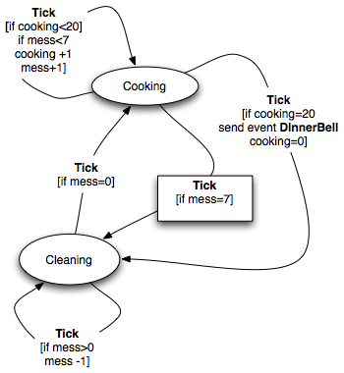
State transition diagram Miner’s Wife

Slide 57
Volunteer to draw the State Transition Table.

Slide 58
Miner’s Wife State Transition Table
State | Event | Condition | Action | New State
Cooking | Move | if cooking=20 | Send Event DinnerBell Print “ringing dinner bell” cooking=0 | Cooking
Cooking | Move | if mess=7 |  | Cleaning
Cooking | Move |  | +1 cooking +1 mess | Cooking
Cleaning | Move | if mess>0 | -1 mess Print “cleaning” | Cleaning
Cleaning | Move |  |  | Cooking

Slide 59
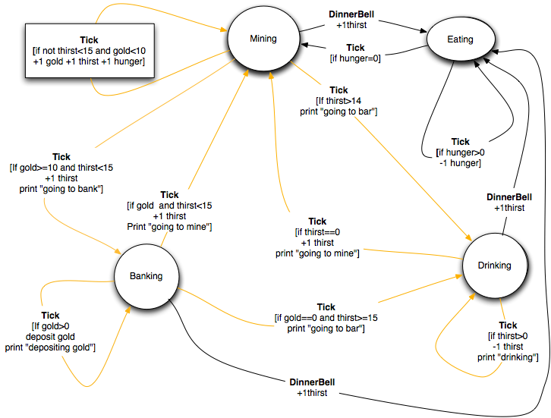
State transition diagram Miner

Slide 60
Anyone want to draw that?

Slide 61
Previous Miner 49er State Transition Table
State | Event | Condition | Action | New State
Mining | Move | thirst>14 | +1 thirst Print “going to bar” | Drinking
Mining | Move | gold>=10 | +1 thirst Print “going to bank” | Banking
Mining | Move |  | +1 thirst, +1 gold Print “digging gold” | Mining
Banking | Move | gold>0 | account += gold, gold=0 Print “depositing gold” | Banking
Banking | Move | thirst>=15 | Print “going to bar” | Drinking
Banking | Move |  | Print “going to mine” | Mining
Drinking | Move | thirst>0 | -1 thirst Print “drinking” | Drinking
Drinking | Move |  | +1 thirst Print “going to mine” | Mining

Slide 62
Miner 49er State Transition Table
State | Event | Condition | Action | New State
Mining | Move | thirst>14 | +1 thirst Print “going to bar” | Drinking
Mining | Move | gold>=10 | +1 thirst Print “going to bank” | Banking
Mining | Move |  | +1 thirst, +1 gold, +1 hunger Print “digging gold” | Mining
Banking | Move | gold>0 | account += gold, gold=0 Print “depositing gold” | Banking
Banking | Move | thirst>=15 | Print “going to bar” | Drinking
Banking | Move |  | Print “going to mine” | Mining
Drinking | Move | thirst>0 | -1 thirst Print “drinking” | Drinking
Drinking | Move |  | +1 thirst Print “going to mine” | Mining
Mining | Dinner Bell |  | Print “going to dinner” | Eating
Drinking | Dinner Bell |  | Print “going to dinner” | Eating
Banking | Dinner Bell |  | Print “going to dinner” | Eating
Eating | Move | hunger>0 | -1 hunger Print “eating” | Eating
Eating | Move |  | print “Going back to mine” | Mining

Slide 63
This is a waste...
State | Event | Condition | Action | New State
Mining | Move | thirst>14 | +1 thirst Print “going to bar” | Drinking
Mining | Move | gold>=10 | +1 thirst Print “going to bank” | Banking
Mining | Move |  | +1 thirst, +1 gold, +1 hunger Print “digging gold” | Mining
Banking | Move | gold>0 | account += gold, gold=0 Print “depositing gold” | Banking
Banking | Move | thirst>=15 | Print “going to bar” | Drinking
Banking | Move |  | Print “going to mine” | Mining
Drinking | Move | thirst>0 | -1 thirst Print “drinking” | Drinking
Drinking | Move |  | +1 thirst Print “going to mine” | Mining
Mining | Dinner Bell |  | Print “going to dinner” | Eating
Drinking | Dinner Bell |  | Print “going to dinner” | Eating
Banking | Dinner Bell |  | Print “going to dinner” | Eating
Eating | Move | hunger>0 | -1 hunger Print “eating” | Eating
Eating | Move |  | print “Going back to mine” | Mining

Slide 64
Natural place for a pervasive transition
State | Event | Condition | Action | New State
Mining | Move | thirst>14 | +1 thirst Print “going to bar” | Drinking
Mining | Move | gold>=10 | +1 thirst Print “going to bank” | Banking
Mining | Move |  | +1 thirst, +1 gold, +1 hunger Print “digging gold” | Mining
Banking | Move | gold>0 | account += gold, gold=0 Print “depositing gold” | Banking
Banking | Move | thirst>=15 | Print “going to bar” | Drinking
Banking | Move |  | Print “going to mine” | Mining
Drinking | Move | thirst>0 | -1 thirst Print “drinking” | Drinking
Drinking | Move |  | +1 thirst Print “going to mine” | Mining
* | Dinner Bell |  | Print “going to dinner” | Eating
Eating | Move | hunger>0 | -1 hunger Print “eating” | Eating
Eating | Move |  | print “Going back to mine” | Mining

Slide 65
How do we send the DinnerBell event?

Slide 66
How do we send the DinnerBell event?
Miner’s Wife holds reference to Miner
call Miner.doEvent()
private communication

Slide 67
How do we send the event?
Event Bus
Bus holds references to all FSA
Miner’s Wife calls EventBus.sendEvent()
Bus calls all registered listeners
Broadcast communication
Can also be used for tick

Slide 68
Lets look at some code

Slide 69
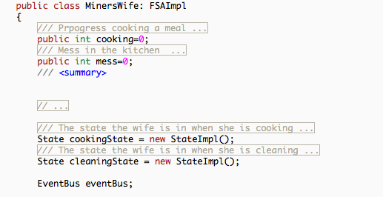
Miner’s Wife header

Slide 70
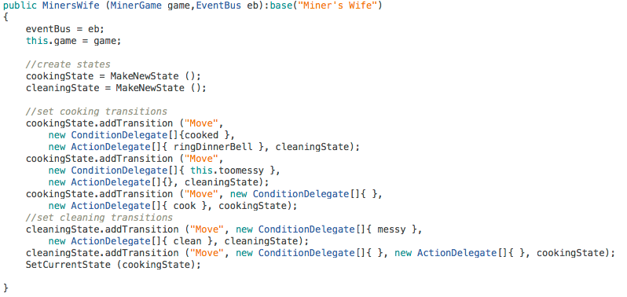
Miner’s Wife Constructor

Slide 71
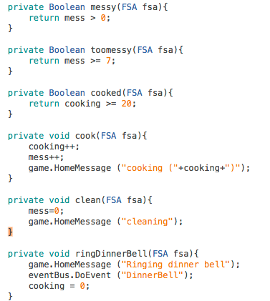
Miner’s Wife actions

Slide 72
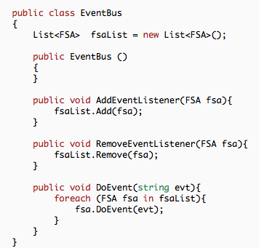
Event Bus

Slide 73
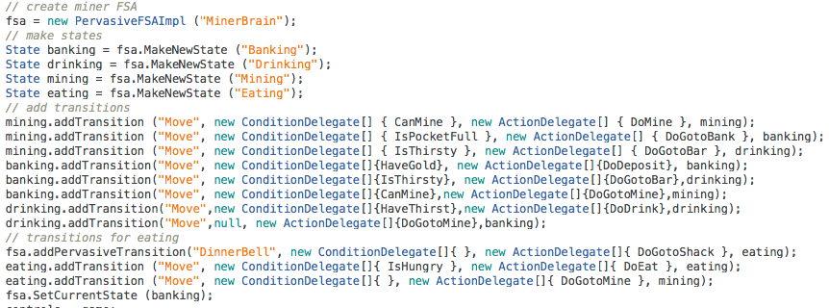
Married Miner

Slide 74
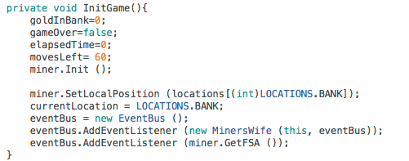
Event Bus Setup in Married MinerGame

Slide 75
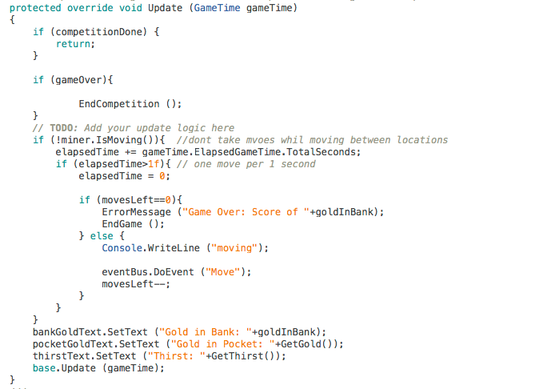
Update in Married MinerGame

Slide 76

New Interface
PervasiveFSA

Slide 77
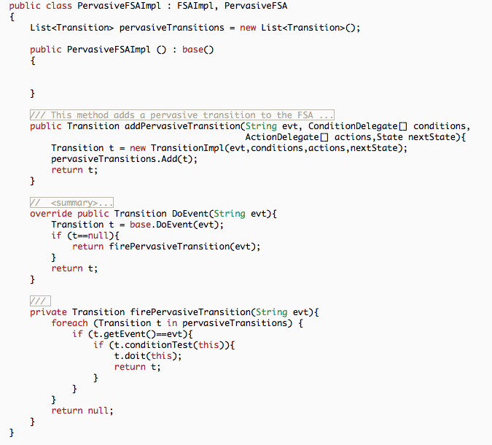

Slide 78
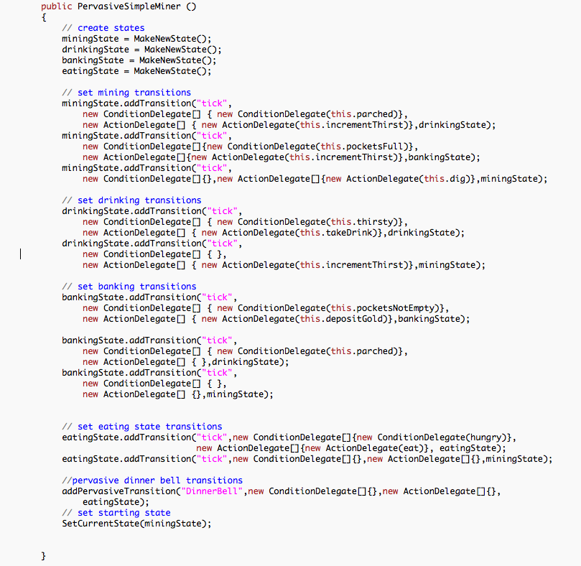
Pervasive Married Miner

Slide 79
Hirearchical State Machines
In the real-world, state machines are often stacked
A parent state machine can have, as its states, a set of state machines.
When a parent state machine is sent an event, which ever child machine is the parent’s “current state” gets the event.
If an event is not handled by the child state machine,it is “percolated” or “bubbled” up to the parent.
Allows for more control and state re-use

Slide 80
Why Hierarchical FSA?

Slide 81
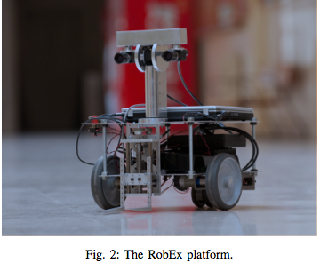
Often used in robotics
Robust Behavior and Perception using Hierarchical
State Machines: A Pallet Manipulation Experiment R. Cintas, L. J. Manso, L. Pinero, P. Bachiller and P. Bustos
http://www.jopha.net/index.php/jopha/article/download/86/77

Slide 82
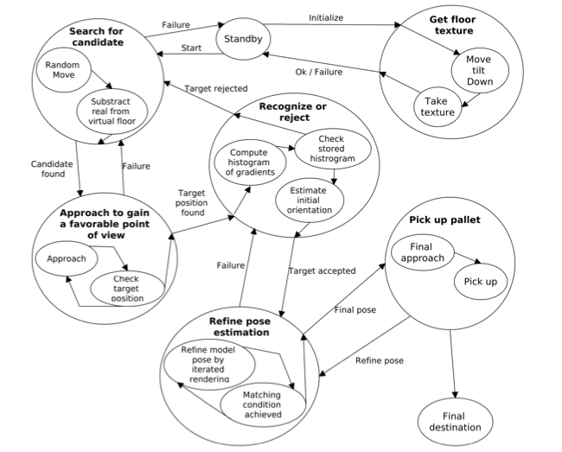
Reason 1:
Organizational Power

Slide 83
Reason 2:
State Proliferation
An adjunct to PFSA
Each FSA remembers its current state independently

Slide 84
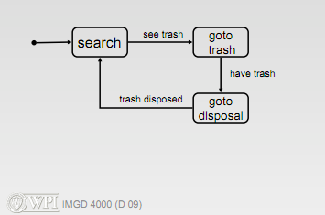
The Trashbot

Slide 85
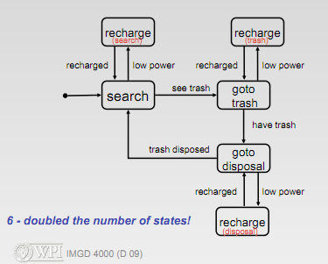
Interruption

Slide 86
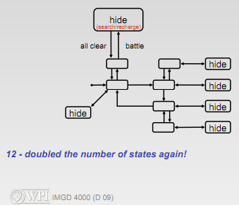
Another interruption

Slide 87
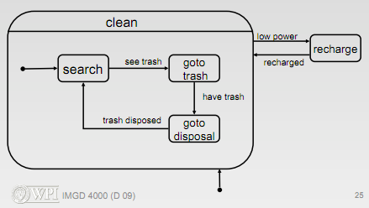
Hierarchical FSA
1 interruption
What would two interruptions look like?

Slide 88
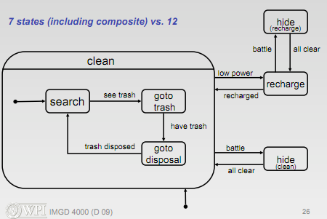
Hierarchical FSA
2 Interruptions

Slide 89
Lets build a Hierarchical Stationary FSA Guard
Standing Guard
Goes to Investigating state if he hears a noise
Goes to Alarmed state if the alarm is triggered
Investigating
Walks in direction of noise for distance D
Returns to previous state if he sees nothing
Goes to Alarm state if he sees anything
Goes to Alarmed state if the alarm is triggered
Alarm state
Goes to closest check point
Triggers alarm
Goes to Alarmed state
Alarmed state
Goes to triggered alarm
Goes to closest noise
Attacks
if opponent defeated, go to next closest noise and attack
if no noise, go to standing guard

Slide 90
Reason 3:
State Reuse

Slide 91
Lets build a Hierarchical Patrolling FSA Guard
Patrolling
Walks between 3 check points.
Clocks in at each check point
Goes to Investigating state if he hears a noise
Goes to Alarmed state if the alarm is triggered
Investigating
Walks in direction of noise for distance D
Returns to previous state if he sees nothing
Goes to Alarm state if he sees anything
Goes to Alarmed state if the alarm is triggered
Alarm state
Goes to closest check point
Triggers alarm
Goes to Alarmed state
Alarmed state
Goes to triggered alarm
Goes to closest noise
Attacks
if opponent defeated, go to next closest noise and attack
if no noise, go to patrolling

Slide 92
How could we improve state reuse?

Slide 93
Adding Push/Pop to the FSA
Two new kinds of Transitions
PushTransitionImpl
PopTransitionImpl

Slide 94
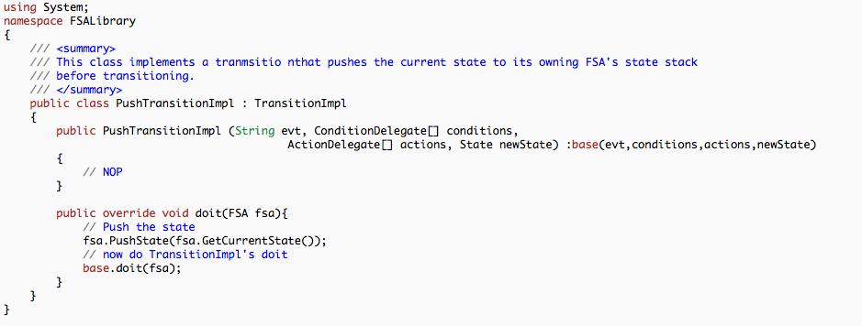
PushTransitionImpl

Slide 95
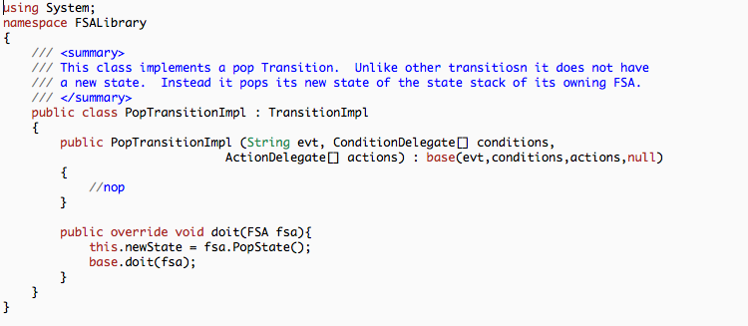
PopTransitionImpl

Slide 96
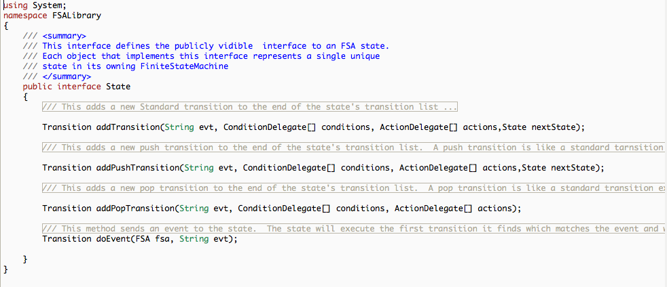
New State methods to make Push and Pop transitions

Slide 97
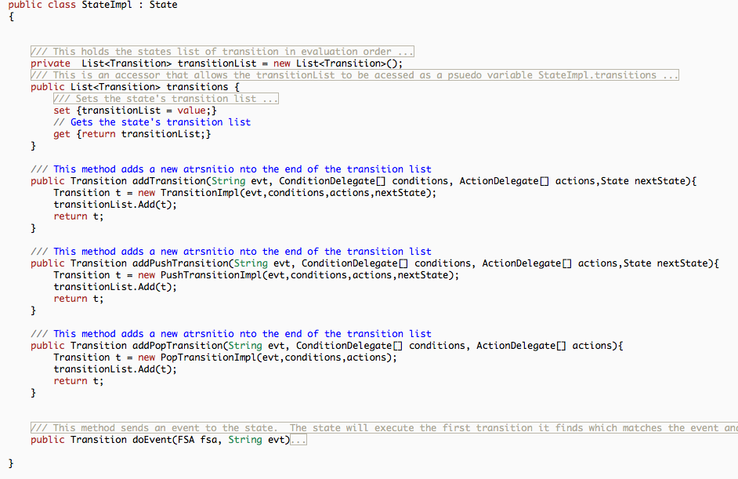
New StateImpl.cs

Slide 98
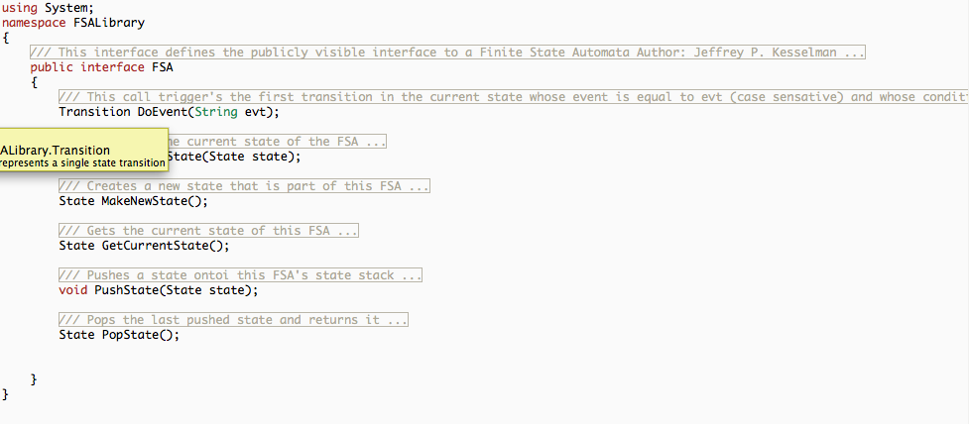
New FSA Methods

Slide 99
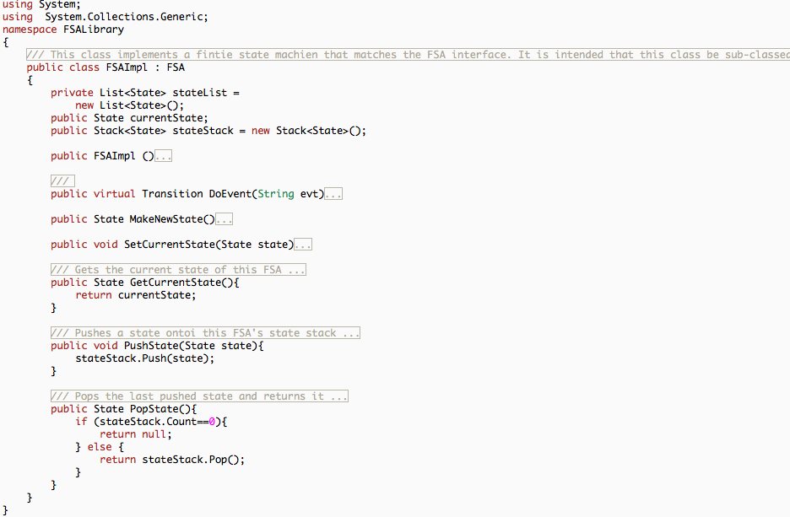
New FSAImpl.cs

Slide 100
Hierarchical FSA Implementation
What makes a HierarchicalFSA different from our existing PervasiveFSA?

Slide 101
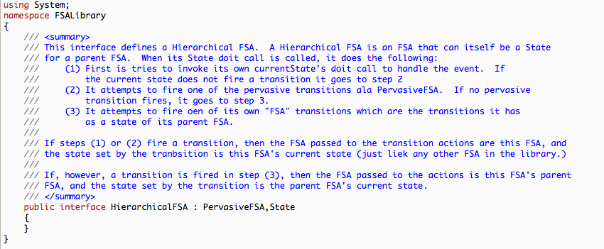
HierarchicalFSA is also a State

Slide 102
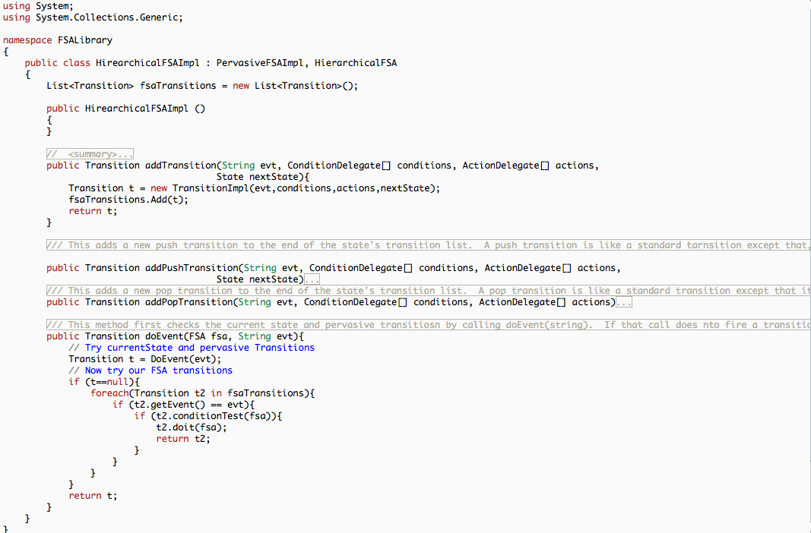
HierarchicalFSAImpl.cs

Slide 103
Implementation of Sneeker32

