Slide 1

Unit one: The history of Multi-player
The Evolutionary Architecture of Online Games

Slide 2
Lecture Overview, Day One
Day One, Lecture
Evolution of games
Review: Single Player Game Structure
Multi-Player game structure

Slide 3
Where game architecture comes from
Game software has DNA
It carries the history of the industry within it
In order to understand current games, you need to understand that history

Slide 4
Where game architecture comes from
Game software has DNA
It carries the history of the industry within it
In order to understand current games, you need to understand that history
Game software usually evolves incrementally
Game development is generally risk adverse
Game development is on tight schedules
Games generally vary only in minor ways from their immediate predecessors

Slide 5
Single Player Game Architecture
The Game Loop, A Review

Slide 6
In the beginning...
The primordial ooze of games
BASIC “guess the number”
10 N = INT(RND(1)*100+1)
20 PRINT “Guess a number between 1 and 100”
30 INPUT G
40 IF G = N GOTO 100
50 IF G < N GOTO 80
60 PRINT “Too high, guess again”
70 GOTO 30
80 PRINT “Too low, guess again”
90 GOTO 30
100 PRINT “You got it!”
110 END

Slide 7
Contains all the “organs” of a modern game
The Game Loop
First, initialize game state
Now loop around update and render
10 N = INT(RND(1)*100 + 1)
20 PRINT “Guess a number between 1 and 100”
30 INPUT G
40 IF G = N GOTO 100
50 IF G < N GOTO 80
60 PRINT “Too high, guess again”
70 GOTO 30
80 PRINT “Too low, guess again”
90 GOTO 30
100 PRINT “You got it!”
110 END
Update and Render are intermingled because BASIC isn’t a structured language

Slide 8
All games have a game loop
Turn Based Games
Stop in update to collect input
One loop around is 1 turn
Example: Chess
Update
Input chess move
Run AI to calculate response
Render
Redraw the board in its new state

Slide 9
All games have a game loop
Real Time Games
Poll input in update and continue
Once around loop is part of a turn
Example: First Person Shooter
Update
Read input keys
Calculate player motion or fire (if any)
Calculate MOB motion and fire (if any)
Move player and Mobs
Render
Animate N ticks (1 frame) of motion and fire

Slide 10
Differences btw Turn Based and Real Time
Turn based
Blocking input
One trip around the loop == 1 game action
Real Time
Polled input
One trip around the loop == fraction of game action

Slide 11
Multi-player games
An evolutionary line

Slide 12

Multi-player, the next evolution
Multiple players on one computer
Turn based
Each player enters their move sequentially in Update
Real Time
Each player has their own set of keys or input device
All players are polled in update
Single Computer
t
u
t
p
u
n
p
I
n
I

Slide 13
Multi-station, the first networked games
Played on LANs
Non-local players are on virtual devices
Other player input happens on foreign machines
Is communicated over network
Is processed on Update at every machine as is all input was local
Computer 1
Input
Computer 2
t
u
t
p
u
n
p
I
n
I

Slide 14
“Lock-step” execution
Every station is running the same game/simulation
Waiting for other input is latency sensitive
Works because LAN latency is effectively infinitesimal
Computer 1
Input
Computer 2
t
u
t
p
u
n
p
I
n
I

Slide 15
Open Loop/Asynchronous Communication
First used in Flight sims
Based on work for SimNet (DIS)
Each system has its own variant world state
Each vehicle is simulated on its “home” machine
Periodic time-stamped state updates sent to others
Lower freq then controller input
Computer 1
Object
Computer 2
State
t
u
t
p
u
n
p
I
n
I

Slide 16
Dead Reckoning
What to do between updates?
Each sim makes a “best guess” at non-local positions
Can use vehicle model to assist eg “tanks don’t fly”
Correct as updates are received
Note: Updates always in past
Requires conflict resolution mechanism
Simplest is “shooter decides”
Computer 1
Object
Computer 2
State
t
u
t
p
u
n
p
I
n
I

Slide 17
Stepping into Cyberspace
First Internet capable games/techniques
Kali
NBIOS emulator over TCP/IP
Lock-step games tended to play badly
reducing packets per second helped bandwidth
latency buffering helped “lag” to some degree
Open loop/asynch tended to play well
Already designed for limited bandwidth hand real net latencies
TCP/IP support added directly to games
Pluggable “net drivers”
More attention paid to latency and bandwidth issues upfront

Slide 18
Internet Play:
Lockstep Pros and Cons
Pros ?

Slide 19
Internet Play:
Lockstep Pros and Cons
Pros
Reasonably cheat proof
Exact synchronization assured
Cons ?

Slide 20
Internet Play:
Lockstep Pros and Cons
Pros
Reasonably cheat proof
Exact synchronization assured
Cons
Everyones experience limited by worst case
Handles latency spikes poorly
Needs to wait til timeout to determine drop v. spike

Slide 21
Internet Play:
Open Loop/Asynch Pros and Cons
Pros?

Slide 22
Internet Play:
Open Loop/Asynch Pros and Cons
Pros
Good at hiding latency
Smooth predict/correct over many frames
Better bandwidth control
Shapable
“Out of sight, out of mind.”
Cons ?

Slide 23
Internet Play:
Open Loop/Asynch Pros and Cons
Pros
Good at hiding latency
Smooth predict/correct over many frames
Better bandwidth control
Shapable
“Out of sight, out of mind.”
Cons
Vulnerable to cheating
Need to trust sender as to position
Need to trust shooter as to hit/miss
Occasional warping or other artifacts
In general, used by all vehicle sims & most MMORPGs

Slide 24
Quake, the first client/server game
Server runs authoritative simulation
Clients sends controller up
Gets OpenLoop/Asynch messages back
Think of client as a really rich controller
Game Server
U
t
O
d
p
O
u
t
u
U
b
p
j
t
a
j
b
n
p
p
d
e
c
e
e
I
n
a
t
c
I
t
t
e
Computer 1
Computer 2
t
u
t
p
u
n
p
I
n
I

Slide 25
Quake, the first client/server game
Pros?
Game Server
U
t
O
d
p
O
u
t
u
U
b
p
j
t
a
j
b
n
p
p
d
e
c
e
e
I
n
a
t
c
I
t
t
e
Computer 1
Computer 2
t
u
t
p
u
n
p
I
n
I

Slide 26
Quake, the first client/server game
Pros
Cheating more difficult
Still not impossible eg. Aimbot
Cons ?
Game Server
U
t
O
d
p
O
u
t
u
U
b
p
j
t
a
j
b
n
p
p
d
e
c
e
e
I
n
a
t
c
I
t
t
e
Computer 1
Computer 2
t
u
t
p
u
n
p
I
n
I

Slide 27
Quake, the first client/server game
Pros
Cheating more difficult
Still not impossible eg. Aimbot
Cons
What looks like a hit to shooter can miss
“Low Ping Bastard” effect
Game Server
U
t
O
d
p
O
u
t
u
U
b
p
j
t
a
j
b
n
p
p
d
e
c
e
e
I
n
a
t
c
I
t
t
e
Computer 1
Computer 2
t
u
t
p
u
n
p
I
n
I

Slide 28
First Person Shooters Today
Still fundamentally the Quake model
Player interactivity limited to control LPB effect
Packet encryption to defeat aimbot and its kin
Far from perfect protection, but generally good enough give transitory nature of game

Slide 29
Game Discovery: LANs
How to find other players?
On LAN, done with broadcast
Initially, game data was broadcast
Limit: One game session per LAN
Later, broadcast game announcement, multi-cast game data
Allows multiple game sessions on same LAN

Slide 30
Game Discovery: WANs
In Cyberspace, nobody can hear you scream
Internet doesn’t allow broadcast
Initially, players manually entered IPs
Found each other through IRC
GameSpy offered discovery service
Programmatic but still over IRC
Simple directory server & chat channels
Funded by advertising on client
TEN and MPath offered complete services
Star network with central matcher and packet server

Slide 31
Game Discovery Today
TEN and MPath are gone
Gamespy offers game-integrated services
Paid for by license fee from developer
Now has comm API
Thin wrapper over sockets
XBox Live/PC Live
Microsoft’s attempt to be TEN/Mpath
Funded by user fees and purchases
Seeing new activity attached to digital distribution
Most notably Steam

Slide 32
Next Up
MUDS and MMORPGs or “The British are coming!”

Slide 33
The British are coming
The evolution of MUDs and MMORPGs
Also, the technologies of the Internet Part 1 or “There and back again”

Slide 34
MUD’s and MMORPGs
Foreign DNA
Born in England

Slide 35
The Multi-User Dungeon
Extension of text adventures for multiple simultaneous players
Textual commands and world simulation
Player submits string to server eg “take sword”
Server updates world state and sends text describing new state to all players
Scaling issue... (any thoughts?)
MUD Server
T
x
t
t
T
e
e
x
e
x
T
e
x
t
T
t
Text terminal
Text Terminal
t
x
t
e
x
T
e
T

Slide 36
Scaling the MUD
Concept of “Room” used to divide players into communication groups
Only players in the same room see each others’ actions
What if you run out of rooms?
No room at the inn...
Room
Room
T
t
e
t
T
x
x
x
e
t
e
e
x
T
T
t
Text terminal
Text Terminal
t
x
t
e
x
T
e
T

Slide 37
Scaling the MUD
Concept of “Room” used to divide players into communication groups
Only players in the same room see each others’ actions
What if you run out of rooms?
“virtual” or “instanced” rooms
Room
Room
T
t
e
t
T
x
x
x
e
t
e
e
x
T
T
t
Text terminal
Text Terminal
t
x
t
e
x
T
e
T

Slide 38
Ultima Online: The first visual MUD
2D Game for client
Levels or “maps” as in other 2D games
Each player has a position on the map
Server was still a MUD
Map is a feature of the room (now a Zone)
Position is a feature of player
Communication still by text
What issues might this architecture have?
Zone
Zone
T
t
e
t
T
x
x
x
e
t
e
e
x
T
T
t
Local Sim
Local Sim
t
u
t
p
u
n
p
I
n
I

Slide 39
Ultima Online: The first visual MUD
Issues
Over-crowding of popular Zones (“fire marshall limit”)
Scalability limited by power of single server
replicated to handle more users
Server crash loses state of entire world
Static world designs
Key user data persisted
experience
inventory
quest flags
Zone
Zone
T
t
e
t
T
x
x
x
e
t
e
e
x
T
T
t
Local Sim
Local Sim
t
u
t
p
u
n
p
I
n
I

Slide 40
Everquest: The birth of the Shard
EQ needed more power
More users
More work per user (3D world)
Solved by clustering
Each Zone runs on its own machine
A cluster of Zone servers makes a single world instance or a“Shard”
World cluster is represented to user as a “server”
terminology left over from UO
Zone
Zone
Server
Server
t
t
x
x
T
e
e
T
e
T
T
e
x
x
t
t
Local Sim
Local Sim
t
u
t
p
u
n
p
I
n
I

Slide 41
Everquest: Further load reduction
Moved MOB AI to separate servers
Seen as special kind of player by zone server
Other special purpose servers
chat
commerce
physics (CoX)
Issues?
AI
Zone
Zone
AI
Server
Server
Server
Server
t
t
x
x
T
e
e
T
e
T
T
e
x
x
t
t
Local Sim
Local Sim
t
u
t
p
u
n
p
I
n
I

Slide 42
Everquest: Further load reduction
Issues
Many single points of failure
Zone server failure means loss of Zone state
Like UO but only partial loss of world
Over-crowded zones
return of the fire marshall
Under utilized zones
Waste of resources
AI
Zone
Zone
AI
Server
Server
Server
Server
t
t
x
x
T
e
e
T
e
T
T
e
x
x
t
t
Local Sim
Local Sim
t
u
t
p
u
n
p
I
n
I

Slide 43
Phantasy Star Online:
Return of the Virtual Room
Question: Can we do better scaling then shards?
PSO Answer: Mission Instancing
Limited functionality fixed zone “hubs”
chat
create party
get mission
Mission is virtual zone
process created on a random machine from a pool of zone servers
exists until end of mission

Slide 44
MMORPGs Today
Heavily instanced worlds
Little to no permanent zones
Special servers for chat and commerce
Special servers for statistical tracking

Slide 45
Some challenges facing online games today
Scale continues to increase
Player demands continually grow
Revenue per user on decline
Subscription model under siege from “f2P” and “no monthly fee” games
GW2 may be the nail in the coffin
Micro-transaction revenues over-hyped and under-performing
Zynga, at its best, made $1/user/year in profit

Slide 46
So where can we go from here?
rethinking the role of the server
instead of simulating all game state, act as game communication auditor/verifier
“Rules cop”
comes from F2P side of the world
can scale much better
relaxes real-time constraints
BUT is much more complex to implement and has greater risks of security holes

Slide 47
The Technology of the Internet
How the internet works

Slide 48
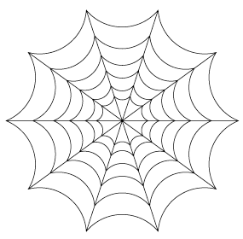
The internet is NOT the web
A phone is not a telecommunication network
Phones use telecommunication networks to communicate information
The web is made of web servers and web browsers
Web servers and browsers use the internet to communicate information

Slide 49
So what is the internet?
Thoughts? Whats it made of?

Slide 50
The internet is a set of interconnected computers
Computers pass data of in a relay-race manner across a variety of data carriers
Telephone lines
Microwave links
Satellite links
etc

Slide 51
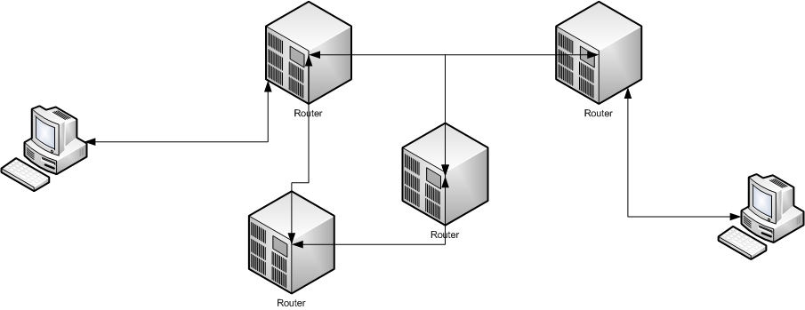
Simplified view of the Internet
Two kinds of computers
client computers
routers
Data “hops” from one router to the next until it reaches its destination
Multiple possible routes
Can watch it travel
traceroute in Unix
tracert in windows

Slide 52
IP and Packets
IP stands for Internet Protocol
The agreed upon language of routers and clients
Every computer on the internet has an IP Address
Unique number that identifies it
Of the form xxx.xxx.xxx.xxx (IP4)

Slide 53
IP addresses are hierarchical
Kind of like your home address
Analogy only: country.city.street.number
Why order it this way?
Hint: How do you go to someone’s house on the same block? How about in a different city in the same country

Slide 54
Network Names
You don’t (usually)connect to an ip address
eg 119.212.32.21
You connect to a name
eg www.facebook.com
How does that become an IP address?

Slide 55
Domain Name System (DNS)
Every destination on the internet is served by a DNS registration sever
maps names to IP addresses
DNS servers tell neighboring DNS servers about their registered servers
every DNS server has at least 2 neighbors
“flood-fills” information on all names over the net
loose, redundant system
very reliable, but takes time to propagate

Slide 56
Passing data on the internet
The act of finding a destination computer is called routing
Every machine knows who its neighbors are (called “peers”)
Machines are arranged hierarchically according to IP
Data passed to next machine “more local’ to destination address.
could be more then one
redundancy deliberate for reliability

Slide 57
Sometimes, data doesn’t arrive
Internet is inherently unreliable
Data can get lost in transit
How might data get lost?
Router failure
Carrier failure
Carrier partial failure (garbled data)
Router overload
dropped from queue

Slide 58
Sometimes data arrives out of order
Sent byte[] A, then byte[] B, then byte[] C all to same destination
Arrive in the order B,C,A
Why?

Slide 59
Sometimes data arrives out of order
Recall that there are multiple routes from sender to receiver
Some routes are faster then others

Slide 60
For thursday
Packets and Making the Internet Reliable
The LAMP stack and Facebook

Slide 61
The Internet: Part 2
Making the Internet Reliable
LAMP and Facebook

Slide 62
Making the internet reliable
For many applications, in order and guaranteed delivery of data are important
TCP/IP is a packet protocol on top of IP that supports this behavior.
What is a packet?

Slide 63
Packets
Fundamental unit of IO on the internet
Header
Generally has an op-code
Might have other info
Sender and receiver
Packet size
etc
Payload
The data being sent
0 or more fields
Can be 0 if no more info then the op-code is needed

Slide 64
Packet Protocol
A definition of a set of related valid packets
Generally defines header
May define one or more structured payloads
typically as “fields”

Slide 65
Nested Protocols
A packet is just a structured hunk of bytes
A packet protocol can define the payload of one of its packets to be all the bytes of a packet from another protocol
Typically outer packet is processed and then payload is passed to logic that processes payload as a complete packet of inner protocol.
Sort of like inheritance for data
Can be many layers deep

Slide 66
IP is the basic protocol of data transfer
Does pretty much everything we’ve discussed so far

Slide 67
UDP is a simple nested protocol
The payload of a UDP packet is an IP packet
UDP header adds some error detection to ensure that we know if a packet arrives mangled.
A Datagram protocol (unconnected)
Still unordered
Stil unreliable

Slide 68
TCP/IP is another nested protocol
TCP/IP Payload is an IP packet
Header says where packet came from and is going to, size of data,etc
Payload of IP packet is transmitted bytes
TCP/IP Header contains reliability information
Packet count
A Stream protocol (connected)
Ordered
Reliable

Slide 69
Overly Simplified TCP/IP Logic
TCP/IP has evolved over 30 years
Complex algorithm that balances reliability and performance with needs of the network.
In a way-overly simplified form:
Each packet in a stream has a monotonically increasing packet number
If a packet is received that has a packet number more then last packet number +1, we lost one
Hold onto this packet and don’t deliver until after lost ones have been delivered
Send a request back to sender to resend lost packets.

Slide 70
Advantages?
When might you want to use TCP/IP?
When might you want to use UDP?

Slide 71
Advantages?
When might you want to use TCP/IP?
when order and reliability are critical
When might you want to use UDP?
when latency is critical
resends result in TCP “stalls”
when bandwidth is critical
under most conditions, TCP has about 28 more bytes per packet then UDP

Slide 72
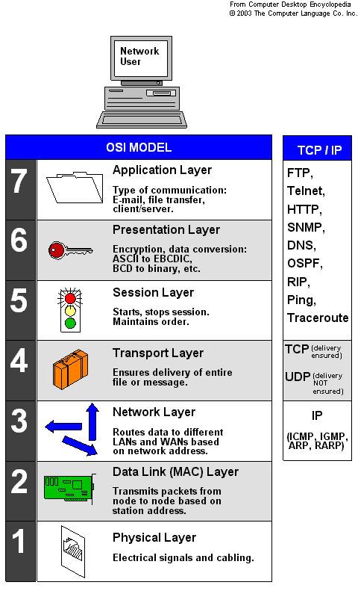
The 7 layer networking stack
A standard logical organization of nested communication protocols
Each higher layer has the lower layer nested within it

Slide 73
All of these application protocols are built on top of TCP or UDP
HTTP ( the web)
built on top of .... ?
RTP (streaming audio and video)
built on top of ... ?
SSH (remote secure login)
built on top of ... ?
Guild Wars
built on top of ... ?
Unreal networking
built on top of ... ?

Slide 74
All of these application protocols are built on top of TCP or UDP
HTTP ( the web)
built on top of TCP/IP
RTP (streaming audio and video)
built on top of UDP
SSH (remote secure login)
built on top of TCP/IP
Guild Wars
built on top of TCP/IP
Unreal networking
built on top of UDP

Slide 75
Hybrids are rare but possible
TEN’s BULLET protocol
TEN was fundamentally a TCP/IP service
BULLET traded bandwidth for latency spike reduction
Main game stream of packets was TCP/IP
Sent a side-channel of UDP packets with sliding window of recent packets
Would “fill in” for stalled TCP/Ip packets if missing ones available in UDP window.

Slide 76
Web Games
Web Games differ from traditional games in a number of ways
They have to handle orders of magnitude more people
They have to work wherever the web works
eg through high firewalls

Slide 77
Web Technologies
Web games rely heavily on web technologies
Scaling is a known problem
By definition work through firewalls
Need to start up quickly
By and large are “asynchronous multi-player”
Players play individually
Can limitedly view and effect other players’ game states

Slide 78
The LAMP Stack
“Linux, Apache, Mysql, PHP”
Also SAMP (Solaris...) and WAMP (Windows...)
The basic server model of the web
Other stacks are possible but have the same basic functions

Slide 79
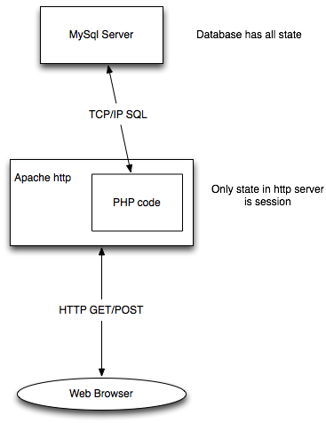
A typical stack
Apache HTTP gets GET/PUT request from browser
PHP is attached to “page” (specific url)
PHP gets and sets state in database as needed, returns resulting http to browser

Slide 80
Linux/Solaris/Windows
The operating system all the servers run on
Linux is most popular (historical reasons)
Solaris arguably is the most scalable
Windows is only used by those who don’t know any better
Usually client-oriented windows shops
WAMP can be useful for local testing on windows box
IMPORTANT: Stack acts more or less the same regardless of operating system its running on

Slide 81
Apache
The industry standard web server
Been around about as long as the web
reliable, fast, well know
A web server receives HTTP requests and serves back HTTP responses

Slide 82
HTTP
The protocol browsers use to talk to the web server
Two kinds of requests
GET
Has parameters on URL
PUT
Has parameters in HTTP message body
Why might these be different? (Hint: look at names)

Slide 83
PHP
The most common web page scripting language (not the only one)
Good for writing simple code to generate web pages
Game REST services written in PHP
Has challenges when writing big systems
Structural support fairly minimal
Performance is not optimal
Often mitigated by scaling horizontally...

Slide 84
MySql
Most commonly used traditional database on the net
First decently featured free enterprise-grade database server
Has a lot of support
All persistent game state lives in the database
transient state can be in session in http server

Slide 85
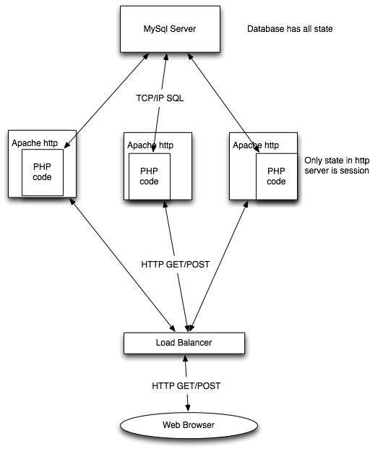
Horizontal Scaling
PHP servers are usually first bottleneck
Scale by replication
Load balancer
Most common type is “round robin dns”
Sticky balancer returns requests from same IP to same server
only needed if there is session state

Slide 86
Web Services
Web services are a way of connecting servers
An API that can be called over the internet to provide arbitrary data function
A number of competing standards
SOAP
JINI
REST
REST won
Simple & elegant
Uses existing web technology

Slide 87
Pure REST
View the server as a set of resources
A resource lives at a distinct url
eg http://nameserver.com/usernames
GET http calls query the resource
eg http://nameserver.com/users?op=find&pattern=Kesselman
PUT http calls modify the resource
eg http://nameserver.com/users
modified version of structure returned in GET is body contents
POST http call makes a new resource
DELETE http call removes a resource

Slide 88
REST as more commonly used
API that may span many resources
GET requests to query
PUT requests to change state
POST and DELETE often unused

Slide 89
Example: Facebook
Facebook serves your web page from your web server in an IFRAME
Facebook provides a REST-ish APi called the GraphAPI for your web app to access its data
example resource: user likes
https://graph.facebook.com/btaylor/likes
returns JSON object with likes data

Slide 90
Authorization
How to keep anyone from accessing REST API
eg what keeps me from querying your “likes” without your permission?

Slide 91
OAUTH 2.0
Based on keys
A key identifies app
Another key identifies user

