Slide 1

R Statistical Tool
Statistical computing and graphics tool
The language is very powerful for writing programs.
Many statistical functions are already built in.
Very powerful for data scientists (YOU)

Slide 2
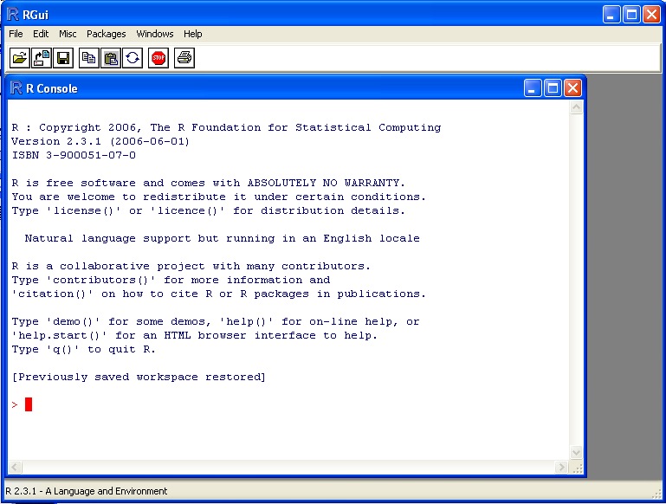
Need to learn it …
The R GUI?

Slide 3
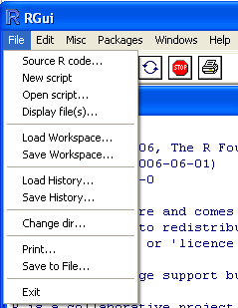
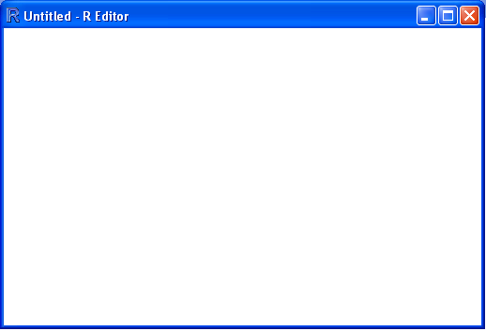
Need to learn it …
Opening a script.
This gives you a script window.

Slide 4
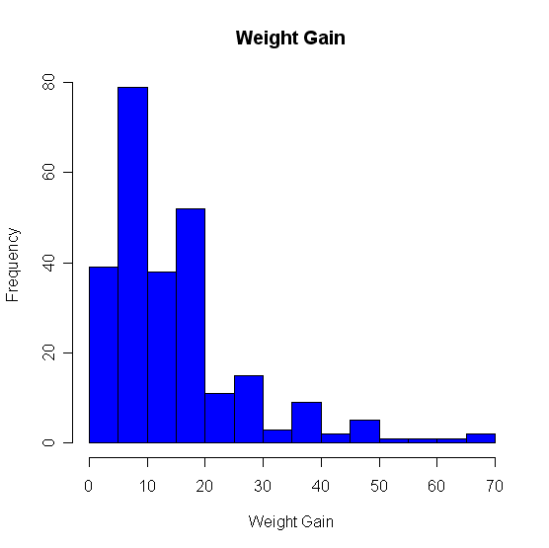
Basic Graphics
Changing colors…
Use the col statement.
  ?colors will give you help on the colors.
  Common colors may simply put in using the name.
  hist(D$wg, main=“Weight Gain”,xlab=“Weight Gain”, ylab =“Frequency”, col=“blue”)

Slide 5
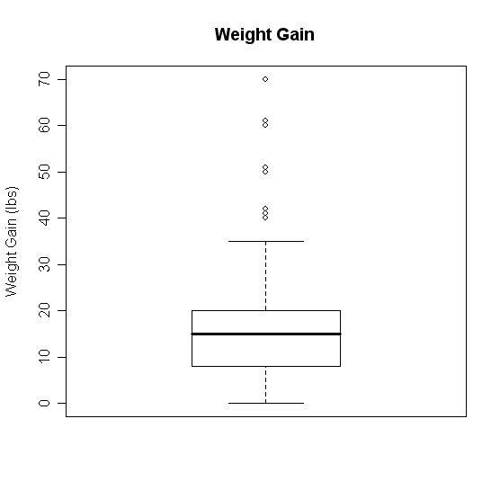
Boxplots
Change it!
boxplot(D$wg,main='Weight Gain',ylab='Weight Gain (lbs)')

Slide 6

RHadoop
R’s Limitations
  Centralized (on single machine)
  Data should fit in memory
Make it distributed…Make it Scalable

Slide 7


RHadoop
From R, you can:
  Write map-reduce jobs
  Submit jobs to Hadoop
  Read/Write from/to HDFS
  All of R’s capabilities

Slide 8
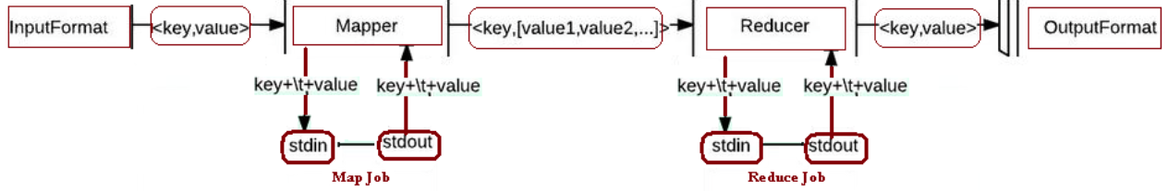
Underlying Mechanism➔ Hadoop Streaming
Can be R code
Rhadoop takes care of building this execution flow
You just write code in R

Slide 9
Lets Have Demo

