Slide 1

Apache YARN
Hadoop Next Generation Compute Platform
Sachin sudarshana

Slide 2
Agenda
What is YARN?
MapReduce1 revisited
Limitations of MR1
Birth of YARN
Architecture of YARN
Application Lifecycle
YARN v/s MRv2
Change in the Hadoop Ecosystem
DEMO
Key Benefits of YARN

Slide 3

What is YARN?
Stands for “Yet-Another-Resource-Negotiator”
  Cluster Resource Managament
A new framework that facilitates writing “arbitrary” distributed processing frameworks and applications.
Popularly christened as the “Data Operating System” for Hadoop

Slide 4
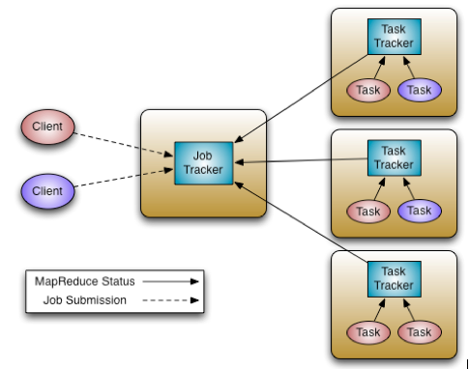
MapReduce1 revisited
Current MR system consists of:
  JobTracker – which is the master
  TaskTrackers – the per-node slaves

Slide 5
Limitations of MR1
Low cluster utilization
  Issues when “map slots” are full while “reduce slots” might be empty and vice-versa
Scalability bottlenecks
  Overburdened JobTracker
  Tracking of resource consumption and job life-cycle management becomes very difficult
Lacks support for Alternate Paradigms and Services
  Everything needs to be MapReduce
  Google Pregel/ Apache Giraph, MPI

Slide 6

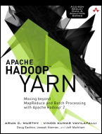
Birth of YARN
YARN was designed to overcome these shortcomings of MR1
Born out of Yahoo! in 2008
  Currently a sub-project of the Apache Hadoop project
Included in Apache Hadoop 2.x onwards
Being proactively developed by Hortonworks

Slide 7
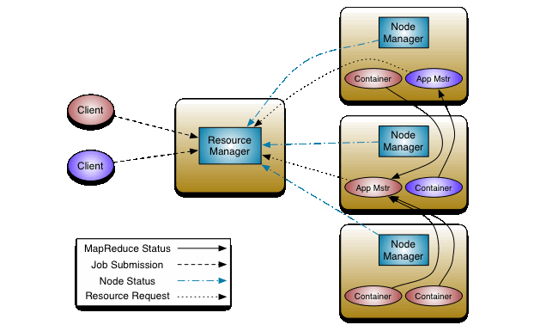
Architecture of YARN
Resource Manager
Containers
Application Master
Node Manager
Source: Hortonworks

Slide 8
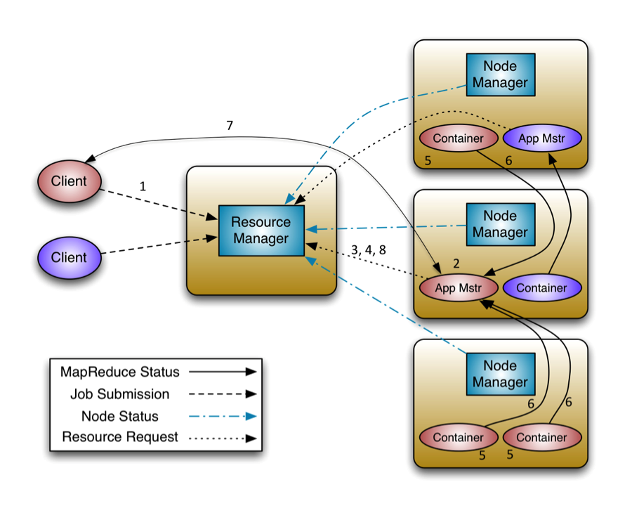
Application Lifecycle
Source: Hortonworks

Slide 9
YARN v/s MRv2 debate
YARN != MRv2
YARN is a framework that can run applications which do not follow the MapReduce model
To run MapReduce jobs on YARN, the old MRv1 was rewritten into MRv2
Each MR job now controls its destiny via its own AppMaster
YARN is a generic platform for any form of distributed application to run on, while MR2 is one such distributed application that runs the MapReduce framework on top of YARN.

Slide 10
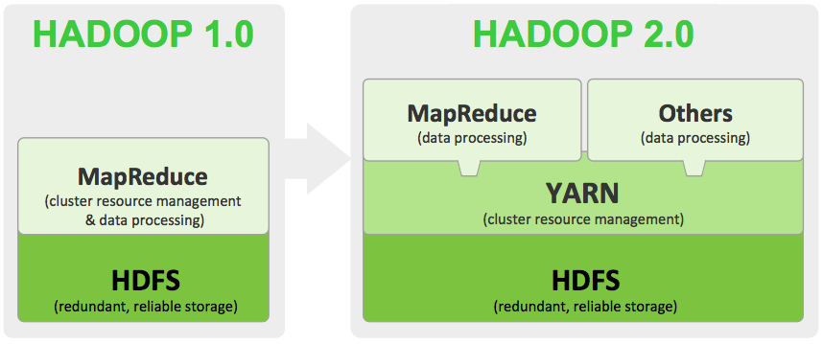
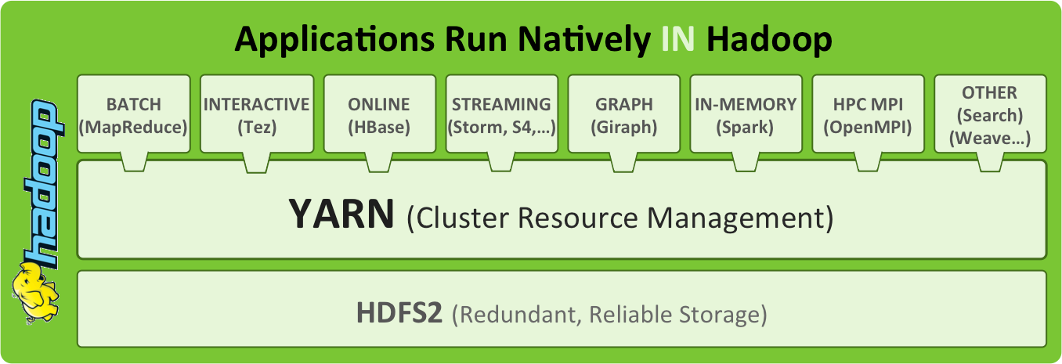
Change in the Hadoop ecosystem
Source: Hortonworks

Slide 11
DEMO

Slide 12
Key Benefits of YARN
Feature | Description
Multi-tenancy | YARN allows multiple access engines (either open-source or proprietary) to use Hadoop as the common standard for batch, interactive and real-time engines that can simultaneously access the same data set. Multi-tenant data processing improves an enterprise’s return on its Hadoop investments.
Cluster utilization & Pluggable Scheduler | YARN’s dynamic allocation of cluster resources improves utilization over more static MapReduce rules used in early versions of Hadoop Allows developers to plug-in their own resource-management code
Scalability | Data center processing power continues to rapidly expand. YARN’s ResourceManager focuses exclusively on scheduling and keeps pace as clusters expand to thousands of nodes managing petabytes of data.
Compatibility | Existing MapReduce applications developed for Hadoop 1 can run YARN without any disruption to existing processes that already work
Source: Hortonworks

Slide 13


