Slide 1
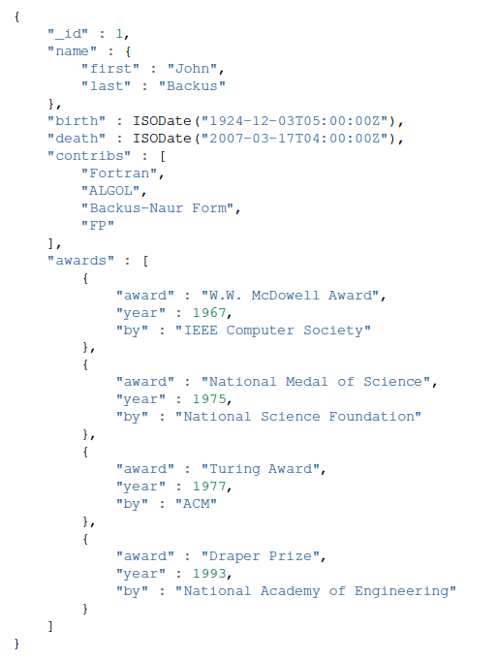
Q1: Report the documents of users where the name is “Alex Chen”
Q2: Update the birth date of _id = 1 to 1944-11-07
Q3: Report the documents of users who got an award after year 1990
Q4: Report only the name of users who have “FP” in the contributions list
Q5: Report only one document where the number of awards is exactly 3
Q6: For user with Id = 1, delete from the awards array the award(s) in year 1977

Slide 2
Q1: Report the documents of users where the name is “Alex Chen”
db.users.find({name: {first: "John", last: "Backus" }})
db.users.find({"name.first": "John", "name.last": "Backus" })
Q2: Update the birth date of _id = 1 to 1944-11-07
db.users.update(
{_id: {$eq: 1} },
{ $set: { birth: "1944-11-07" }}
)
Case Sensitive, Single-Rec update
Q3: Report the documents of users who got an award after year 1990
db.users.find({ "awards.year": {$gt: 1990} } )
Q4: Report only the name of users who have “FP” in the contributions list
db.users.find({contribs: "FP"}, {name: 1, _id: 0} )
Q5: Report only one document where the number of awards is exactly 3
db.users.findOne({awards: {$size: 3}})
Q6: For user with Id = 1, delete from the awards array the award(s) in year 1977
db.users.update(
{_id: 1},
{$pull: {awards: {year:1977}}} )
db.users.update(
{_id: 1},
{$push: {awards: {award: "Myself", year:2010}}} )
For adding to array

