Slide 1
Keyword search in databases: the power of RDBMS

Slide 2
Introduction
Two approaches:
One is to generate a set of relational algebra expressions and evaluate every such expression using SQL on an RDBMS directly or in a middleware on top of an RDBMS indirectly.
Due to a large number of relational algebra expressions needed to process, most of the existing works take a middleware approach without fully utilizing RDBMSs.
The other is to materialize an RDB as a graph and find the interconnected tuple structures using graph-based algorithms in memory

Slide 3
Introduction (cont.)
In supporting IR-styled search, commercial RDBMSs (such as DB2, ORACLE, SQL-SERVER) support full-text keyword search using a new SQL predicate of contain(A, k) where A is an attribute name and k is a user-given keyword.
The middleware(graph-based in-memory algorithms by materializing an RDB as a graph) approach does not fully utilize the functionality of RDBMSs, and only uses SQL to retrieve data.

Slide 4
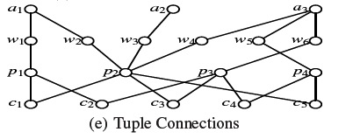
Graph

Slide 5
Preliminary
GD(V,E) on the schema graph GS. Here, V represents a set of tuples, and E represents a set of connections between tuples.
It is worth noting that we use GD to explain the semantics of keyword search but do not materialize GD over RDB.

Slide 6
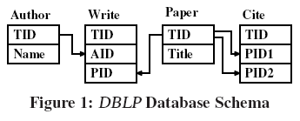
DBLP Database schema

Slide 7
Three types of keyword queries
Connected tree semantics
Distinct root semantics
Distinct core semantics

Slide 8
Connected Tree Semantics
result of such a query is a minimal total joining network of tuples, denoted as MTJNT
a joining network of tuples (JNT) is a connected tree of tuples where every two adjacent tuples, ti 2 r(Ri) and tj 2 r(Rj) can be joined based on the foreign key reference defined on relational schemas Ri and Rj in GS
a joining network of tuples must contain all the m keywords (by total).
a joining network of tuples is not total if any tuple is removed (by minimal).

Slide 9
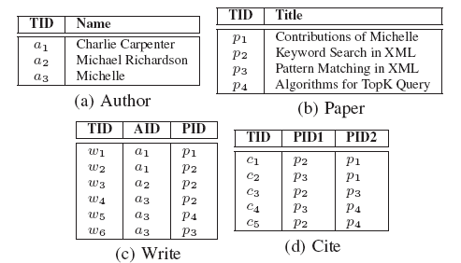
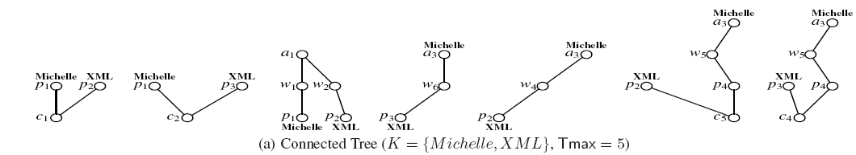
Connected Tree Semantics

Slide 10
Connected Tree Semantics
The size of an MTJNT is the total number of nodes in the tree. Because it is not meaningful if an MTJNT is too large in size, a user-given parameter Tmax specifies the maximum number of nodes allowed in MTJNTs
with a 2-keyword query K = {Michelle,XML} and Tmax = 5. There are 7 MTJNTs shown in following figure.For example, the first connected tree means that paper p1 is cited by paper p2 as specified by tuple c1. Here p1 contains Michelle and p2 contains XML

Slide 11
Distinct Root Semantics
Suppose that there is a result rooted at tuple tr. For any of them-keyword, say kl, there is a tuple t in the result that satisfies the following conditions.
(1) t contains the keyword kl.
(2) Among all tuples that contain kl, the distance between t and tr (tuple root) is minimum.
(3) The minimum distance between t and tr must be less than or equal to a user given parameter Dmax

Slide 12
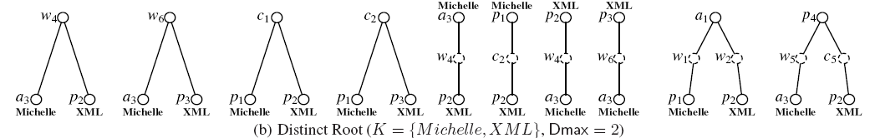
Distinct Root Semantics

Slide 13
Distinct Core Semantics
A community, Ci(V,E), is specified as follows. V is a union of three subsets of tuples, V = Vc union Vk union Vp.
Vk represents a set of keyword-tuples where a keyword-tuple vk element of Vk contains at least a keyword
Vc represents a set of center-tuples where there exists at least a sequence of connections between vc element of Vc and every vk element of Vk such that dis(vc, vk) Dmax, and
Vp represents a set of path-tuples which appear on a shortest sequence of connections from a center-tuple vc element of Vc to a keyword-tuple vk 2 Vk if dis(vc, vk) Dmax.
Note that a tuple may serve several roles as keyword/center/path tuples in a community

Slide 14
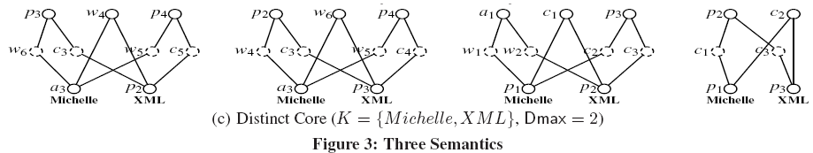
Distinct Core Semantics

Slide 15
CONNECTED TREE IN RDBMS
A candidate network (CN) corresponds to a relational algebra that joins a sequence of relations to obtain MTJNTs over the relations involved. The set of CNs is proved to be sound/complete and duplication-free .
In the second candidate network evaluation step, all CNs generated are translated into SQL queries, and each is evaluated on an RDBMS to obtain the final results.

Slide 16
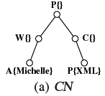
CONNECTED TREE IN RDBMS
CN is a sequence of joins, where the number of nodes is less than or equal to Tmax, and the union of the keywords represented in a CN is ensured to include all the m- keywords.
P{XML} means contain(XML)(￢contain(Michelle)P), or equivalently the following SQL:
select * from Paper as P
where contain(Title, XML)
and
not contain(Title, Michelle)

Slide 17
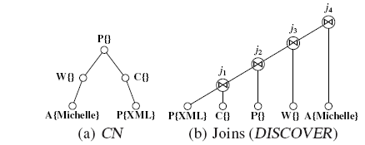
CONNECTED TREE IN RDBMS
All CNs are computed using SQL. An operator tree (join plan) is shown in Figure below to process the CN in Fig. (a) using 5 projects and 4 joins.

Slide 18
CONNECTED TREE IN RDBMS
They propose to use semijoin/join sequences to compute a CN. A semijoin between R and S is defined in Eq. (2), which is to project () the tuples from R that can possibly join at least a tuple in S.
R ⋉S = project(R)(R join S) (2)
Based on semijoin, a join R 1 S can be supported by a semijoin and a join as given in Eq. (3).
R join S = (R ⋉S) join S (3)

Slide 19
CONNECTED TREE IN RDBMS
Given a large number of joins, it is extremely difficult to obtain an optimal query processing plan. It is because one best plan for an operator tree may make others slow down, if its nodes are shared by other operator trees

Slide 20
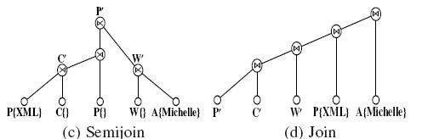
CONNECTED TREE IN RDBMS

Slide 21
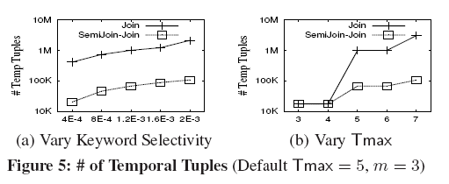
Semi-join better than join operation

Slide 22
Remark
Based on their findings, when processing a large number of joins for keyword search on RDBMSs, it is the best in practice to process a large number of small joins to avoid intermediate join results to be very large and dominative, if it is difficult to find an optimal query processing plan or the cost of finding an optimal query processing plan is large.

Slide 23
DISTINCT CORE IN RDBMS
In the first step, for each keyword ki, we compute a temporal relation, Pairi(tidi, disi, TID), with three attributes, where both TID and tidi are TIDs and disi is the shortest distance between TID and tidi (dis(TID, tidi)), which is less than or equal to Dmax

Slide 24
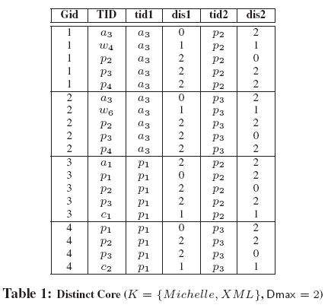
DISTINCT CORE IN RDBMS

Slide 25
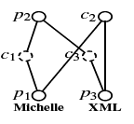
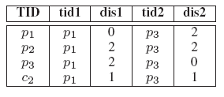
DISTINCT CORE IN RDBMS
the distinct core,
p1 contains keyword Michelle (k1) and
p3 contains keyword XML (k2), and
the 4 centers, {p1, p2, p3, c2}, are listed on the TID column. Any center can reach all tuples in the core, {p1, p3}, within Dmax.

Slide 26
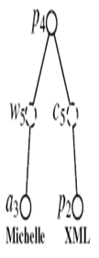

DISTINCT ROOT IN RDBMS
Over the same temporal relation S, we can also obtain the distinct root results by grouping tuples on the attribute TID. Consider the query K = {Michelle,XML} and Dmax = 2, the rightmost result in Fig. below is obtained as follows.
The distinct root is represented by the TID, and the rightmost result in Fig. 3(b) is the first of the two tuples, where a3 contains keyword Michelle (k1) and p2 contains keyword XML (k2).
Note that a distinct root means a result is uniquely determined by the root. As shown above, there are two tuples with the same root p4. We select one of them using the aggregate function min, following the

Slide 27
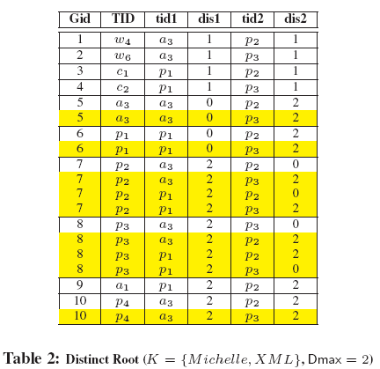
DISTINCT ROOT IN RDBMS

Slide 28
DISTINCT ROOT IN RDBMS
Table 2 shows the same content as Table 1 by grouping on TID in which the yellow colored tuples are removed using the SQL aggregate function min to ensure the distinct root semantics.

Slide 29
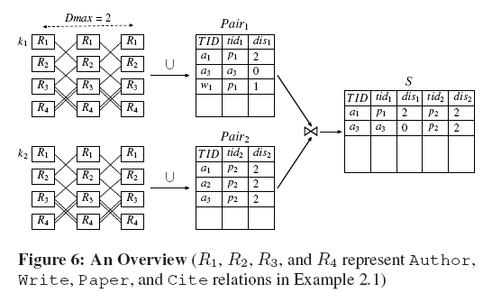
Naive Algorithms

Slide 30
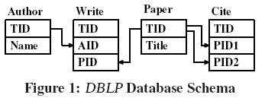
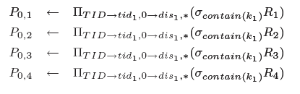
Naive Algorithms

Slide 31
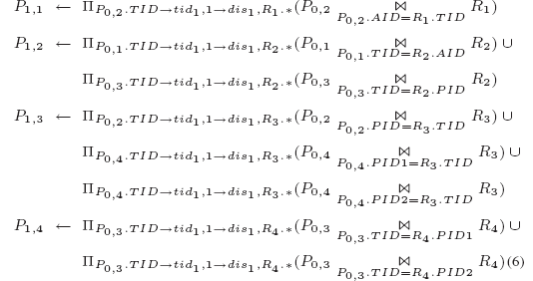
Naive Algorithms

Slide 32
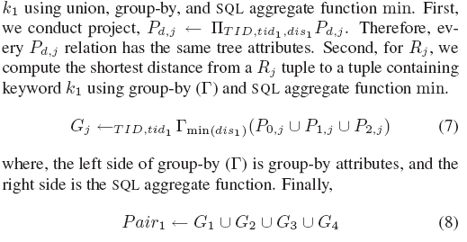
Naive Algorithms

Slide 33

Naive Algorithms
Rule-1: If the same (tidi, TID) value appears in two different Pd′,j and Pd,j , then the shortest distance between tidi and TID must be in Pd′,j but not Pd,j , if d′ < d. Therefore, Eq. (7) can be computed as follows.
There does not exist a shortest path between tid1 and TID before

Slide 34
Naive Algorithms
Rule-2: If there exists a shortest path between tidi and TID value pair, say, disi(tidi, TID) = d′, then there is no need to compute any tuple connections between the tidi and TID pair, because all those will be removed later by group-by and SQL aggregate function min. In Eq. (6), every P1,j , 1 < j < 4, can be further reduced as

Slide 35
Naive Algorithms
The naive algorithm DR-Naive() to compute distinct roots can be implemented in the same way as DC Naive() 2 with 2 group-bys as follows:

Slide 36
Three-phase reduction Algorithm
in the three-phase reduction, we significantly prune the tuples from an RDB that do not participate in any communities.

Slide 37
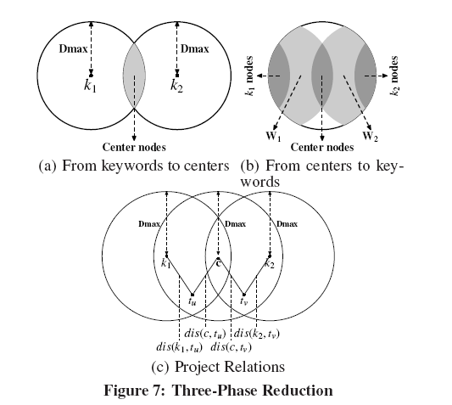
Three-phase reduction

Slide 38
The first reduction phase (from keyword to center):
We consider a keyword ki as a virtual node, called a keyword-node, and we take a keyword-node, ki, as a center to compute all tuples in an RDB that are reachable from ki within Dmax.
Let Gi be the set of tuples in RDB that can reach at least a tuple containing keyword ki within Dmax, for 1 <i< m. Based on all Gi, we can compute Y = G1 join G2 join · · · join Gm which is the set of center-nodes that can reach every keyword-node ki, 1 <i< m, within Dmax

Slide 39
The second reduction phase (from center to keyword)
A tuple t within Dmax from a virtual center-node means that the tuple t is reachable from a tuple in Y within Dmax. We compute all tuples that are reachable from Y within Dmax. Let Wi be the set of tuples in Gi that can be reached from a center in Y within Dmax, for 1 <i< m. Note that Wi subset Gi.
Obviously, only the tuples, that contain a keyword within Dmax from a center, are possibly to appear in the final result as keyword tuples

Slide 40
The third reduction phase (project DB)
We project an RDB′ out of the RDB, which is sufficient to compute all multi-center communities by join Gi join Wi, for 1 <i< m. Consider a tuple in Gi which contains a TID t′ with a distance to the virtual keyword-node ki, denoted as dis(t′, ki), and consider a tuple in Wi which contains a TID t′ with a distance to the virtual center node c, denoted as dis(t′, c).
The sum of two distances range[0,Dmax]

Slide 41
Performance studies
Conducted 3 algo :
semijoin/join based algorithm, denoted Semijoin- Join
the join based algorithm , denoted Join
the block pipeline algorithm (BP) to compute the top 10 answers.

Slide 42
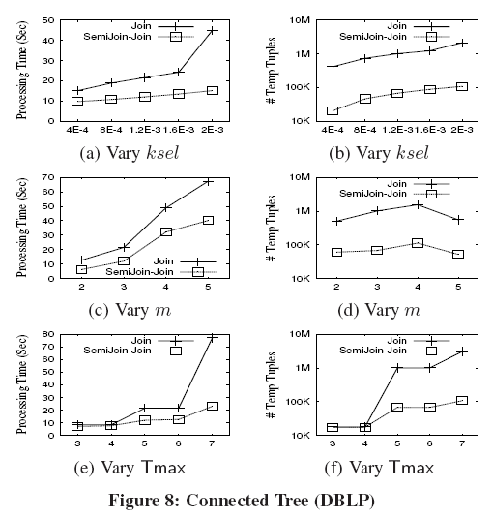
Exp-1: Selectivity Testing
Connected Tree
Ksel :keyword
SelectivityS
M:number of
Keywords
Tmax: Tree size

Slide 43
Exp-1: Selectivity Testing
Connected Tree
Semijoin-Join outperforms Join. When Tmax increases from 3 to 4 or from 5 to 6, the time and number of tuples generated for both do not change, because when the tree size is even, at least one of the Write or Cite tuple will be a leaf node, and such a tree is invalid because Write or Cite do not have text-attributes.

Slide 44
Exp-1: Selectivity Testing
BP is an algorithm to compute top-k connected trees by pushing the ranking connected trees into the CN evaluation with Tmax, and the cost saving of finding top-k is at the expense of computing more SQL to randomly access an RDB.
BP may be unstable because the time for BP does not largely depend on the keyword selectivity but on the distribution of the result trees with large scores. The time for BP increases when m increases, and is not effected by increasing Tmax because the top-k results tend to have small sizes, e.g. <=3.

Slide 45
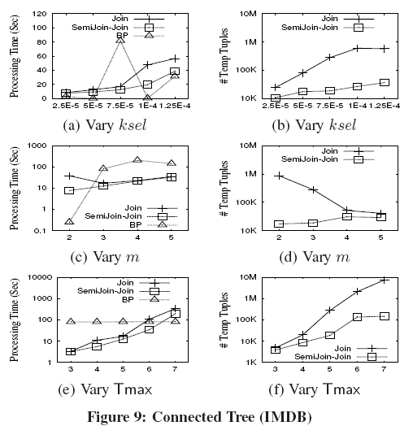
Exp-1: Selectivity Testing

Slide 46
Exp-1: Selectivity Testing
DC generates less number of temporal tuples in all cases, but when Dmax <=2, DC is slower than DC-Naive. This is because, when Dmax is small, the number of intermediate results for DC-Naive is not large. In such a case, the performance of more small joins is not as effective as the performance of joins

Slide 47
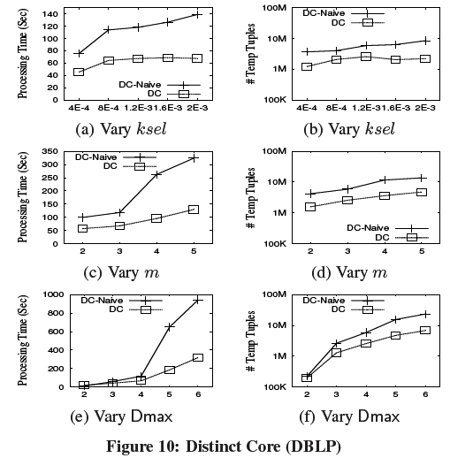
Exp-1: Selectivity Testing

Slide 48
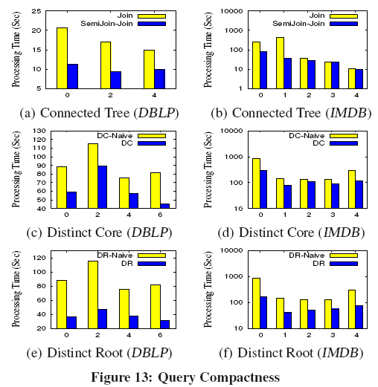
Exp-2: Compactness Testing

Slide 49
Exp-2: Compactness Testing
When the compactness of a query is small, the relationship between tuples that contain different keywords in the query will be tight, the tuples that contain different keywords can be connected even for a small Tmax, and
the number of connected trees generated will be large. It results in large processing time.
Semijoin-Join outperforms Join, because the number of intermediate tuples generated by Semijoin-Join is much smaller.

Slide 50
Exp-2: Compactness Testing
The impact of the compactness values of queries under the distinct core semantics is not as obvious as that under the connected tree semantics.
For example, the processing time with c = 0 is smaller than that with c = 2 under the distinct core semantics. It is because in the first step of the algorithms under the distinct core semantics, all keywords are evaluated individually.
As a result, the cost for the first step is independent with the compactness, and it is possible that the cost for the first step becomes the dominant factor when the number of tuples generated in the first step is large

Slide 51
Contribution
We propose a middleware free approach, to support three types of keyword queries to find the three different interconnected tuple structures.
We take a tuple reduction approach using SQL without additional new indexing to be built and maintained and without any precomputing required
a new approach to prune tuples that do not participate in any resulting connected trees followed by query processing over the reduced relations.
new three-phase reduction approach to effectively prune tuples from relations followed by query processing over the reduced relations

