Slide 1
CS561- Advanced topics in database systems
CS561-Spring 2012
WPI, Mohamed eltabakh
Introduction & Logistics

Slide 2
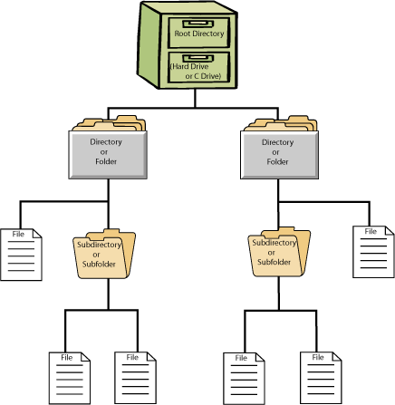
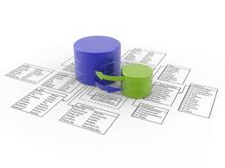
History of dbms
Database systems have evolved since 70s to replace the file system w.r.t storing and querying the data
File system
DBMS

Slide 3
Why dbms ???
Storing and querying the data in file system has many disadvantages
Data redundancy and inconsistency
Multiple file formats, duplication of information in different files
Multiple records formats within the same file
No order enforced between fields
Difficulty in accessing data
Need to write a new program to carry out each new task
No indexes, always scan the entire file
Integrity problems
Modify one file (or field in a file), and not changing the dependent fields or files
Integrity constraints (e.g., account balance > 0) become “buried” in program code rather than being stated explicitly

Slide 4
Why dbms (cont’d) ???
Concurrent access by multiple users
Many users need to access/update the data at the same time (concurrent access)
Uncontrolled concurrent access can lead to inconsistencies
Example: Two people are updating the same bank account at the same time
Security problems
Hard to provide user access to some, but not all, data
Recovery from crashes
While updating the data the system crashes
Maintenance problems
Hard to search for or update a field
Hard to add new fields

Slide 5
Dbms provides solutions
Modeling of applications semantics and constraints
Data consistency even with multiple users
Efficient access to the data
Data integrity embedded in the DBMS
Recovery from crashes, security

Slide 6
Traditional applications of dbms
Transactional data, banking systems, retail stores, airline reservations, restaurant systems, etc…
Characteristics of these applications
Simple and well-structured data
No complex relationships or operations
Simple data types
Querying and reporting is not very complex
Given these ingredients ➔ Relational Database Systems (RDBMS) is a perfect system

Slide 7
Emerging applications !!!
DBMSs are the natural home of the data
Because of all DBMSs desired properties
But, applications are getting more complex
The assumed characteristics of simplicity no longer hold
Database management systems have to change and expand to cope with the new requirements and challenges
Tons of research on advanced topics in DBMSs in many directions
New data models and data formats
New features and access methods
New optimizations and query processing
…

Slide 8
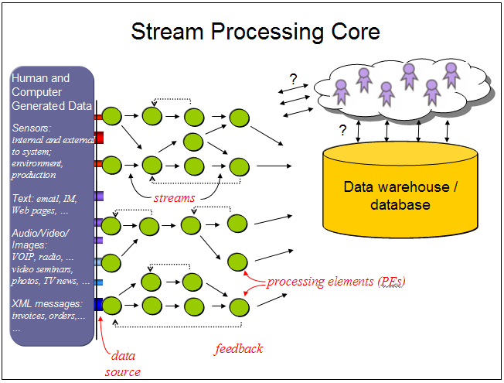

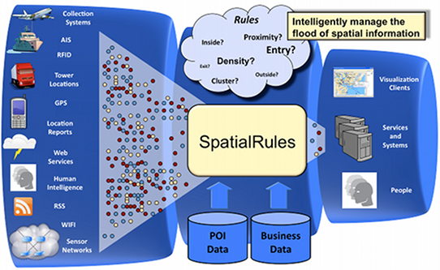
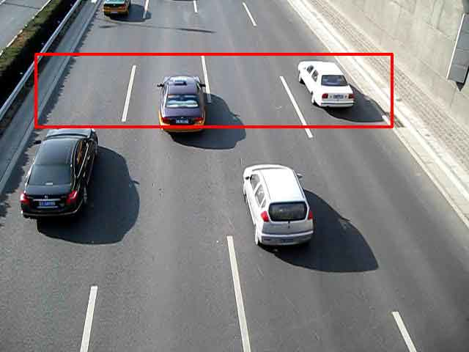
Examples of emerging applications
Data Stream Management Systems
Data are continuously arriving (no persistency)
One-pass main memory processing
Load balancing and load shedding
Moving objects and spatio-temporal applications
Continuous streams of moving objects
Data, by definition, has two key dimensions (space & time)
Special query types, e.g., range queries, KNN queries

Slide 9

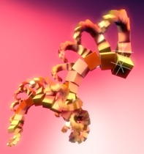

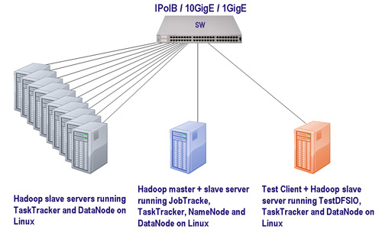
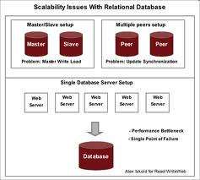
Examples of emerging applications
Scientific Data Management
E.g., in biology, chemistry, physics, atmospheric science, etc.
Complex data types, e.g., arrays, images, sequences, structures
Metadata, annotations and comments about the data
Complex processing and workflows
Provenance and lineage information
Large-Scale Data Analytics and Distributed Processing
Massive scale data processing (terabytes and petabytes)
Highly distributed and parallel processing
New infrastructure and computing paradigms
Distributed DBMSs and Hadoop/MapReduce
framework

Slide 10
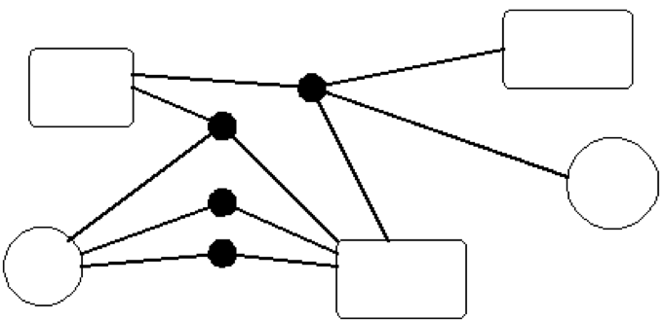
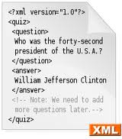
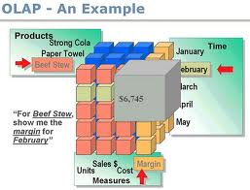
Examples of emerging applications
Data Models for Complex Structures
Object-oriented data model (OODBMS)
Object-relational data model (ORDBMS)
Semi-structured data model (XML)
Data Integration and Data Mining/OLAP
Integrating data from various sources
Entity resolution, schema mapping, etc.
Discovering hidden knowledge (without the users knowing what they want)
The list goes on and on….

Slide 11
Course plan and roadmap
Touch various advanced topics in database systems
Lectures will have two flavors
Typical presentations (given by the instructor) covering book chapters
Research-oriented presentations (given by students) covering research papers

Slide 12
Course plan and roadmap (what you expect to learn)
Typical presentations will cover (By instructor)
Object-oriented and object-relational data models
Semi-structured (XML) data model
Distributed and parallel database
Active Databases and authorizations
Information Integration and OLAP
Hadoop and scientific data management
Research-oriented presentations (By students)
Flexibility based on your interest
Suggested areas are:
Scientific data management
Hadoop/MapReduce Infrastructure
Keyword search in database systems
Cloud computing
Data integration
50% of lectures
50% of lectures

Slide 13
Brief overview on course’s topics (Typical Presentations)

Slide 14
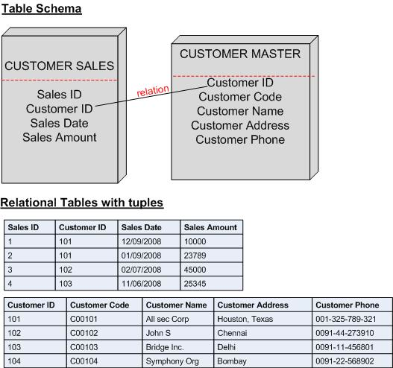
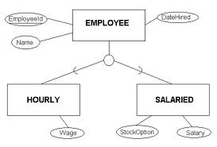
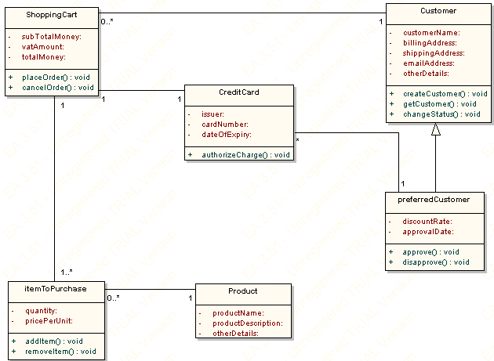
1- Object-oriented & object-relational model
Relations are the key concept, everything else is around relations
Primitive data types, e.g., strings, integer, date, etc.
Great normalization, query optimization, and theory
Application are getting more complex
CAD: Computer Aided Design, CAM: Computer aided manufacture
Multimedia, document management, telecommunication
What is missing in relational model ??
Handling of complex objects and complex relationships
Handling of complex data types
Code is not coupled with data
No inherence, encapsulation, etc.
Relational model
Object-Oriented model

Slide 15
1- Object-oriented & object-relational model
Object-Oriented Database (OODBMS)
Depends purely on concepts from OO programming, e.g., C++ or Java
Define classes, objects, inheritance, etc.
Tries to take some concepts from the relational model, e.g., SELECT statement
New languages ODL (object definition language) & OQL (object query language)
Object-Relational Database (ORDBMS)
Still the fundamental concept is ‘Relation’
Extend the relational model with concepts from OO programming, e.g., complex types, inherence, encapsulation, etc.
Extended SQL called SQL3 (or SQL-99)
ODL & OQL
SLQ-99

Slide 16
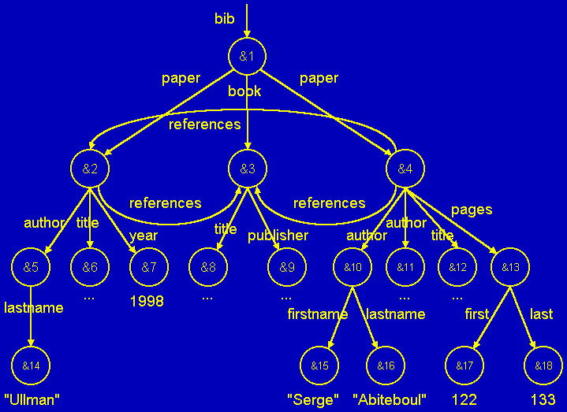
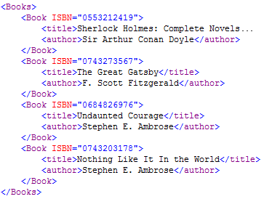
2-semistructured (XML) Data model
Key motivation is the flexibility
Schema is not fixed or not known in advance
New attributes or optional attributes
Different cardinality for different objects
Other models have schema, but semi-structured model is schemaless
Data is self-describing through the tagging system
XML has two modes
Well-formed XML ---No Schema at all
Valid XML --- governed by DTD (Document Type Definition)
More flexible than relational or OO models
Allows validation and more optimizations and pre-processing
Semi-structured model (Tree—without relationships, Graph—with relationships)
XML document

Slide 17
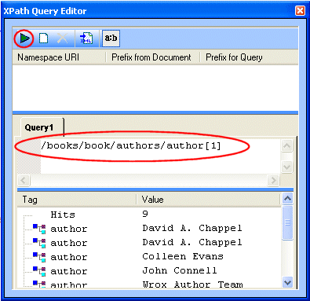
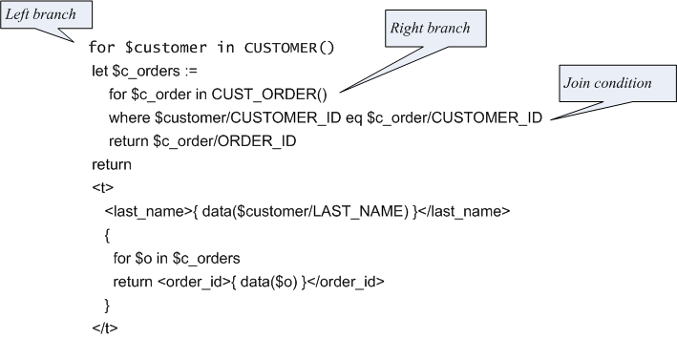
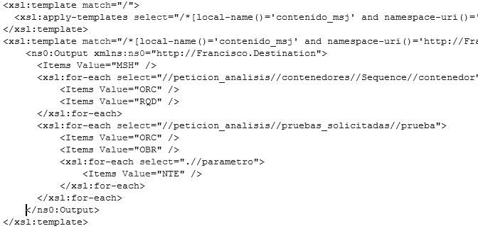
2-semistructured (XML) Data model
Programming and Query Languages
XPath: Path expressions to navigate in a graph of semi-structured data
XQuery: extension to XPath by adopting features from SQL
XSLT: document transformation to produce another XML document or HMTL document
XPath example
XQuery example
XSLT example

Slide 18
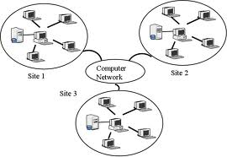
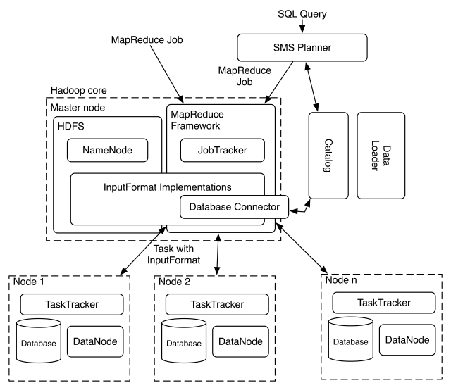
3-Distributed and parallel databases
Traditional Distributed Databases
Distributed transactions
Distributed concurrency control and two-phase commit
Distributed query processing
Hadoop/MapReduce Infrastructure
New computing paradigm with high scalability, flexibility and fault tolerance
Storage paradigm (HDFS)
Computing paradigm (Map phase & Reduce phase)
Distributed DB
Hadoop Infrastructure

Slide 19
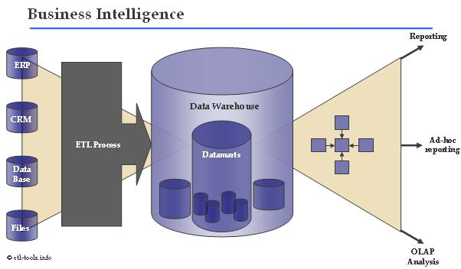
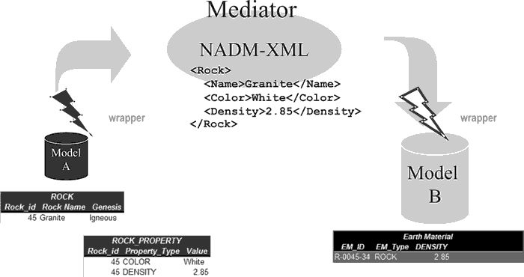
4-Information integration & OLAP
Data exist in multiple sources (databases or others)
Information integration is about merging (integrating) the data from all these sources
Make all data query-able
E.g., Kayak (search engine for hotels/flights) integrates data from many sources
Three main architectures
Federated database
Databases are independent of each other
But there a communication link between the individual sources
Data warehousing:
One storage (warehouse) materializing all data (possibly aggregated)
Issues of periodic updates
Mediation
Virtual database (with a virtual schema), has no data
It routes a query (after transformation) to each source, and then composes the final answer to the individual ones
Data warehouse
Mediation

Slide 20
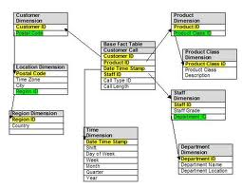
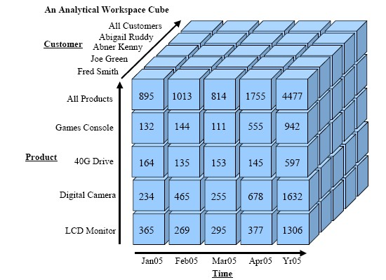
4-Information integration & OLAP
OLAP: Online Analytic Processing
Complex queries involving aggregations over one or more dimensions of the data
Touch large amount of data for discovering patterns
Two important concepts
Star schema: one fact table and multiple dimension tables
Data cubes: data aggregated over different dimensions
Star schema
Data cubes

Slide 21
Course logistics

Slide 22
Course Management
Web page: http://web.cs.wpi.edu/~cs561/s12/
WPI electronic system
Blackboard pilot: https://blackboard.wpi.edu/
Lectures
Tuesday/Thursday: (4:00pm -5:20pm)
Location: SL-407
Office Hours
Tuesday/Thursday: (2:00pm -3:00pm)
Location: My office FL-235
Course content (slides, presentations) will be available on both systems
Homework submissions, discussions among students, and grading will be within blackboard system
No required textbook
Depend on slides + papers + scanned documents that will be posted

Slide 23
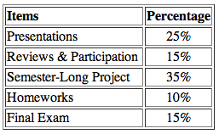
Course load
Homework (10%)
4 short homeworks covering the topics given by the instructor
Tentative release dates available on the website
Presentation (25%)
2 presentations in the semester ---Select dates
Reviews & Participation (15%)
Will talk more about this task
Basically, when another student is presenting, you should go over the paper and submit a 1-page review
Participate in the class discussion
Final exam (15%)
Covering the topics given by the instructor
One semester-long project (35%)

Slide 24
Late policy
Homework
One-day late submission is accepted with 10% off the max grade.
Two-day late submission is accepted with 20% off the max grade.
Beyond that, no late submission is accepted.
Reviews
No late submission is accepted.
Each student may skip at most two reviews without affecting his/her grade.
Policy is available on the website (under Grading tab)

Slide 25
Presentations
Several candidate papers in different areas are available on the website
Select your topic of interest + lecture slot
Then discuss with the instructor which paper to cover
Paper to be presented should be scheduled at least one week before the presentation
So others can prepare a review
First-come-first-served
Empty slots will be assigned by the instructor
Hints for good presentation are available on the website (under Grading tab)

Slide 26
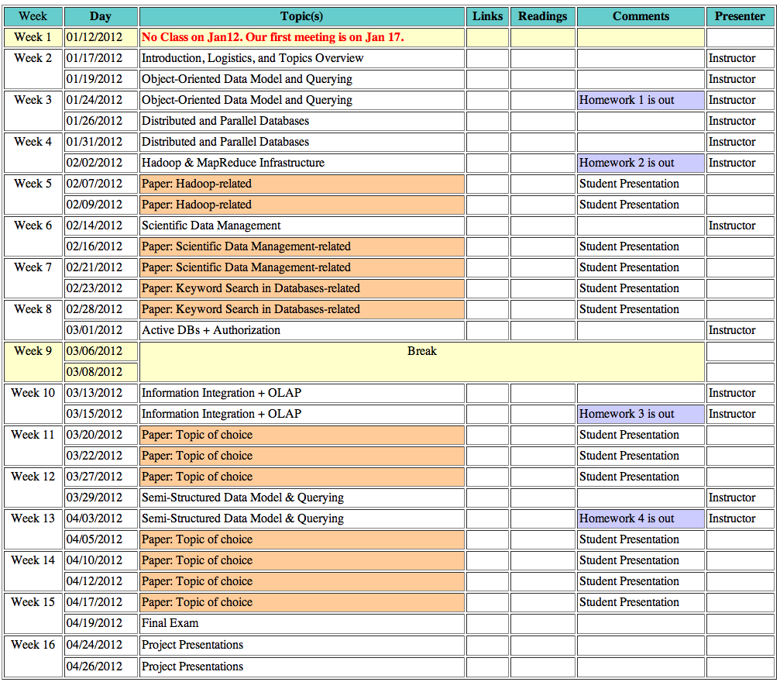
Expected schedule

Slide 27
Reviews
When a student is presenting a paper, others are reviewing that paper
Reading and understanding the paper
Preparing a 1-page review
This process will help the discussion in the lecture
Structure of good review
Summary (one paragraph 5-10 lines): describe briefly the addressed problem and main challenges, and the solution.
Strong Points (2-3 points): why this work is novel, what is the most interesting idea behind the solution, does the paper have enough evaluation and performance measures.
Weak Points (2-3 points): what do you think have not been addressed adequately, possible weaknesses, assumptions that are not practical, or extensions you think are good.

Slide 28
Project
Teams of 2 (or 3)
Several candidate projects to select from (or come up with new ideas)
Platform to work on:
PostgreSQL, or
Hadoop
Work closely with instructor for continues feedback and directions
Study and comparison between different techniques or exploring new ideas
By next Thursday (Jan. 26) groups should be formed and the project is selected

