Slide 1
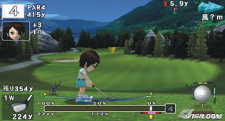

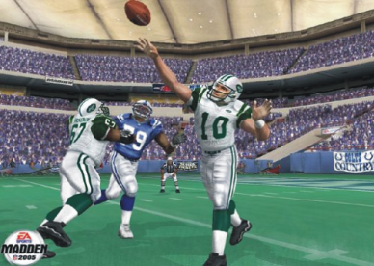



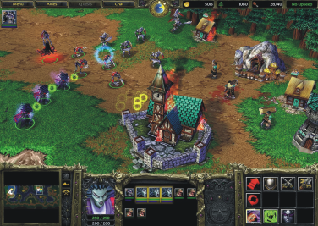
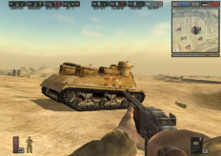
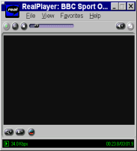
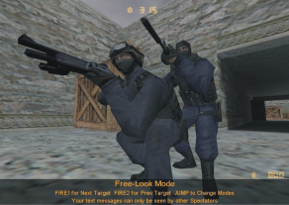





Mark Claypool’s MQP Projects
Network Games
Streaming Media
http://www.cs.wpi.edu/~claypool

Slide 2

Fire Escape!
Need real data on how people evacuate
  Tough to gather safely and realistically
Goal: Build a multiplayer “game” to model!
Methodology:
  Build/mod multiplayer FPS
  Design levels maps
  Run user studies (play game!)
  Analyze data
Students:
  2+ tech
  1+ art

Slide 3
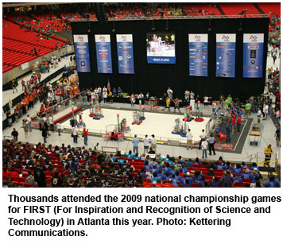
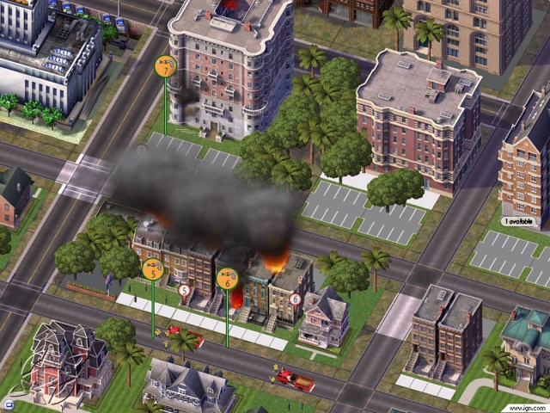
Empowerment
Help inform about energy decisions (and environment)
Physical, tactile game (arena game, in a gym) and online computer game (MMO)
Approach: Develop social playable by all (Facebook!), linked to and from physical game
Methodology:
  Design, build, test
  Deploy
Students:
  1-3 Tech
  1-3 Art
(With Prof Moriarty)

Slide 4

Gameplay Programming on a Wii/DS
Sponsor: ImaginEngine
Integrate into a project as gameplay programmers
  As regular members of a team!
Work on upcoming Nintendo Wii/DS title
Learn game engine technology
Provide time estimates for assigned tasks
Provide creative input
Possible summer internship

Slide 5
Latency and Games
Latency determines how players experience online gameplay
Latency compensation techniques to mitigate latency → how effective?
Goal: Test effects of latency on gameplay
Methodology:
  build/mod game
  design game maps
  run user studies
  analyze data
Students:
  2-3 tech
  0-1 art

Slide 6
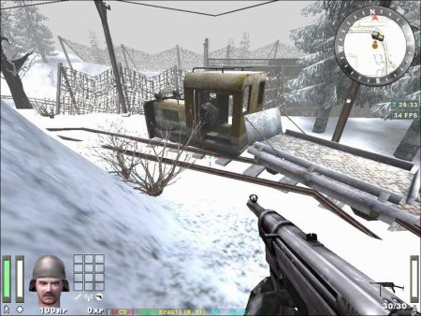

Effects of Display Settings on Games
Computer games have many display options
  Size, Resolution, Frame rate, Shadows, Textures …
Better quality displays may look better, but do they make you play better?
  Established Frame rate matters lots, Resolution less
Goal: Effect of Frame Rate/Resolution on lower gamplay
  Ex: fundamental user interactions
Methodology:
  build/mod game based on low-level actions
  design game maps
  run user studies
  analyze data
Students:
  2-3 tech
  0-1 art

Slide 7
Better Game Server Selection
Choosing a “good” server is critical for multiplayer games, but how do you define “good”?
  Lowest ping? Should use 1 ping or 10 or …?
How to pick the best server for you, your friend in California, and your friend in Florida?
  Lowest average ping? Fairest ping? Use ping to handicap?
Goal: Better game server selection
Methodology:
  Build/Modify custom software to gather ping data
  Run experiments on real/emulated Internet
  Incorporate into server browser
Students:
  2-3 tech

Slide 8
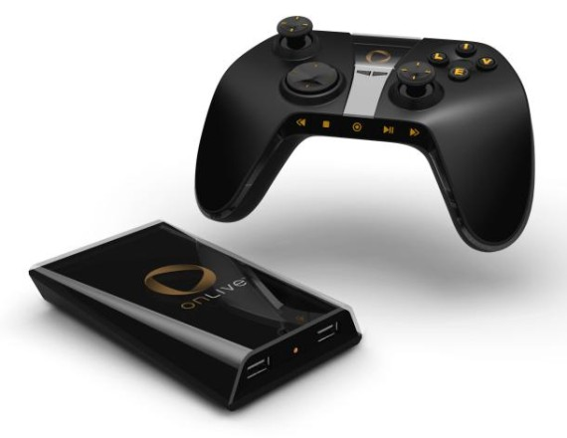
Games on Thin Clients
Have beefy server send game to lesser client
  Mobile phone, PDA, Sony PSP (remote play)
Best way to use bandwidth with low latency?
Goal: Measure thin client performance for games, propose improvements, implement and evaluate
Methodology:
  Determine “streaming” game environment
  Performance evaluation of thin clients (Sony, RDP, X, VNC …)
  Run experiments
  Feedback to drive innovation
Students:
  2-3 tech

Slide 9
Streaming Media in the Home
Many options to stream media in the home
  PCs (Orb)
  Game consoles (Sony PS3, Xbox 360)
  Slingbox, LocationFree, Apple T.V.
Much of it now wireless (802.11), which affects performance
  Loss rate, signal strength, other clients…
  Determines “best” streaming rate for video
Goal: characterize performance (network and application) for home streaming devices
Methodology:
  Setup laboratory (hardware, software)
  Design experimental parameters
  Measure and analyze data
  Propose and build better streaming devices
Students:
  2-3 tech

Slide 10
Questions?
http://www.cs.wpi.edu/~claypool
claypool@cs.wpi.edu

